Slide 1
Django with Python
An Interactive Guide

Slide 2
What is Django?
Django is a high-level Python web framework.

Slide 3
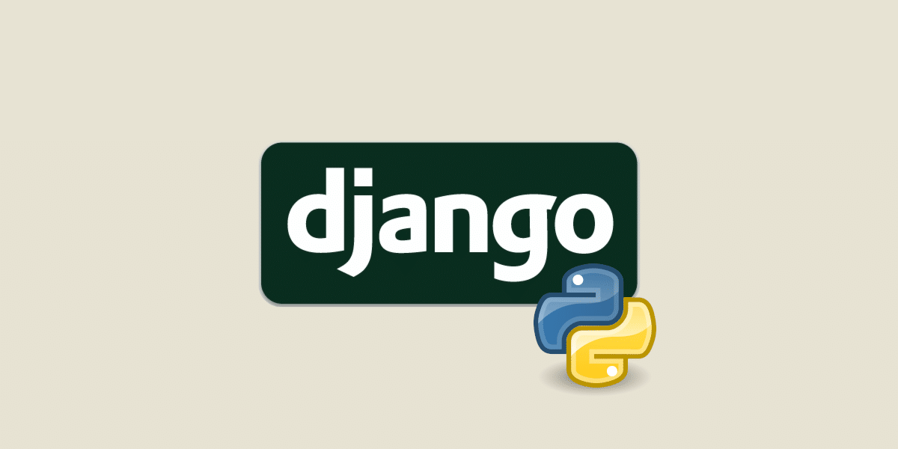
Django Logo

