Slide 1
Machine Learning & AI Basics
Apt Computing Labs
Apt Computing Labs | Slide 1

Slide 2
Agenda
1. What is AI?
2. What is Machine Learning?
3. AI vs ML vs DL
4. Supervised Learning
5. Regression (Linear)
6. Classification
7. Unsupervised Learning
8. PCA Visualization
9. K-Means Clustering
10. Reinforcement Learning
11. Neural Networks
12. Summary
Apt Computing Labs | Slide 2

Slide 3
What is Artificial Intelligence?
Systems that mimic human intelligence.
Examples: Speech assistants, image recognition.
Apt Computing Labs | Slide 3

Slide 4
What is Machine Learning?
Algorithms learn patterns from data.
Learns function f(x) without explicit rules.
Apt Computing Labs | Slide 4

Slide 5
AI vs ML vs DL
Deep Learning ⊂ Machine Learning ⊂ Artificial Intelligence.
DL uses multi-layer neural networks.
Apt Computing Labs | Slide 5

Slide 6
Supervised Learning
Data has input-output pairs.
Regression → numeric, Classification → categories.
Apt Computing Labs | Slide 6

Slide 7
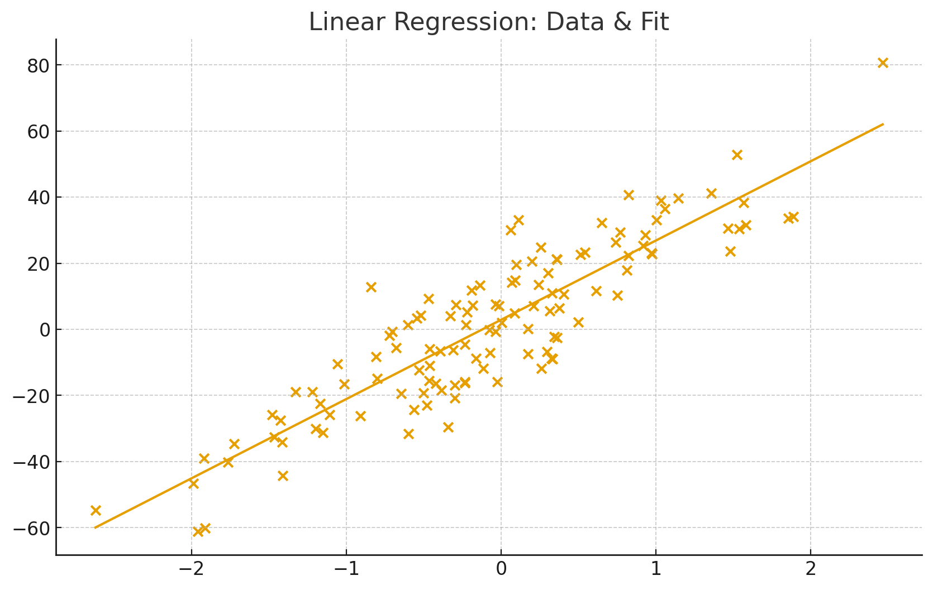
Linear Regression
Fits a line y = w·x + b to minimize error.
Apt Computing Labs | Slide 7

Slide 8
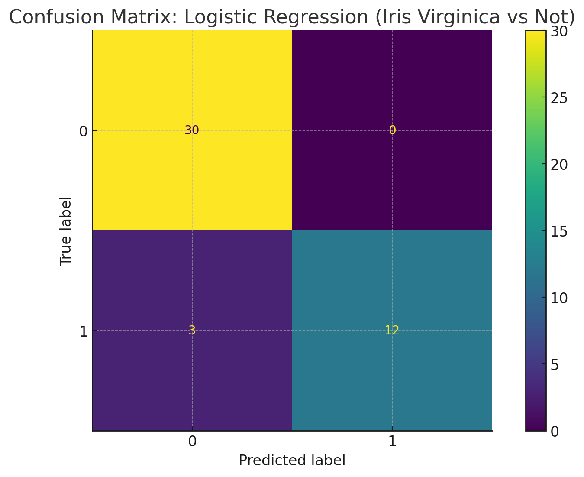
Classification & Confusion Matrix
Predicts categories; Confusion matrix shows TP, FP, TN, FN.
Apt Computing Labs | Slide 8

Slide 9
Unsupervised Learning
No labels; find structure in data (clustering, PCA).
Apt Computing Labs | Slide 9

Slide 10
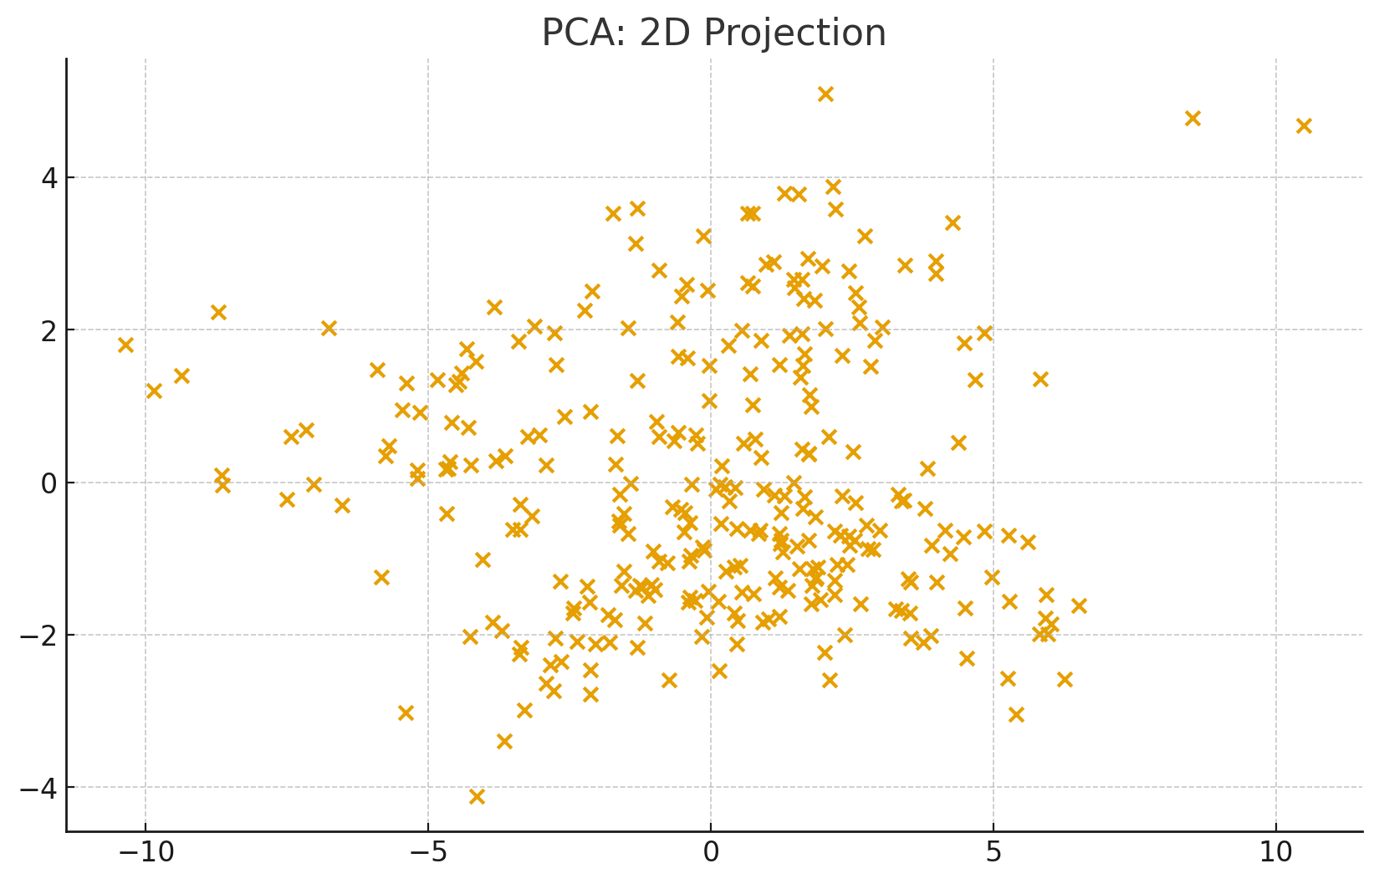
PCA Visualization
Reduces dimensions while preserving variance.
Apt Computing Labs | Slide 10

Slide 11
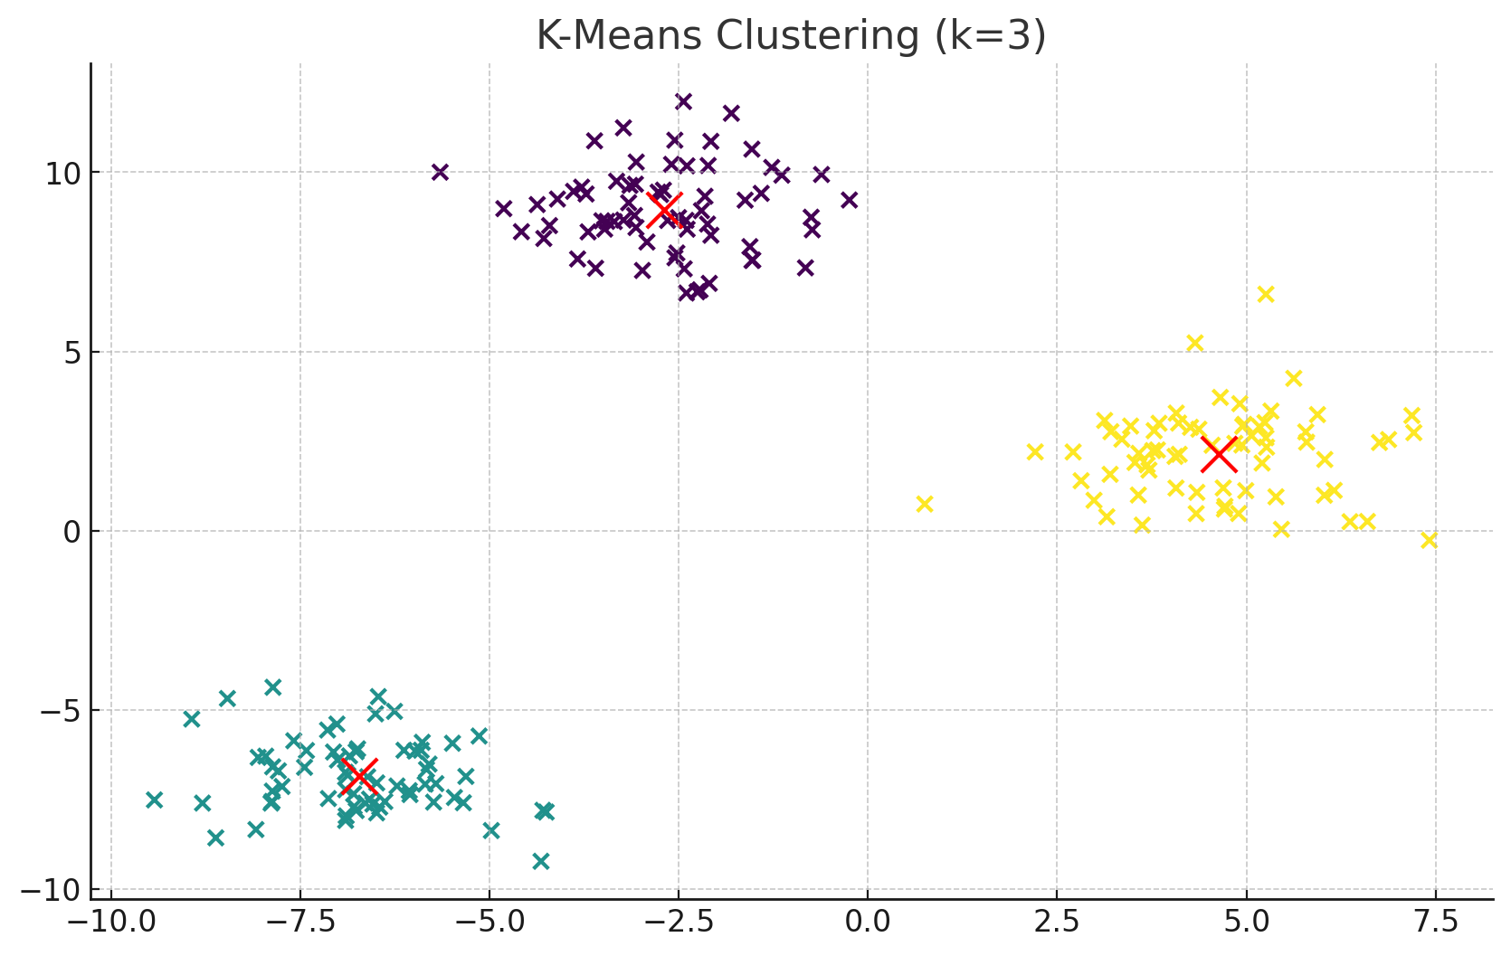
K-Means Clustering
Partitions data into k groups.
Apt Computing Labs | Slide 11

Slide 12
Neural Networks
Layers of neurons with activation functions.
Apt Computing Labs | Slide 12

