Slide 1
Machine Learning & AI Basics
Apt Computing Labs
Apt Computing Labs
Notes:
Welcome! Introduce course goals. Agenda: AI vs ML vs DL, learning types, algorithms, evaluation, applications.

Slide 2
Agenda (Preview Deck 1–12)
1. What is AI?
2. What is Machine Learning?
3. AI vs ML vs DL
4. Supervised Learning
5. Regression (Linear)
6. Classification (Confusion Matrix)
7. Unsupervised Learning
8. K-Means Clustering
9. Reinforcement Learning
10. Neural Networks (Basics)
11. Evaluation Metrics
12. PCA Visualization
Apt Computing Labs
Notes:
Walk through topics and expected outcomes; mention code & visuals.

Slide 3
What is Artificial Intelligence (AI)?
Systems that perform tasks requiring human-like intelligence.
Examples: speech assistants, vision systems, recommendation engines.
Goal: perceive → reason → act under uncertainty.
Apt Computing Labs
Notes:
Give concrete demos students know (spam filter, maps). Emphasize AI broader than ML.

Slide 4
What is Machine Learning?
Algorithms learn patterns from data to predict/decide without explicit rules.
Learns f(x) from examples; performance improves with experience.
Types: supervised, unsupervised, reinforcement.
Apt Computing Labs
Notes:
Contrast rule-based vs data-driven. Stress importance of data quality and features.

Slide 5
AI vs ML vs DL
Deep Learning ⊂ Machine Learning ⊂ Artificial Intelligence.
ML: learn models from data; DL: multi-layer neural networks.
Choose simplest model that works; not every task needs DL.
Apt Computing Labs
Notes:
Clarify scope with simple Venn analogy. Provide everyday examples.

Slide 6
Supervised Learning
Has input features and known labels (answers).
Tasks: regression (numeric) and classification (category).
Aim: generalize well to new, unseen data.
# Supervised Learning (sketch) from sklearn.model_selection import train_test_split from sklearn.linear_model import LinearRegression from sklearn.datasets import make_regression X, y = make_regression(n_samples=120, n_features=1, noise=12.0, random_state=42) X_tr, X_te, y_tr, y_te = train_test_split(X, y, test_size=0.2, random_state=42) model = LinearRegression().fit(X_tr, y_tr) print("R^2:", model.score(X_te, y_te))
Apt Computing Labs
Notes:
Use house-price prediction and email spam examples. Mention train/test split.

Slide 7
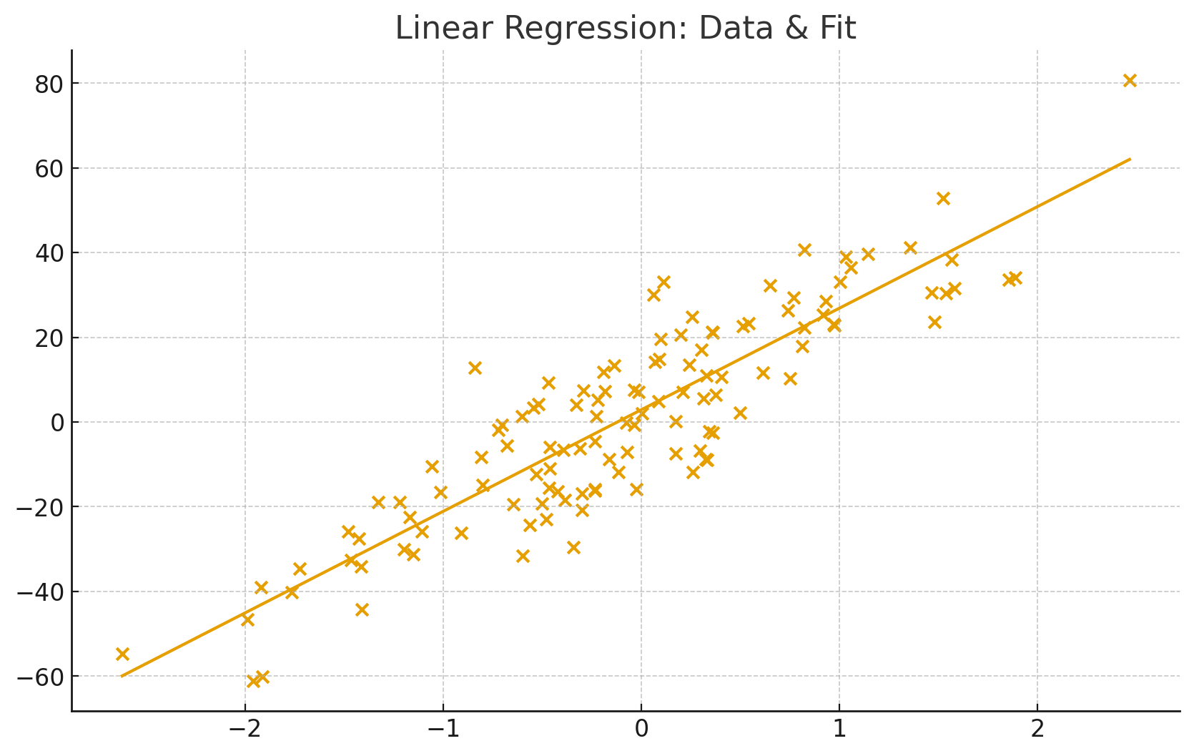
Linear Regression
Fits a line y = w·x + b minimizing squared error.
Interpret slope and intercept; validate with R² and residuals.
Useful baseline; extend to polynomial/regularized variants.
# Linear Regression (fit) from sklearn.datasets import make_regression from sklearn.linear_model import LinearRegression X, y = make_regression(n_samples=120, n_features=1, noise=12.0, random_state=42) model = LinearRegression().fit(X, y) print(model.coef_, model.intercept_)
Apt Computing Labs
Notes:
Show scatter + line; discuss assumptions and outliers.

Slide 8
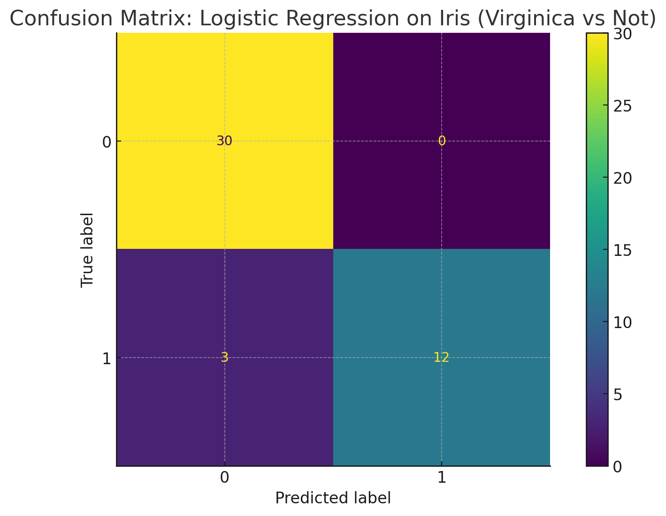
Classification & Confusion Matrix
Classification predicts categories; confusion matrix shows TP/FP/TN/FN.
Accuracy can mislead; also consider precision/recall/F1.
Adjust decision threshold to trade off precision vs recall.
# Logistic Regression on Iris from sklearn.datasets import load_iris from sklearn.model_selection import train_test_split from sklearn.pipeline import make_pipeline from sklearn.preprocessing import StandardScaler from sklearn.linear_model import LogisticRegression from sklearn.metrics import confusion_matrix iris = load_iris() X, y = iris.data, (iris.target == 2).astype(int) X_tr, X_te, y_tr, y_te = train_test_split(X, y, test_size=0.3, random_state=42, stratify=y) clf = make_pipeline(StandardScaler(), LogisticRegression(max_iter=1000, random_state=42)).fit(X_tr, y_tr) pred = clf.predict(X_te) print(confusion_matrix(y_te, pred))
Apt Computing Labs
Notes:
Walk through an Iris example predicting Virginica vs Not.

Slide 9
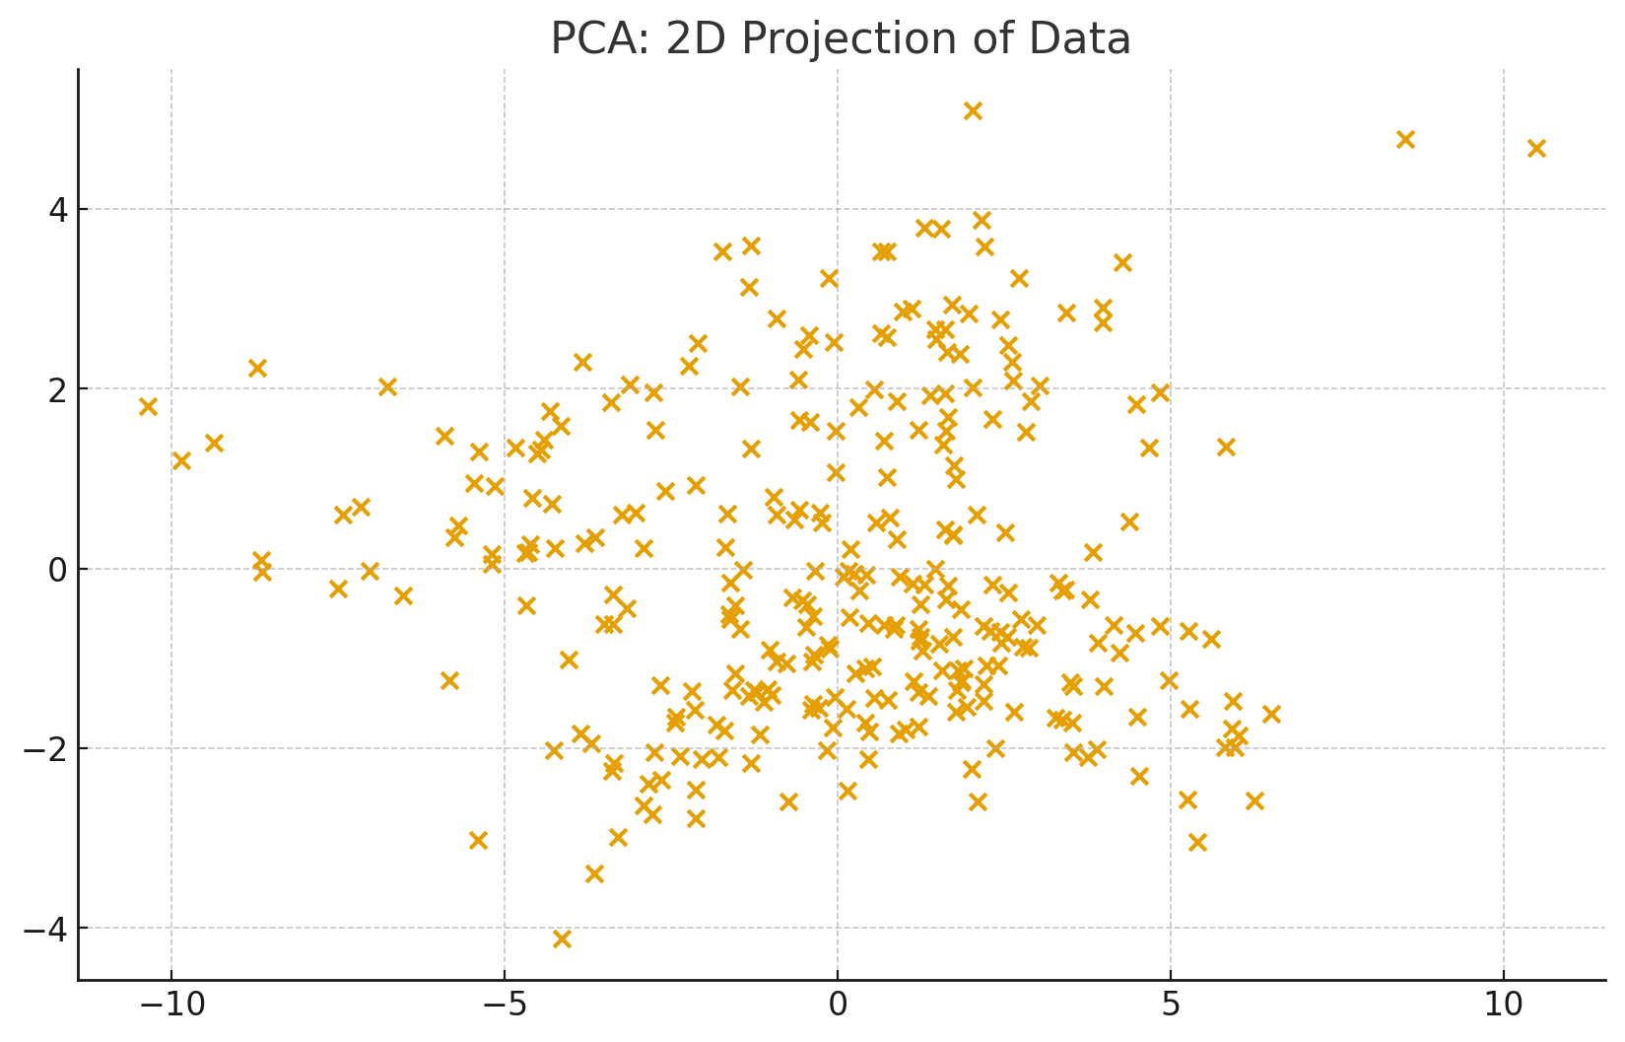
Unsupervised Learning
No labels; discover structure (clustering, dimensionality reduction).
Use for exploration, anomaly detection, compression.
Often precedes supervised modeling.
# PCA for visualization from sklearn.decomposition import PCA from sklearn.datasets import make_classification X, y = make_classification(n_samples=300, n_features=8, n_informative=4, random_state=7) X2 = PCA(n_components=2, random_state=7).fit_transform(X) print(X2[:3])
Apt Computing Labs
Notes:
Explain PCA for visualization and clustering for segmentation.

Slide 10
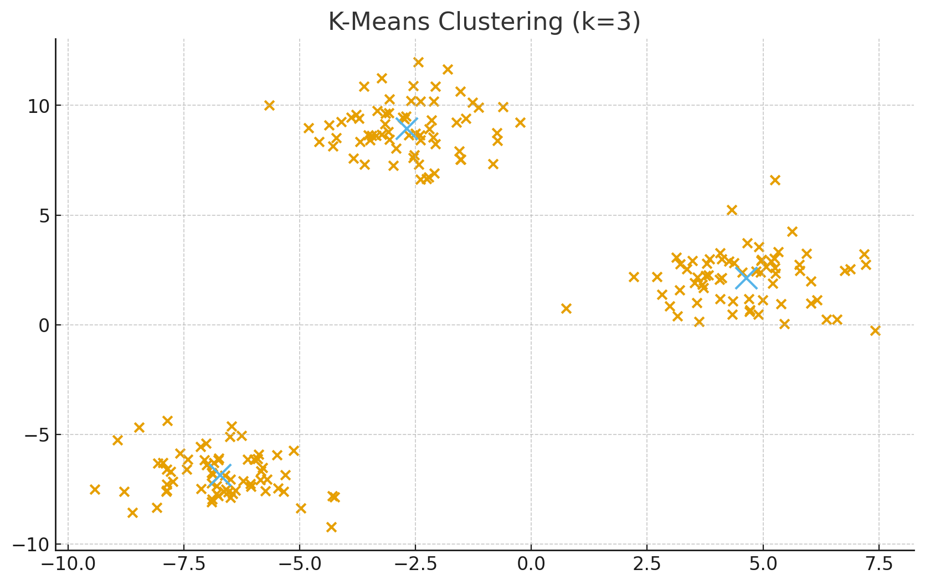
K-Means Clustering
Assigns points to nearest of k centers; iteratively updates centers.
Pick k via elbow/silhouette; scale features first.
Initialization matters; multiple restarts help.
# K-Means clustering from sklearn.datasets import make_blobs from sklearn.cluster import KMeans X, _ = make_blobs(n_samples=200, centers=3, random_state=42, cluster_std=1.2) kmeans = KMeans(n_clusters=3, n_init=10, random_state=42).fit(X) print("Centers:", kmeans.cluster_centers_)
Apt Computing Labs
Notes:
Discuss variance explained and cluster interpretability.

Slide 11
Reinforcement Learning (RL)
Agent learns by interacting; aims to maximize cumulative reward.
Key pieces: state, action, reward, policy, value/Q.
Applications: games, robotics, operations.
# RL loop (pseudo) # state = env.reset() # while not done: # action = policy(state) # next_state, reward, done, info = env.step(action) # update(policy, state, action, reward, next_state) # state = next_state
Apt Computing Labs
Notes:
Explain exploration vs exploitation; mention MDP framing.

Slide 12
Neural Networks (Basics)
Layers of linear transforms + nonlinear activations learn complex patterns.
Backpropagation computes gradients for weight updates.
Regularize (dropout/weight decay) to combat overfitting.
# Neural Network basics # Input -> Dense -> Activation -> Dense -> Output # Train with backprop + gradient descent # Use Keras/PyTorch for real models
Apt Computing Labs
Notes:
Show simple layer diagram; mention data/compute needs.

