Slide 1
Valgrind
Dynamic Analysis Tool for Detecting Memory, Resource, and Performance Issues in C/C++ Applications

Slide 2
Valgrind
What is Valgrind?
Valgrind is a dynamic binary instrumentation framework used to detect memory, resource, threading, and performance issues in compiled programs.
What does it do?
It executes your program on a synthetic CPU and monitors every memory access, allocation, deallocation, and system call.
Why is it important?
It helps find bugs that are difficult to detect through testing, such as memory leaks, use-after-free, and uninitialized memory usage.

Slide 3
Cont..
Where is it commonly used?
It is widely used in Linux development, embedded systems, system software, networking applications, databases, and server-side C/C++ projects.
Which languages benefit most?
It is primarily used for C, C++, and other native-code languages that directly manage memory.
How does it work?
It intercepts and analyzes machine instructions at runtime before they execute on the real CPU.

Slide 4
Top 10 issue types
SNo | Issue | Typical Valgrind Message
1 | Memory Leak | definitely lost
2 | Use After Free | Invalid read/write
3 | Heap Buffer Overflow | Invalid write of size N
4 | Heap Buffer Underflow | Invalid read/write
5 | Double Free | Invalid free()
6 | Invalid Free | Address is not stack'd, malloc'd or free'd
7 | Uninitialized Variable Use | Conditional jump depends on uninitialised value(s)
8 | Mismatched Allocation/Deallocation | Mismatched free() / delete / delete []
9 | File Descriptor Leak | FILE DESCRIPTORS: N open at exit
10 | Invalid System Call Parameters | Syscall param write(buf) points to unaddressable bytes

Slide 5
Top 10 issue types
Option | Purpose
--leak-check=full | Detailed memory leak report
--show-leak-kinds=all | Show all leak categories
--track-origins=yes | Find source of uninitialized values
--track-fds=yes | Detect file descriptor leaks
--num-callers=N | Show deeper call stack
--read-var-info=yes | Read variable debug information
--error-limit=no | Report all errors
--log-file=file.log | Save output to file
-v | Verbose mode
-s | Show suppression statistics

Slide 6
Helgrind
Detects data races, deadlocks, and synchronization errors in multithreaded applications.
valgrind --tool=helgrind ./app

Slide 7
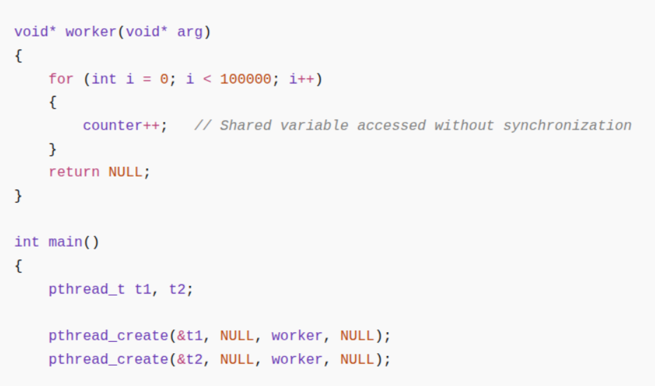
==12345== Helgrind, a thread error detector
==12345== Possible data race during read of size 4 at 0x10C040 by thread #2
==12345== Locks held none
==12345== at 0x10917A: worker (race.c:10)
==12345== This conflicts with a previous write of size 4 by thread #1
==12345== Locks held: none
==12345== at 0x10916B: worker (race.c:10)
==12345== Address 0x10C040 is 0 bytes inside data symbol "counter"

Slide 8
Top 4 issue types
Issue | Description
Data Races | Multiple threads access the same memory simultaneously without proper synchronization.
Lock Order Violations | Threads acquire locks in different orders, potentially leading to deadlocks.
Invalid Mutex Operations | Unlocking an unlocked mutex, locking an invalid mutex, or destroying a locked mutex.
Condition Variable Misuse | Incorrect use of pthread_cond_wait(), pthread_cond_signal(), and related synchronization primitives.

Slide 9
Top 4 Options
Option | Purpose
--history-level=full | Provides complete stack traces and detailed race-condition history.
--history-level=approx | Faster analysis with reduced historical information.
--log-file=helgrind.log | Saves Helgrind output to a file instead of the terminal.
-v (--verbose) | Displays additional diagnostic and synchronization information.

