Slide 1

FFI
(Foreign Function Interface)

Slide 2
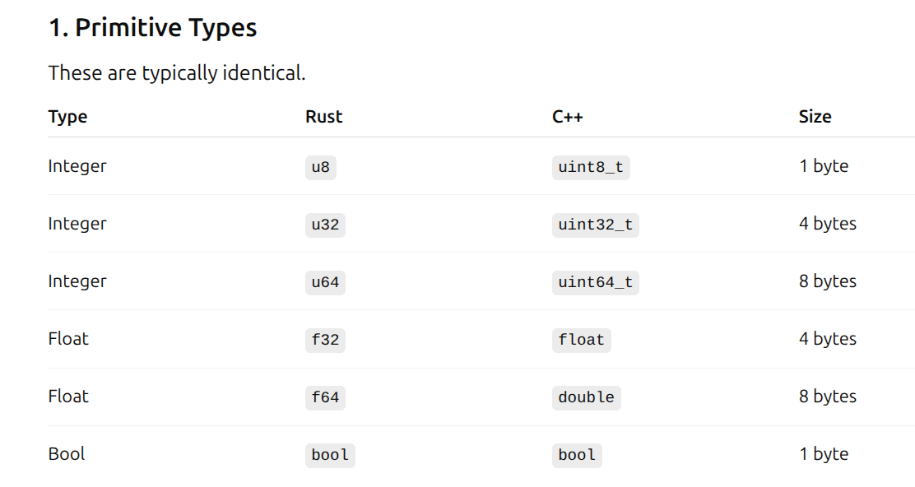
Memory Layout

Slide 3
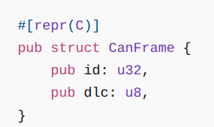
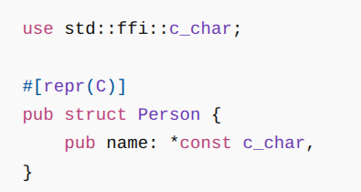
While defining “Structure”

Slide 4
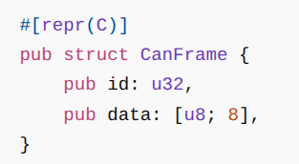
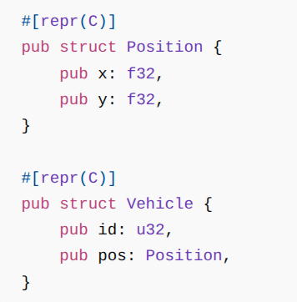
While defining “Structure”

Slide 5
Extern "C": Both C++ and Rust need to disable name mangling and use the standard C ABI to talk to each other.
Bindgen: A Rust tool that parses C/C++ headers and automatically generates Rust FFI declarations.
Cbindgen: A tool that parses Rust code and generates C/C++ headers for Rust functions exported with #[no_mangle] extern "C".
Extern "C"
Bindgen
Cbindgen

Slide 6
Calling Functions
Rust →C++
C++ → Rust
Extern "C"
Bindgen
Cbindgen

Slide 7
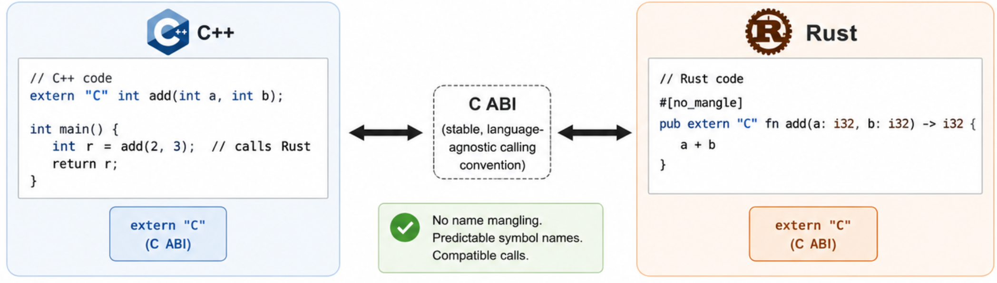
Extern "C"
Bindgen
Cbindgen

