Slide 1

Magnetic Field Sensors
MLA 0103 – Artificial Intelligence And Expert Systems
Guided By : Dr.Prakash.M
Presented By:
Kamalli Shree V (192525030)

Slide 2


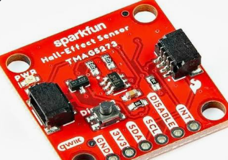
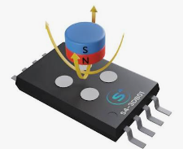
What is a Magnetic Field Sensor?
A magnetic field sensor is a device that detects magnetic fields and measures their strength or direction.
It can detect the presence or movement of a magnet or magnetic object without physical contact.
Common sensing technologies include:
Hall Effect sensors
Magnetoresistive sensors
Magnetometers
The sensor converts the detected magnetic field into an electrical signal that can be processed by an electronic system.

Slide 3
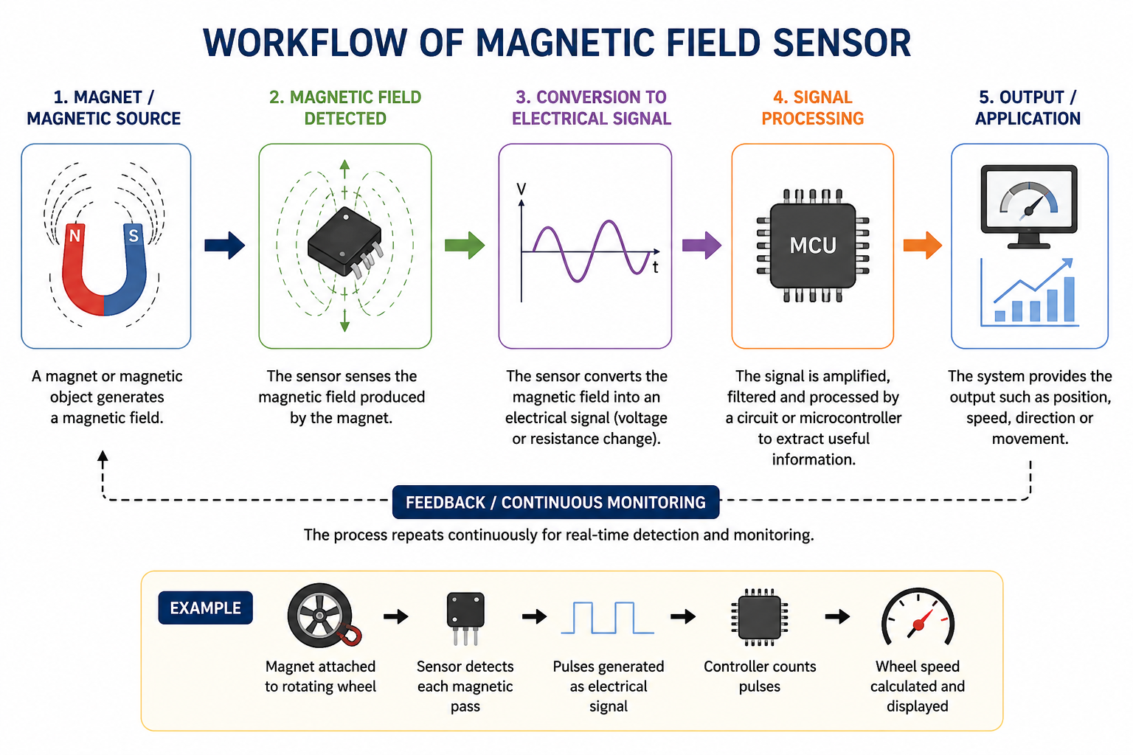
Functionality of the Sensor
The sensor detects a magnetic field using a sensing element such as a Hall-effect sensor or magnetoresistive sensor.
When a magnet or magnetic field is nearby, the sensor produces a change in voltage or resistance.
This electrical change is processed by a circuit or microcontroller.
The system then determines the position, speed, direction, or movement of the object.

Slide 4
Where and How Is It Used?
Application | How it is used
Automobiles | Detect wheel rotation and engine position
Smartphones | Detect Earth's magnetic field for compass applications
Electric Motors | Detect rotor position and control motor operation
Security Systems | Detect whether doors or windows are open/closed
Industrial Automation | Detect object position and movement
Speedometers | Count magnetic pulses to calculate speed

Slide 5


