Slide 1
CAUSE AND EFFECT

Slide 2
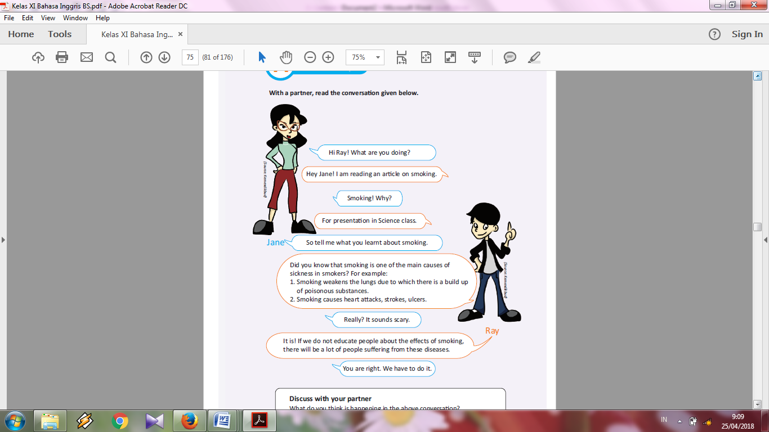
Read the conversation given below!

Slide 3
The reason or motive, for an action
CAUSE
Why something happens
Happens first (may not be written first)
Example :
It rained

Slide 4
Result or conclusion of an action
EFFECT
What happened
Happens due to a cause
Example:
I got wet

Slide 5
To find a cause, ask, why did this happen?
To find an effect, ask, what happen?

Slide 6
When we talk about cause, we use the following signal words :
Because
The reason for
On account of
Bring about
Give rise to
Created by
Contributed to
Led to
Due to
For this reason
Unless

Slide 7
When we talk about an effect resulting from a certain cause, we use the following signal words:
As a result
Then
Hence
For this reason
Outcome
So
Consequently
Finally
Therefore
In order to

Slide 8
Some examples of Cause and Effect relationship
Sentences | Cause & Effect Relationship
Sumatran tigers are almost extinct because people killed too many of them. | Cause – People killed too many of them. Effect – Sumatran tigers almost became extinct
Haze is caused by massive forest burning. | Cause – massive forest burning Effect – haze
Since they are in love, they forgive each other’s mistakes. | Cause – They are in love Effect – They forive each other’s mistake
Early man learnt to grow food, and as a result, their lives became easier. | Cause – early man learnt to grow food Effect – their lives became easier

Slide 9
Let’s take a look at the sentences structure of cause and effect.
A. Due to, because of, owing to and thanks to are followed by a noun
Due to | + Noun
Because of
Owing to
Thanks to
B. Because, Since, as, for are followed by a verb
Because | Subject + verb
Since
As
For

Slide 10
Examples :
Owing to her had work and intellegence, we won the trophy.
Thanks to Siti and John’s effective planning, the event went well.
Because of his hard work, he managed to get the best student award.
I have a stomachache because I ate too much.
There was a lot of homework and tests, as a result most of the students were unhappy and couldn’t go anywhere during the weekend.

Slide 11
1. Early man used weapons because they needed to find food.
2. The glaciers began to melt; therefore; the land bridge between Asia and North America became flooded.
3. Because they want wanted to learn about different civilizations that existed, archeologists studied artifacts.
4. Early man slowly started to grow food, and as a result, their lives became easier.
5. My sister was very tired because she stayed up past midnight.
Exercise :

Slide 12
Thank You

