Slide 1
Mental Health Detection using Gradient Boost
1
Authors
Vana chandhana
Kamal nadh
Lukesh
divya

Slide 2
Problem Statement
2
Mental health issues affect millions worldwide, yet many go undiagnosed.
Traditional diagnosis methods rely on self-reporting, which may be inaccurate.
Machine learning can help identify individuals needing treatment based on responses to key mental health indicators.

Slide 3
Project Objective
3
Develop a predictive model to determine if an individual should seek treatment.
Compare different machine learning models based on accuracy and error rates.
Deploy a web application to provide easy accessibility to users.

Slide 4
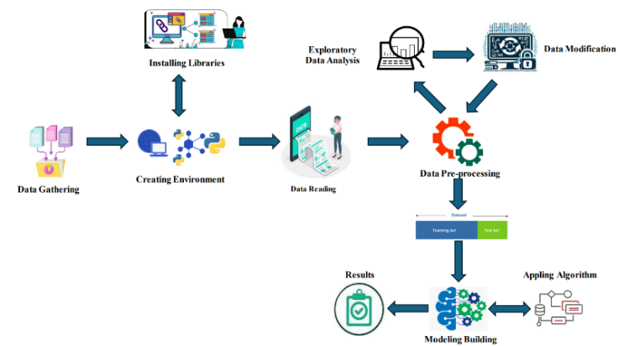
Step-by-Step Approach
4

Slide 5

Dataset Overview
5
Data sourced from Peoples Dataset.
Features include demographic data, workplace culture, and mental health history.
Target Variable : whether the person requires mental health treatment (Yes/No)
Data preprocessed to handle missing values, encoding, and scaling.

Slide 6
Data Cleaning
6
Removed duplicate entries and missing values.
Addressed imbalanced classes using oversampling/under sampling.
Standardized text-based responses into numerical format.
Detected and removed outliers.

Slide 7
Feature Selection
7
Used correlation analysis & feature importance ranking.
Selected most relevant features such as Age, Work Place , past treatment.

Slide 8
Encoding & Scaling
8
Categorical variables (e.g., Gender) encoded using One-Hot Encoding.
Numerical features scaled using MinMax Scaler for optimal model performance.

Slide 9
Train-Test Split
9
Data split into 80% training and 20% testing for evaluation.
Applied cross-validation to avoid overfitting.

Slide 10
Machine Learning Models & Results
10
Logistic Regression
A simple yet effective classification model.
Uses a sigmoid function to predict probabilities.
Suitable for binary classification problems.

Slide 11
11
Logistic Regression - Results
Accuracy: 77.78%
Mean Absolute Error (MAE): 22.22%

Slide 12
12
Decision Tree
A tree-based model that splits data into decision nodes.
Works well with categorical and numerical data.

Slide 13
13
Decision Tree - Results
Accuracy: 76.75%
Mean Absolute Error (MAE): 18.25%

Slide 14
14
Random Forest
An ensemble of decision trees that reduces overfitting.
Takes majority voting from multiple decision trees.

Slide 15
15
Random Forest - Results
Accuracy: 76.54%
Mean Absolute Error (MAE): 17.46%

Slide 16
16
Gradient Boost
Gradient boosting algorithm optimized for categorical data.
Works well with imbalanced datasets.

Slide 17
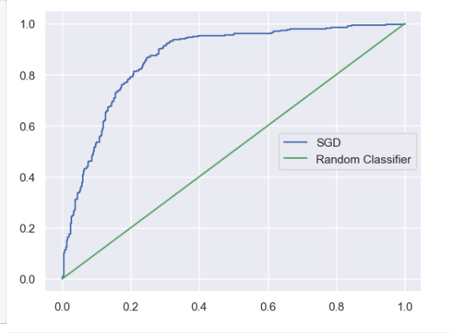
17
Gradient Boost - Results
Accuracy: 79.9%
Mean Absolute Error (MAE): 17.86%

Slide 18
18
SVM (Support Vector Machine)
Finds the optimal hyperplane that separates classes.
Useful for high-dimensional data.

Slide 19
19
SVM - Results
Accuracy: 78.56%
Mean Absolute Error (MAE): 19.44%

Slide 20
20
Neural Network
A multi-layer perceptron model for complex patterns.
Uses activation functions like ReLU and Softmax.

Slide 21
21
Neural Network - Results
Accuracy: 75.76%
Mean Absolute Error (MAE): 20.24%

Slide 22
22
Best Model Selection
Gradient Boost achieved the highest accuracy (79.7%) and the lowest error.
Chosen as the final model for web app deployment.

Slide 23
23
Web App Overview
Developed a user-friendly web application for easy predictions.
Users input basic information to get treatment recommendations.

Slide 24
24
Tech Stack Used
Backend: Flask + Python
Frontend: HTML, CSS, JavaScript
Model Integration: GradientBoost

Slide 25
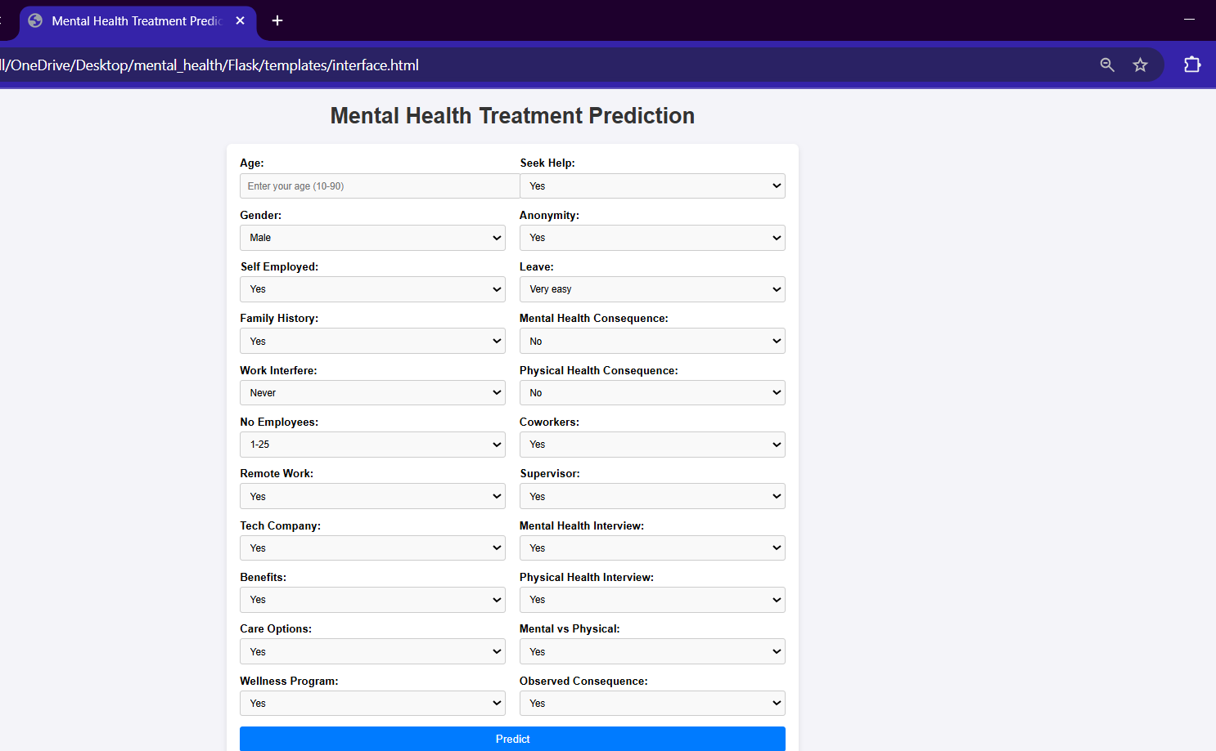
25
User Interface

Slide 26
Workflow of the Web App
26
User enters mental health details.
Data is processed and sent to the trained ML model.
Model predicts whether treatment is recommended.
Result is displayed on the screen.

Slide 27
Conclusion
27
The Mental Health Detection Project successfully demonstrates the power of machine learning models in identifying patterns indicative of mental health conditions such as depression, anxiety, or stress.
By utilizing various datasets and algorithms like Supervised Learning, the project provides valuable insights into how technology can be harnessed to predict and monitor mental health

Slide 28
Future Scope
28
Integration with Wearables
Data Privacy and Ethics

Slide 29
Future Scope
29
Expansion to Other Mental Health Disorders
Real-time Monitoring

Slide 30
THANK YOU
30

