Slide 1

Rationale
  Play the introduction animation, which explains the rationale of this course.
Use the IJ_Intro animation

Slide 2


Objectives
  In this session, you will learn to:
    Get familiar with Java
    Identify the building blocks of a Java program
    Access class members

Slide 3

Introducing Java
  Scenario:
Needs to create a jumbled word game named Classic Jumble Word.
The game must be compatible across various operating systems.
The code of the game should be efficiently written to ensure minimum complexity.
Sam

Slide 4
Introducing Java (Contd.)
  Scenario (Contd.):
To cater to the preceding requirements, Sam uses the Java programming language.
Due to its powerful features and underlying architecture, Java is used widely as a programming language to create efficient console or GUI based applications.

Slide 5
Simple
Object-oriented
Platform independence
Portable
Distributed
Secure
Robust
Multithreaded
Identifying the Features of Java
  Some of the features of Java are:

Slide 6
Java Architecture
  The Java architecture defines the components that are essential to carry out the creation and execution of code written in the Java programming language.
  The various components of the Java architecture are:
Source file
Class file
JVM
Application Programming Interface

Slide 7
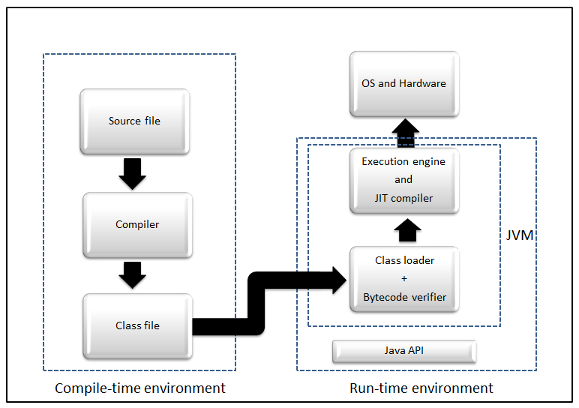
Java Architecture (Contd.)
  The various components in the Java architecture are shown in the following figure.

Slide 8
Java Architecture (Contd.)
  The source code of a Java application is saved in a source file with the extension, .java.
  JVM is responsible for executing the bytecode and generating the machine specific code for the machine on which the Java program needs to be executed.
  The Java API is a collection of software components, such as classes, interfaces, and methods.

Slide 9
Just a minute
  Which one of the following features of Java allows a program to simultaneously execute multiple tasks?
    Multithreading
    Portability
    Distributed
    Garbage collection

Slide 10
Just a minute (Contd.)
  Solution:
    Multithreading

