Slide 1



Identifying the Building Blocks of a Java Program
  Scenario:
Needs to build a Java program in order to develop the Classic Jumble Word application.
Sam

Slide 2
Identifying the Building Blocks of a Java Program (Contd.)
  Scenario (Contd.):
A Java program comprises
Classes
Data types
Class members
Packages

Slide 3
Defining a Class
  A class defines:
    The characteristics and behavior of an object.
    The member variables and methods of objects that share common characteristics.
  The following code snippet shows how to declare a class:
  class <ClassName>
  {
  //Declaration of member variables
  //Declaration of methods
  }

Slide 4
Defining a Class (Contd.)
  There are certain rules that should be followed to name Java classes.
  Some of these rules are:
    The name of a class should not contain any embedded space or symbol, such as ?, !, #, @, %, &, {}, [], :, ;, “, and /.
    A class name must be unique.
    A class name must begin with a letter, an underscore (_), or the dollar symbol ($). Or, it must begin with an alphabet that can be followed by a sequence of letters or digits (0 to 9), ‘$’, or ‘_’.
    A class name should not consist of a keyword.

Slide 5
Defining a Class (Contd.)
  Keywords:
    Are the reserved words with a special meaning for a language, which express the language features.
    Cannot be used to name variables or classes.
    Should be written in lowercase only.

Slide 6
Defining a Class (Contd.)
  The following table lists the Java keywords.
abstract | boolean | break | byte
case | catch | char | class
const | continue | default | do
double | else | extends | final
finally | float | for | goto
if | implements | import | instanceof
int | interface | long | native
new | package | private | protected
public | return | short | static
strictfp | super | switch | synchronized
this | throw | throws | transient
try | void | volatile | while
enum | assert

Slide 7
Defining a Class (Contd.)
  The following naming conventions should be followed for naming a Java file:
    A file name must be unique.
    A file name cannot be a keyword.
    If a class is specified as public, the file name and class name should be the same.
    If a file contains multiple classes, only one class can be declared as public. The file name should be the same as the class name that is declared public in the file.
    If a file contains multiple classes that are not declared public, any file name can be specified for the file.

Slide 8
Identifying Data Types
  While working with an application, you need to store and manipulate varying data.
  To handle such varying data in an application, Java supports various data types.
  There are eight primitive data types in Java, which are further grouped into the following categories:
Integer
Can store integer values.
Floating point type
Can store decimal numbers.
Boolean type
Can store only the values, true and false.
Character type
Can store a single character, such as a symbol, letter, and number.

Slide 9
Identifying Data Types (Contd.)
  In order to use the primitive data types as objects, Java provides wrapper classes.
  A wrapper class acts like an object wrapper and encapsulates the primitive data types within the class.
  The various wrapper classes, such as Boolean, Character, Integer, Short, Long, Double, and Float, are provided by the java.lang package.

Slide 10
Identifying Class Members
  In Java, a class can contain the following members:
Variables
Objects
Inner classes
Methods

Slide 11
Identifying Class Members (Contd.)
  A variable:
    Is used essentially as a container for the storage of varying kinds of data.
    Represents a name that refers to a memory location where some value is stored.
    Needs to be declared before it is accessed.
  The following code snippet shows how to declare a variable:
      <type> <variablename>; // Single variable of given type.
      <type><variable1name,variable2name.....variable_n_name> // Multiple variables of given type.

Slide 12
Identifying Class Members (Contd.)
  The following code snippet shows how to assign values to a variable:
      <type> <variablename>=<value>; // During declaration.
      <variablename>=<value> // After declaration.
  The following code snippet can be used to assign a value to a variable at the time of its declaration:
      int num1=5;
  A literal:
    Is a value that is assigned to a variable or constants.
    Contains a sequence of characters, such as digits, alphabets, or any other symbol, which represents the value to be stored.

Slide 13
Identifying Class Members (Contd.)
  The various types of literals in Java are:
Integer literals
Floating point literals
Are numeric values that contain a fractional part.
Boolean
Can store only the values, true and false.
Character type
Can store a single character, such as a symbol, letter, and number.
String literals
Are enclosed in double quotation marks.
Binary literals
Are the literals that can be used to express the primitive integer data types into binary form.
Are non-fractional numeric values.

Slide 14
Identifying Class Members (Contd.)
  A method:
    Is a set of statements that is intended to perform a specific task.
    Provides encapsulation and is also essential to refer to the data members and access them.
    Consists of two parts, method declaration and method body.
    Syntax:
      <Access specifier> <Return type> <Method name>(Parameter list) //method declaration
      {
      <Method body> // body of the method
      }

Slide 15
Identifying Class Members (Contd.)
  While adding a method to a class, you should adhere to the following method naming conventions:
    The method names should be verb-noun pairs.
    The first letter of the method should be in lowercase.
    If the method name consists of several words, the first letter of each word, except the first word, should be capitalized.
  When a method is invoked from a Java program, the control is transferred to that method.
  The syntax for calling a method is:
    <Method name>(argument list);
  In object-oriented languages, when you instantiate a class, special methods called constructors are automatically called.

Slide 16
Identifying Class Members (Contd.)
  Constructors are:
    Methods that have the same name as that of the class and have no return type.
    Used to construct an object of a class and initialize it.
  An object is an instance of a class and has a unique identity.
  To create an object, you need to declare, and then, instantiate an object.
  The following code snippet shows how to declare an object of the class:
    class_name object_name;

Slide 17
Identifying Class Members (Contd.)
  To allocate memory to the object, you need to instantiate the object by using the new operator.
  The new operator allocates memory to an object and returns a reference to that memory location in the object variable.
  The following code snippet shows how to create an object:
  object_name= new class_name();
  In Java, a class can also contain another class. Such a class is known as an inner class or a nested class.

Slide 18

Identifying Class Members (Contd.)
  The concept of an inner class is shown in the following figure.
  The following types of inner classes can be created in Java:
    Regular inner class
    Static nested class
    Method-local inner class
    Anonymous inner class

Slide 19
Defining a Package
  A package:
    Is a collection of classes.
    Provides the space essentially used to organize classes that are related to each other.
    Ensures that the non-related classes with the same name do not conflict with each other.
  The following syntax is used to define a package:
  package <package_name>;

Slide 20
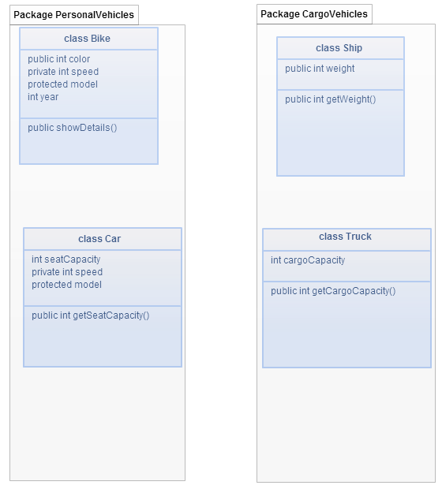
Defining a Package (Contd.)
  The following figure represents the concept of packages in Java.

Slide 21
Just a minute
  Which one of the following types of literals can be specified only by values, true or false?
    String
    Boolean
    Integer
    Floating point

Slide 22
Just a minute (Contd.)
  Solution:
    Boolean

