Slide 1


Using the Unary Operators
  An operator that requires one operand is called a unary operator.
  The types of unary operators:
Unary Plus operator (+)
Indicates a positive value.
Unary Minus operator (-)
Indicates a negative value.
Decrement operator (--)
Logical Complement operator (!)
Increment operator (++)
Increments the value by 1.
Decrements the value by 1.
Inverts the value.

Slide 2
Using the Unary Operators (Contd.)
  Play the animation, which explains some of the concept of unary operators.
Use the UnaryOperators animation

Slide 3
Using the Unary Operators (Contd.)
  The increment and decrement operators can be applied in the prefix and postfix forms.
  In the prefix form:
  In the postfix form:
The operator precedes the operand.
The value is incremented or decremented before it is assigned to the operand.
The operator follows the operand.
The value is incremented or decremented after it has been assigned to the operand.

Slide 4
Using the Bitwise Operators
  Bitwise operators are used:
    For the manipulation of data at the bit level.
    To operate on the individual bits of their operands.
  The operands can be of various data types, such as int, short, long, char, and byte.
  Bitwise operators can be categorized into:
Bitwise Operators
Bitwise NOT (~)
Bitwise OR (|)
Bitwise XOR (^)
Bitwise AND (&)

Slide 5
Using the Bitwise Operators (Contd.)
  Bitwise AND operator:
    Performs an AND operation on two operands.
    Results 1 if both bits are 1 else 0 in all other cases.
  The following table lists the bitwise AND operation.
Operand 1 | Operand 2 | Operand 1 & Operand 2
0 | 0 | 0
0 | 1 | 0
1 | 0 | 0
1 | 1 | 1

Slide 6
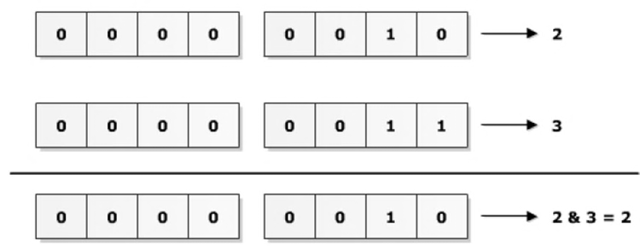
Using the Bitwise Operators (Contd.)
  The following figure displays the bitwise AND operation for 2 and 3.

Slide 7
Using the Bitwise Operators (Contd.)
  Bitwise OR operator:
    Performs the OR operation on two operands.
    Results, 0, if both bits are 0, else 1 in all other cases.
  The following table lists the bitwise OR operation.
Operand 1 | Operand 2 | Operand 1 | Operand 2
0 | 0 | 0
0 | 1 | 1
1 | 0 | 1
1 | 1 | 1

Slide 8
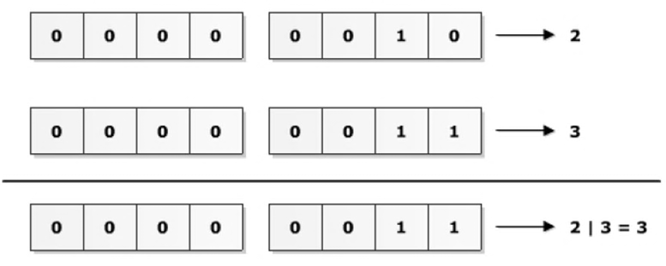
Using the Bitwise Operators (Contd.)
  The following figure displays the bitwise OR operation for 2 and 3.

Slide 9
Using the Bitwise Operators (Contd.)
  Bitwise NOT operator:
    Is a unary operator.
    Is used to performs the NOT operation on each bit of a binary number.
    Is also called Bitwise complement.
    Is used to invert or complement each of the bits of a binary number.
  The following table lists the bitwise NOT operation.
Operand 1 | ~Operand 2
0 | 1
0 | 0

Slide 10
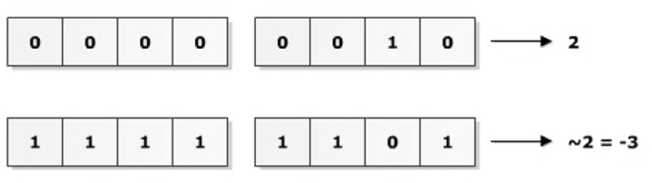
Using the Bitwise Operators (Contd.)
  The following figure displays the bitwise NOT operation for 2.

Slide 11
Using the Bitwise Operators (Contd.)
  Bitwise XOR operator:
    Performs the XOR operation on two operands.
    Results in 1, if exactly one bit is 1, else 0 in all other cases.
  The following table lists the bitwise XOR operation.
Operand 1 | Operand 2 | Operand 1 ^ Operand 2
0 | 0 | 0
0 | 1 | 1
1 | 0 | 0
1 | 1 | 1

Slide 12
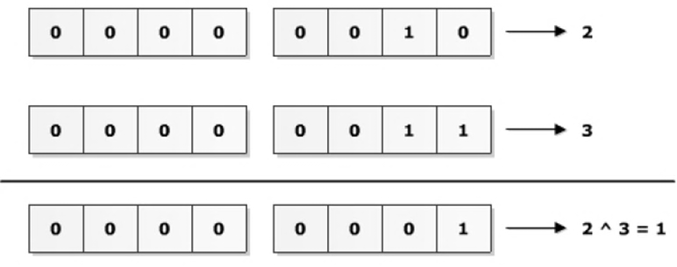
Using the Bitwise Operators (Contd.)
  The following figure displays the bitwise XOR operation for 2 and 3.

Slide 13
Using the Shift Operators
  A shift operator is used to shift the bits of its operand either to the left or to the right.
  The various types of shift operators:
Types of Shift Operators
Right Shift Operator(>>)
Left Shift Operator(<<)
Unsigned Shift Operator(>>>)

Slide 14
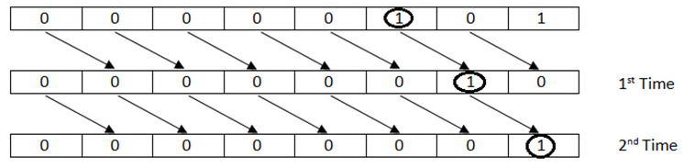
Using the Shift Operators (Contd.)
  Right shift operator:
  The following figure displays the right shift operation of the 5>>2 expression.
Shifts all the bits of a binary number in the right direction.
The syntax for the right shift operator is:
operand >> num

Slide 15
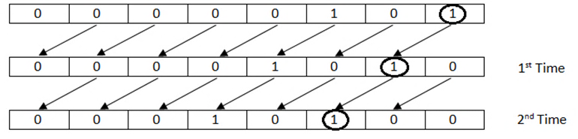
Using the Shift Operators (Contd.)
  Left shift operator:
  The following figure displays the left shift operation of the 5<<2 expression.
Shifts all the bits of a binary number in the left direction.
The syntax for the left shift operator is:
operand << num

Slide 16
Using the Shift Operators (Contd.)
  Unsigned right shift operator:
Shift the bits of a binary number to the right.
Fills the leftmost bits of a binary value with 0, irrespective of whether the number has 0 or 1 at the leftmost bit.
Is generally used with the 32 and 64 bit binary numbers.

Slide 17
Using the Ternary Operator
  Ternary operator is used to:
    Evaluate an expression.
    Work on a logical expression and two operands.
  The syntax of ternary operator is:
      boolean_expression ? expression 1 : expression 2
  It returns one of the two operands depending on the result of the expression.

Slide 18
Just a minute
  Which one of the following operators is used to find the remainder and assign the result to a variable?
    %
    %=
    /
    /=

Slide 19
Just a minute (Contd.)
  Solution:
    %=

