Slide 1


Objectives
  In this session, you will learn to:
    Manipulate arrays
    Manipulate enums
    Manipulate strings

Slide 2

Manipulating Arrays
  Scenario:
Needs to store 100 different words that will be used in the game.
Therefore, to store these values, a programmer needs to declare 100 variables.
A Programmer

Slide 3
Manipulating Arrays (Contd.)
  Scenario (Contd.):
However, it is difficult to keep track of 100 variables in a program which makes the program code long and complex. Therefore, in such a situation, a programmer needs to declare a variable that can store 100 words. This can be achieved by declaring an array variable.

Slide 4
Manipulating Arrays (Contd.)
  Play the animation, which explains the concept of arrays.
Use the Array Animation

Slide 5
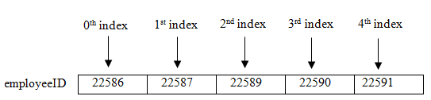
Manipulating Arrays (Contd.)
  An array is a collection of elements of a single data type stored in adjacent memory locations.
  An array element can be accessed by specifying the name and the subscript number of the array.
  The subscript number:
    Specifies the position of an element within the array.
    Is also called the index of the element.
  The following figure shows the array of employeeID.

Slide 6
Creating Arrays
  You can create the following types of arrays:
  One-dimensional array:
One-dimensional array
Multidimensional array
Is a collection of elements with a single index value.
Can have multiple columns but only one row.

Slide 7
Creating Arrays (Contd.)
  The creation of a one-dimensional array involves two steps:
    Declare an array.
    Assign values to the array.
  One-dimensional array is declared by using the following syntax:
arraytype arrayname[] = new arraytype[size] ;
  The following code snippet declares an array to store three string values:
String jumbledWords[] = new String[3];
  You can assign values to each element of the array by using the index number of the element.

Slide 8
Creating Arrays (Contd.)
  You can also assign values to the array at the time of declaration.
  To assign values at the time of declaration, you are not required to specify the size of the array, as shown in the following code snippet:
  String jumbledWords[] ={“alpep”,”argneo”,”rgaeps”};
  Multidimensional arrays are arrays of arrays.
  The commonly used multidimensional array is a two-dimensional array where you can have multiple rows and columns.

Slide 9
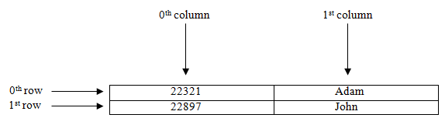
Creating Arrays (Contd.)
  The following figure shows a two-dimensional array.
  The creation of a two-dimensional array involves two steps:
    Declare an array.
    Assign values to the array.

Slide 10
Creating Arrays (Contd.)
  You can declare a two-dimensional array by using the following syntax:
      arraytype arrayname[][] = new arraytype[rowsize][columnsize];
  The following code snippet declares a two-dimensional array:
  String[][] words = new String[4][2];
  You can assign values to each element of the array by using the index number of the element.
  You can also assign values to the array at the time of declaration, as shown in the following code snippet:
    String[][] jumbledWords = new String[][]
    {{“elapp”,“apple”},{“argneo”,”orange”},
    {“agrspe”,“grapes”}};

Slide 11
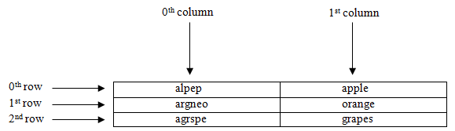
Creating Arrays (Contd.)
  The following figure shows a two-dimensional array, JumbledWords.

Slide 12
Just a minute
  Identify the total number of elements, if an array is declared as:
  int [] arr = new int [5];
    3
    4
    5
    6

Slide 13
Just a minute (Contd.)
  Solution:
    5

Slide 14
Accessing Arrays
  To perform various manipulations on the array, you need to access the following types of arrays:
    One-dimensional array
    Two-dimensional array
  To access a one-dimensional array, the following syntax is used:
      arrayname[index];
  To display all the elements stored in the array, you can use the for loop, as shown in the following code snippet:
    String jumbledWords[] = {“alpep”,”argneo”,”rgaeps”};
    for(int i=0;i<3;i++)
    System.out.println(jumbledWords[i]);

Slide 15
Accessing Arrays (Contd.)
  However, if you do not know the total number of elements in the array, then traversing through the entire array will be difficult. This can be simplified by using the length property of an array.
  The following code snippet is used to traverse through the array using the for loop and the length property:
    String jumbledWords[] = {“alpep”,”argneo”,”rgaeps”};
    for(int i=0;i<jumbledWords.length;i++)
    System.out.println(jumbledWords[i]);
  Java provides the for-each loop to iterate through an array. This loop increases the readability and simplifies the code.
  The syntax of the for-each loop to use in an array is:
for(type var: arrayobject)

Slide 16
Accessing Arrays (Contd.)
  The following code snippet is used to display all the elements stored in the array using the for-each loop:
    String[] jumbledWords = {“alpep”,”argneo”,”rgaeps”};
        System.out.println(“Elements stored in array are: “);
        for (String i : jumbledWords)
        {
        System.out.println(i);
    }
  Two-dimensional array is accessed by using the following syntax:
    arrayname[row][column]]

Slide 17
Accessing Arrays (Contd.)
  However, if you want to display all the elements, you can use the for loop, as shown in the following code snippet:
    String[][] jumbledWords = new String[][]{
    {“elapp”,”apple”},{“argneo”,”orange”},{“agrspe”,”grapes”}};
    System.out.println(“Elements stored in array are: “);
    for (int i=0; i<2; i++)
    {
    for (int j=0; j<2; j++)
    {
    System.out.print(jumbledWords[i][j]);
    }

Slide 18
Accessing Arrays (Contd.)
  You can use the length property in the for loop, as shown in the following code snippet:
int a[][] = {{1,2},{4,3}};
    for(int i=0; i<a.length; i++)
    {
    for(int j=0; j<a[i].length; j++)
    System.out.println(a[i][j]);
    }

Slide 19
Accessing Arrays (Contd.)
  Further, you can use the following code snippet to display all the elements stored in the two-dimensional array using the for-each loop:
    String[][] jumbledWords = new String{“elapp”,”apple”},{ “argneo”,”orange”},{ “agrspe”,”grapes”}};;
    System.out.println(“Fruits are: “);
    for (String[] i : jumbledWords)
    {
    for (String j : i)
    {
    System.out.println(j);
    }
    }

