Slide 1


Objectives
  In this session, you will learn to:
    Implement inheritance
    Implement polymorphism

Slide 2
Implementing Inheritance
  In an object oriented programming language, such as Java, you can reuse or extend the functionalities and capabilities of an existing class in a new class.
  A class can inherit the features of a related class and add new features, as per the requirement.

Slide 3

Implementing Inheritance (Contd.)
The levels will be based upon the maximum number of attempts that can be availed by a player.
Each level will add more sets of functionality to the game, such as a timer and score.
  Scenario:
Needs to implement different levels to the game.
Sam

Slide 4
Implementing Inheritance (Contd.)
  Scenario (Contd.):
Sam needs to reuse the existing code. Therefore, he decides to implement the inheritance feature of Java. In Java, inheritance can be implemented through classes and interfaces.

Slide 5
Identifying the Various Types of Inheritance
  Java supports the following types of inheritance:
Single level inheritance
Multilevel inheritance
Hierarchical inheritance

Slide 6
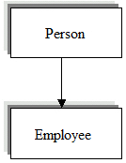
Identifying the Various Types of Inheritance (Contd.)
  In single level inheritance, a single subclass derives the functionality of an existing superclass.
  The following figure explains the concept of single level inheritance.

Slide 7
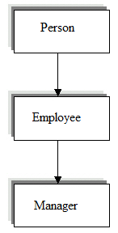
Identifying the Various Types of Inheritance (Contd.)
  In multilevel inheritance, a subclass inherits the properties of another subclass.
  The following figure explains the concept of multilevel inheritance.

Slide 8
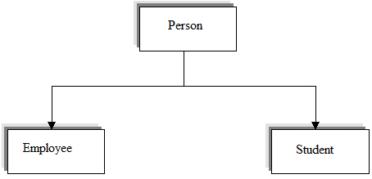
Identifying the Various Types of Inheritance (Contd.)
  In hierarchical inheritance, one or more subclasses are derived from a single superclass.
  The following figure shows the concept of hierarchical inheritance.

Slide 9
Inheriting a Class
  Inheritance signifies the relationship between a superclass and its subclass.
  In order to inherit a class, you need to use the extends keyword.
  For example:
    If you have a superclass named Books and a subclass named PaperBooks that share common functionalities and properties with the superclass, such as printing the book details and author name, total number of pages, and price.
  In order to implement single level inheritance for the Books class, you can use the code given in the embedded document:

Slide 10
Inheriting a Class (Contd.)
  Inheritance can also be implemented by using abstract classes.
  An abstract class:
    Is a class that contains one or more abstract methods.
    Cannot be instantiated but can be inherited by other classes by using the extends keyword.
    Acts as a blueprint for other classes.
  You can define an abstract class by using the following syntax:
    <access_specifier> abstract class <abstract_class_name>
    {
    //variables
    // abstract and concrete methods
    }

Slide 11
Inheriting a Class (Contd.)
  You can declare an abstract method by using the following syntax:
    abstract return-type methodname(parameter-list);
  Scenario:
Each of the games in the game console must offer functionalities to play the game, compute the score, display the score, and exit the game.
Some of the functionalities, such as play the game and compute the score, will vary for every game.
Some of the functionalities, such as display the score and exit the game, will remain the same for all the games.

Slide 12
Inheriting a Class (Contd.)
  Scenario (Contd.):
Therefore, for the game console, an abstract class named GameConsole can be created.

Slide 13
Inheriting a Class (Contd.)
  You can use the code given in the embedded document, to implement the GameConsole abstract class:
  Sometimes within a method or a constructor, there may be a need to refer to the object that has invoked it.
  You may have a requirement where the class variables and the method or constructor variables have the same name.
  In order to cater to the mentioned requirements, Java provides the this keyword.
  The this keyword helps to differentiate between the member and the local variables of a method or constructor in case the
  member and the local variables of a method have the
  same name.

Slide 14
Inheriting a Class (Contd.)
  For example, consider the following code:
      class Vehicle
      {
      int max_speed = 210;
      Vehicle(int max_speed)
      {
      max_speed = max_speed;
      }
      public void showmaxspeed()
      {
      System.out.println("The top speed is " + max_speed);
      }

Slide 15
Inheriting a Class (Contd.)
    }
    class MainClass {
    public static void main(String args[])
    {
    Vehicle a = new Vehicle(250);
    a.showmaxspeed();
    }
    }
  In addition to this keyword, Java provides the super keyword to refer to the member variables and methods of the superclass in a subclass.

Slide 16
Inheriting a Class (Contd.)
  You can use the code given in the embedded document to understand the usage of the super keyword:

