Slide 1


Objectives
  In this session, you will learn to:
    Explore UI components
    Manage layouts

Slide 2
Exploring UI Components
  In a Character User Interface (CUI) application, a user needs to remember all the commands to work with the application.
  The user enters the commands by using the keyboard, and the application displays the result of the commands.
  A notification is displayed to the user if the user enters a wrong command. On the other hand, the GUI provides a graphical way of interacting with the application.
  The user provides an input most of the time by using a mouse and sometimes by using a keyboard.
  The introduction of GUI made the application easier to learn and use.
  In addition, it improved the navigation and appearance of the application, which increased the productivity of the user.

Slide 3
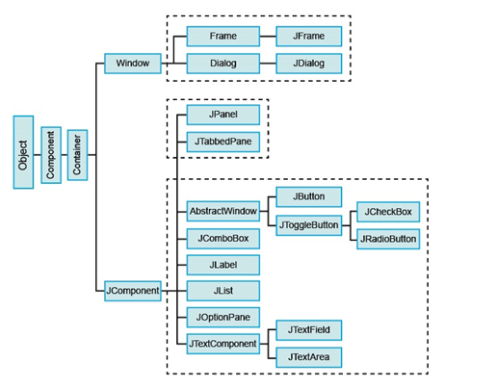
Identifying UI Components
  Java defines components according to the class hierarchy given in the following figure.

Slide 4
Identifying UI Components (Contd.)
  The most commonly used containers and components are:
    Jframe
    Jdialog
    Jpanel
    JTabbedPane
    JMenuBar
    Jmenu
    JMenuItem
    Jlabel
    JTextField
    JTextArea
    JCheckBox
    JRadioButton
    JList

Slide 5
Identifying UI Components (Contd.)
    JComboBox
    Jbutton
    JOptionPane

Slide 6
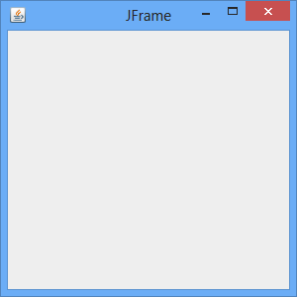
Identifying UI Components (Contd.)
  Jframe:
    It works as a window that is used to place other components of an application.
    It contains the title, border, and minimize, maximize, and close buttons.
    The following figure shows the JFrame window.

Slide 7
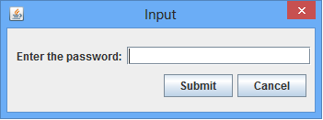
Identifying UI Components (Contd.)
  Jdialog:
    It works as a dialog box that is used to display information to the user or to prompt the user for a response.
    It enables you to create the modal and modeless dialog boxes.
    The following figure shows the Input window created using the JDialog class.

Slide 8
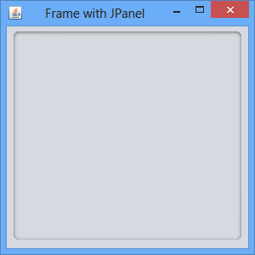
Identifying UI Components (Contd.)
  JPanel:
    It is an intermediate component that is used to organize or to group other components within a window.
    The following figure shows JPanel within the frame.

Slide 9
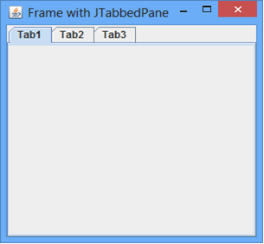
Identifying UI Components (Contd.)
  JTabbedPane:
    It is used to create multiple tabbed panes.
    These panes can hold other components.
    You can switch between these panes by clicking the respective tab.
    The following figure shows JTabbedPane within the frame.

Slide 10
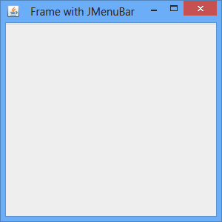
Identifying UI Components (Contd.)
  JMenuBar:
    It is used to display a menu bar on the frame.
    The following figure shows the JMenuBar within the frame.

Slide 11
Identifying UI Components (Contd.)
  JMenu:
    It is used to add the menus on the menu bar.
    The following figure shows JMenu on the menu bar.

Slide 12
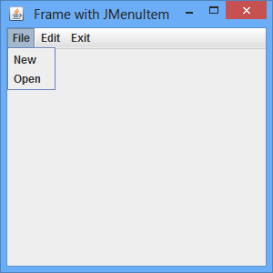
Identifying UI Components (Contd.)
  JMenuItem:
    It is used to add the menu items on menu.
    The following figure shows JMenuItem of the menu.

Slide 13
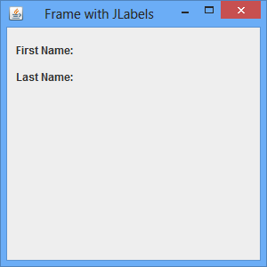
Identifying UI Components (Contd.)
  JLabel:
    It is used to display a text or an image.
    By default, a label that displays the text is left aligned and a label that displays the image is horizontally centered.
    The following figure shows JLabel within the frame.

Slide 14
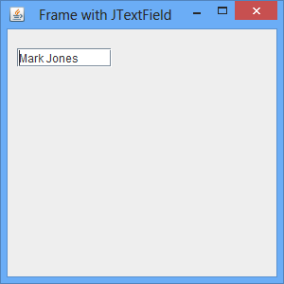
Identifying UI Components (Contd.)
  JTextField:
    It is used to insert or edit a single line of text.
    The following figure shows JTextField within the frame.

Slide 15
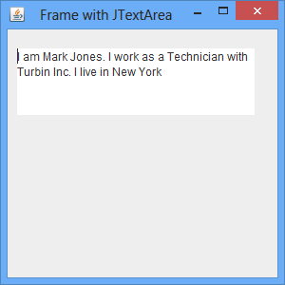
Identifying UI Components (Contd.)
  JTextArea:
    It is used to insert or edit multiple lines of text.
    The following figure shows JTextArea within the frame.

Slide 16
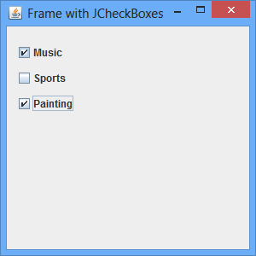
Identifying UI Components (Contd.)
  JCheckBox:
    It is used to display the state of something by selecting or deselecting the check box.
    The following figure shows JCheckBox within the frame.

Slide 17
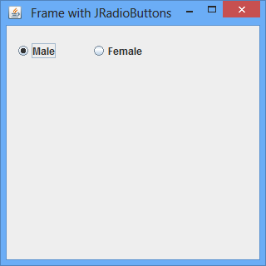
Identifying UI Components (Contd.)
  JRadioButton:
    It is used to accept only one value from the predefined set of options.
    The following figure shows JRadioButton within the frame.

Slide 18
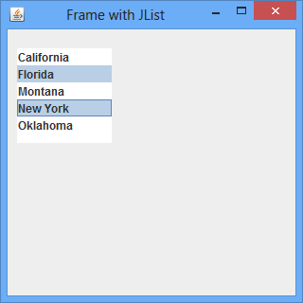
Identifying UI Components (Contd.)
  JList:
    It is used to provide a list of items that enables a user to select one or more items from the list.
    The following figure shows JList within the frame.

Slide 19
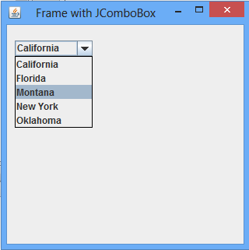
Identifying UI Components (Contd.)
  JComboBox:
    It is used to display a combination of a text field and a drop-down list.
    It enables you to type or select a value from the list.
    The following figure shows JComboBox within the frame.

Slide 20
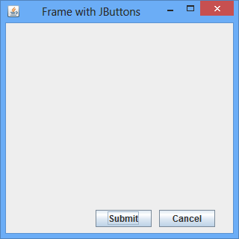
Identifying UI Components (Contd.)
  JButton:
    It is used to provide the clickable functionality that enables you to initiate a command.
    The following figure shows JButton within the frame.

Slide 21
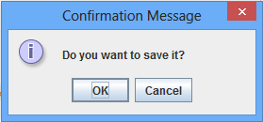
Identifying UI Components (Contd.)
  JOptionPane:
    It is used to display the dialog boxes that prompt users for a value or giving information.
    The following figure shows the Confirmation Message dialog box created using the JOptionPane class.

