Slide 1


Exploring NYC Airbnb Listings
NYC Airbnb Open Data 2019 deep dive.
Objectives: price, availability, geography, hosts analysis.
Tools: Python, Streamlit, Matplotlib, Seaborn, Folium.
Audience: hosts, investors, policymakers for data-driven decisions.
by Kamalnayan Pathak

Slide 2


Market Snapshot: Key Metrics
Total Listings
Avg. vs. Median Price
Comprehensive inventory after filtering
Right-skewed due to luxury outliers
Avg. Availability (365 days)
Indicates demand versus saturation
Price skewness shows luxury influence on averages.

Slide 3
Price Distribution & Borough Comparison
Price Histogram + KDE
Box Plot by Borough
Highlights price spread and skew
Median, IQR, and outliers by borough
Manhattan commands highest prices with market segmentation.

Slide 4
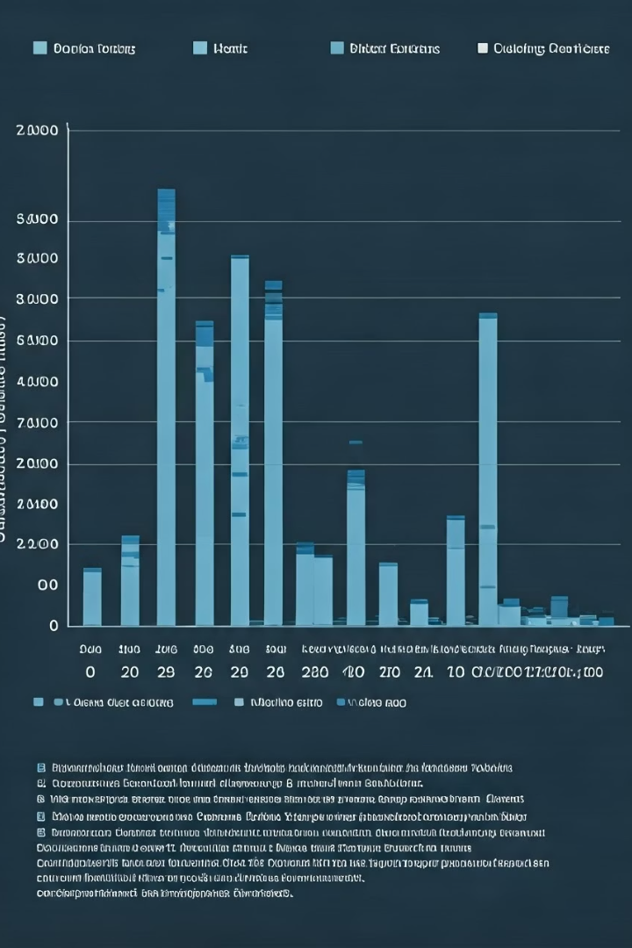
Host Dynamics: Who Runs the Listings?
Small-scale Hosts
Multi-listing Hosts
Make up majority of listings
Act more like business operators
Availability Differences
Signal varied booking strategies

Slide 5
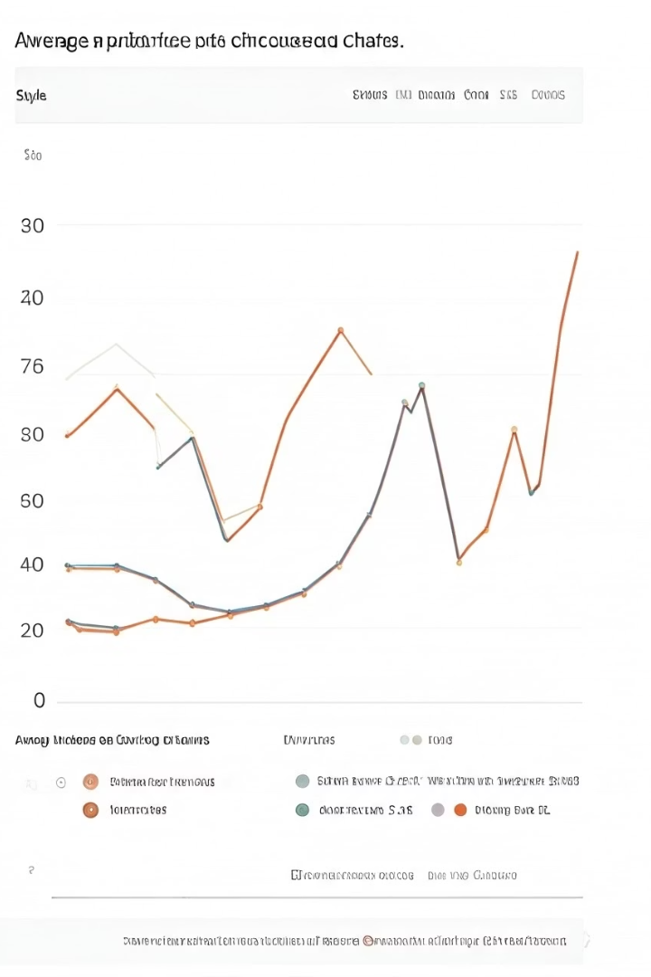



Temporal Trends: Market Activity Over Time
Seasonal Pricing
Correlates with travel patterns
Booking Spikes
Identify peak demand months
Dynamic Pricing
Insights for pricing models

Slide 6
Reviews & Popularity Dynamics
Reviews vs. Price
Reviews vs. Availability
High reviews indicate popularity or value
Top-left cluster shows high booking frequency
Room type clusters reveal pricing sweet spots.

Slide 7
How Do Prices Vary by Location & Room Type?
Borough Price Differences
Room Type Premium
ANOVA reveals significant price variation across boroughs (F=633.75, p<0.05).
Welch’s t-test confirms entire homes cost about $75 more than private rooms (t=95.7, p<0.05).
Manhattan commands the highest average prices.
Market favors whole-unit listings with a clear price premium.
Brooklyn and Queens show moderate pricing.
This highlights geographically driven pricing strategies.

Slide 8
Does Listing Type Affect Availability?
Chi-square result: Room type and availability category are dependent (χ²=72.71, p<0.05).
Availability insight: Entire homes more frequently “Not Available.” Consider calendar incentives to boost bookings.
Correlation highlights: Reviews/month strongly correlates with total reviews (r≈0.68), availability has a weaker link to reviews/month (r≈0.21).
Price impact: Price shows near-zero correlation with reviews/availability, driven mainly by location and type.

Slide 9
Can Availability Predict Price?
Linear Regression Model: Price predicted by availability shows weak influence.
Statistical Results: R²≈0.01, slope β₁= –0.15 (p=0.04) indicates minimal impact.
Key Insight: Availability slightly lowers price but is not a strong factor.
Recommendation: Focus pricing strategies on borough and room type instead.

Slide 10
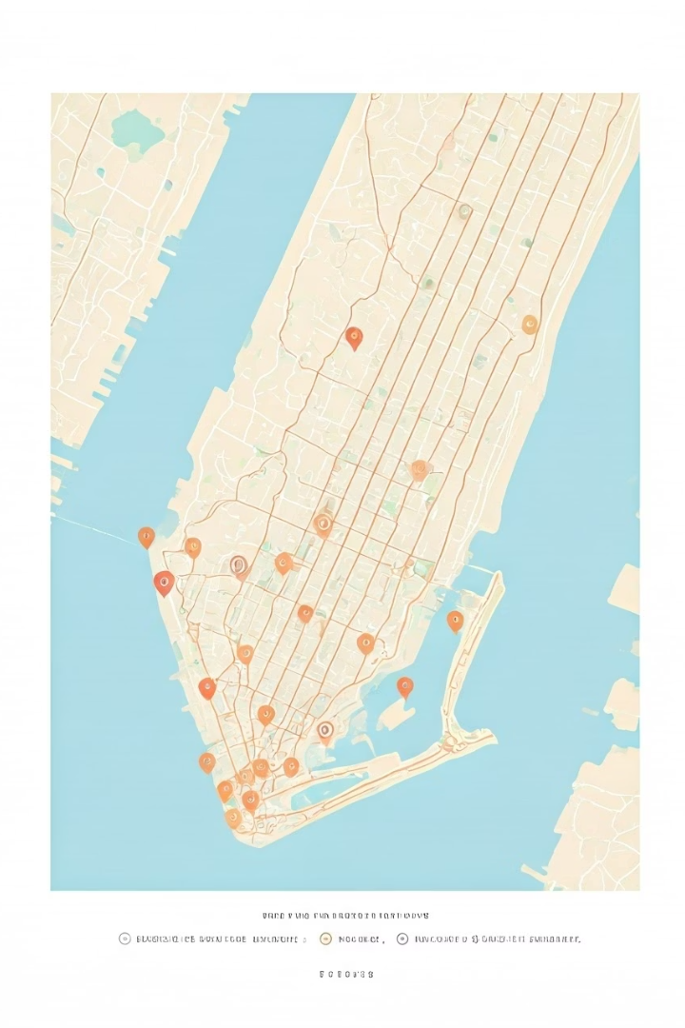



Geo-Visual Analysis: Location, Price & Density
Premium Hotspots
High Density Zones
Investment Strategy
Manhattan, Brooklyn waterfront focus
Indicate supply and competition intensity
Location critical for returns

Slide 11

Strategic Takeaways & Next Steps
1
Pricing Skew
Median better reflects market center
2
Booking Efficiency
Demand and availability patterns matter
3
Host Impact
Business vs. small-scale strategies differ
4
Location & Seasonality
Drive pricing power and returns
Data supports optimized decisions for all stakeholders.

Slide 12
THANK YOU

