Slide 1

Women’s E-Commerce Clothing Reviews
ML Models for Sentiment Analysis

Slide 2

Alfonso Toruno Chris Campbell Himani Manglik Kamal Mukherjee Shivani Thakkar

Slide 3
89% of consumers worldwide make the effort to read reviews before buying products (Trustpilot, 2020), and almost half of all internet users worldwide say they post reviews about a product, company, or service each month (GlobalWebIndex, 2019). Needless to say, companies looking to retain and grow their customer base must be able to interpret and act on the feedback they receive.
Why it Matters

Slide 4

About Our Data
Our dataset came from Kaggle and is a collection of women’s clothing e-commerce reviews, written perspective buyers and actual customers.
All references to retailers have been anonymized.
The raw columns consist of the following:
Clothing ID
Reviewer Age
Review Title
Review Text
Rating
Recommended (binary values)
Positive Feedback Count
Division Name
Department Name
Class Name

Slide 5
Process Overview
ETL Process
ML Analysis
Raw Data Cleanse
Replaced null values with mode values
Transposed the dataframe
Calculated polarity score and sentiment
Data Visualization
Plotly, PIL
Matplotlib, Seaborn
Python, Pandas
ML Toolkits
Wordcloud
NLTK
SciKit-Learn (SkLearn)
ML Analysis Benchmark
Drop stop words
Tokenize & Lemmatize
Identify Positive and Negative words
Processing TD-IDF Matrix
Train, Test, Predict (x5)
Logistic Regression
Support Vector Machines
Naïve Bayes
Random Forest
Neural Network

Slide 6
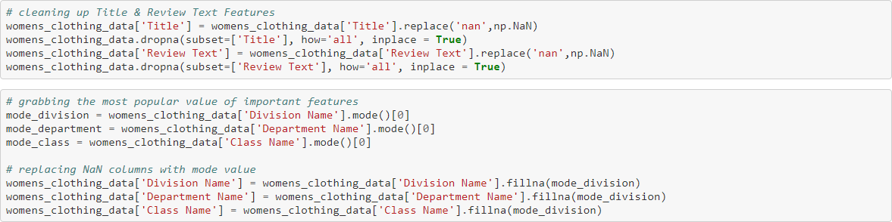
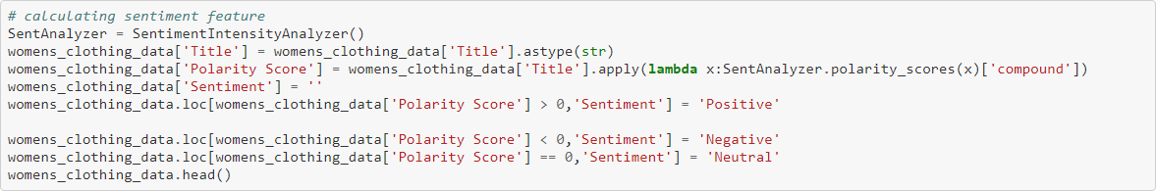
Data Cleaning
Drop & Average Null Values
Drop null ‘Title’ and ‘Review Text’ rows.
Replace null values in the Division, Department and Class Names columns with the mode value of each column.
Calculate polarity score off of the ‘Title’ text and assign a ‘Positive,’ ‘Negative’ or ‘Neutral’ sentiment accordingly.
Save and export the cleaned dataframe for further exploration.

Slide 7
Data Visualizations

Slide 8
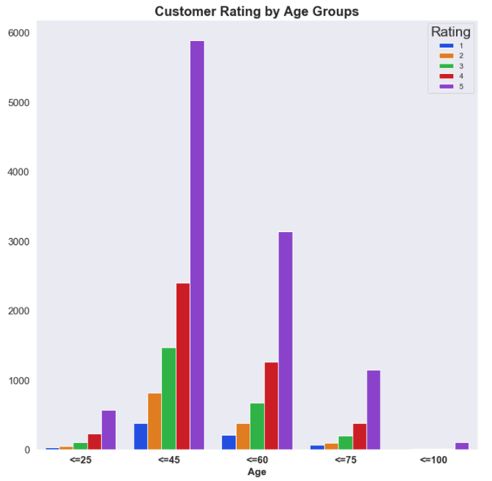
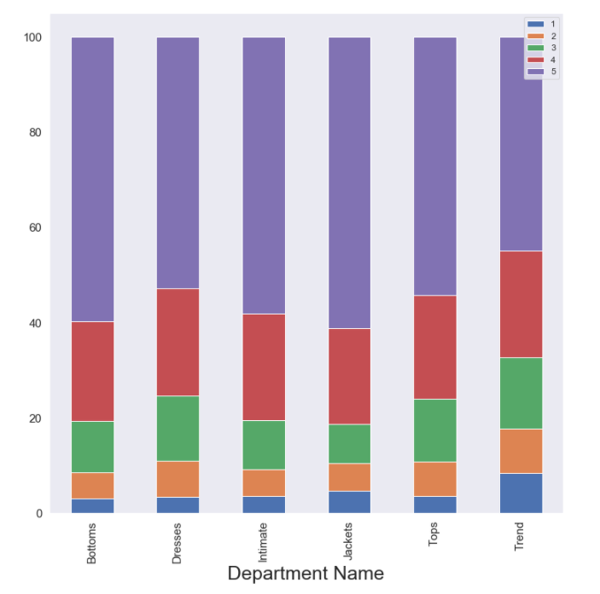
Ratings by Age Group & Department
Notes:
Count of Ratings by Age Group:
0-25: 993
26-45: 10,961
46-60: 5,679
61-75: 1,898
76-99: 144
Rating Percentages by Dept.:
The distribution was similar across all departments. That said, jackets seem to skew slightly better and dresses slightly worse

Slide 9
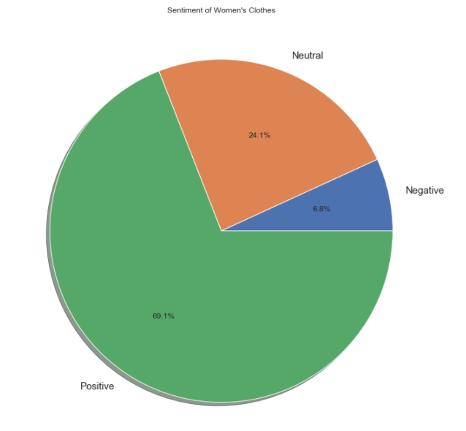
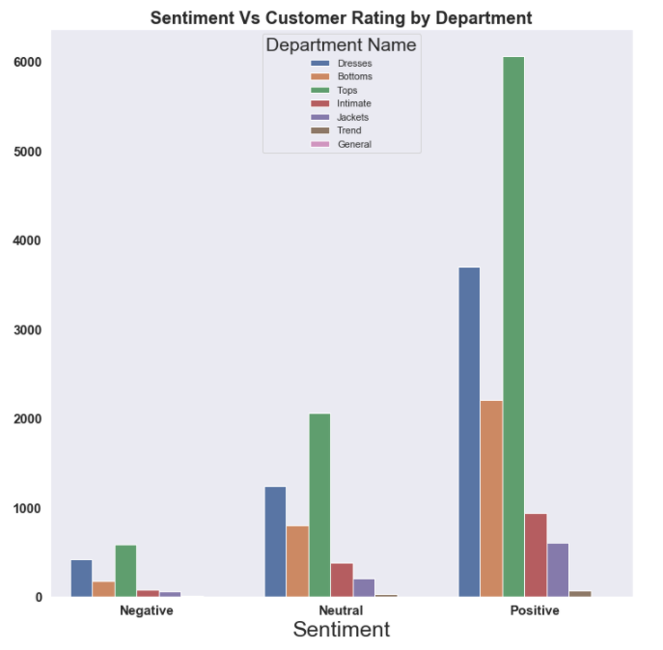
Sentiment Allocation & ‘Sentiment v. Rating’ by Dept.
Notes:
The majority of sentiment is positive with Tops being the most reviewed department name, followed by Dresses and Bottoms.

Slide 10
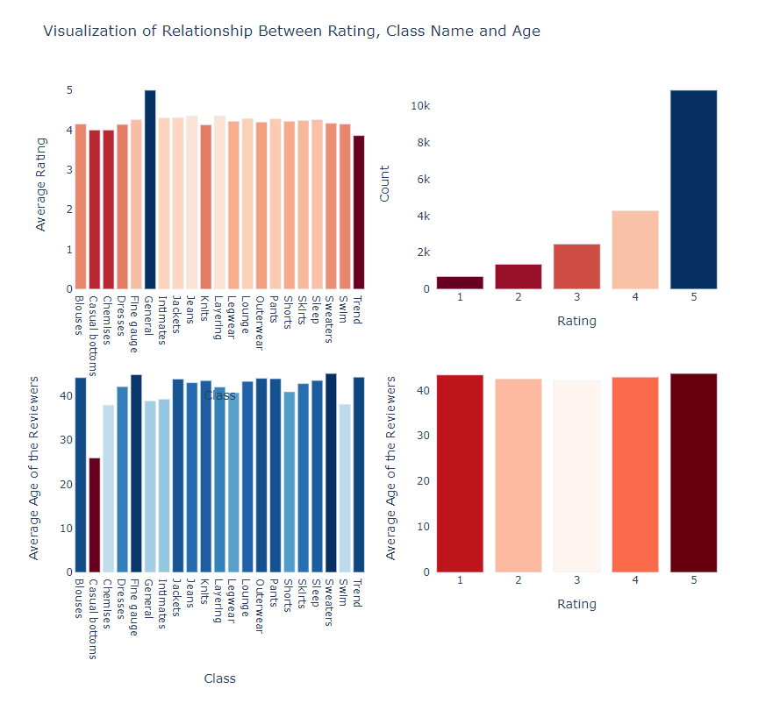
Relationship Between Rating, Class Name and Age
Notes:
There were far more ratings ranked 5 than any other score, with the “General” being the highest driver of perfect 5 ratings.

Slide 11
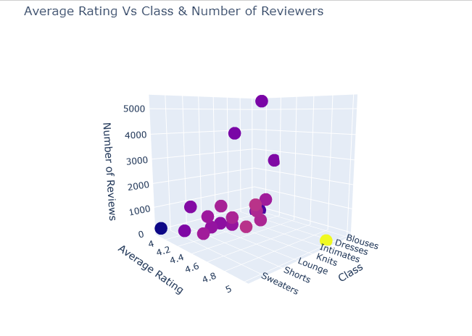
Average Rating v. Class & Number of Reviews
Notes:
While many Class items like Lounge, Layering and Louge averaged fairy high ratings, the majority of reviews were of Blouses, Dresses and Knits.

Slide 12
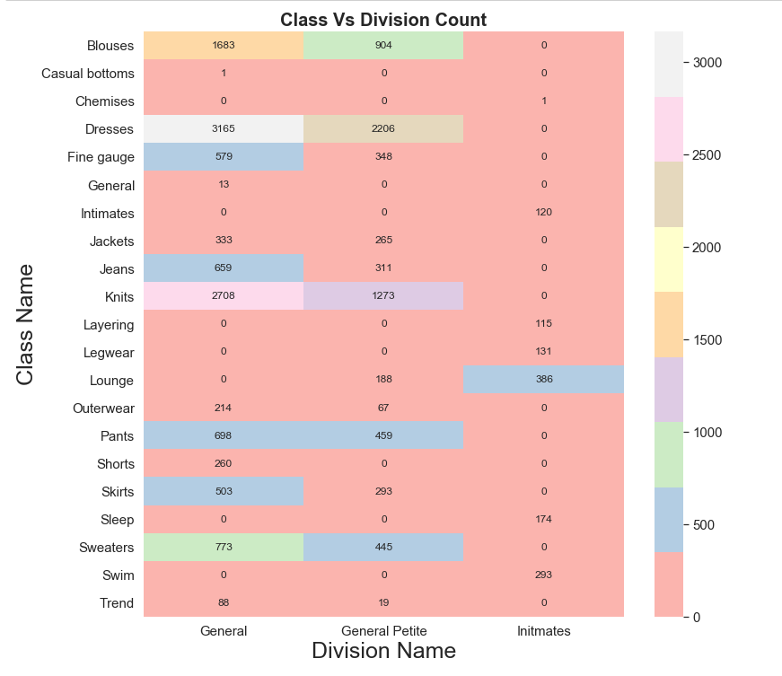
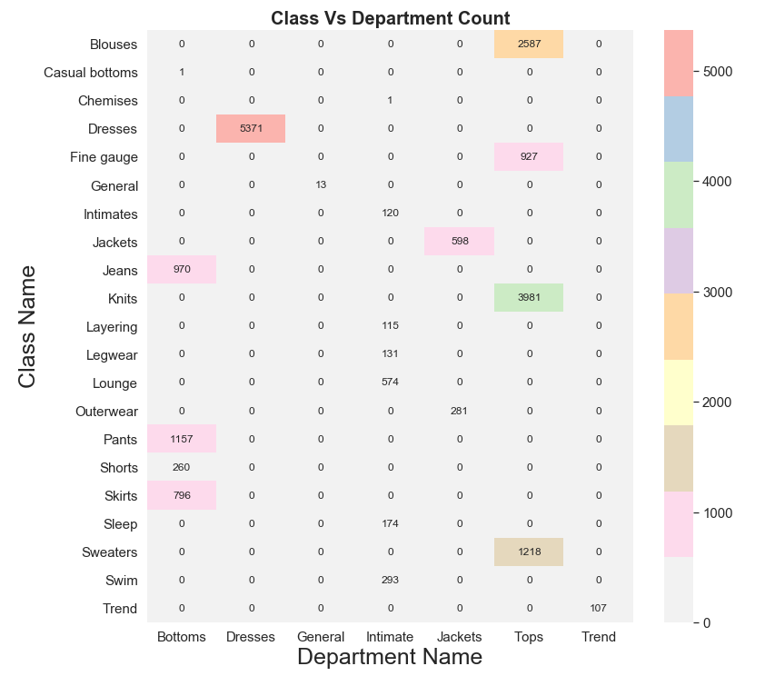
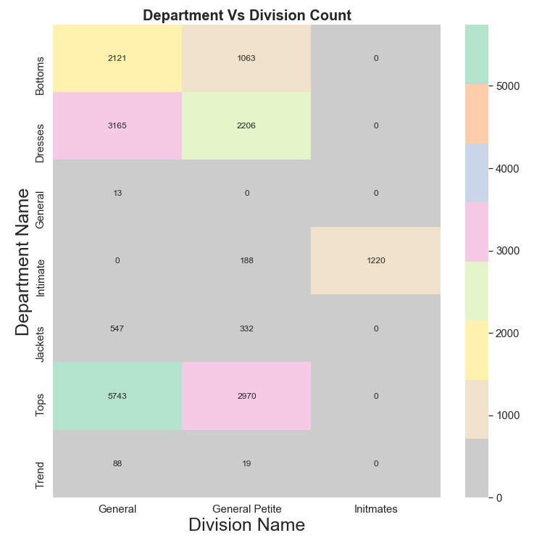
Heatmaps
Notes:
The 3 heatmaps above illustrate the overlap and breakout of review counts by Division > Department > Class.

Slide 13
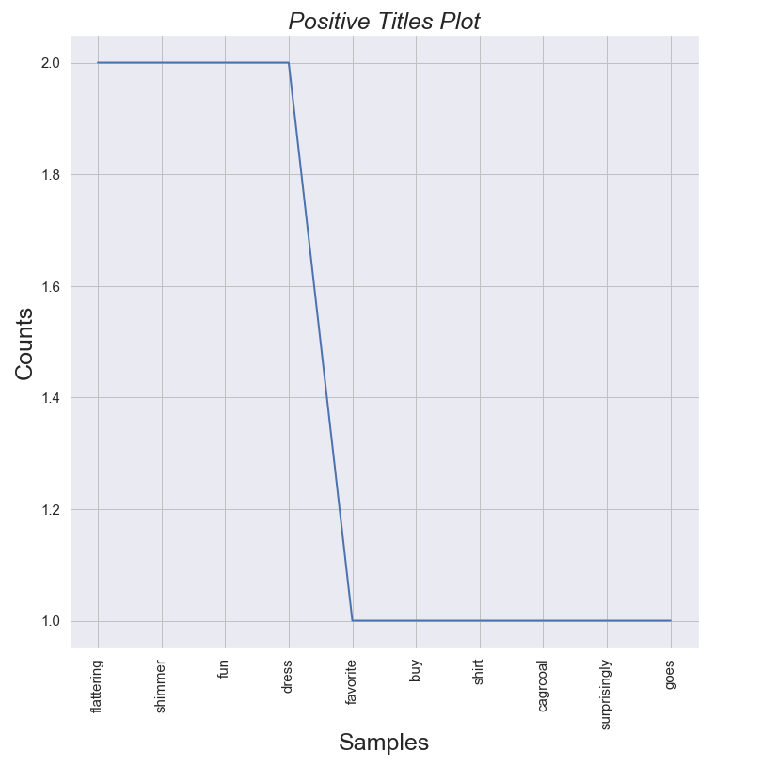
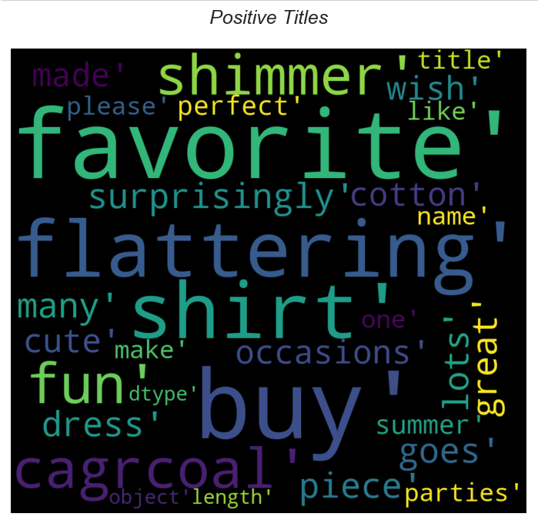
Positive Title Plot & Wordcloud

Slide 14
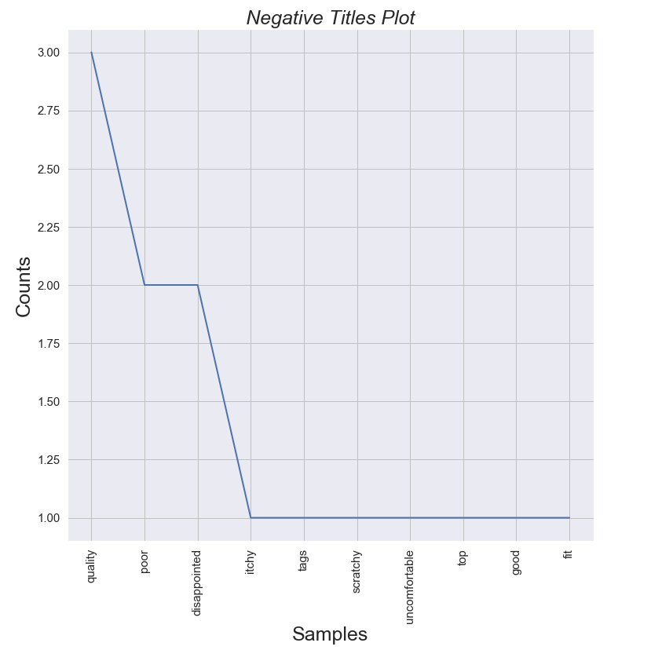
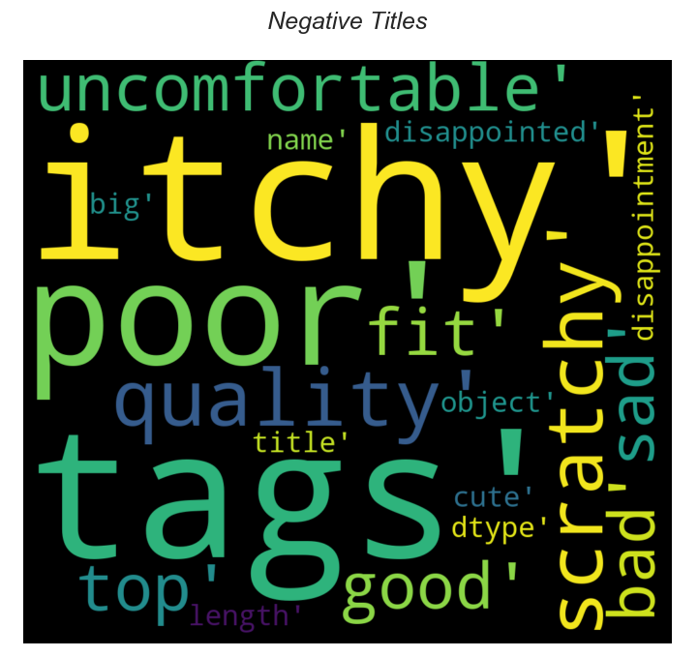
Negative Title Plot & Wordcloud

Slide 15
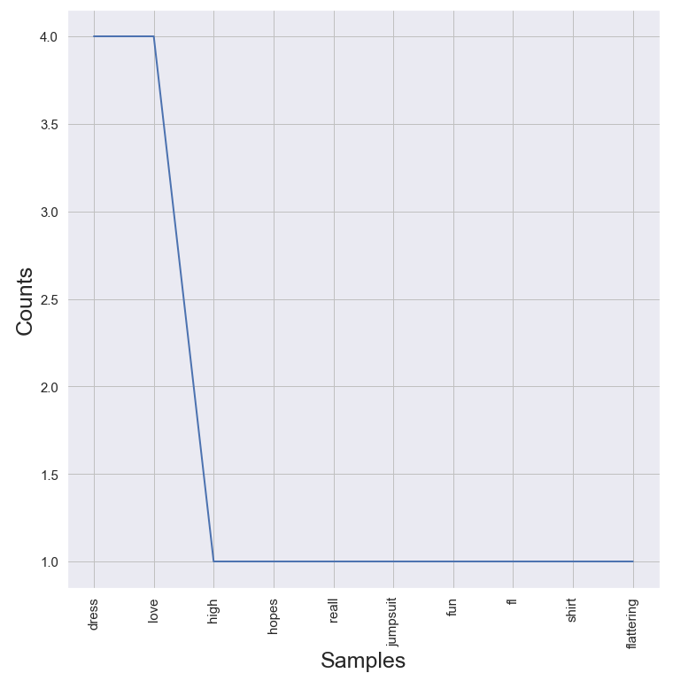
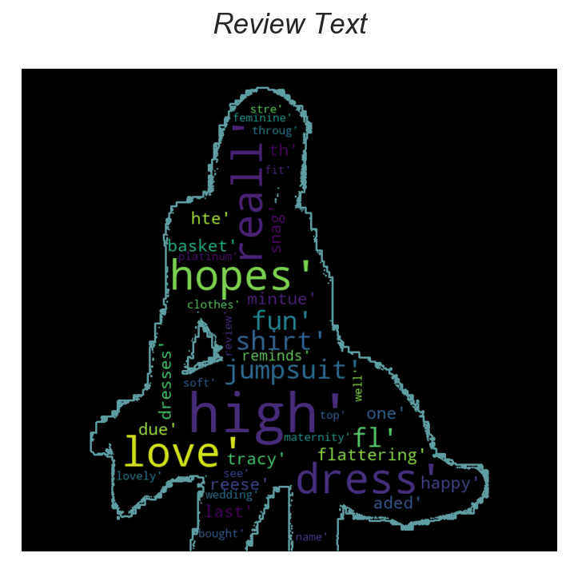
Review Text Plot & Wordcloud

Slide 16
We will feed our dataset into various ML models (e.g. Naive Bayes, Logistic Regression etc.) and compare which model can most accurately predict consumer sentiment. Based on the review text, we want the model to predict which customer is most likely to make a purchase.

Slide 17
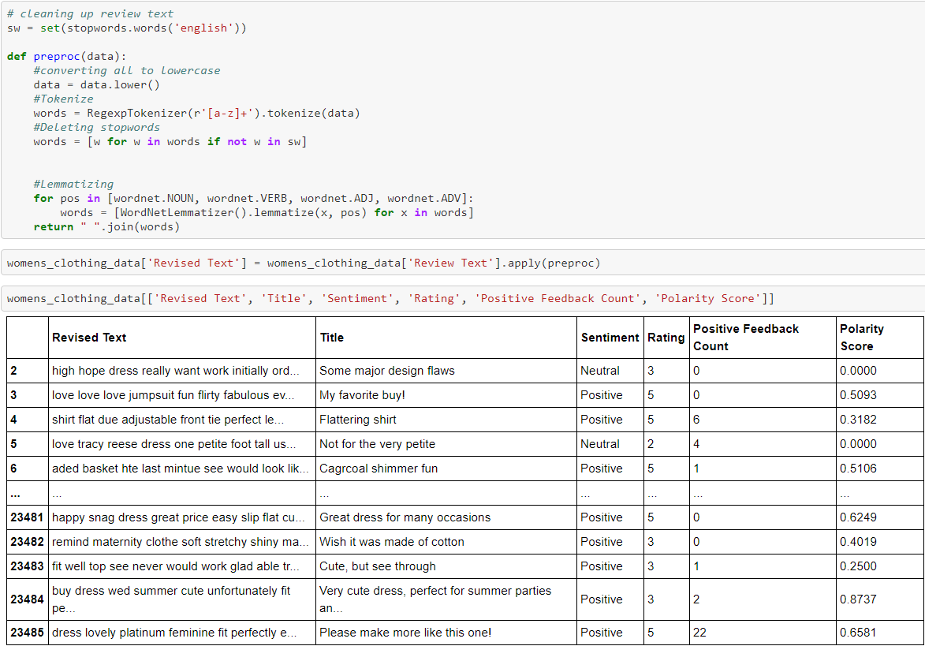
ML Data Prep: ‘preproc()’ function
Drop stop words from the ‘Review Text’ column data.
Tokenize the data using the RegexpTockenizer().
Lemmatize the data.
The ‘preproc()’ function we created applies all three of the above steps to each customer’s ‘Review Text’ and allows us to output a new ‘revised_text’ object.
The new ‘revised_text’ data, along with ‘sentiment_class’ data is then separated into training and testing buckets (at an 80-20% split)

Slide 18
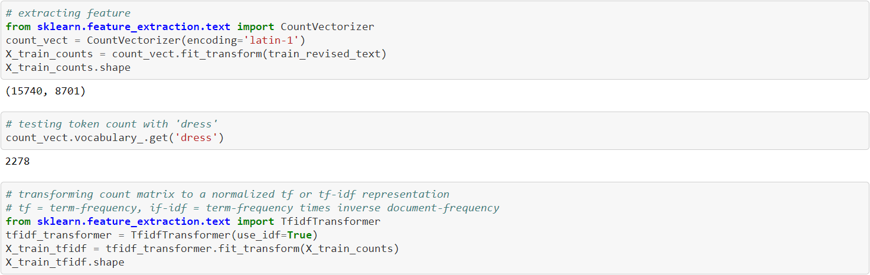
ML Data Prep: TD-IDF Matrix
The last step before running our ‘revised_text’ data through each of the 5 ML models is to scale it based on feature vectors… in other words, identify and weigh the words found in multiple documents so that the model can give prominence to words with more meaning.

Slide 19
Machine Learning Outcomes: Train, Test & Predict (x5):
Logistic Regression
Support Vector Machines
Naive Bayes
Random Forest
Neural Network

Slide 20
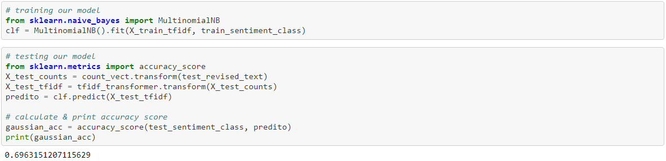
Naive Bayes Accuracy: 69.63%

Slide 21
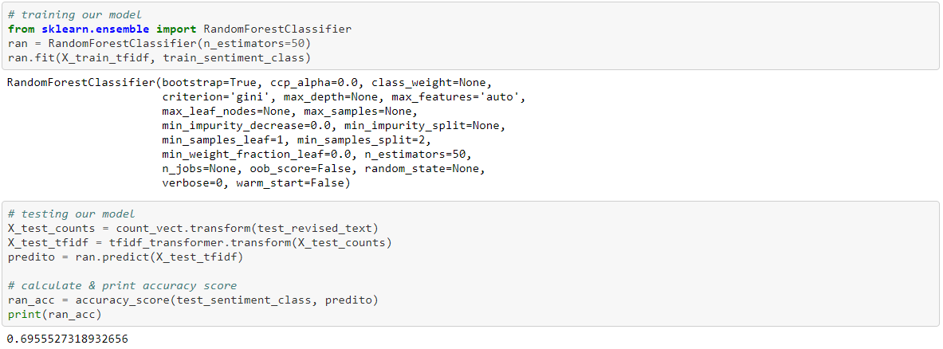
Random Forest Accuracy: 69.56%

Slide 22
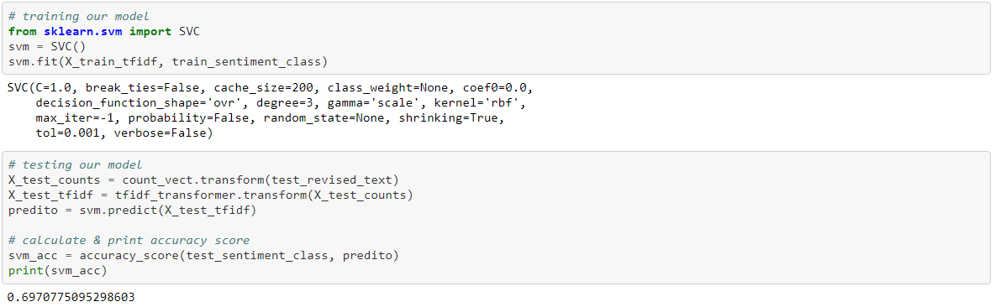
Support Vector Machine Accuracy: 69.71%

Slide 23
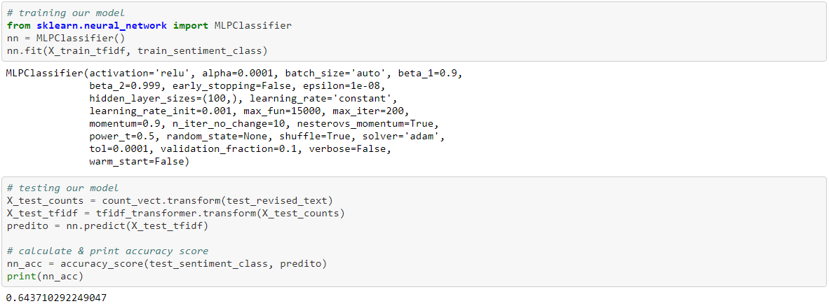
Neural Network Accuracy: 64.37%

Slide 24
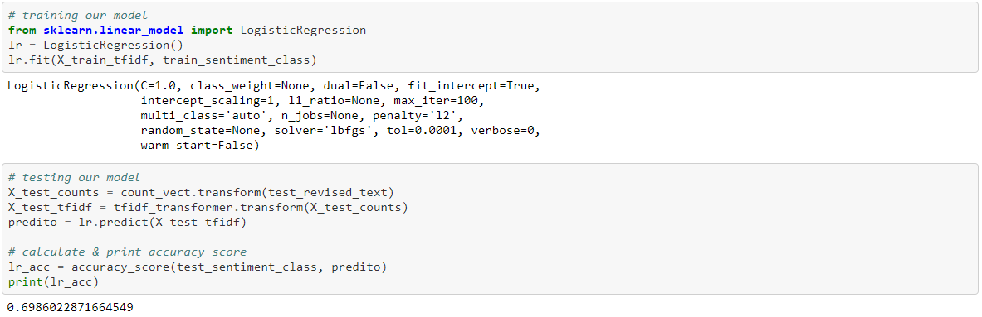
Logistic Regression Accuracy: 69.86%

Slide 25
Analysis
Millennials proved to be the most outspoken with their product reviews, followed by the Generation X. Interesting enough, the youngest age group, Generation Z (who allegedly spend most of their time of smartphones), contributed the least amount of reviews. Due to extremely low participation, we have omitted the “Silent Generation” (i.e. age 76 years or older).
The majority of the reviews in this dataset are incredibly positive (4 & 5), and we see that same trend across all age groups. This e-commerce retailer seem to offer a very well-rounded portfolio that is appealing to most age groups.
Looking at various visualizations between Department, Division and Class Name, consumers left the most reviews about categories like Tops, Dresses and Knits, while leaving far fewer about sleepwear, swimwear, casual bottoms etc.
Our Sentiment Analysis demonstrates that the consumers usually have a strong sentiment one way or the other and for this dataset, less than 25% of the reviewers expressed a neutral sentiment.
While our dataset does not provide any information on actual sales conversions, by looking at other consumer behavior datasets we can confidently assume that customers with positive sentiment are likely to make (or have made) an actual purchase.
We have also processed our dataset through five different machine learning models to project consumer’s sentiment based on their review text. For our dataset Logistic Regression was the most accurate model and Neural Network was the least.

Slide 26
Next Steps
For our own learning and self-improvement we would like to continue to work on following areas beyond this course:
Implement Feature Engineering and Hyper Parameterization to fine tune our models.
Identify datasets that provide review information along with sales conversion and abandon cart information so that we can provide more accurate predictions.
Convert our Jupyter Notebook into a Python app with Bootstrap / ES6 frontend and deploy it on Heroku, AWS or similar platform.

