Slide 1
Parallel Convex Hull & K-Means using OpenMP and MPI Respectively
By – akash Gujarathi & KAMAL PATHAK

Slide 2

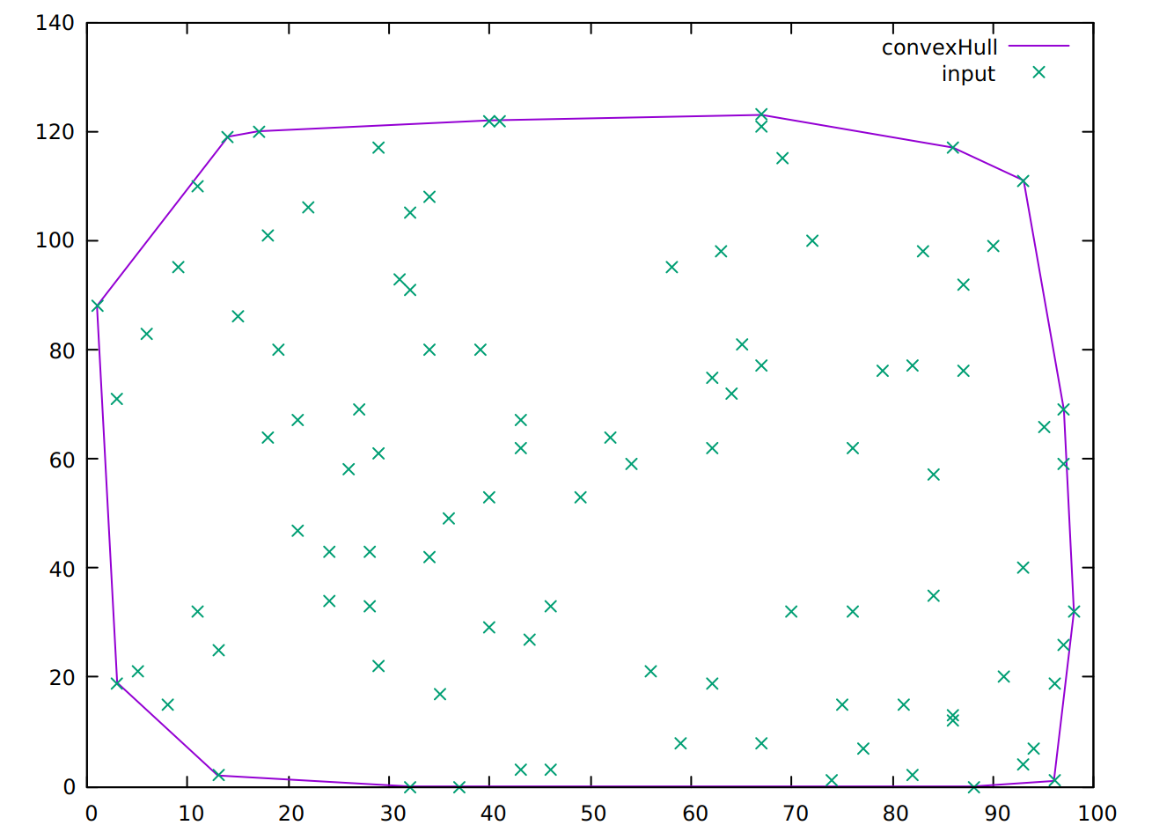

Convex Hull
Smallest convex polygon set that contains all the points in given set.
Algorithms for solving convex hull problems
Gift Wrapping aka Jarvis march: Θ($n^{2}$)
Graham scan: O(nlogn)
Quick Hull: O($n^{2}$)
Andrew’s Algorithm: O(nlogn)
Chan’s Algorithm: O(nlogn)
Output for 100 2-D input points

Slide 3
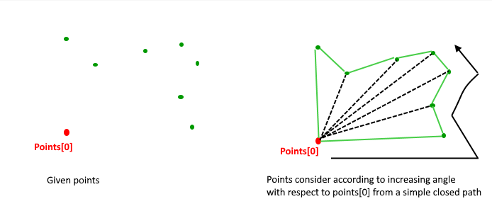
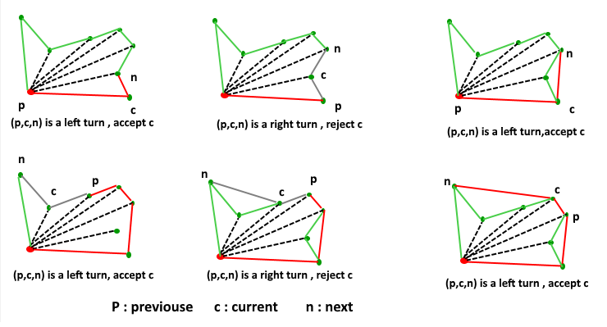
Graham Scan Algorithm
Find bottom most point comparing ‘y’ coordinate, same value of y smallest ‘x’ value is considered
Sort the remaining ‘n-1’ points by angles in anticlockwise, if two values are same then choose the nearest value first
Check for same angle: remove the points of same angle from the set and just keep the farthest point ‘P0’, Let new result array_size = size
If size < 3 then convex hull is not possible
Else, Create a stack and push first 3 points in stack
Process remaining size-3 points, for every point
Keep removing points from the stack while the orientation of following 3 points is not anticlockwise
Point next to top of stack
Point at the top of the stack
Point[i]
Push points[i] to stack
Print Content of stack

Slide 4
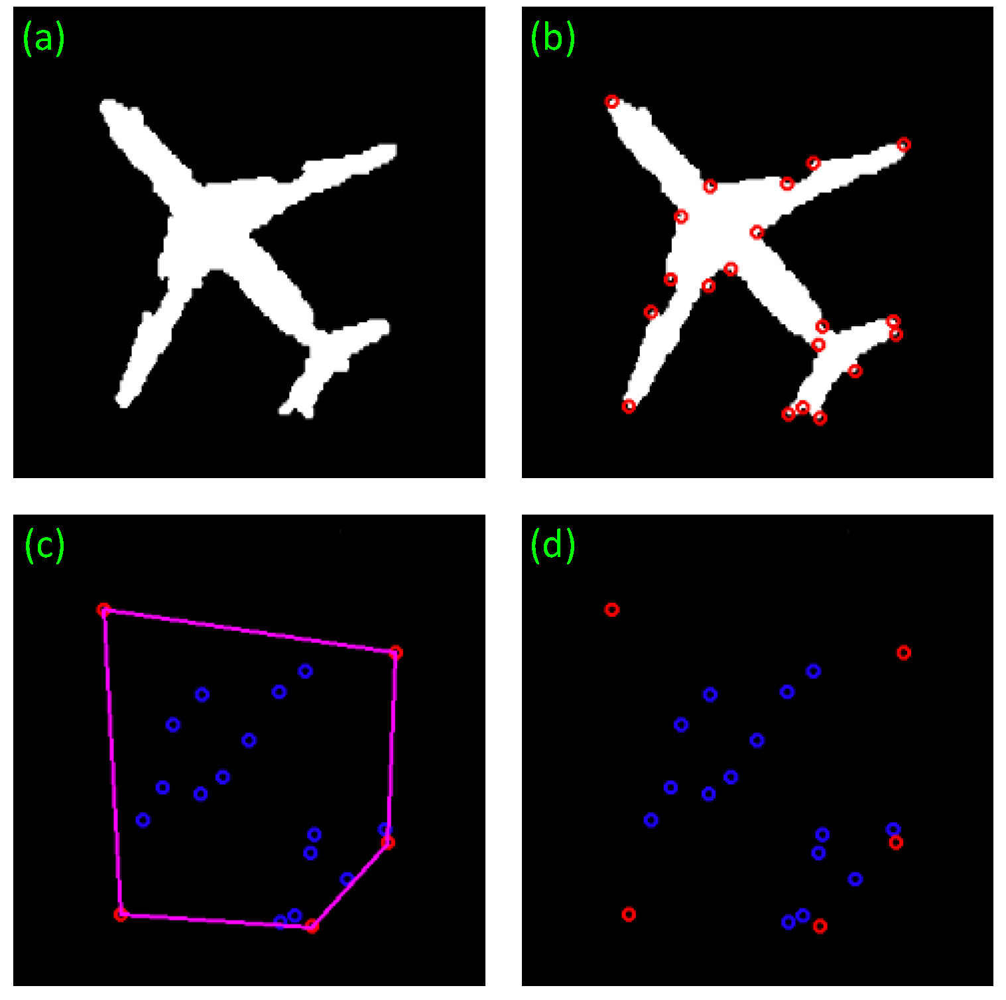
Applications & High Performance
Image Processing
Pattern recognition
Statistics
Game Theory
Geographic information system
In real world all the applications require high performance and have large input data (millions….billions…)

Slide 5
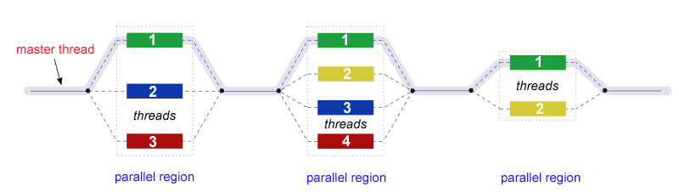
OpenMP
Application programming interface (API) that supports multi-platform shared memory multiprocessing programming in C, C++ and Fortran
OpenMP is implementation of multithreading, a method of parallelizing, where by master thread forks a specific number of worker thread and divides the task among them
#pragma omp parallel for num_threads(omp_get_max_threads()) schedule(static/dynamic/guided/auto/runtime) private (variables) shared (variables)

Slide 6
Parallel Algorithm
#pragma omp parallel for num_threads(omp_get_max_threads()) schedule(guided)
#pragma for
{
Check for same angle: remove the points of same angle from the set and just keep the farthest point ‘P0’, Let new result array_size = size
If size < 3 then convex hull is not possible
Else, Create a stack and push first 3 points in stack
}
#pragma for
{
Process remaining size-3 points, for every point
Keep removing points from the stack while the orientation of following 3 points is not anticlockwise
Point next to top of stack
Point at the top of the stack
Point[i]
Push points[i] to stack
}

Slide 7
#pragma omp parallel for num_threads(noOfThreads) schedule(guided)
for (int i=1; i<n; i++)
{
while (i < n-1 && orientation(p0, points[i],points[i+1]) == 0)
i++;
points[m] = points[i];
m++;
}
if (m < 3) { exit(2); }
std::stack<Point> S;
S.push(points[0]); S.push(points[1]); S.push(points[2]);
#pragma omp for
for (int i = 3; i < m; i++)
{
while (orientation(nextToTop(S), S.top(), points[i]) != 2) { S.pop(); }
S.push(points[i]);
}

Slide 8
Output Time Analysis
Data \ Threads | 1(Sequential) | 2 | 3 | 4
10 | 0 | 0 | 0 | 1
50 | 0 | 0 | 0 | 4
100 | 0 | 0 | 3 | 5
500 | 0 | 0 | 0 | 0
1000 | 0 | 0 | 0 | 2
10000 | 6 | 5 | 5 | 5
100000 | 71 | 66 | 69 | 75
10000000 | 100032 | 50477 | 25144 | 9030

Slide 9
Sequential vs Parallel

Slide 10
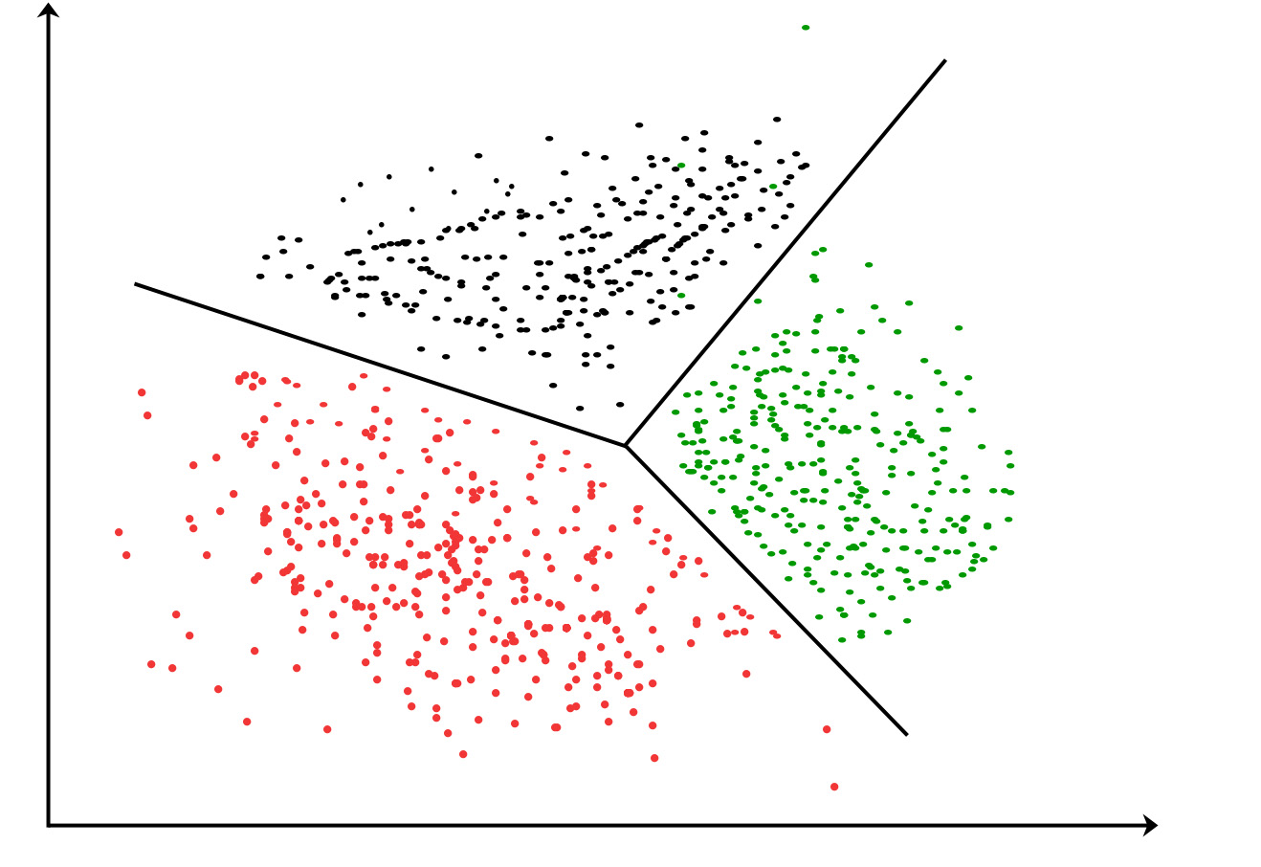
Clustering
What is Clustering ?
Clustering is the task of assigning a set of objects into groups (called clusters) so that the objects in the same cluster are more similar (in some sense or another) to each other than to those in other clusters.
As an example: animals can be clustered as land animals, water animals and amphibians.

Slide 11
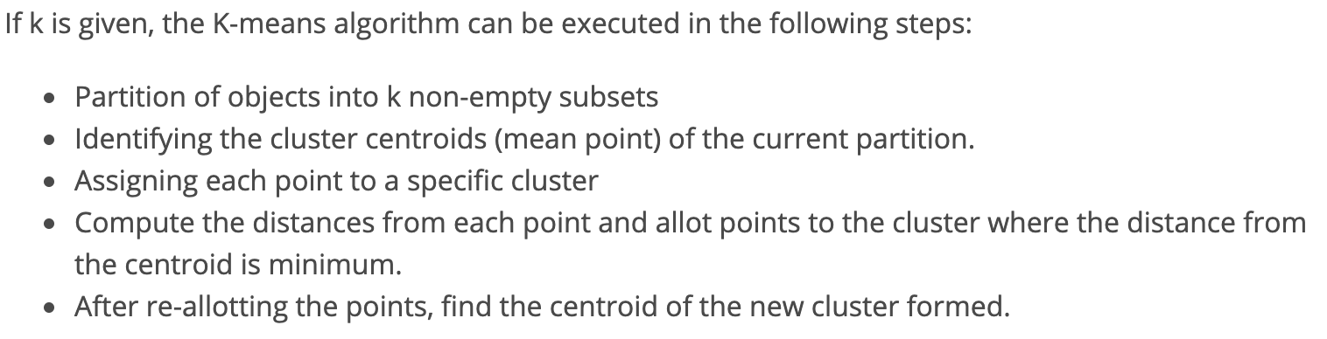
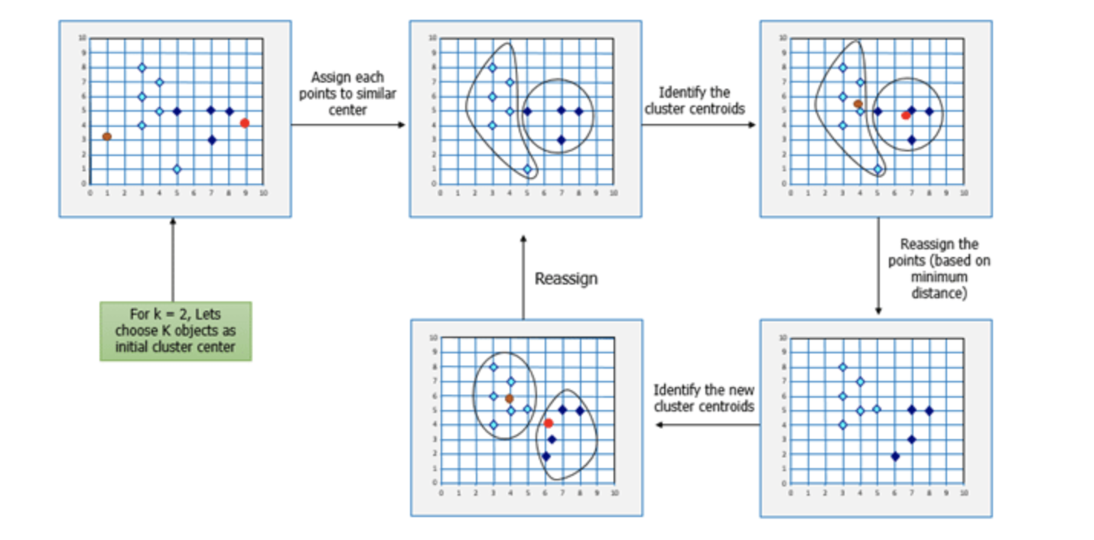
K-means Clustering
k-means clustering is a method of clustering which aims to partition n data points into k clusters (n >> k) in which each observation belongs to the cluster with the nearest mean.
The nearness is calculated by distance function which is mostly Euclidian distance or Manhattan distance.
K-means clustering : Sequential algorithm

Slide 12
MPI (Message Passing Interface)
MPI is a specification for the developers and users of message passing libraries. By itself, it is NOT a library - but rather the specification of what such a library should be.
MPI primarily addresses the message-passing parallel programming model: data is moved from the address space of one process to that of another process through cooperative operations on each process.
Simply stated, the goal of the Message Passing Interface is to provide a widely used standard for writing message passing programs. The interface attempts to be:
Portable
Efficient
Flexible

Slide 13
K-Means Implementation using MPI
Consider N data points each of it is vector and P processors.
Assign N/P data points to each processor.
Node 0 randomly choose K points and assigns them as cluster means and broadcast.
In each processor for each data point find membership using the cluster mean.
Recalculate local means for each cluster in each processor.
Globally broadcast all local means for each processor find the global mean.
Go to step (3) and repeat until the number of iterations > 10000 or number of points where membership has changed is less than 0.1 %.

Slide 14
Time Analysis (Sequential vs Parallel)
Clustering Time (ms)
Number of Data Points

Slide 15
Time Analysis (MPI Time Readings)
Number of Processors
 | 2 | 4 | 8 | 16
1000 | 0.0316 | 0.0176 | 0. 01065 | 0.00789
10000 | 0.3552 | 0.2097 | 0. 10899 | 0. 05737
100000 | 4.0649 | 2.1348 | 1. 02921 | 0.53855
1000000 | 22.5727 | 16.5231 | 8.12979 | 5.03628
Number of Data Points

Slide 16
Applications
Document Classification
Delivery Store Optimization
Identifying Crime Localities
Customer Segmentation
Fantasy League Stats Analysis

Slide 17
References
Lutz Kettner, Kurt Mehlhorn, Sylvain Pion, Stefan Schirra, Chee Yap, Classroom examples of robustness problems in geometric computation, ScienceDirect, 13 July 2007
Website: https://www.openmp.org/ accessed: 04/25/2019.
Tim Mattson, Larray Meadows, A “Hands-on” Indroduction to OpenMP

Slide 18
Thank You!

