Slide 1

KNOWLEDGE DISTILLATION IN NEURAL NETWORK
By -
Sarthak Rawat (2021202006)
Shreyash Agrawal (2021201074)
Kamal Phoolwani (2021201054)

Slide 2
OUTLINE
Knowledge Distillation
Model Compression
Hard Target and Soft Targets
Experiments
MNIST Dataset
CIFAR10
Conclusion
References

Slide 3
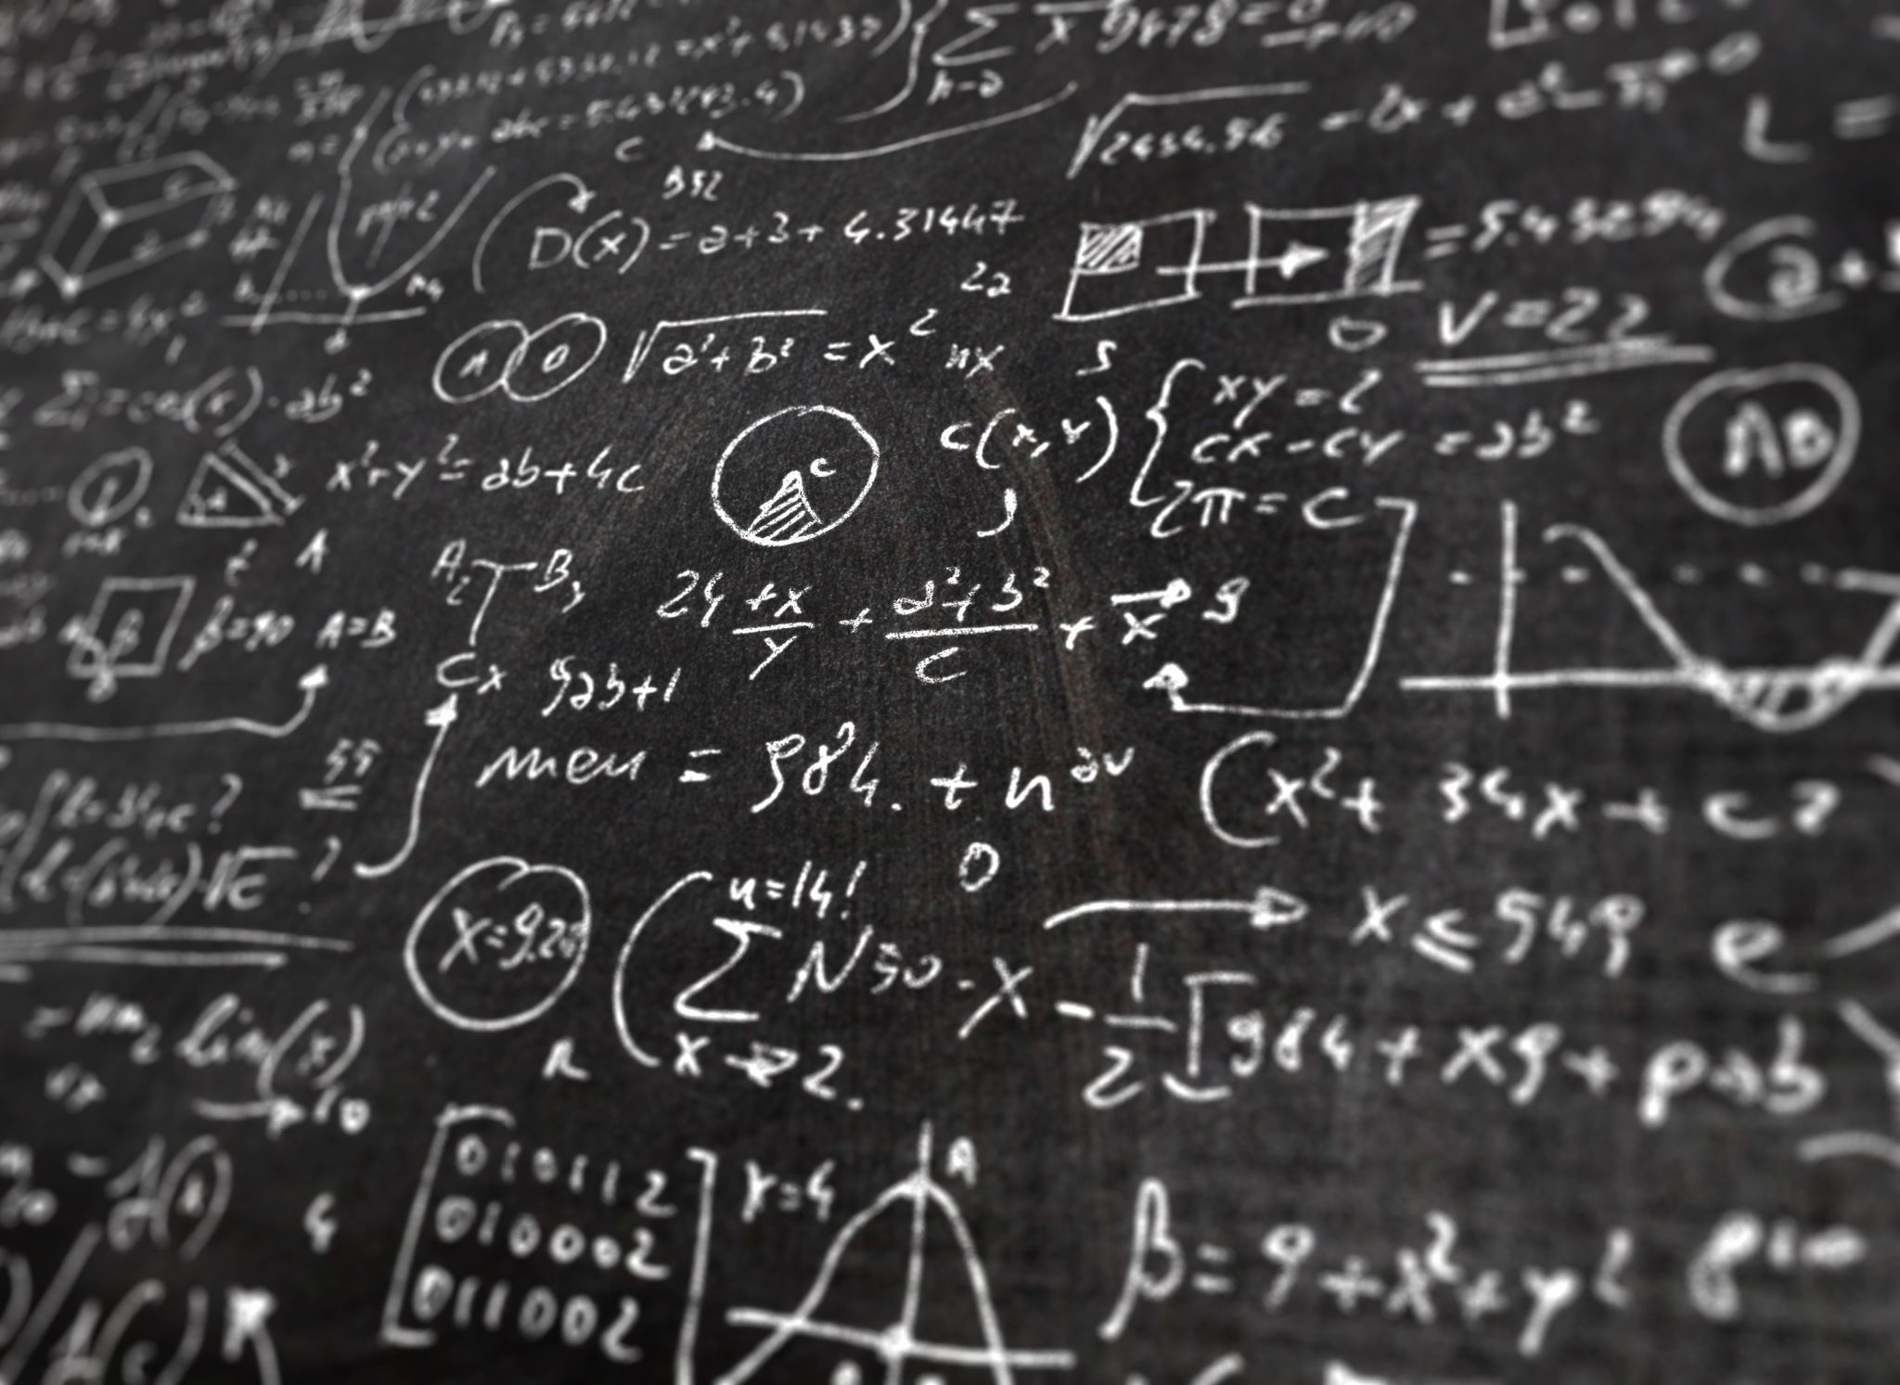
Keywords
Knowledge
Distillation
Temperature
Logits
SoftMax
KL Diversions

Slide 4
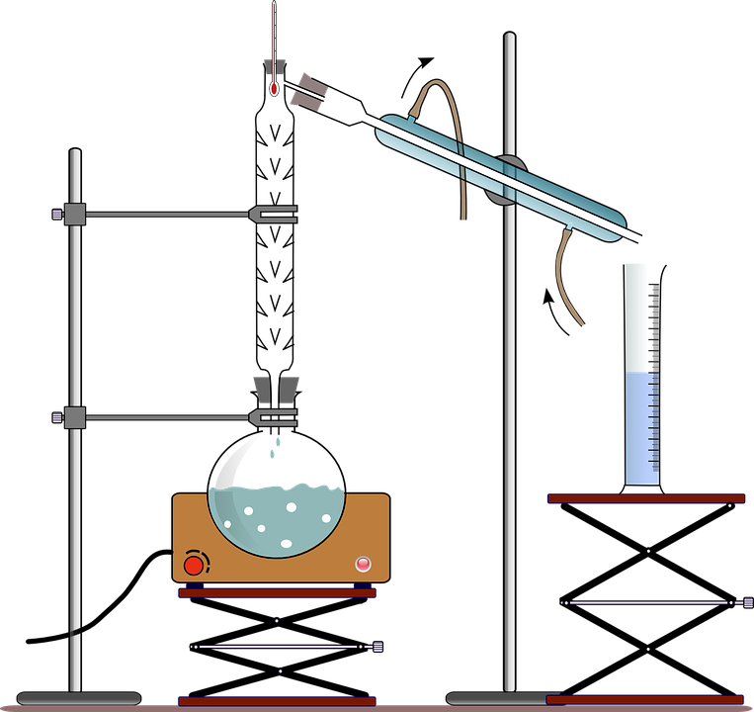
Knowledge Distillation
Knowledge distillation is a process of distilling or transferring the knowledge from a (set of) large, cumbersome model(s) to a lighter, easier-to-deploy single model, without significant loss in performance.

Slide 5
Model Compression
Ensemble Learning
Cumbersome and may be too computationally expensive
Solution
The knowledge acquired by a large ensemble of models can be transferred to a single small model.
We call “distillation” to transfer the knowledge from the cumbersome model to a small model that is more suitable for deployment.

Slide 6
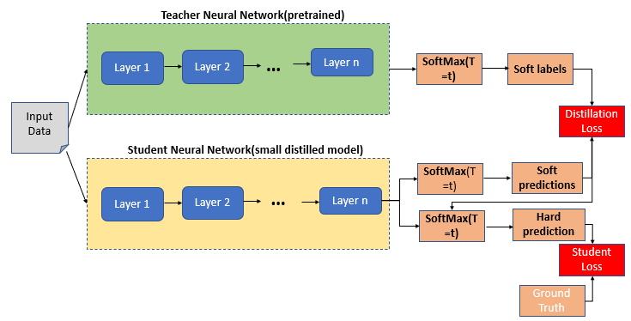
Knowledge Distillation

Slide 7
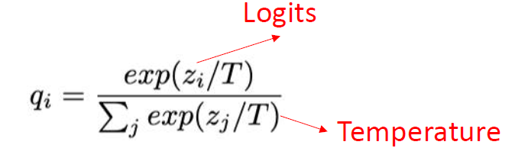
Distillation
Distillation loss uses the soft targets to minimize the squared difference between the logits produced by the cumbersome model and the logits produced by the small model.
Knowledge is transferred to the distilled model by training the cumbersome model with a high temperature in its SoftMax to generate soft target distribution. The same high temperature is used for training the distilled model, but after it has been trained, it uses a temperature of 1.

Slide 8
Hard Targets and Soft Targets
Hard targets are generated when using a SoftMax function. Using the SoftMax function, the model almost always produces the correct answer with very high confidence and has very little influence during transfer of Knowledge from Teacher to Student.
Soft targets use the logits, the inputs to the final SoftMax rather than the SoftMax's probabilities as the targets for learning the small model. When the soft targets have high entropy, they provide much more information per training case than hard targets.

Slide 9
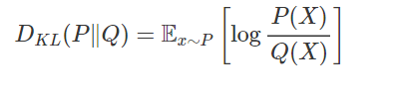
KL Divergence
The Kullback-Leibler divergence (hereafter written as KL divergence) is a measure of how a probability distribution differs from another probability distribution. Classically, in Bayesian theory, there is some true distribution P(X)P(X); we'd like to estimate with an approximate distribution Q(X)Q(X). In this context, the KL divergence measures the distance from the approximate distribution QQ to the true distribution PP.
Mathematically, consider two probability distributions P,QP,Q on some space XX. The Kullback-Leibler divergence from QQ to PP (written as DKL(P∥Q))

Slide 10
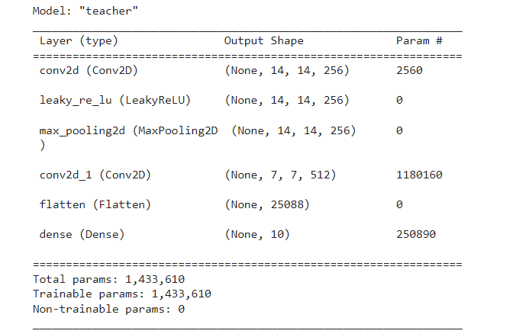
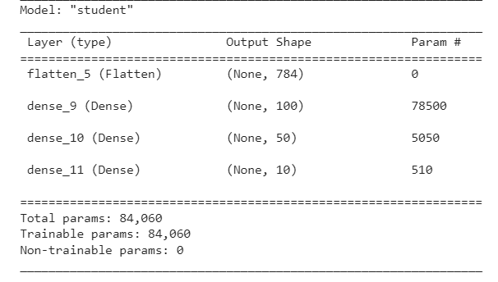
MNIST Dataset

Slide 11
MNIST Dataset
Teacher Accuracy: 97.86%
Student Model (without Distillation)
Accuracy - 91.28%
Epochs – 10
Ground Truth Loss - Sparse Categorical Cross-entropy
Student Model(with Distillation)
Accuracy – 91.86%
Epochs - 10
Alpha – 0.1
Temperature – 3
Distillation Loss - KL Divergence
Ground Truth Loss - Sparse Categorical Cross-entropy

Slide 12
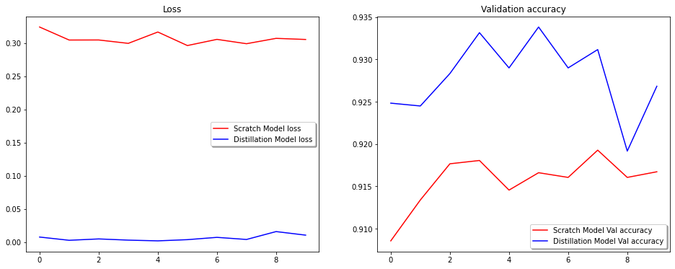
Distilled VS Scratch Model

Slide 13
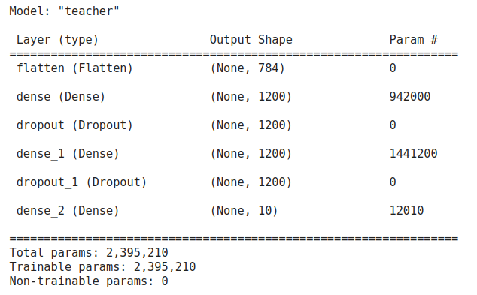

MNIST Dataset (training without 3)

Slide 14
MNIST Dataset (training without 3)
We trained the student model with the data without label 3. The teacher model was trained on the complete dataset.
Teacher Model had 2 hidden layers both with 1200 units each.
Student Model had 2 hidden layers with 800 units each and temperature was set to 7.
Despite this, the student learned the parameters required for classifying 3 and was able to generalize well over the unseen translations.
The model gave accuracy of 74.75 on test data with only 3.

Slide 15
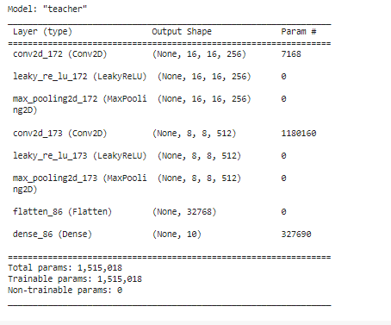
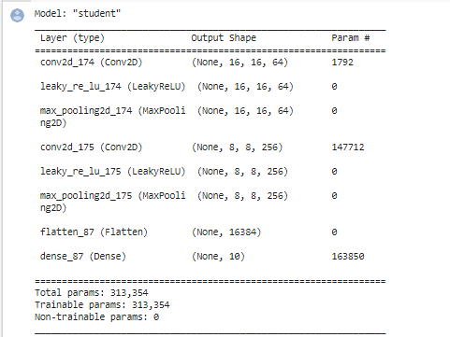
CIFAR10 Dataset

Slide 16
CIFAR10 Dataset
Teacher Accuracy: 76.12%
Student Model (with distillation)
Accuracy - 71.07%
Epochs - 5
Alpha – 0.3
Temperature – 2
Distillation Loss - KL Divergence
Ground Truth Loss - Sparse Categorical Cross-entropy
Student Model (without distillation)
Accuracy - 70.19%
Epochs - 5
Loss - Sparse Categorical Cross-entropy

Slide 17
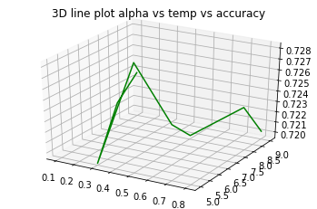
3D plot

Slide 18
CIFAR10 with RESNet
Teacher
Accuracy – 82.1 %
Epochs – 9
Student
Accuracy – 83.1 %
Epochs – 11
Alpha – 0.5
Temperature – 1
Distillation Loss - KL Divergence
Ground Truth Loss - Sparse Categorical Cross-entropy

Slide 19
Conclusion
We have shown that distilling works very well for transferring knowledge from an ensemble or from a large highly regularized model into a smaller, distilled model.
On MNIST, distillation works remarkably well even when the transfer set that is used to train the distilled model lacks any examples of one or more of the classes.
On CIFAR10, according to our observations an increase in accuracy was found in distillation model.

Slide 20

References
https://keras.io/examples/vision/knowledge_distillation/
https://medium.com/analytics-vidhya/knowledge-distillation-in-a-deep-neural-network-c9dd59aff89b
https://arxiv.org/abs/1910.02551

