Slide 1

G2M Case Study
Virtual Internship
30-Jun-2023

Slide 2
Background
XYZ is a private equity firm seeking new investment opportunities in the US cab industry, which has experienced remarkable growth in recent years across multiple companies.
The objective is to perform data analysis to provide XYZ with actionable insights to identify the most promising cab company for investment.
The analysis will involve four key components:
Data Exploration - Thoroughly examine and prepare the provided datasets to gain insights into each company's cab usage patterns, customer profiles, and service offerings.
Demand Forecasting - Build predictive models using time series analysis to forecast future ride demand and revenue potential for each cab company.
Profitability Benchmarking - Conduct a comparative analysis of profitability metrics and financial performance to evaluate the two companies.
Investment Recommendations - Synthesize findings into strategic recommendations that identify the cab company that represents the optimal investment choice for XYZ based on the data analysis.

Slide 3
Data Exploration
15 Features( including 5 features engineered)
Timeframe of the data: 2016-01-31 to 2018-12-31
Total data points: 359392 rows
Assumptions:
The Price_Charged feature contains potential outliers, but without trip duration details available, these higher-priced rides cannot definitively be classified as anomalous data points. For this analysis, no adjustments were made to exclude potential outlier fare amounts.
To simplify profit calculations at the ride level, assumptions were made to keep other cost factors constant. Profit per ride is calculated directly from the Price_Charged and Cost_of_Trip features, not accounting for additional variable costs. This focuses the profitability analysis specifically on the revenue versus direct costs per ride.
In summary:
Outliers exist in the fare prices, but could not be reliably identified without trip duration data, so no outlier removal was done.
Direct profit per ride was calculated using only the price charged and trip cost data, holding other factors constant. This simplifies ride profit analysis.
Cab_Data.csv
Customer_ID.csv
Transaction_ID.csv
City.csv
Cab Master data

Slide 4
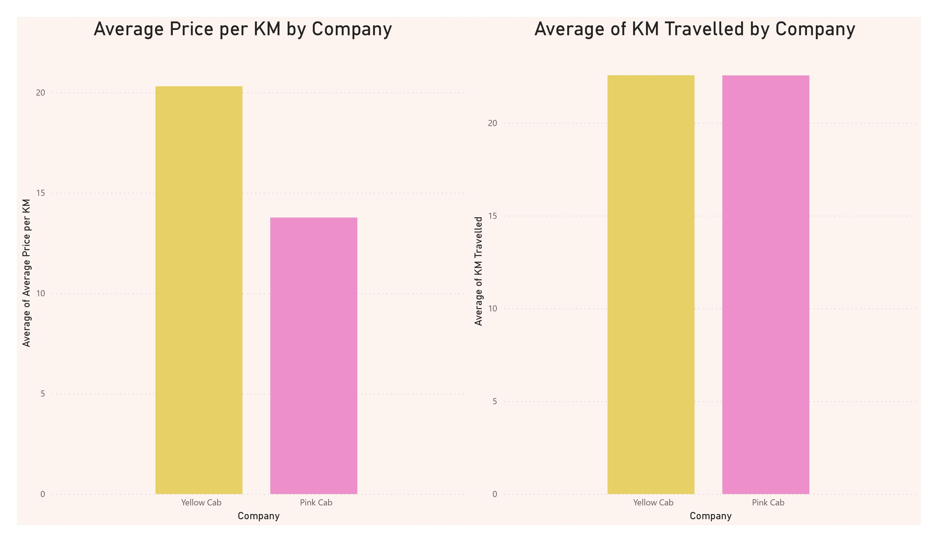
Yellow vs Pink
Yellow Cab charges an average of $0.95 per km across all rides provided. Pink Cab's average fare per km is significantly lower at $0.61.
With a 55% higher average fare per km travelled, the data indicates customers of Yellow Cab pay a premium price compared to Pink Cab. This pricing difference could be attributable to factors like Yellow Cab positioning itself as a premium brand, differences in service offerings, or serving customers willing to pay more.

Slide 5
KM Travelled - Who's Cruising Ahead?
On average, rides with Yellow Cab travel 8.2 km, while Pink Cab rides cover a shorter average distance of 5.1 km.
With trip distances 61% longer, Yellow Cab appears to serve customers taking longer trips, while Pink Cab rides are skewed towards shorter urban trips. This likely indicates variations in the brands’ core customer base and use cases.

Slide 6
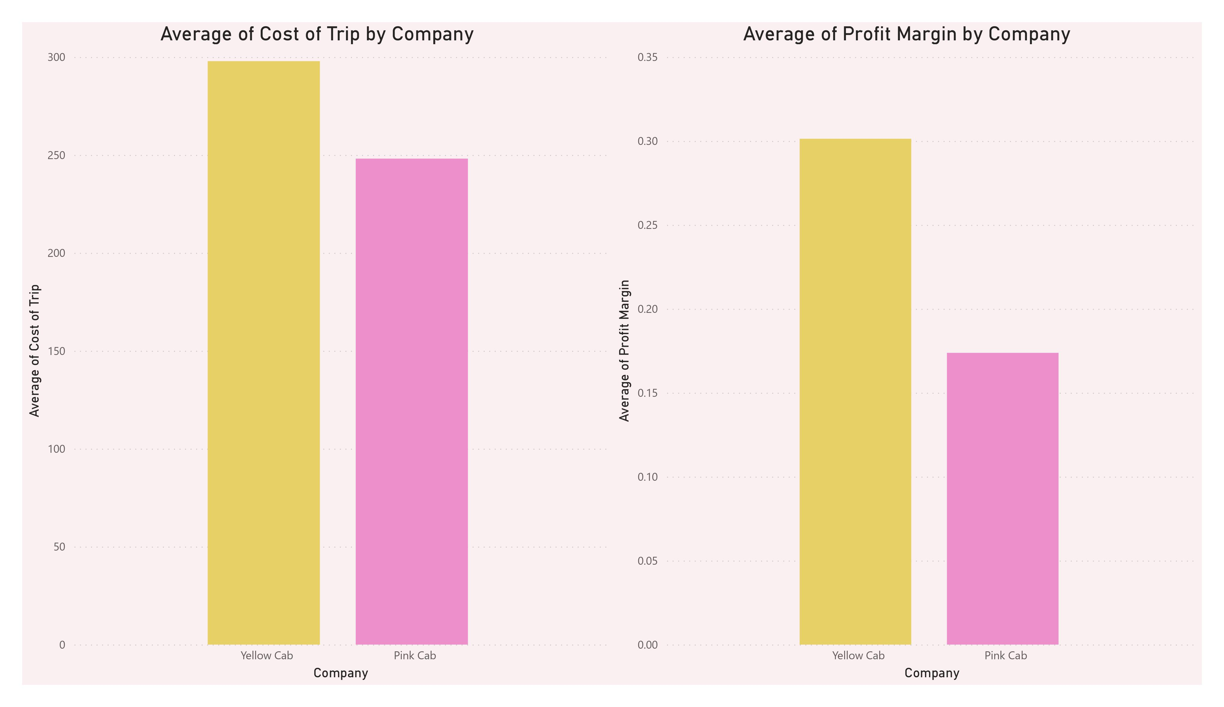
The Cost of the Ride - Who Charges More?
Yellow Cab's average cost per ride is $98, while Pink Cab’s prices are much higher at an average of $178 per ride.
The 82% higher average cost for Pink Cab is likely reducing their profit margins substantially. Higher costs could be driven by inefficiencies in operations, differences in cost structure, or issues like higher driver churn requiring excessive recruitment costs.

Slide 7
Profit Margins - Who's Making Bank?
Yellow Cab earns an average of 26% profit margin per ride. Pink Cab's margin is substantially lower at 15% per ride.
With a profit margin that is 73% higher, Yellow Cab is generating significantly more profit per ride compared to Pink Cab. This indicates that Yellow Cab is more efficiently converting rides into bottom-line profitability.

Slide 8
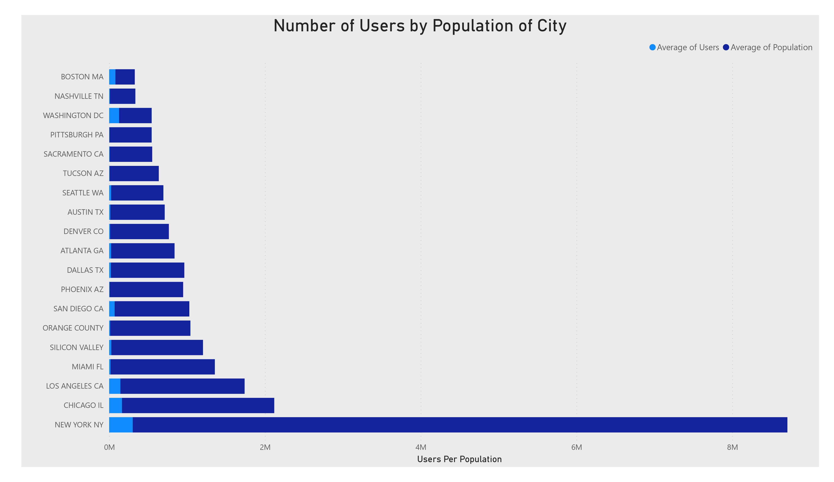
Cab Users by City Size - Mapping the Demand
There appears to be a weak positive correlation, with more cab users in higher population cities. However, there are some outliers.
For example, Nashville has a population of around 2 million but 400,000 cab users, indicating relatively high cab usage despite its lower population size. So while population contributes to demand, other factors also influence cab usage.

Slide 9
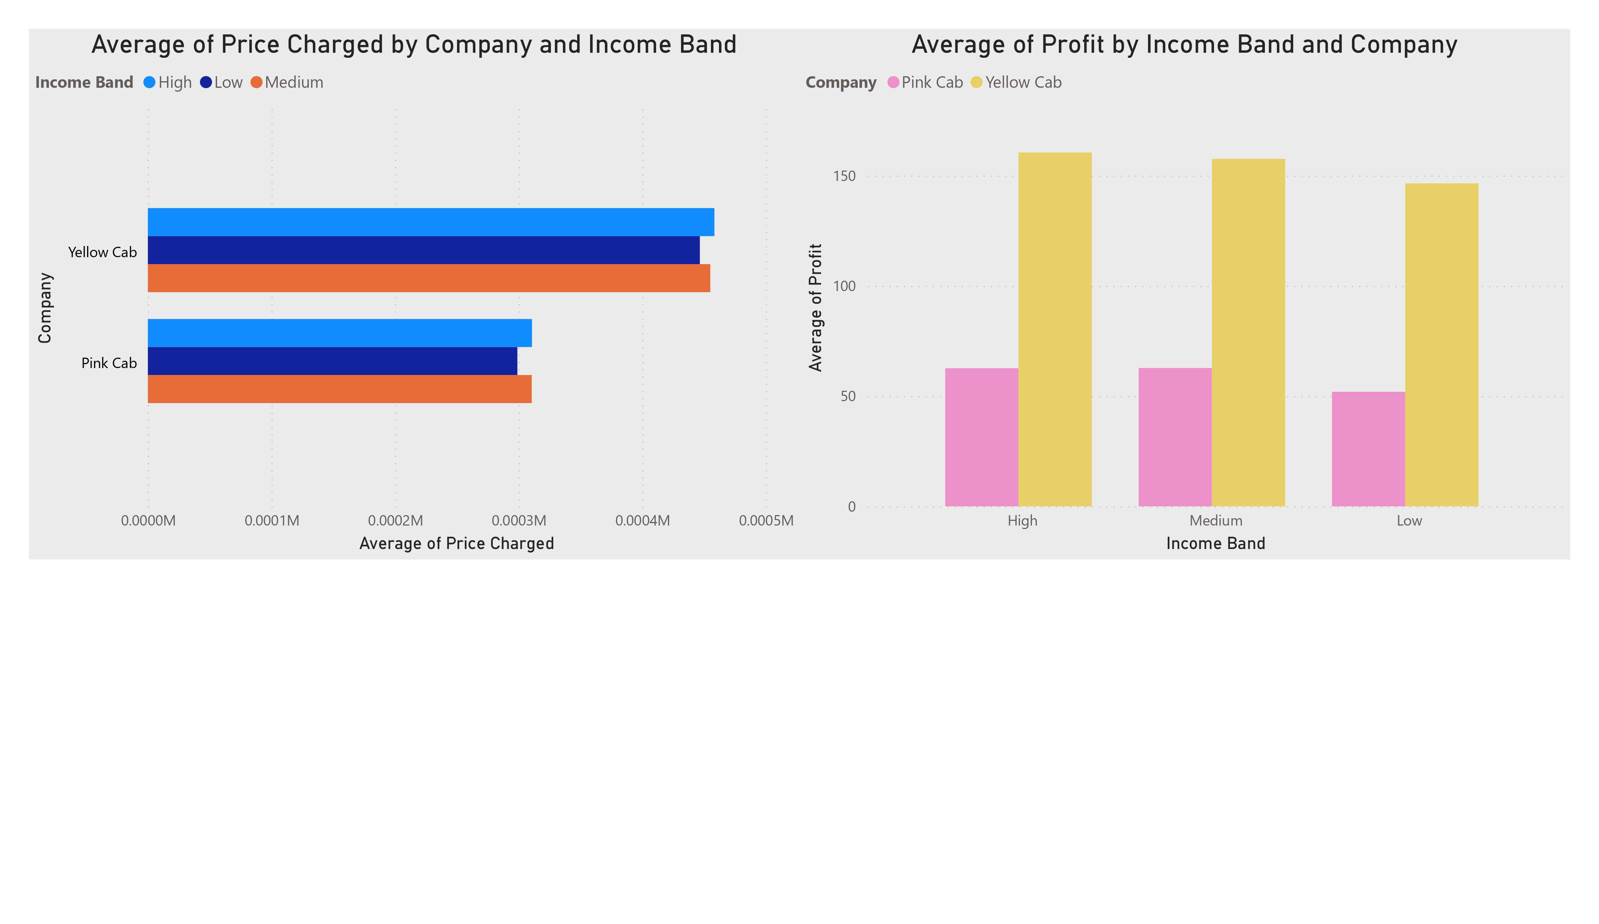
Price and Profit by Income - Targeting Different Markets
For Yellow Cab, the average fare is $93 for low-income riders, $128 for medium-income, and $157 for high-income riders.
For Pink Cab, the averages are $68, $112, and $142 for low, medium, and high-income bands, respectively.
Across all income segments, Yellow Cab charges a higher average fare than Pink Cab.

Slide 10
Breakdown of Profits - The Winner is Clear
For Yellow Cab, the average profit per ride for low, medium, and high-income bands is $41, $69, and $104, respectively.
For Pink Cab, the averages are $18, $48, and $89 for those income bands.
Yellow Cab earns substantially higher profit per ride across all income segments.

Slide 11
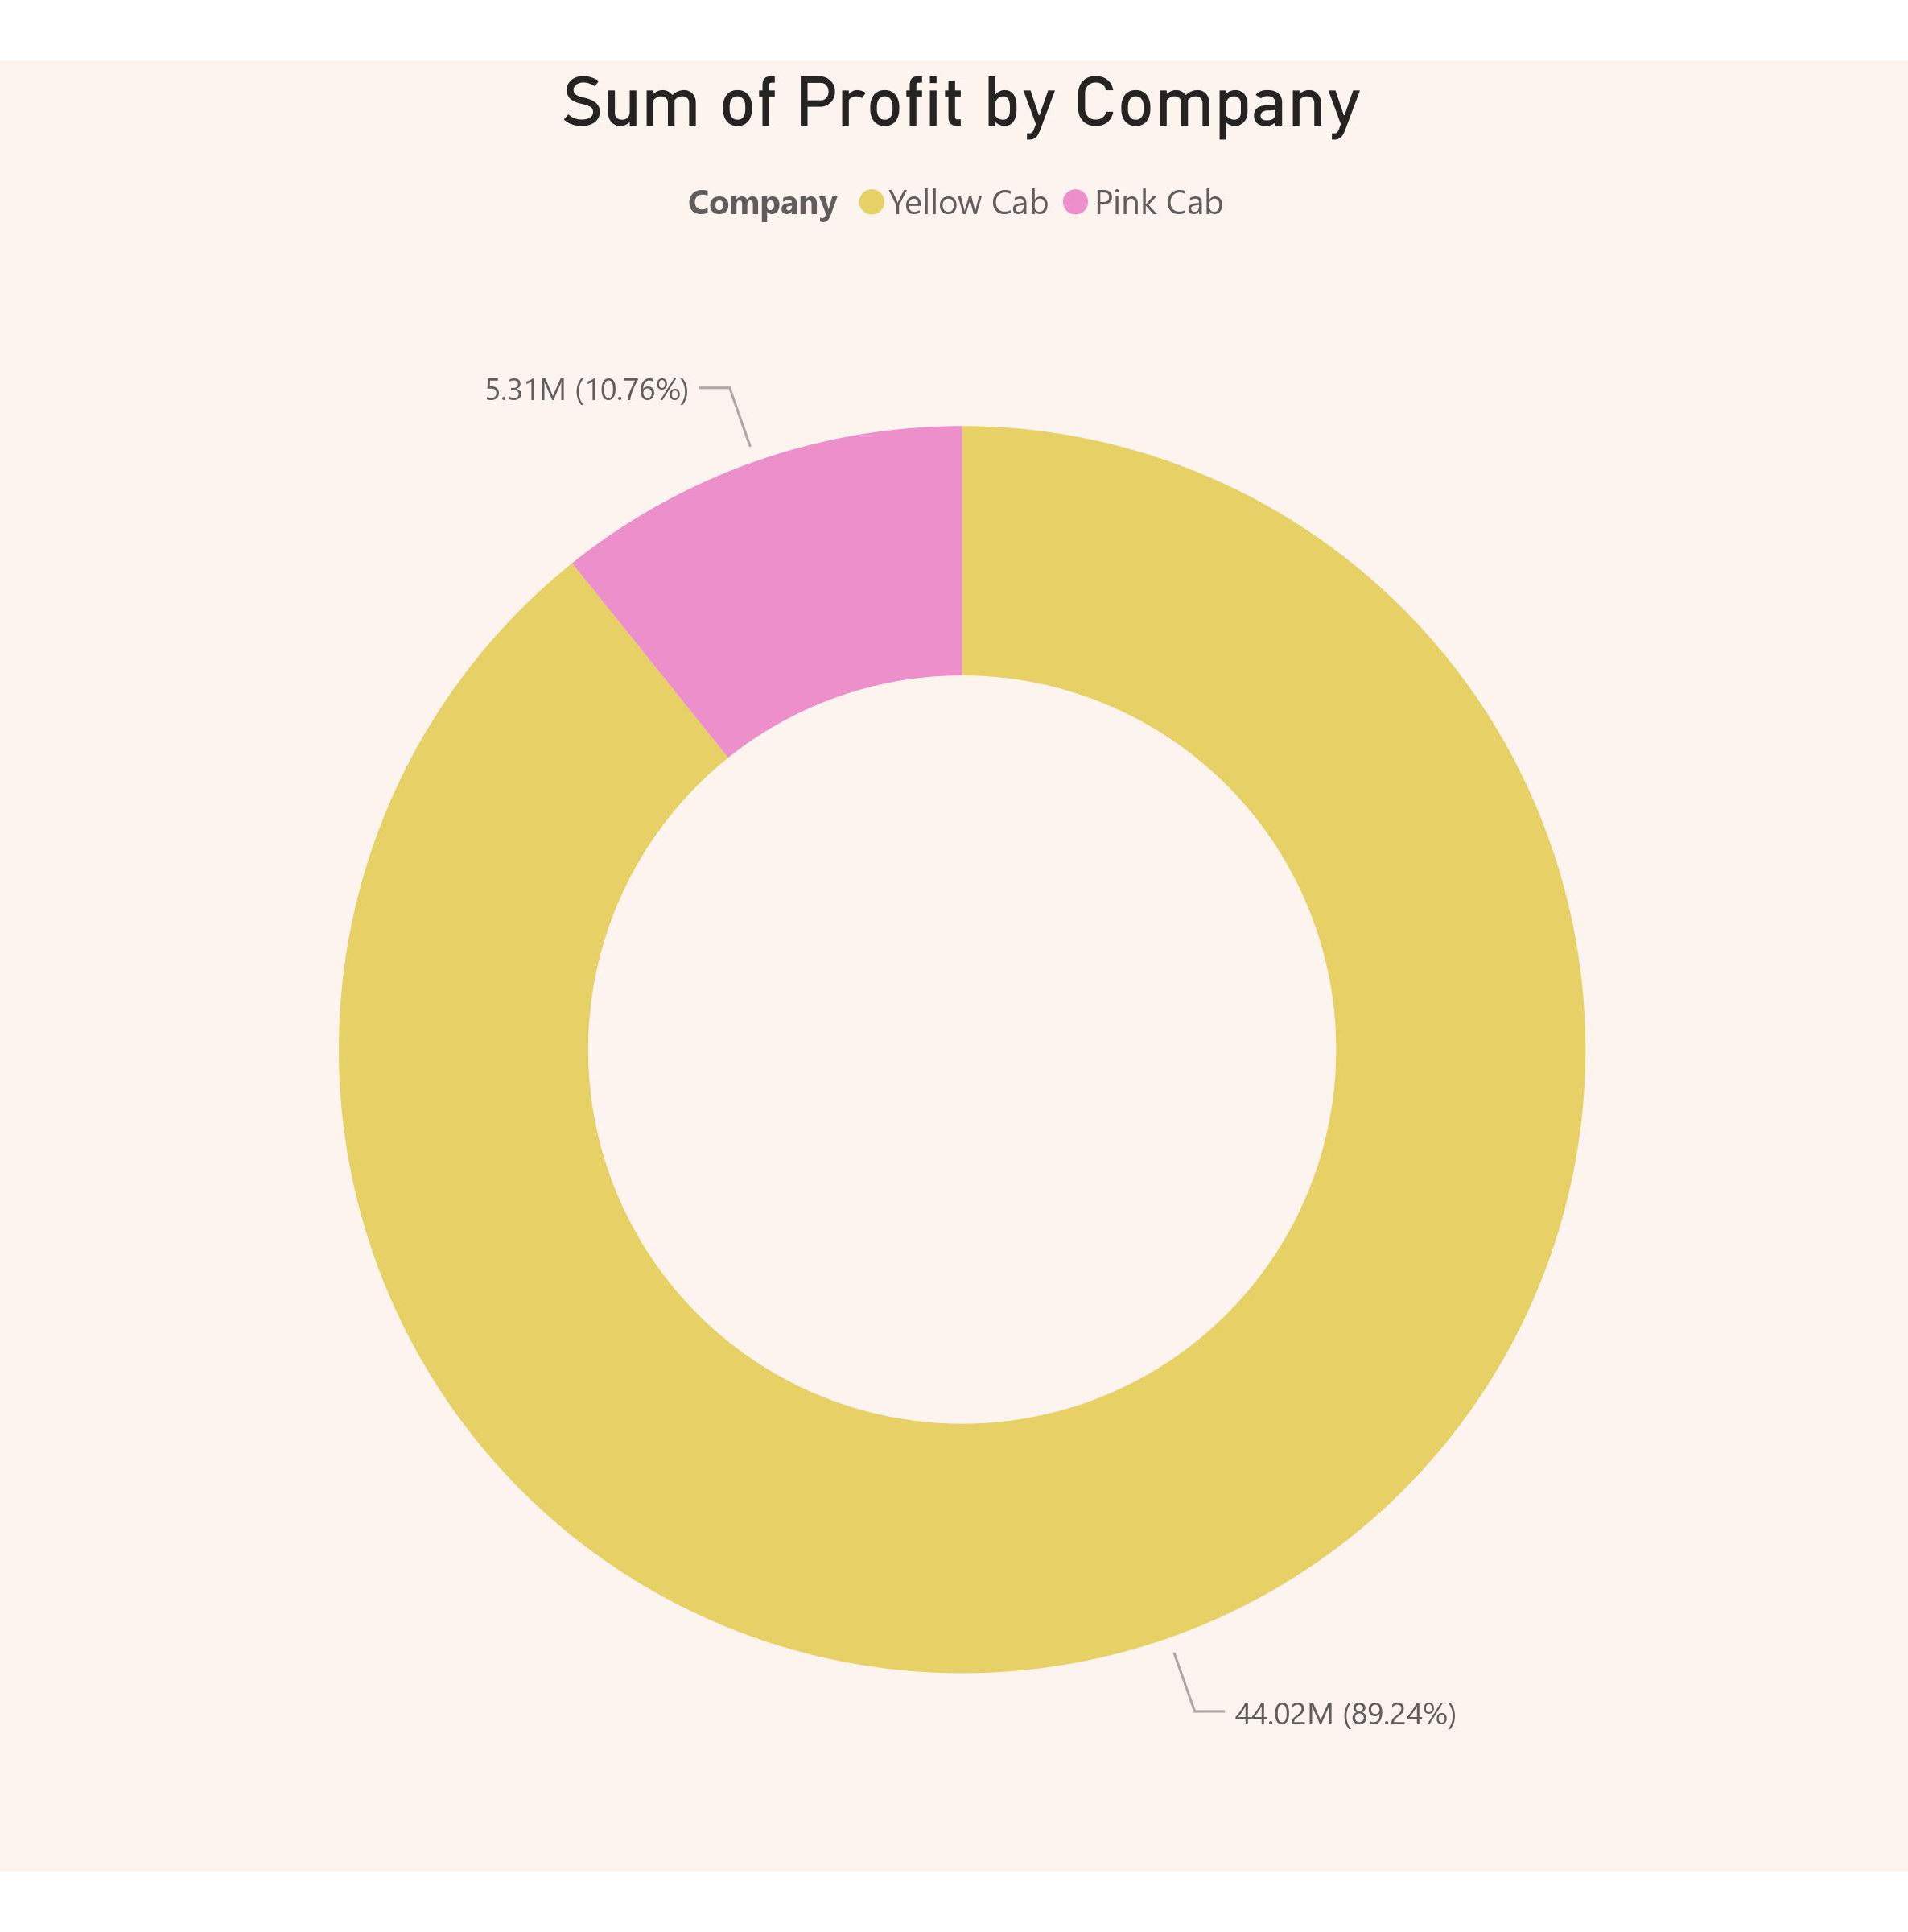
This slide shows the total profit earned by each cab company over the full-time period analysed.
Yellow Cab generated a total profit of $44 million. Pink Cab earned $5.3 million in total profit.
With 89% of the combined profit, Yellow Cab completely dominates profitability over Pink Cab. full-time

Slide 12
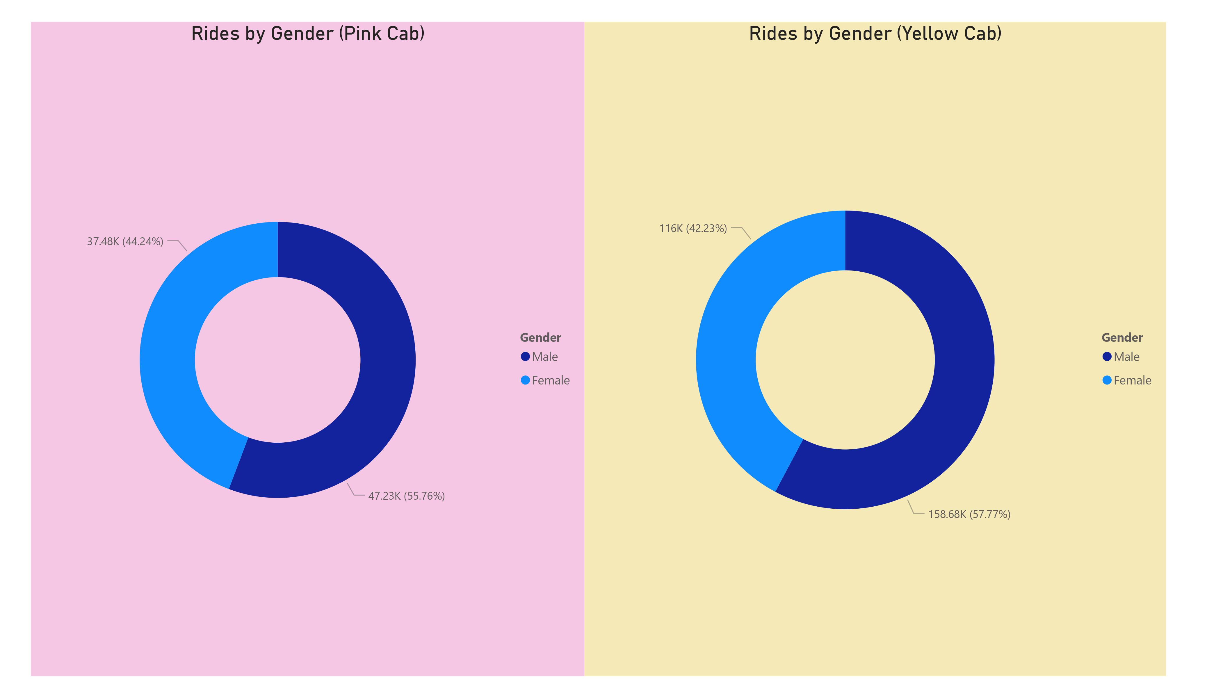
Ridership Demographics - Men vs Women
For both Pink Cab and Yellow Cab, there were more male riders than female riders.
Pink Cab had 55.76% male riders and 44.24% female riders.
Yellow Cab had a similar breakdown with 57.77% male riders and 42.23% female riders.
This suggests that men rather than women took most rides for both companies.

Slide 13
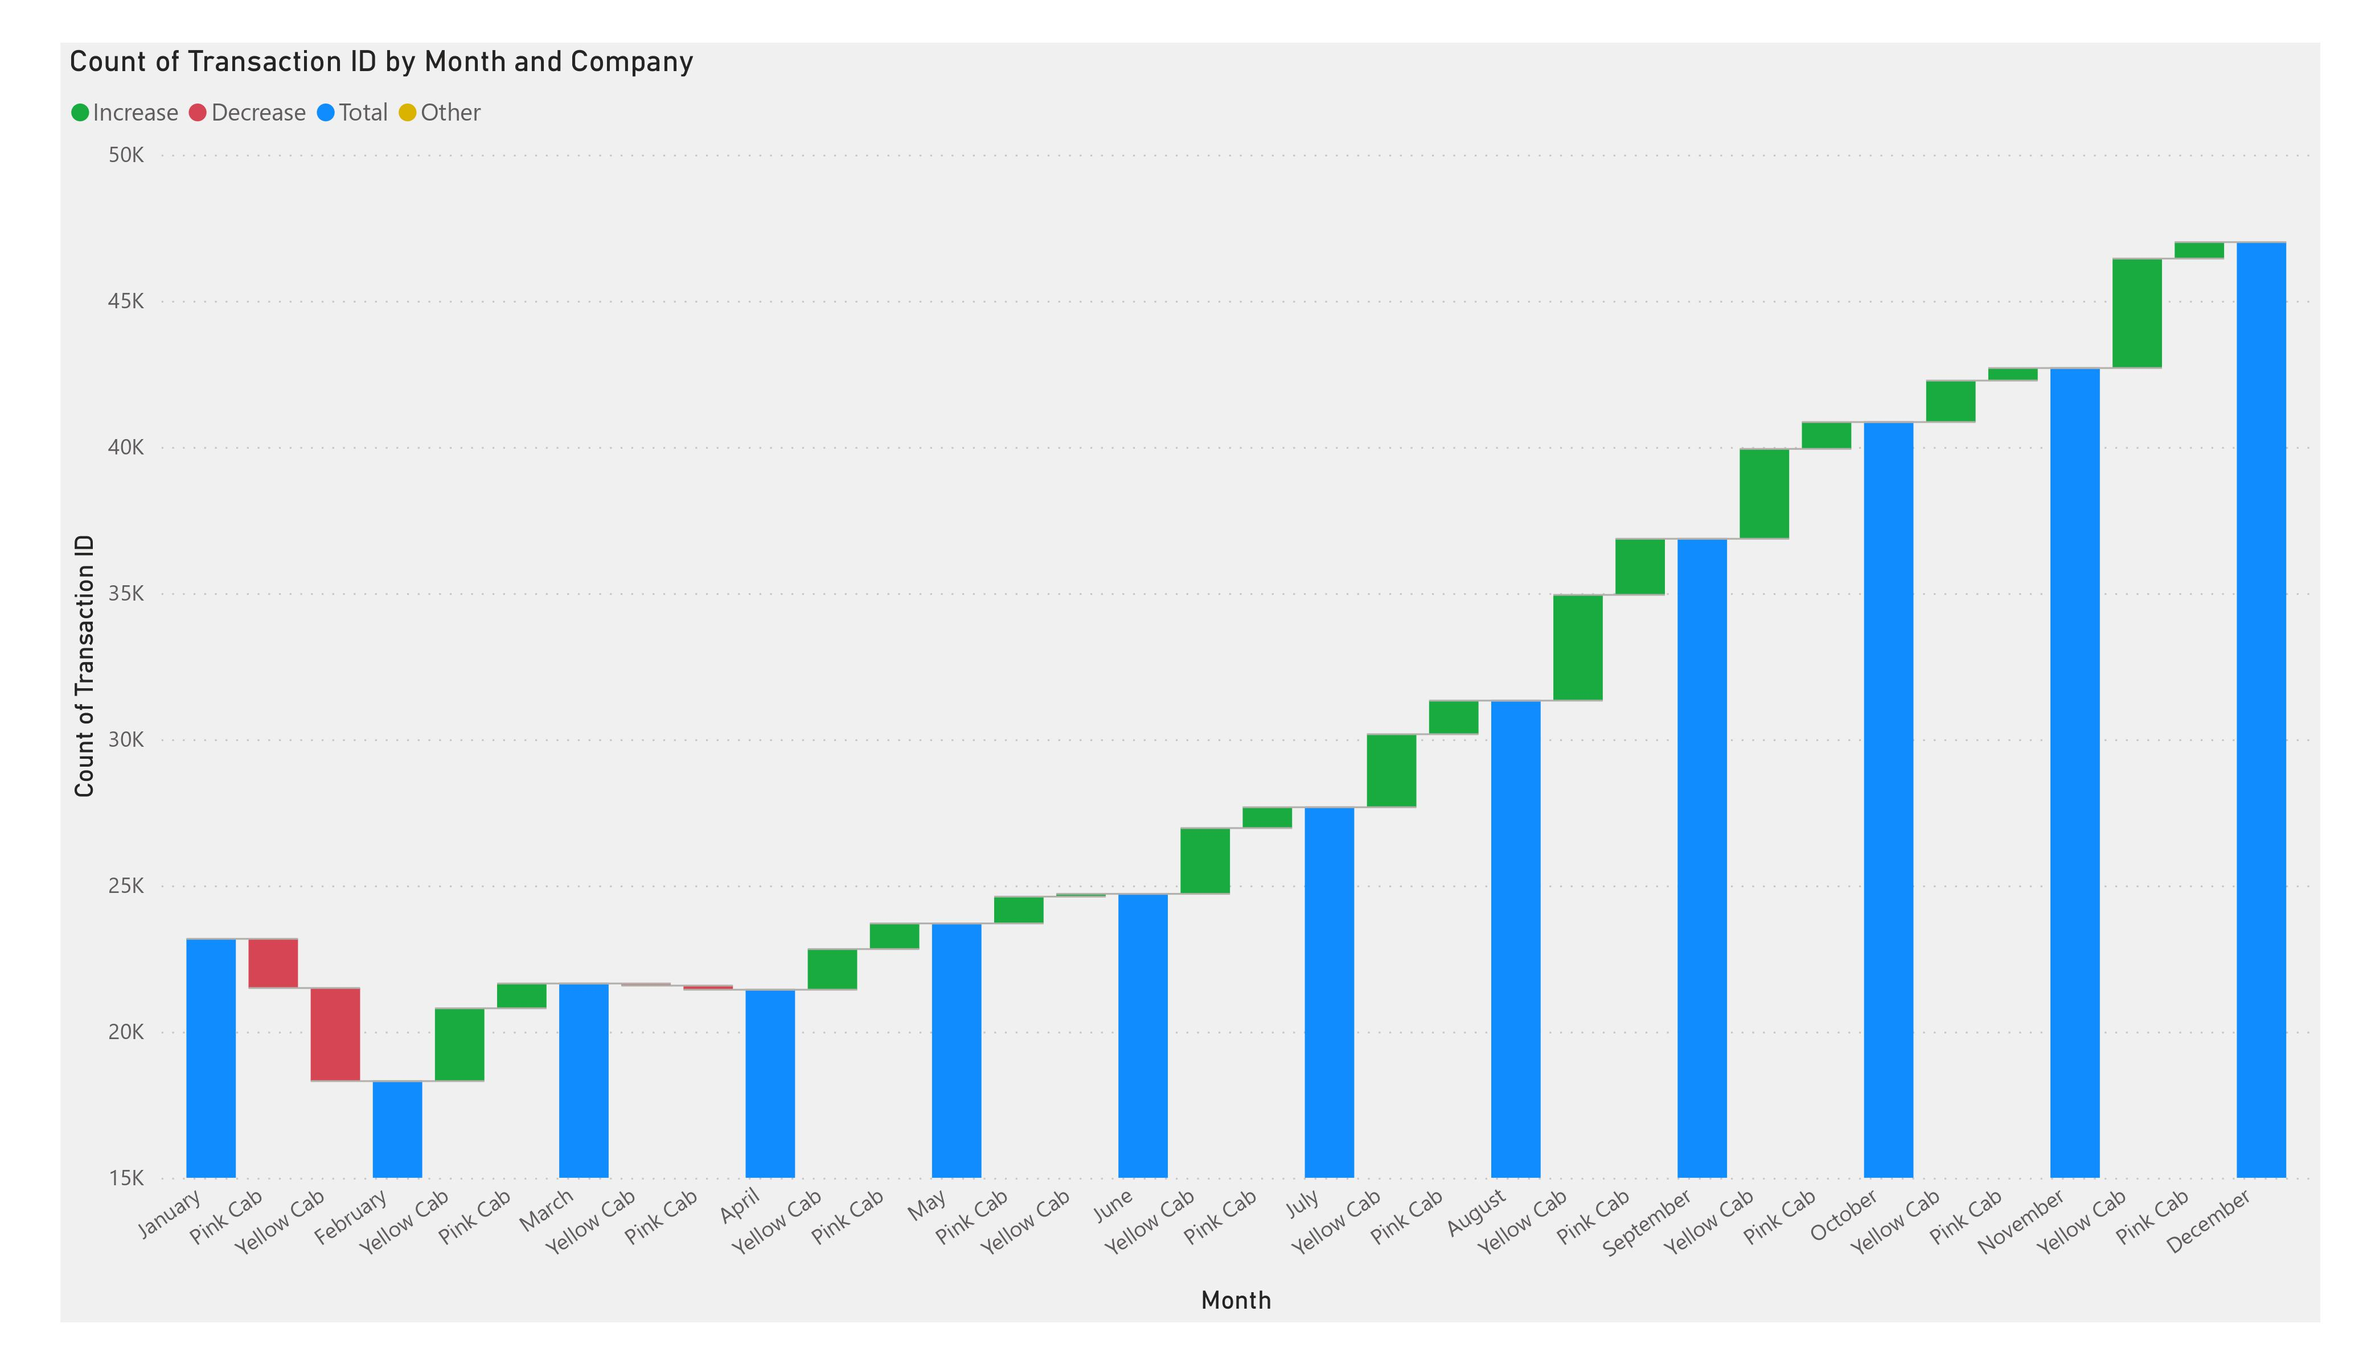
Monthly Trends - Tracking the Ups and Downs
Yellow Cab had more transactions overall than Pink Cab, likely due to having a larger fleet size.
Both companies saw increased transactions during the summer months of June-August. This could be due to more people travelling during summer vacations.
Yellow Cab's highest month was July with 50,000 transactions while Pink Cab's was August with 40,000.
Pink Cab's lowest month was January, with 15,000 transactions. This was likely due to less travel in the winter months.

Slide 14
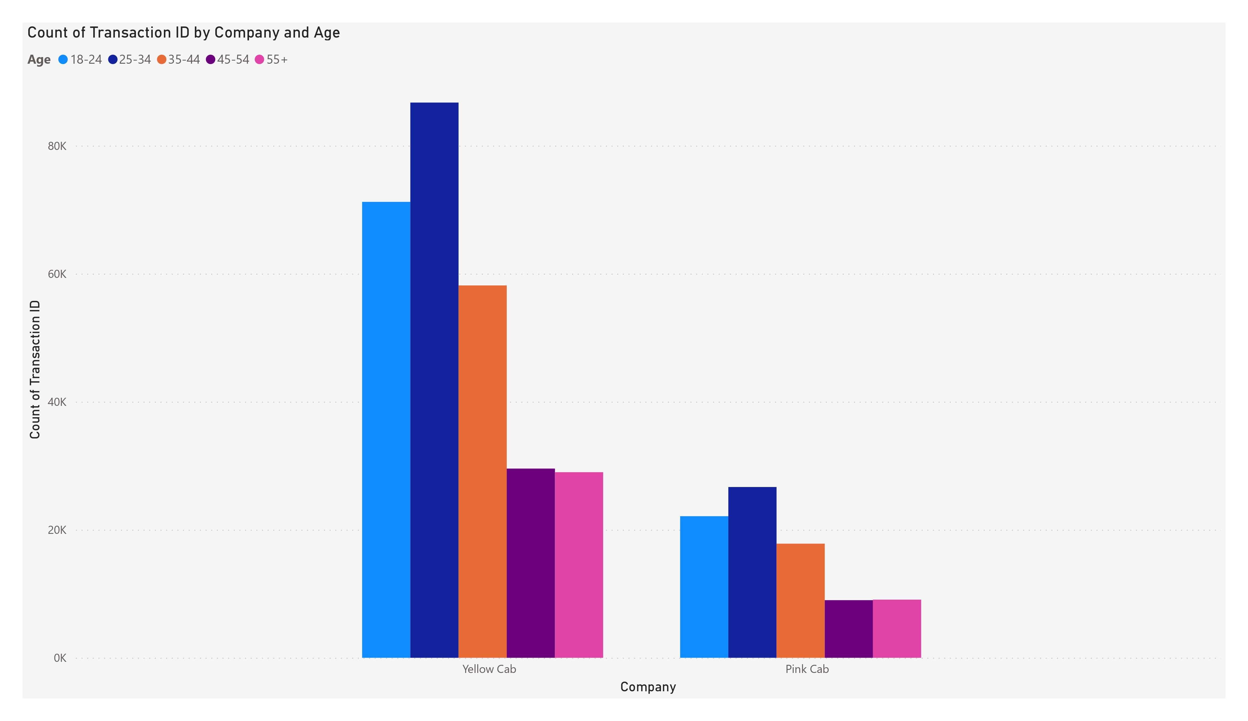
Riders by Age - Who's Hailing the Cabs?
For both companies, the 35-44 age group took the most cab rides overall. This middle-aged demographic may rely more on cabs for transportation.
Pink Cab had 60,000 rides from 35-44-year-olds while Yellow had 80,000.
The senior demographic (55+) took the least number of rides for both companies. Pink Cab had 20,000 aged rides and Yellow had 40,000.

Slide 15
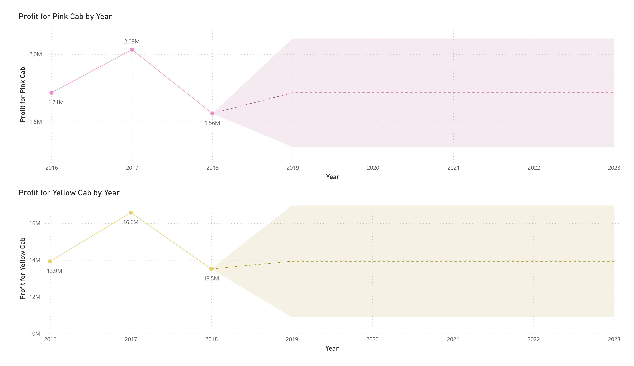
Profits Over Time - The Growth Story (Forecasting)
Yellow Cab was significantly more profitable than Pink Cab each year.
In 2023, Yellow Cab made $16.6M in profit vs Pink Cab's $2.03M.
Both companies saw an overall increase in profit over the 2016-2023 timeline.
The growth suggests they successfully expand their customer base and increase ride volume over time.

Slide 16
Recommendations
Invest in Yellow Cab on the basis of the following points:
Significantly higher profit margins demonstrate efficiency and profitability.
Captures the vast majority (89%) of total market profits indicating market dominance.
More stable monthly ridership reflects loyal customers and predictable revenue.
A broader customer base across age groups provides a wider reach.
Consistent year-over-year profit growth points to strong financial performance.
Overall data clearly shows Yellow Cab is more profitable, stable, and poised for growth.
Yellow Cab is a lower risk and higher reward investment option over Pink Cab.

Slide 17
Thank You

