Slide 1

SMART INDIA HACKATHON 2026
TITLE PAGE
Problem Statement ID – SIH26126
Problem Statement Title – Vision Based Autonomous Navigation for Unmanned Ground Vehicle for Outdoor environment
Theme – Smart Automation
PS Category – Software
Team ID – 14
Team Name – QSLAM

Slide 2
QSLAM — maps and vision replace GPS, end to end
QSLAM
Proposed solution
Innovation and uniqueness
Operator gives one destination in UTM — nothing else
Stereo vision, IMU and wheel odometry carry the UGV there
Preloaded satellite / DEM maps replace the satellite fix
No GNSS receiver at any stage — nothing to jam or spoof
★ Map-anchored global localization
Passive BEV ↔ satellite / DEM matching fixes pose, heading and drift — the role GPS used to play.
★ Localizability-aware navigation
A custom Nav2 cost layer scores feature density, so the route stays where vision keeps working.
How it addresses the problem
Start pose and heading from map matching, no compass needed
Map re-anchoring every ~200 m keeps drift bounded on one-way runs
Semantic + 2.5D elevation perception finds safe ground
Hybrid-A* and MPPI drive it; Collision Monitor guards it
★ Localization integrity monitor
Cross-checks VIO against IMU and wheels every cycle — degraded mode instead of silent drift.
− 88 %
− 59 %
0
position error after 3 km, no GNSS
89.6 m → 10.6 m (PoC)
arrival error vs traversability-only
planner, for +18 % path (PoC)
GNSS receivers, at any stage
of any mission

Slide 3
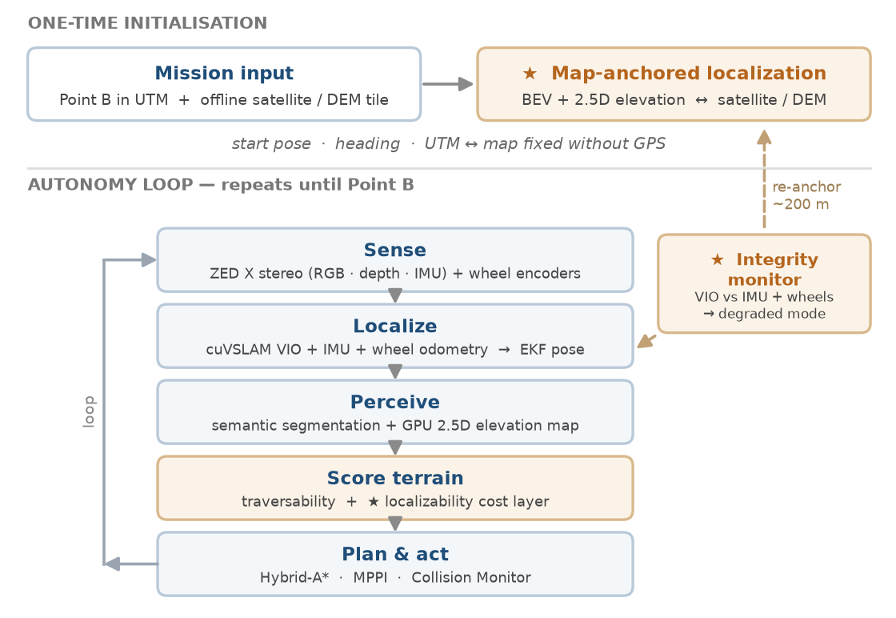
TECHNICAL APPROACH
QSLAM
Technologies to be used
Methodology and process for implementation
● Sensing
ZED X stereo camera (RGB · depth · IMU) · wheel encoders · no GNSS receiver
● Localization
Isaac ROS cuVSLAM · robot_localization EKF · cross-view BEV-to-satellite matcher · GeographicLib
● Perception
SegFormer fine-tuned on RELLIS-3D + RUGD · TensorRT · elevation_mapping_cupy (GPU)
● Planning & control
ROS 2 Nav2 · Smac Hybrid-A* · MPPI · Collision Monitor · custom C++ costmap plugins
● Platform
ROS 2 Jazzy · CUDA · C++17 / Python · Jetson AGX Orin target · Isaac Sim 6 on RTX 4090
● Maps & data
ISRO Bhuvan / Cartosat imagery + DEM, preloaded offline · RELLIS-3D, RUGD for training
★ marks QSLAM's own contribution
Everything else is production-grade, open-source software we reuse rather than rebuild.
Proven components reused · QSLAM adds the new modules

Slide 4
FEASIBILITY AND VIABILITY
QSLAM
Analysis of the feasibility — measured, not asserted
− 59 %
− 88 %
189 m
PoC-1 · localizability layer
arrival error vs traversability-only planner (+18 % path)
1 km synthetic terrain · 300 Monte-Carlo runs
PoC-2 · map anchoring
position error after 3 km with no GNSS (89.6 m → 10.6 m)
match σ 5 m · 75 % success · 300 runs
Integration testbed · Isaac Sim 6
GPS-free traverse to a UTM goal, 1.09 m drift
7 recoveries handled autonomously
Potential challenges and risks → strategies for overcoming them
Challenge / risk | Strategy for overcoming it
Start pose and heading unknown | BEV-to-satellite / DEM match gives UTM pose and heading; surveyed launch point as fallback
VIO drift on one-way runs | Re-anchor to the map every ~200 m; wheel-odometry EKF and localizability-aware routing bound the error
Goal lies beyond sensor range | Rolling global costmap; unknown cells carry an optimistic cost; Hybrid-A* replans as the map fills
Ditches, slopes and drops | GPU 2.5D elevation map turns slope, step height and roughness into costs, fused with semantic classes
Vision degrades — night, dust, low texture | IMU and wheel dead-reckoning bridge outages; degraded mode slows, then safe-stops; thermal as an upgrade
Onboard compute budget | cuVSLAM, TensorRT and CuPy keep every heavy stage on GPU; per-node latency tracked for Jetson AGX Orin

Slide 5
IMPACT AND BENEFITS
QSLAM
Potential impact on the target audience
● Armed forces
Navigate where GNSS is unavailable, jammed or spoofed
● BEL & defence industry
Drop-in ROS 2 navigation module for existing UGV platforms
● Civil GNSS-denied users
Disaster response, mines, tunnels and dense forest
Mission applications
Reconnaissance
Border surveillance
Last-mile resupply
Hazardous / CBRN zones
Benefits of the solution
Strategic — Immune to jamming and spoofing by design — no satellite signal is used at any stage
Social / safety — The UGV takes the risky last mile; fewer soldiers exposed in hazardous zones
Economic — COTS camera and open-source ROS 2 stack; retrofits with no ground infrastructure
Self-reliance — Indigenous, auditable navigation software BEL can own, adapt and certify
Environmental — Passive sensing, no RF emissions; suits electric UGVs and cuts manned sorties
Validation targets · Isaac Sim first, then field trials
≥ 90 %
≤ 2 %
≤ 5 m / 2°
≤ 100 ms
≥ 15 FPS
GPS-denied mission
success (A → B)
position error on
arrival, as % of distance
start alignment from
map matching
sensing-to-command
latency
perception rate on
Jetson AGX Orin

Slide 6
RESEARCH AND REFERENCES
QSLAM
Details / links of the reference and research work
Localization & SLAM
Navigation & planning
Basis for QSLAM innovations
[1] Korovko et al., “cuVSLAM: CUDA Accelerated Visual Odometry and Mapping,” arXiv:2506.04359, 2025
[2] NVIDIA Isaac ROS Visual SLAM — github.com/NVIDIA-ISAAC-ROS/isaac_ros_visual_slam
[3] Cadena et al., “Past, Present and Future of SLAM,” IEEE T-RO, 2016
[4] Moore & Stouch, “Generalized EKF for ROS” (robot_localization), IAS-13, 2014
[5] Macenski et al., “The Marathon 2: A Navigation System,” IROS 2020 — docs.nav2.org
[6] Macenski et al., “Cost-Aware Kinematically Feasible Planning” (Smac), arXiv:2401.13078, 2024
[7] Williams et al., “Information Theoretic MPC” (MPPI), ICRA 2017
[11] Costante et al., “Perception-aware Path Planning,” arXiv:1605.04151 → localizability layer
[12] Shi & Li, “Highly Accurate Vehicle Localization Using Satellite Image,” CVPR 2022 → map anchoring
[13] Sarlin et al., “OrienterNet,” CVPR 2023
Perception & traversability
★ Why these three matter
They are the published basis for QSLAM's own modules: map anchoring, the localizability layer and the integrity monitor.
Data & tools
[8] Miki et al., “Elevation Mapping using GPU,” IROS 2022 — elevation_mapping_cupy
[9] Xie et al., “SegFormer,” NeurIPS 2021
[10] Jiang et al., RELLIS-3D, ICRA 2021; Wigness et al., RUGD, IROS 2019
[14] ISRO / NRSC Bhuvan geoportal — imagery and DEM — bhuvan.nrsc.gov.in
[15] NVIDIA Isaac Sim · Stereolabs ZED X SDK · ROS 2 Jazzy documentation
Reused, proven
cuVSLAM · Nav2 (Smac, MPPI, Collision Monitor) · SegFormer · GPU elevation mapping
QSLAM contribution
Map-anchored localization · localizability layer · integrity monitor · degraded-mode policy
Next research step
Cross-view matcher fine-tuned on Indian terrain (Bhuvan / Cartosat) · thermal for night

