Slide 1
phenotypic diversity & Pseudomonas aeruginosa
Sheng, Kamal, Namani
Notes:
motivation of our project
To improve efficiency of recognizing and clustering medical or clinical image

Slide 2
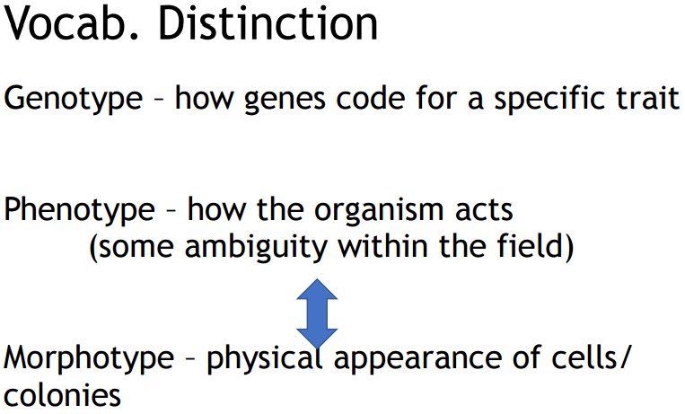

Slide 3
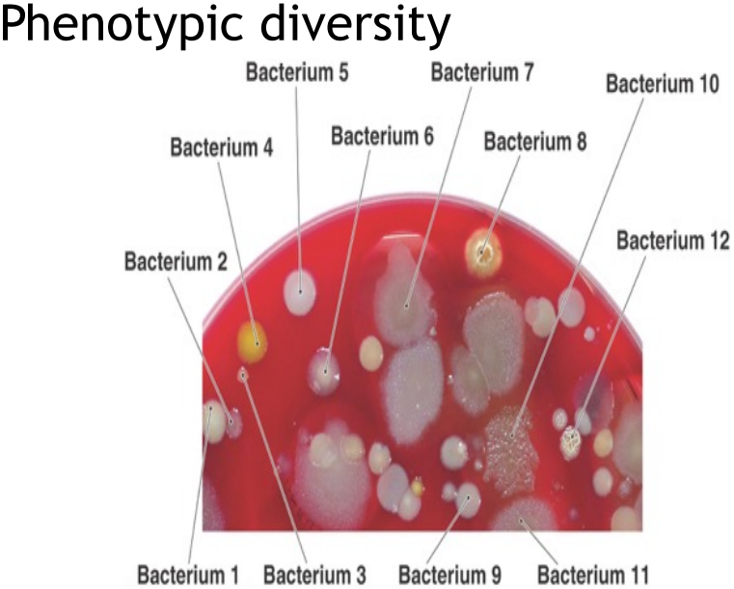

Slide 4
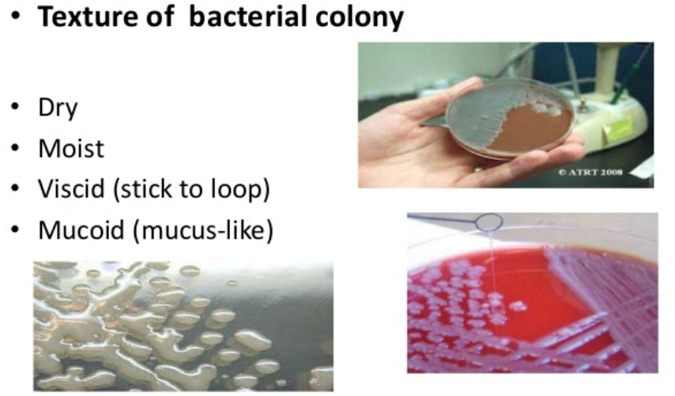

Slide 5
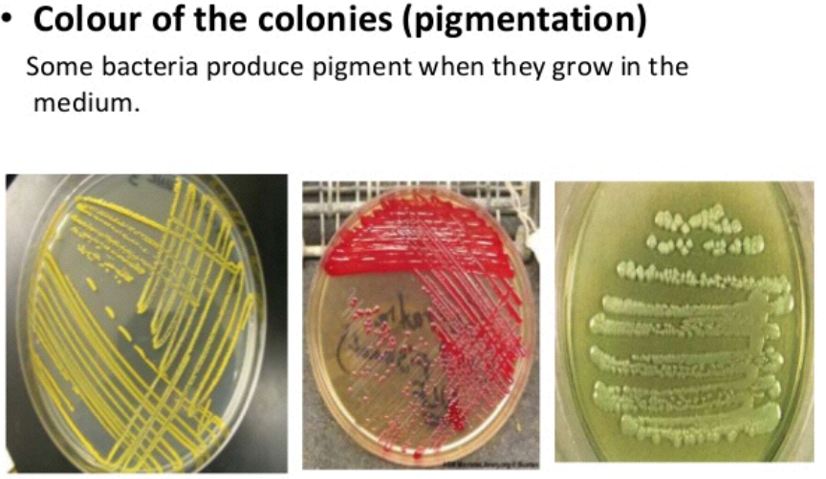

Slide 6
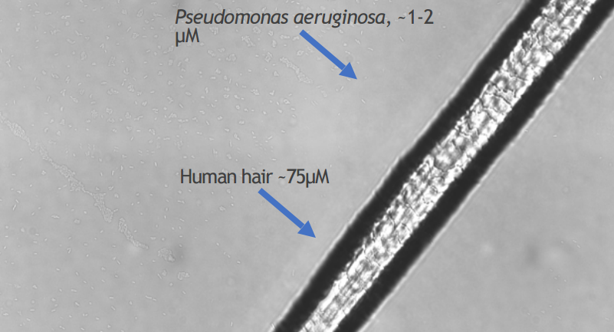

Slide 7
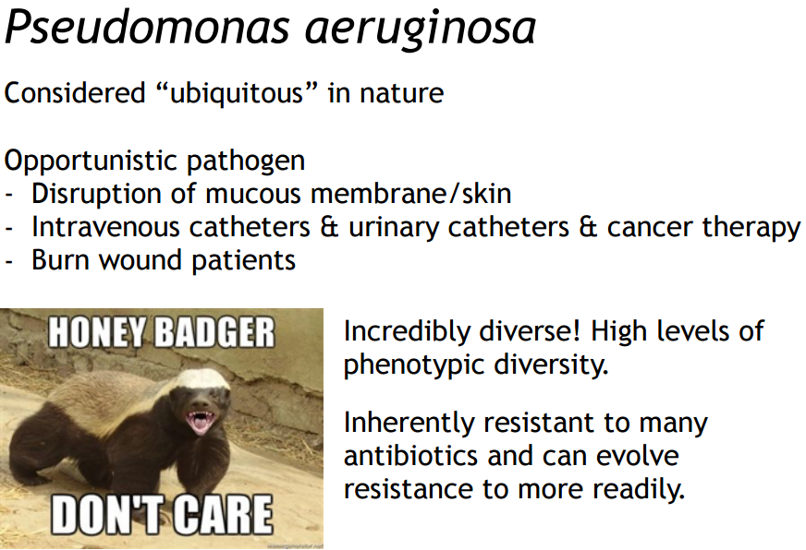
Honey badger
Notes:
The degree of resistance of Pseudomonas aeruginosa isolates to different antibiotics like Penicillin (30µg).
Pseudomonas aeruginosa is a major opportunistic pathogen capable of causing a variety of soft tissue infections in susceptible hosts.

Slide 8
motivation of our project
To improve
To get any information about phenotype from morphotype
To make medically relevant assumptions

Slide 9
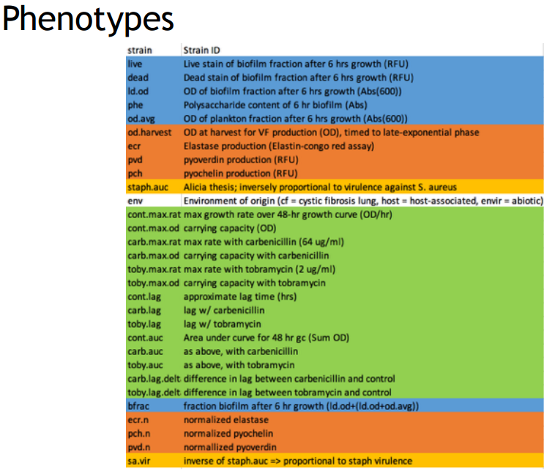

Slide 10
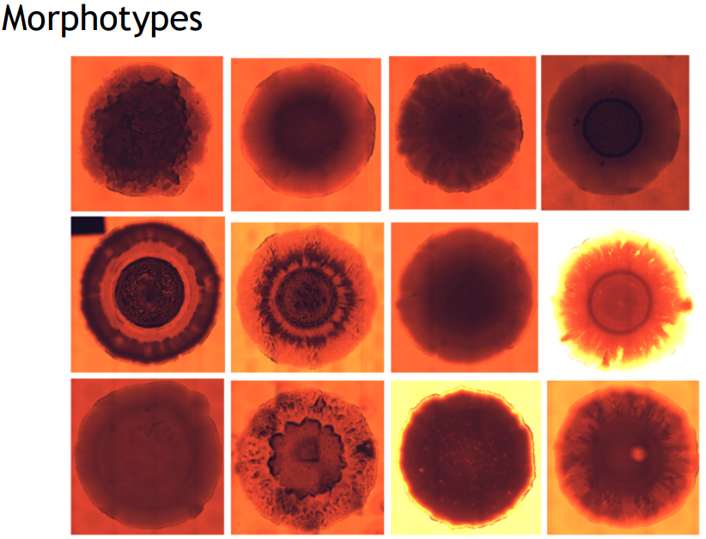

Slide 11
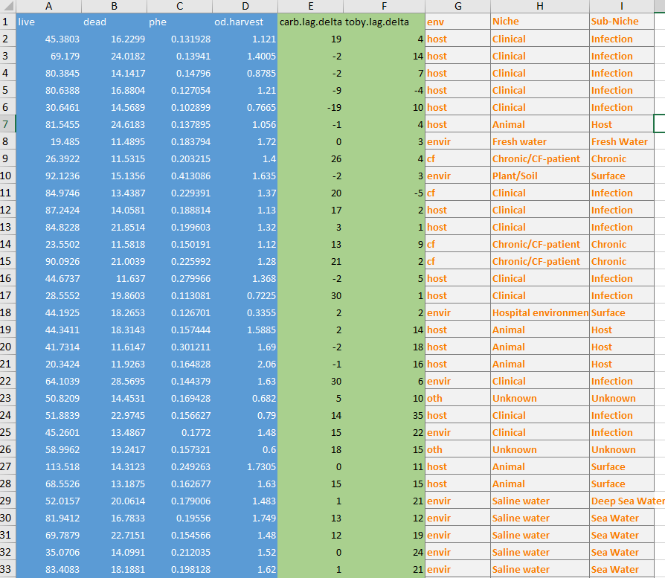

Slide 12
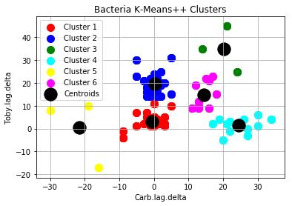

Slide 13
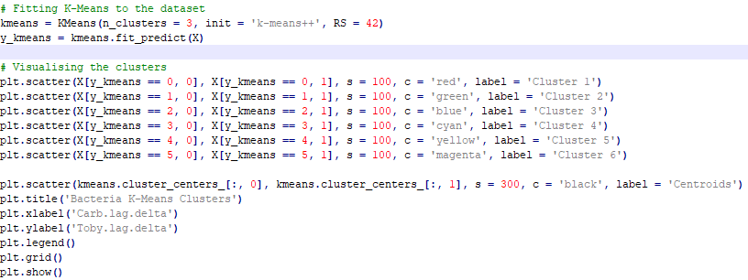

Slide 14
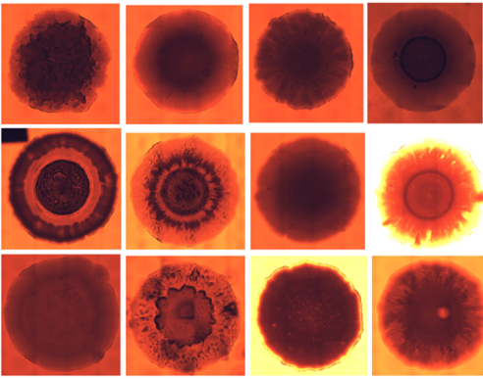
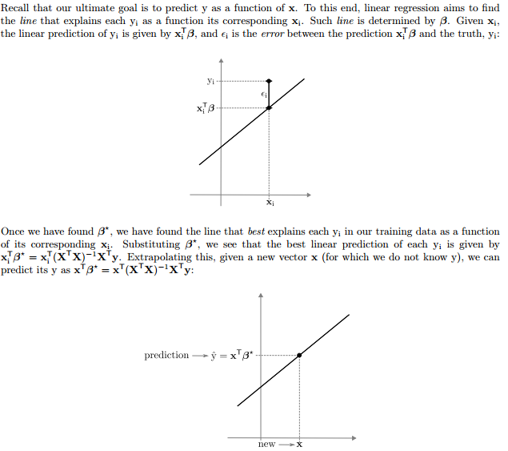
aa
Suppose we have m morphotypes.
Let each morphotype be 1*n array s.t concat to m by n matrix X.
Let all training label the degree of antibiotic resistance be m*2 matrix s.t y

Slide 15
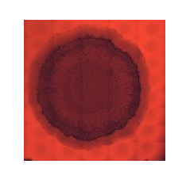
import numpy as np
from PIL import Image
img=Image.open(r"C:\Users\Qiqi\Desktop\DataMining\finalProj\1.jpeg").convert('RGBA')
>>> arr = np.array(img)
>>> shape = arr.shape
>>> flat_arr = arr.ravel()
>>> vector = np.matrix(flat_arr)
>>> arr2 = np.asarray(vector).reshape(shape)
>>> img2 = Image.fromarray(arr2, 'RGBA')
>>> img.show()
>>> img2.show()
>>> print(flat_arr)
[177 49 40 ... 26 41 255]
>>> print(vector)
[[177 49 40 ... 26 41 255]]

Slide 16
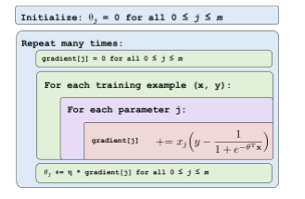

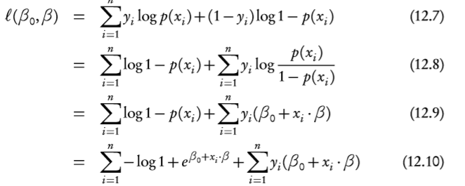
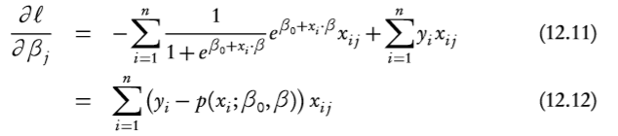
Likelihood Function of Logistic Regression
Notes:
outcome can help to solve the real problem
To get any information about phenotype from morphotype
To make medically relevant assumptions

Slide 17
Sources
https://web.stanford.edu/class/archive/cs/cs109/cs109.1178/lectureHandouts/220-logistic-regression.pdf ~s16
https://www.stat.cmu.edu/~cshalizi/uADA/12/lectures/ch12.pdf ~s14

Slide 18
Thanks!

