Slide 1
Intelligent Classification of Rural Infrastructure Projects
CAPSTONE PROJECT
Presented By:
Student Name-Kamal Sharma
College Name- AIT CSE (AIML) , CHANDIGARH UNIVERSITY

Slide 2
OUTLINE
Problem Statement Proposed System/Solution
System Development Approach (Technology Used)
Algorithm & Deployment
Result (Output Image)
Conclusion
Future Scope
References

Slide 3
Problem Statement
The Pradhan Mantri Gram Sadak Yojana (PMGSY) is a flagship rural development program in India aimed at providing all-weather road connectivity to unconnected habitations.
Over time, the program has evolved into different phases/schemes (PMGSY-I, PMGSY-II, PMGSY-III, RCPLWEA, etc.), each with distinct objectives, funding structures, and project specifications.
Challenges faced by stakeholders:
Manual classification of thousands of projects is time-consuming and error-prone.
Difficulty in monitoring progress, ensuring budget transparency, and assessing impact.
Lack of automation makes scaling analysis across states/districts inefficient.
There is a pressing need for an AI-driven system to automatically classify infrastructure projects into their correct scheme based on their physical and financial attributes.

Slide 4
Proposed Solution
The proposed solution is an Intelligent Classification Model that aims to automatically classify rural infrastructure projects into their respective PMGSY schemes (PMGSY-I, PMGSY-II, PMGSY-III, RCPLWEA, etc.) using their physical and financial attributes.
The solution will consist of the following components:
Data Collection:
Collect structured project data from AI Kosh PMGSY dataset (state, district, number of works, road length, bridges, sanctioned cost, etc.).
Data Preprocessing:
Clean and preprocess the dataset to handle missing values, outliers, and inconsistencies.
Normalize numerical features such as cost, length, and counts of works/bridges for model readiness.
Machine Learning Algorithm:
Deployment:
The trained XGBoost classification model was deployed on IBM Cloud Lite Services.
Predictions are generated directly within the Watsonx.ai environment, ensuring reliability and scalability.
Evaluation:
Implemented a supervised machine learning classification model using XGBoost Classifier (XGBClassifier).
The algorithm was chosen for its ability to handle tabular data, categorical features, and imbalanced datasets effectively.
The model’s performance was evaluated using standard metrics: Accuracy, Precision, Recall, and F1-Score.
Output predictions include probability scores for transparency in classification.

Slide 5
System Approach
This Section Covers the Technology Stack used and System Requirements required to create and use the Intelligent Classification Model.
Technology Stack (IBM only):
IBM Cloud Lite Services – Model deployment and scalability.
Watsonx.ai – Model training, fine-tuning, and inference for classification.
Watsonx.data – Handling structured tabular datasets from AI Kosh (PMGSY dataset).
Watsonx.governance – Ensuring responsible AI with reliable predictions.
System Requirements:
Dataset: AI Kosh PMGSY dataset (public dataset).
Cloud-only approach: No external stack, no front-end.
Interactive prediction view available within Watsonx workspace.

Slide 6
Algorithm & Deployment
This project uses a supervised machine learning approach to automatically classify rural infrastructure projects into their respective PMGSY schemes.
Algorithm Selection:
The chosen algorithm is XGBoost Classifier a gradient boosting method well-suited due to its high accuracy.
It has been chosen for its ability to handle non-linear patterns , categorial and numerical features.
Data Input:
State/District details of road and bridge projects, including the number and length sanctioned, number completed, number balanced, and
associated costs/expenditure.
Training Process:
Data preparation: The dataset was split and preprocessed, which included handling missing values and normalizing numeric data.
Model optimization: Hyperparameter tuning was performed to enhance accuracy, adjusting key settings like max_depth, n_estimators, and learning_rate.
Model validation: Cross-validation was used to ensure the model's reliability and prevent overfitting.
Execution environment: All development and training tasks were completed on IBM's Watsonx.ai platform using a free IBM Cloud Lite account.
Prediction Process:
The trained model predicts the appropriate PMGSY scheme (PMGSY-I, II, III, RCPLWEA, etc.).
Each prediction includes probability scores for greater transparency.

Slide 7
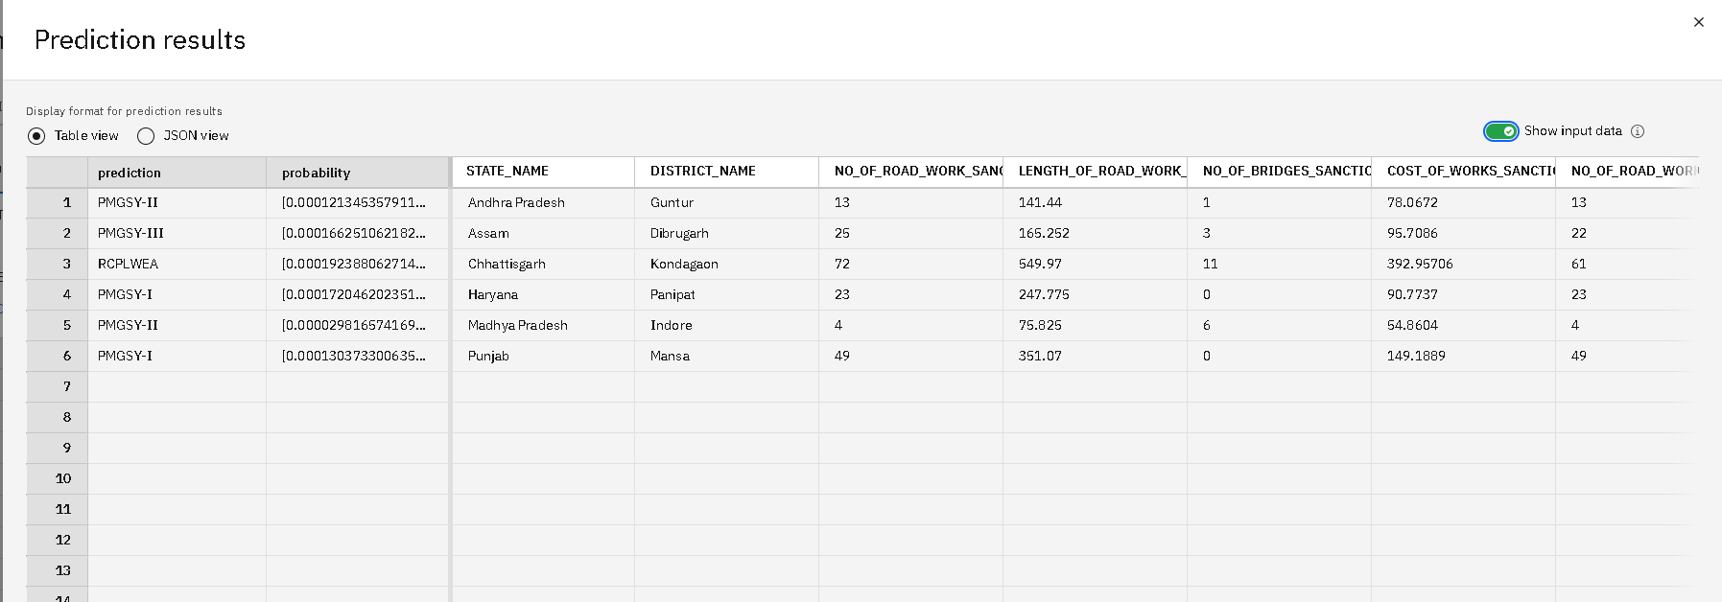
Result
Sample predictions from deployed model:

Slide 8
Conclusion
The Intelligent Classification Agent successfully demonstrates the use of Watsonx on IBM Cloud Lite to:
Automate project classification.
Reduce manual effort and errors.
Provide transparent, scalable, and accurate insights.
Improve monitoring and impact evaluation of rural infrastructure programs.

Slide 9
Future scope
Integration with real-time government project databases.
Use of geospatial data for enhanced classification.
Expansion to other rural development programs beyond PMGSY.
Building interactive dashboards for policymakers.
Multi-lingual insights for accessibility across regions.

Slide 10
References
AI Kosh PMGSY Dataset – https://aikosh.indiaai.gov.in/web/datasets/
IBM Watsonx Documentation – https://www.ibm.com/watsonx
IBM Cloud Lite Services – https://www.ibm.com/cloud
Government of India PMGSY Guidelines and Reports

Slide 11
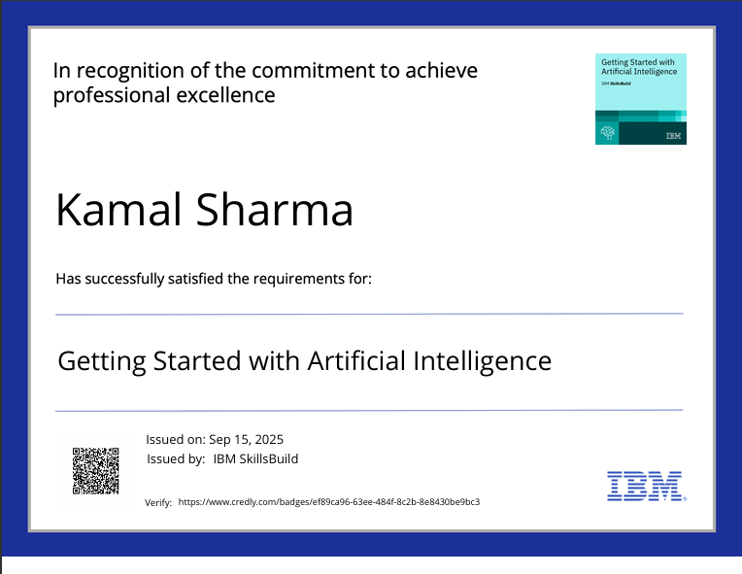
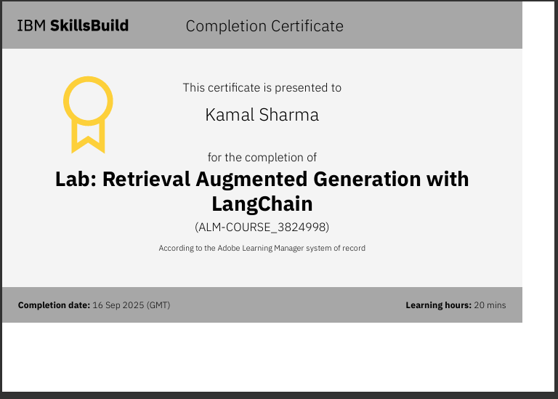
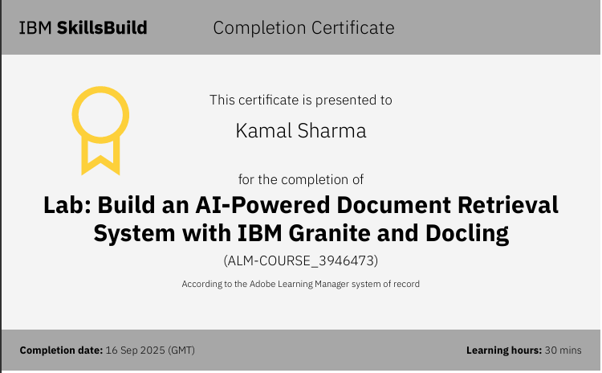
COURSE COMPLETION certifactes and badge

Slide 12
Professional Profiles
GitHub - https://github.com/kamalsharma001
LinkedIn - https://www.linkedin.com/in/sharmakamal1210/

Slide 13


