Slide 1
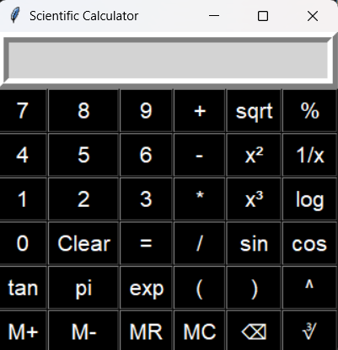
Introduction
A scientific calculator designed to perform both basic and advanced mathematical operations.
Built with Python’s Tkinter library for GUI applications.
Provides a user‑friendly interface with buttons and a display screen.

Slide 2
Features
SCIENTIFIC OPERATIONS
√ Square Root
x² Square
x³ Cube
log Logarithm
sin, cos, tan Trigonometric functions
π Pi
exp Exponential
^ Power
∛ Cube Root
1/x Reciprocal
% Percentage
( ) Parentheses
Basic operations
➕ Addition
➖ Subtraction
✖️ Multiplication
➗ Division
✅ Equal (=)
🔄 Clear

Slide 3
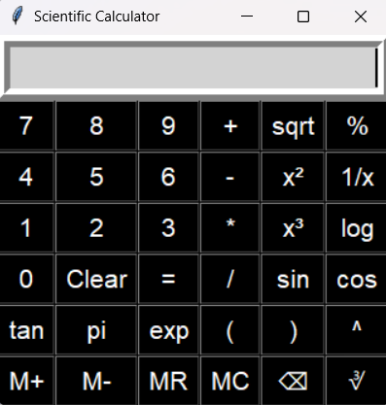
GUI Layout
Entry box at top for input/output.
Buttons arranged in a grid layout for easy access.
Clear separation of:
  Numbers (0–9)
  Arithmetic operators (+, -, *, /)
  Scientific functions (sin, cos, log, etc.)
  Memory functions (m+,m- mr, mc)

Slide 4
Memory Functions
M+ → Add current value to memory.
M- → Subtract current value from memory.
MR → Recall stored memory value.
MC → Clear memory.
Useful for repeated calculations without re‑entering values.

Slide 5
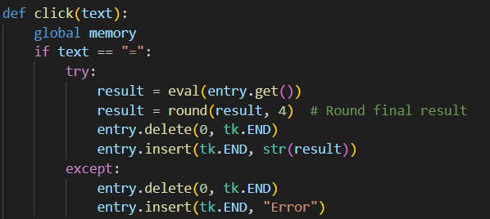
Click Functions
Explanation:
eval() → evaluates expression.
round() → rounds result to 4 decimals.
try/except → prevents crash, shows “Error”.

Slide 6
Error Handling
Negative square root → shows Error.
Division by zero → shows Error.
Invalid inputs → handled with try/except.
Example: √−9 → Error.

Slide 7
Use Of Lambda In Calculator
In Tkinter, each button needs a command (function to run when clicked).
lambda creates a small anonymous function to pass values dynamically.
Without lambda, all buttons would call the same function without knowing which button was pressed.
Syntax:- lambda arguments: expression
Explanation :
  Lambda → defines a small anonymous function (no name).
  Arguments → input values (like x, y).
  Expression → single operation or return value.
Benefit: makes each button independent, reusable, and linked to its own action.

Slide 8
Conclusion
GUI built with tkinter.
Handles both basic and scientific operations.
Error handling makes it robust.
Can be extended with more features.

Slide 9
Thank you!!!
Developed by: Reena Kumari Prasad
Tools used: Python, Tkinter
Inspiration: Standard scientific calculators
Thank You for your attention!

