Slide 1
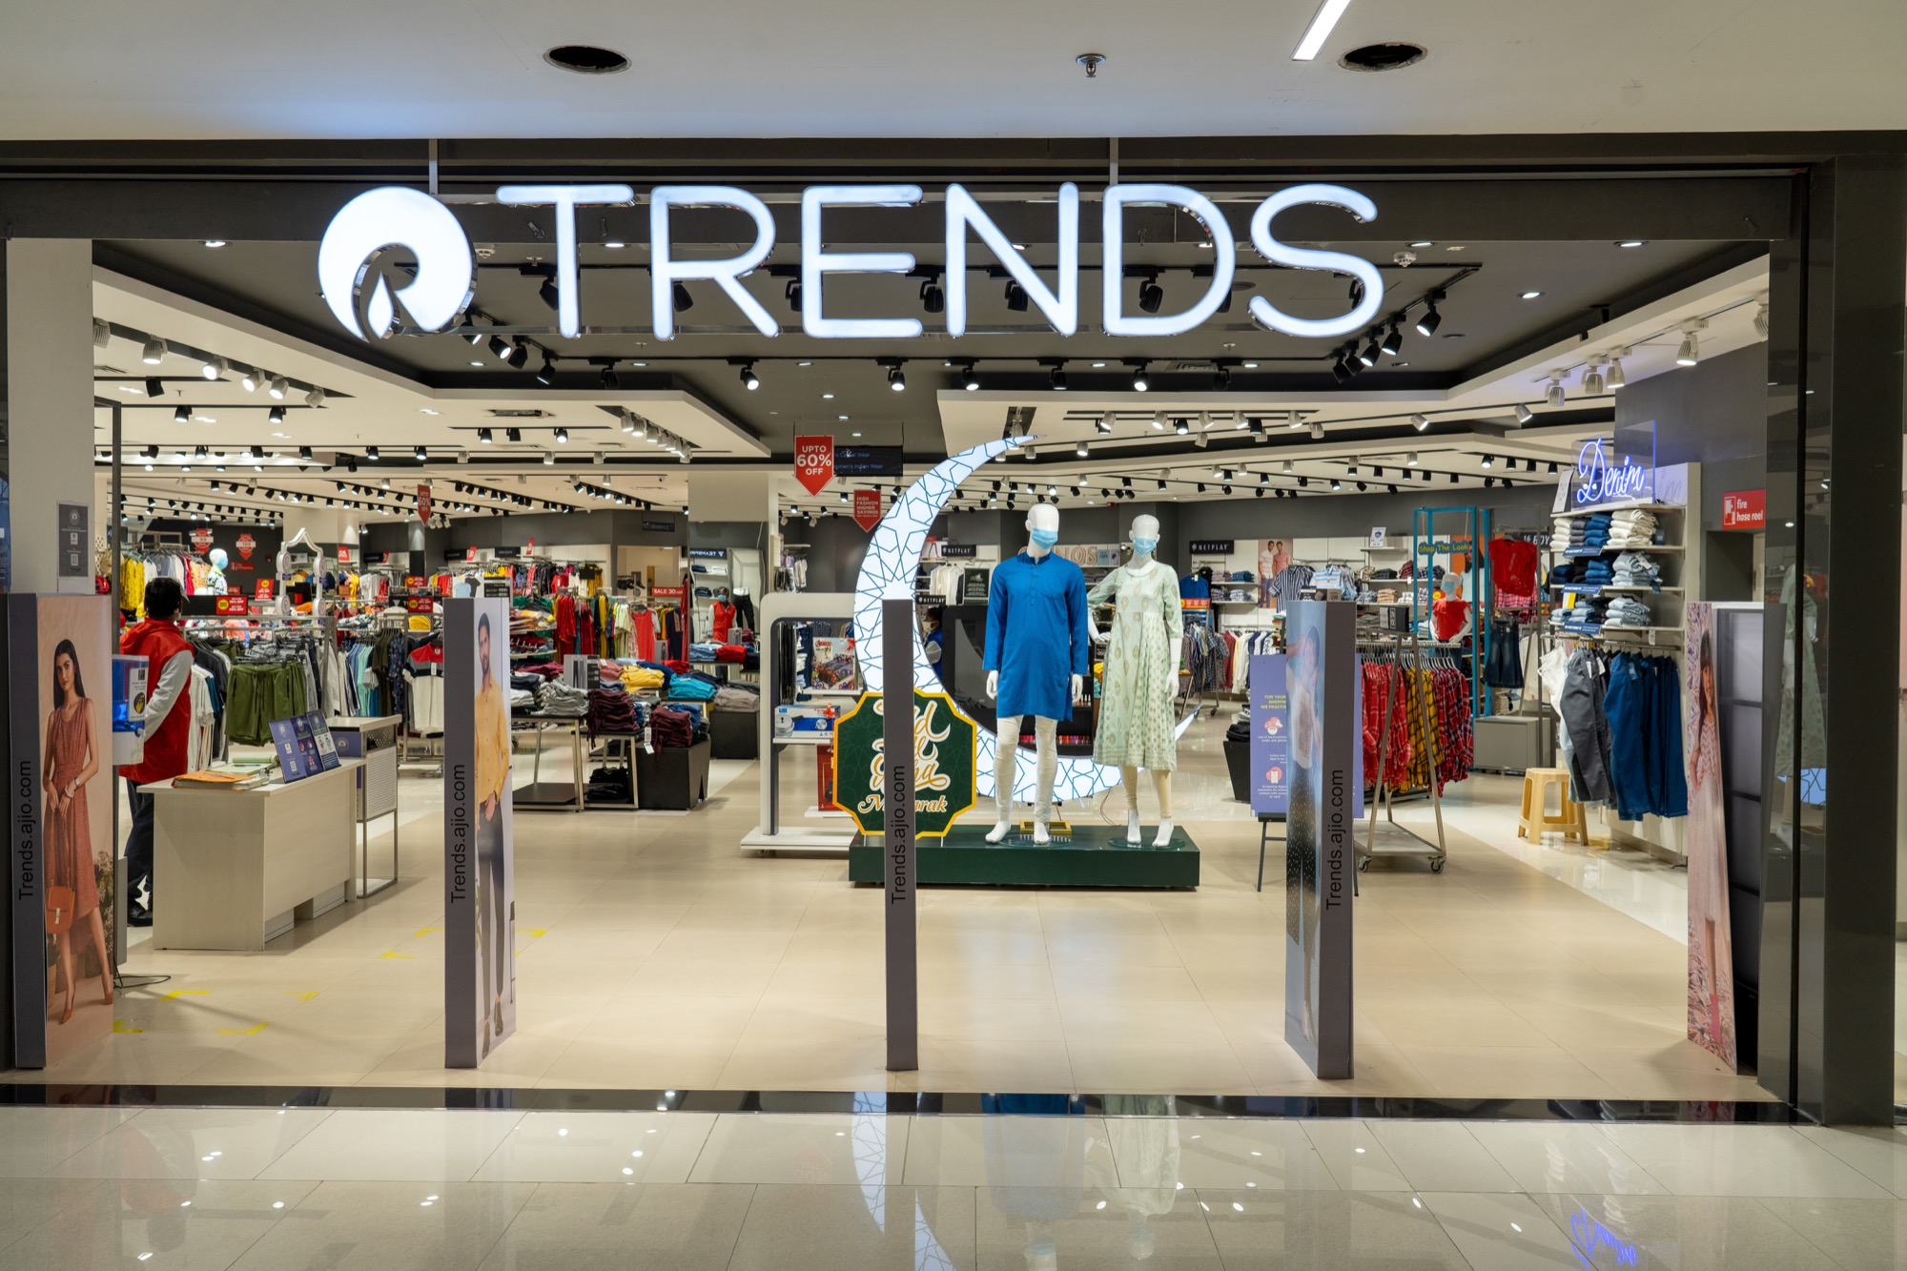

Slide 2
RELIANCE TRENDS FASHION
Introduction.
Count plots.
:- Brand
:- Price Discount
:- Category
:- Categories Contribution
:- Category of Gender
Key Finding.

Slide 3
Introduction
About Dataset :
Trends is India’s largest fashion retail chain across India. Trends offers stylish, high-quality products across Womenswear, Menswear , Kidswear and fashion accessories through a diversified portfolio of own brands, national and international brands. The uniqueness of the store is the core, which delivers "fashion at great value". Spread over 8,000 – 24,000 square feet of shopping area, each Trends store is designed to offer a unique shopping experience for the entire family through wide aisles, coordinated displays and highly trained fashion professionals offering best in class customer assistance.
Total Records: “ 31,582 ”.
Unique Brands: “191 ”.
Unique Categories: “ 9 ”.
Gender Categories: “2 (Men, Women) ”.

Slide 4
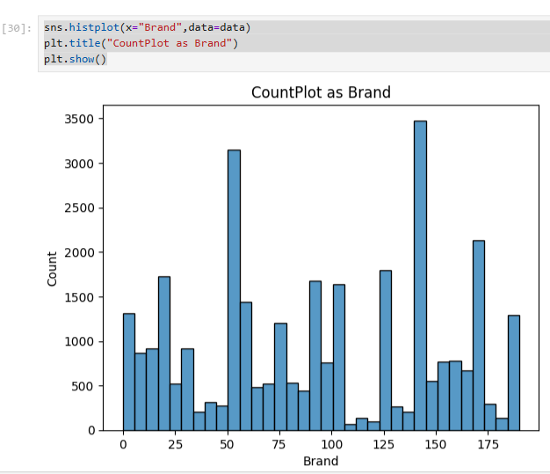
Count plots
Top 10 Brands by Product Count
Performax – 3,029
Teamspirit – 1,908
DNMX – 1,757
Netplay – 1,698
Avaasa Mix n Match – 1,507
John Players – 1,224
Hi-Attitude – 1,1918
W – 1,179
FIG – 1,110
Lee Cooper – 927

Slide 5
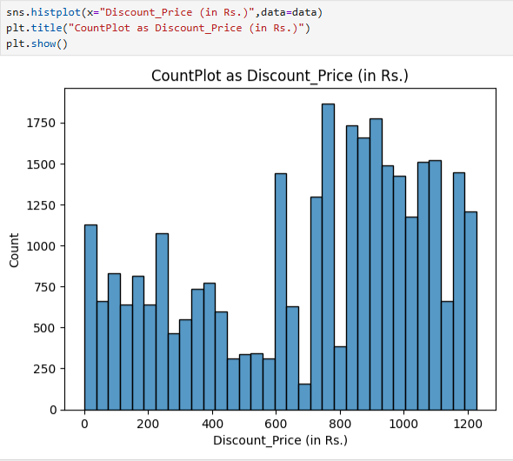
Price Discount
Pricing & Discounts.
Avg Original Price:“₹1,418* ”.
Avg Discount Price: “₹930 ”.
Avg Discount %: “ 33% ”.
Max Price: “₹19,999 ” .
Max Discount %: “ 85% ”.
Average Discount by Gender: Men: “ 33.3% ”.
Women: “ 32.7%”.

Slide 6
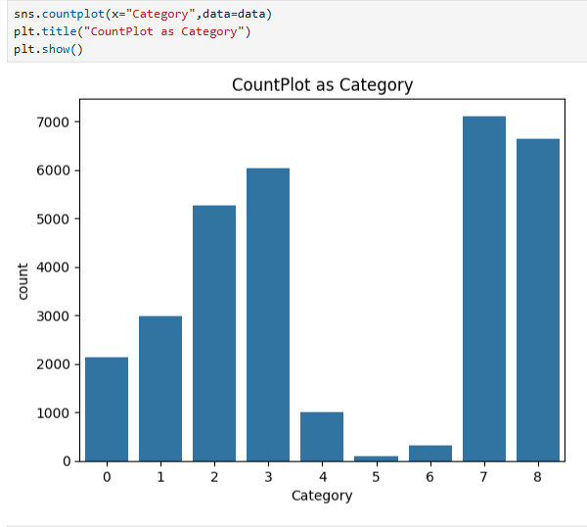
Category
Top Categories.
Topwear :– 7,110.
Westernwear : – 6,641.
Footwea :– 6,030.
Ethnicwear :– 5,265.
Bottomwear :– 2,984.
Others: Activewear, Fusionwear ,
Lingerie, Innerwear.

Slide 7
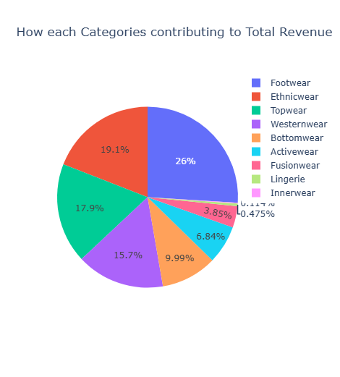
Categories Contribution
The Categories Contribution of Total Revenue in Pie Chart.
:- Footwear ----------26%
:- Ethnicwear --------19.1%
:- Topwear ------------17.9%
:- Westernwear --------15.7%
:- Bottomwear ----------9.99%
:- Activewear ------------6.84%
:- Fusionwear ------------3.85%
:- Lingerie -----------------0.475%
:- Innerwear ---------------0.145%

Slide 8
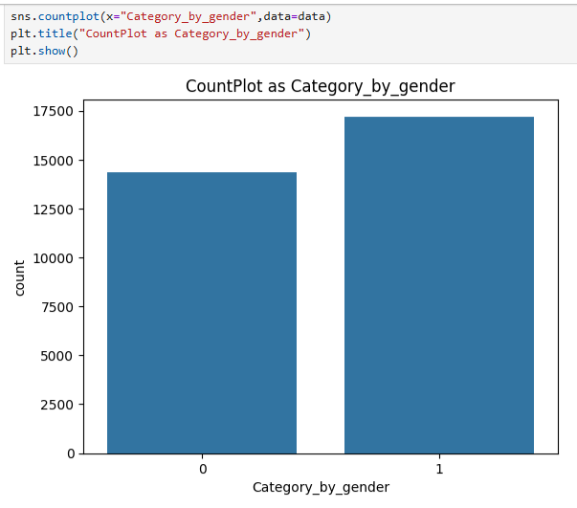
Category of Gender
The Category of Gender.
“0” is of “Men” and “1” is for “Women”.
Men: “ 14,375 products”.
Women: “ 17,207 products ”.
Average Discount by Gender.
Men: “33.3% ”.
Women: “32.7% ”.

Slide 9
Key Finding.
1. “ Performax, Teamspirit, and DNMX”dominate the catalog.
2. “ Topwear & Westernwear” make up almost half the products.
3. “Women’s collection is slightly larger (54.5%), but” “discount percentages are almost equal” across genders.
4. The “average discount is 33%”, meaning heavy reliance on promotions.
5. Some items have “up to 85% discount”, indicating clearance or fast-moving fashion trends.

