Slide 1
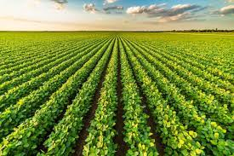
Crop Yield PREDICTION
USING MACHINE LEARNING ALGORITHMS
CREATED BY: KAMAL THAPA

Slide 2
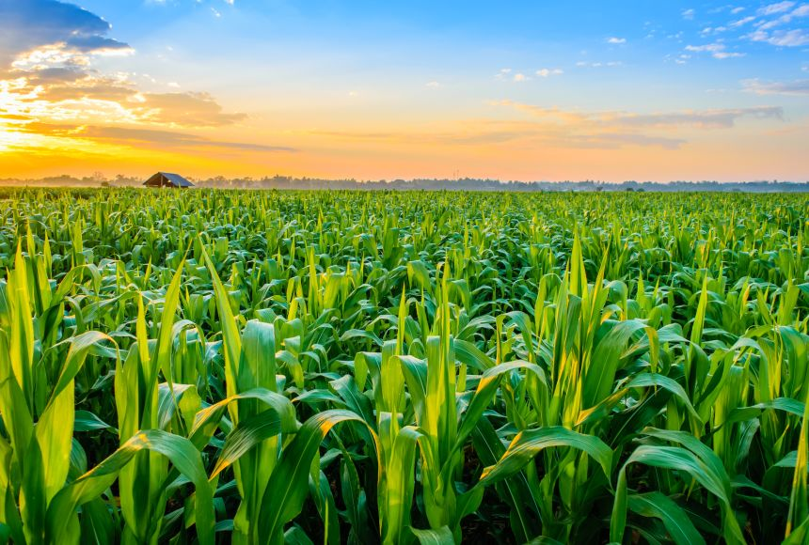
What is Crop Yield?
Crop yield refers to the amount of crop produced per unit of land area.
It’s a key indicator of agricultural productivity and efficiency.
Yield can be measured in various ways, such as: Per Acre, Per Plant, Total Production

Slide 3
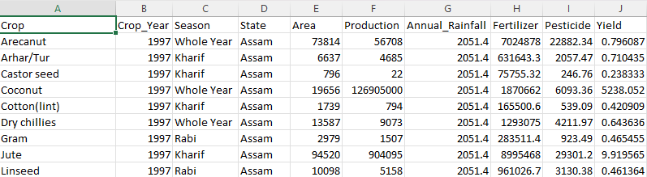
Dataset

Slide 4

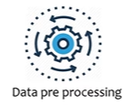
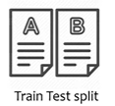


Work Flow
Linear Regression Model
Target Variable Prediction
New Data
Trained Model
Prediction

Slide 5
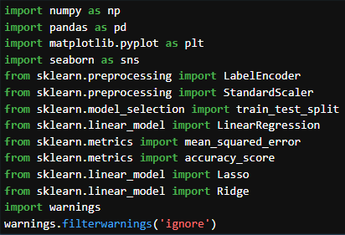
Import all the basic required Libraries

Slide 6
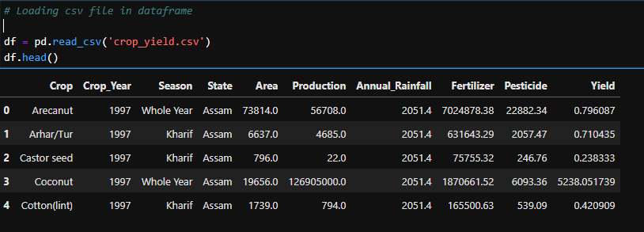
Import the csv file
Imported the csv file with Top 5 rows.

Slide 7
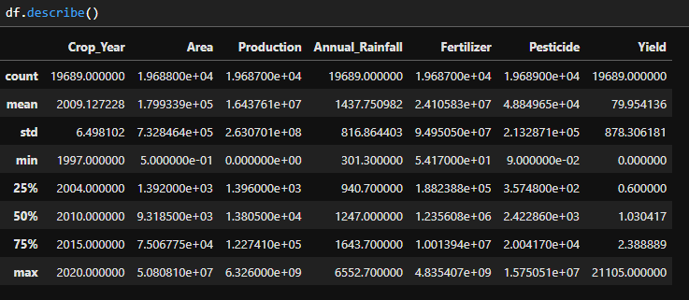
Descriptive Statistics for Numerical columns.

Slide 8
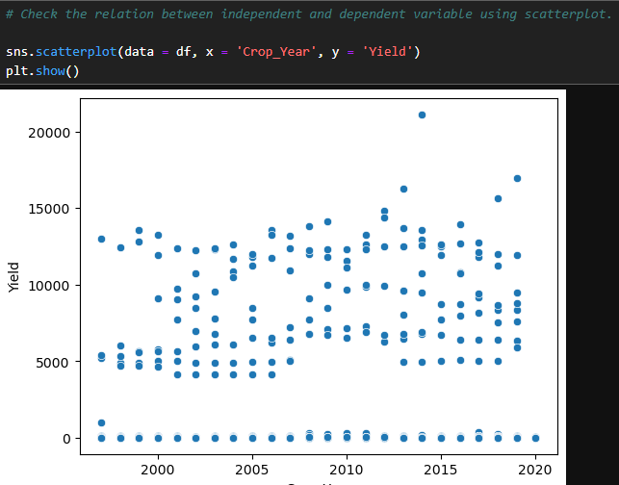
Features(Inputs) Relationship using Scatterplot

Slide 9
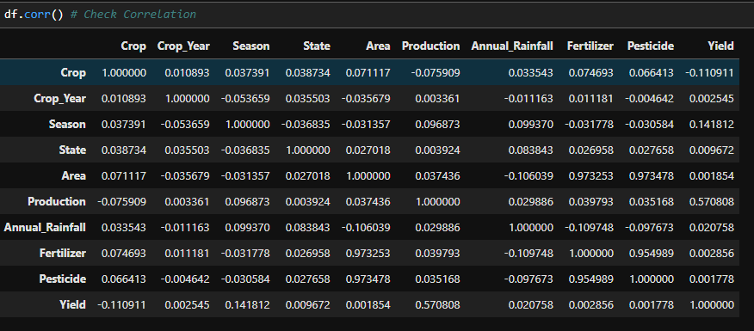
Features Correlation

Slide 10
Model Training Linear Regression Algorithm
Linear regression is a statistical method used to model and analyze the relationship between two variables. Specifically, it explores how the dependent variable (or response variable) changes as the independent variable (or predictor variable) changes.
Equation are: Y=β 0​ +β 1​ X
Y is the dependent variable.
X is the independent variable.
β 0​ is the y-intercept of the line.
β 1​ is the slope of the line.

Slide 11
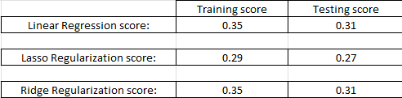
Model Score

Slide 12
Conclusion
All models show relatively low scores, indicating that they are not fitting the data well. This might be due to the complexity of the data or the need for more feature engineering or selection.
Regularization techniques (Lasso and Ridge) do not significantly improve the model's performance. In the case of Lasso, the performance is slightly worse, which may suggest that some potentially informative features are needs to be added.
Linear Regression and regularization technique(Ridge) has got the same training and testing score with the difference of 4 points.

Slide 13
Question & Answer (Q&A)
Thank you for your time. Now, we welcome to the Question & Answer Session.

