Slide 1
Learning Objectives
Functions
Packages
Python Methods

Slide 2
Functions?
This something we have been indirectly using since Day0!
print( ) and input( ) are some functions that you’ve already used. And these are inbuilt functions.
print ("hello world") input ("enter your age")
If you want, you can even create your own function to get some desired output.
Let’s learn more about functions in the video mentioned in the next slide.

Slide 3
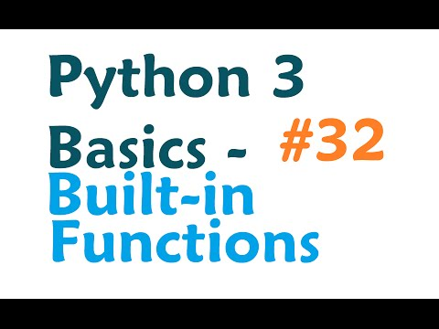
Functions

Slide 4
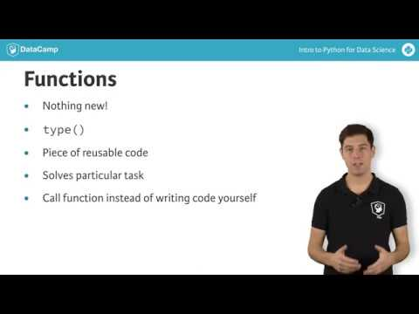
Functions

Slide 5
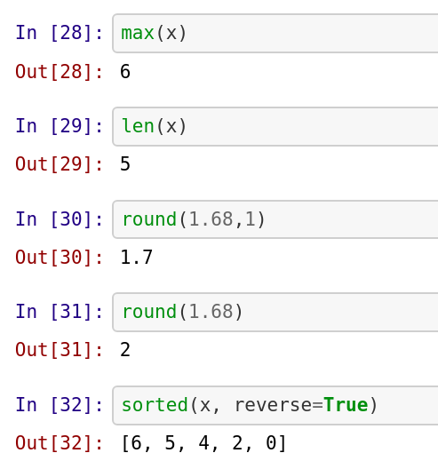

Examples of in-built functions
Find out the purpose of the 2nd argument in round function.

Slide 6
Let’s see how to write functions
In Python a function is defined using the def keyword
In the next tutorial, we will be learning:
How to write a function
How to call a function - Of course, if we have created a function, we need to use it somewhere by calling it right? ;)
We will also learn how to write a function that would convert bitcoin into USD :P
Note: The tutor used some other user-friendly local python ide (similar to Colab or jupyter notebook), so don’t press the panic button looking at the new coding interface. You can comfortably run the same code on collab/jupyter notebook (or any python environment) and it will work.

Slide 7
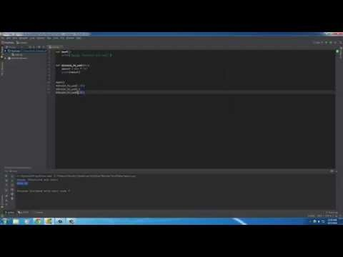
Writing functions
Note: The tutor used a user-friendly python ide (similar to Colab/jupyter notebook), so don’t press the panic button looking at the new coding interface. You can comfortably run the same code on Colab/Notebook and it will work..

Slide 8
Interested to learn more about Functions?
To learn about all the exciting things Python Functions can do, please visit the below link.
https://www.w3schools.com/python/python_functions.asp

Slide 9
Methods in Python
In Python, everything is an object (be it a list, string etc).
A method in Python is somewhat similar to function the only difference is that a method is dependent on the object while a function is independent of the object.
Can you recall we had used a function len() in the earlier modules? Well, this is a function. len() can be used on list, tuple, strings, dictionaries, etc. to get the number of elements in them. While append() is a method that is associated with list only. You cannot use append() method on any of tuple, strings or dictionaries. This append() is associated with list data type only.

Slide 10
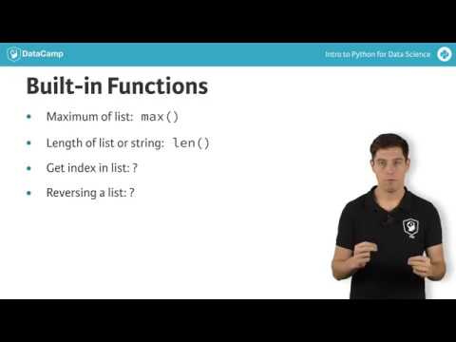
Methods in Python

Slide 11
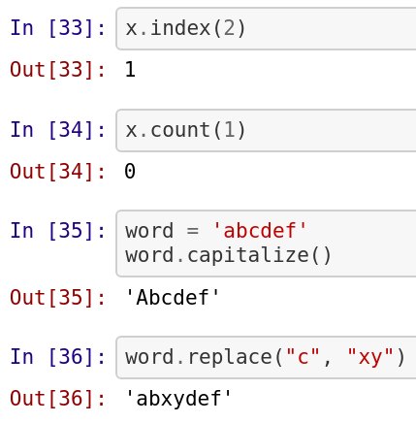
Methods in Python
In Python, everything is an object (be it a list, string etc).
Objects have various methods associated with it (depending on type of the object)

Slide 12
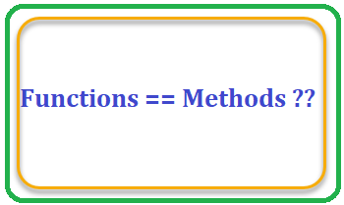
Functions and Methods: are they same?

Slide 13
Functions and Methods: are they same?
You might have a question bugging you: “Why on Earth do we have both functions and methods, when they practically do the same thing?”
Firstly, start with the obvious. There is a clear difference in the syntax:
A function looks like this: function(something)
And a method looks like this: something.method()
Namely: a method always belongs to an object (e.g. in the x.index(2) method .index() needed the x object to be applicable), while a function doesn’t necessarily.
All methods are functions, but not all functions are methods!
If this makes no sense to you (yet), don’t you worry. I promise, the idea will grow on you as you use Python more and more – especially when you start to define your own functions and methods.

Slide 14
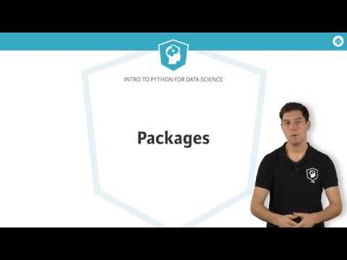
Python Packages

Slide 15
Python Packages & Modules
In simple terms Python packages are collection of multiple Python files
And these Python files are known as modules in Python

Slide 16
Need for Python Packages
If we keep all of our code in the same file, it will result in:
Huge code base: Ends up messy
Lots of code you won't use
Maintenance problem

Slide 17
Packages
If we take an example of ourselves, we don't usually store all of our files on our computer in the same location. We use a well-organized hierarchy of directories/folders for easier access.
Similar files are kept in the same directory, for example, we may keep all the songs in the "music" directory. Analogous to this, Python has packages for directories and modules for files.
As our application program grows larger in size with a lot of modules, we place similar modules in one package and different modules in different packages. This makes a project (program) easy to manage and conceptually clear.
Similarly, as a directory can contain subdirectories and files, a Python package can have sub-packages and modules.

Slide 18
Packages
Directory/Folder of Python Scripts
Where each script is a module that performs a specific function
We can specify functions, methods, types in a script
Thousands of packages are available in python
For data science, the commonly used packages are:
Numpy: Working with arrays
Matplotlib: Data Visualisation
Scikit-learn: ML

Slide 19
Importing packages/modules
A Python package can have sub-packages in it. Further these sub-packages have some modules (i.e. Python files).
Each module consists of some Python functions.
To make use of these functions we need to load the module in our working environment.
To load any package or module we use the term import followed by module name or the package name.

Slide 20
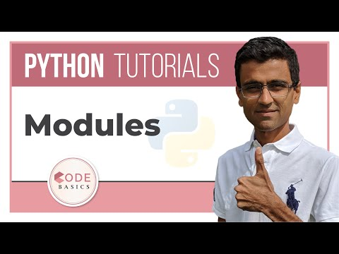
Importing packages/modules
In the video, tutor has loaded ‘math’ module of Python and used functions like sqrt (to calculate square root of a number), pow (to calculate power of a number), etc.

Slide 21
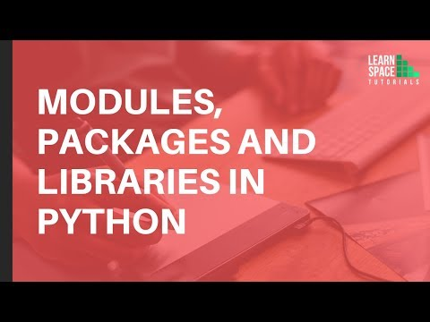
Packages, Libraries & Modules

Slide 22
Importing packages/modules
Follow this resource to learn about how to incorporate packages and make more sophisticated programs.
https://www.learnpython.org/en/Modules_and_Packages
https://www.digitalocean.com/community/tutorials/how-to-import-modules-in-python-3
40 sec video that explains importing package on jupyter notebook: https://www.youtube.com/watch?v=9FX9iRRwaYU
Tip: What is a Module?
A module is same as a code library - a file containing a set of functions you want to include in your application

Slide 23
Let’s Practice!
Write a function addition() such that it can accept two variables and calculate the sum of it. def addition(a, b):
# You should write your function here
addition(5, 6)
#this result should print 11
2. Write a function display( ) such that it can accept two
variables - a string s and a number n and display the string n
number of times.
3. Write a Python function to sum all the numbers in a list.
Sample List : [8, 2, 3, 0, 7]
Expected Output : 20
Hint: There is a built-in method for this purpose

Slide 24
Submitting your quiz answers
Learners who enrolled for the bootcamp can access DPhi Learning Platform to submit their day-wise module quizzes.
Link to learning platform: https://learn.dphi.tech/

Slide 25
That’s it for this unit. Thank you!
Feel free to post any queries on Discuss.

