Slide 1




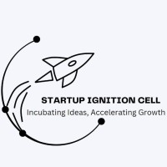








Come with Ideas, Leave with Funded Startups

Slide 2
Basic Details of the team
Idea Title : Eco-friendly incense sticks
Team/ Startup name : Eco Vibe
Team leader :Arya Sinha
Other Team Members : Kamlendra Yadav
Track : Classic Tech Track WhatsApp Video 2023-08-17 at 8.31.16 AM.mp4
START-A-THON : IDEATION Come with Ideas, Leave with Funded Startups

Slide 3
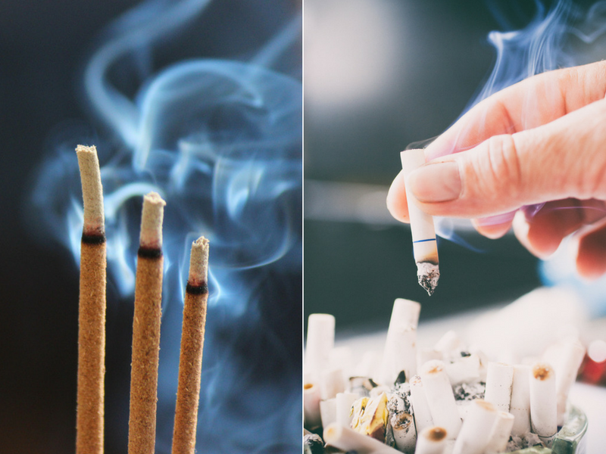
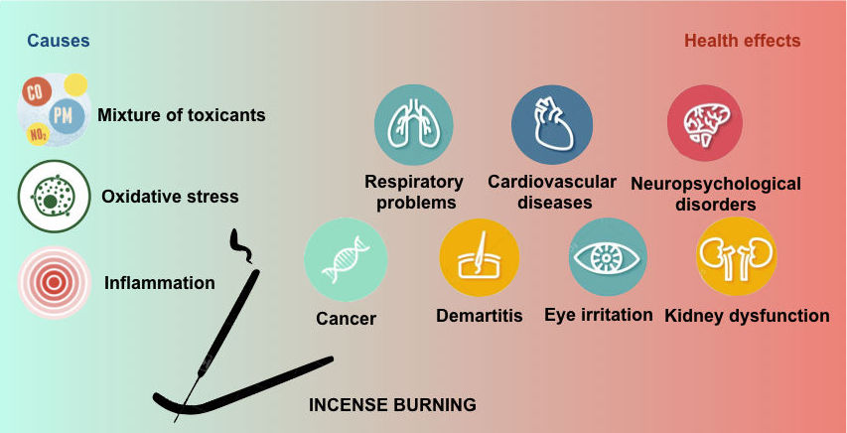
Problem Statement Details
Do you know according to Jetter et. al. [9], the concentrations of carbon monoxide (CO), nitric oxide (NO), and Sulphur dioxide (SO2) gases contained in incense smoke could be high enough to damage human health. Many reports say that it may be as harmful as cigarette smoke! On an average, incense burning produces particulates greater than 45 mg/g burned as compared to 10 mg/g burned for cigarettes.
But incense sticks are most important part of most of Asian cultures.
START-A-THON : IDEATION Come with Ideas, Leave with Funded Startups

Slide 4
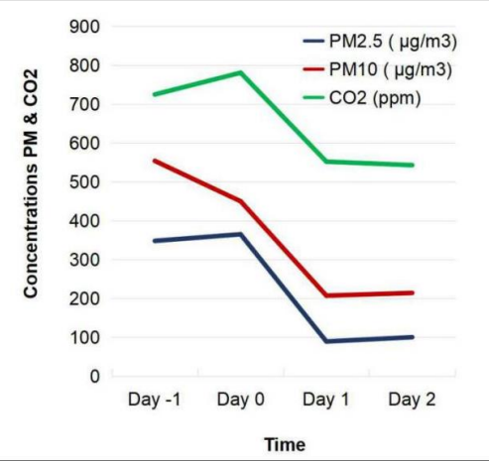
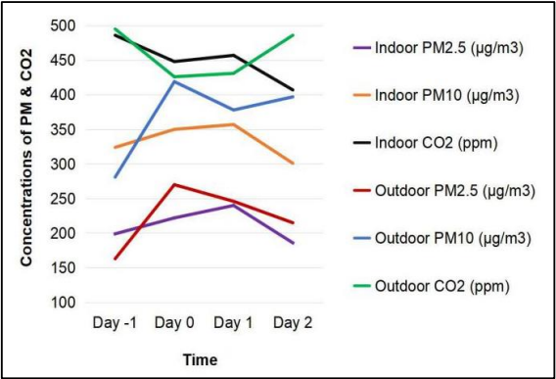
Proposed Solution
This graph shows the pollution level before and after Yajya performed at two different places. Here, Day -1 denotes the day before yagya, Day 0 denotes the day on which yagya was performed, Day 1 and 2 denotes days after yagya.
START-A-THON : IDEATION Come with Ideas, Leave with Funded Startups
The solution lies in the Yajurveda. It describes how Yagya plays an important role in purifying and detoxifying the indoor environment.
Also, researches have found out that ghee play an important role in this process.

Slide 5
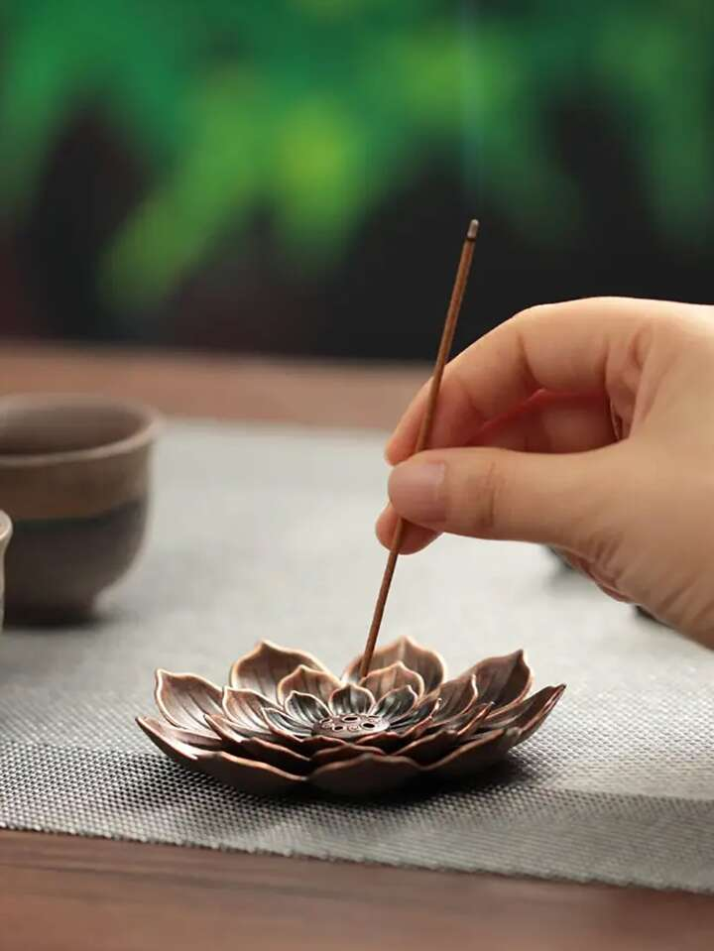
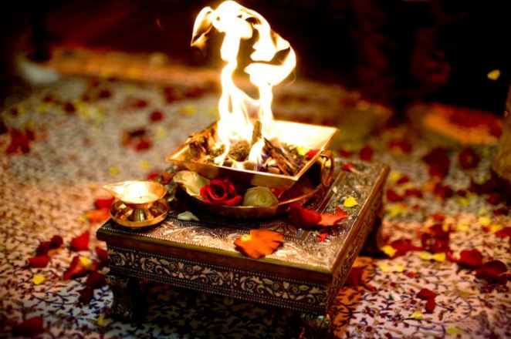
Proposed Solution
START-A-THON : IDEATION Come with Ideas, Leave with Funded Startups
Our solution focuses on manufacturing bamboo-less eco-friendly incense sticks.
Uniqueness about our solution
Use of ghee and Yagya Samagri which can produce almost negligible pollution and also help in reducing indoor pollution.
Use of waste flowers will help in reduction of land and water pollution.
Even its ashes will be beneficial for plants.

Slide 6
Market Opportunity and Competitive landscape
Today, incense sticks business is a 10-12 thousand crore business market in India out of which 1000 crores are exported every year to almost 150 countries, and there are over 1000 producers of incense sticks in India. But, among these, less than 10 are big companies while others are so unorganised. We think Nirmalaya and Phool incense companies as our competitor. We are using hawan samagris that will not only produce nice fragrance but also help in detoxifying the indoor environment and provide mental peace. Also, we conducted a survey to know whether people like hawan samagri smell and were surprised to see that almost 72% out of total votes like the smell but don’t ignite it because of lack of time and the process.
START-A-THON : IDEATION Come with Ideas, Leave with Funded Startups

Slide 7
Business Model , Go-to Market Strategy and Funding Ask
Business Model : Manufacturing eco-friendly incense sticks with nice fragrance. Mention possible Revenue Streams: Direct sales, online platforms Price: Competitive price, also making it affordable for common people.
Future Plans: Expand product line to include other natural and sustainable lifestyle offerings. Also, developing product variants in order to improve fragrance property.
START-A-THON : IDEATION Come with Ideas, Leave with Funded Startups

Slide 8

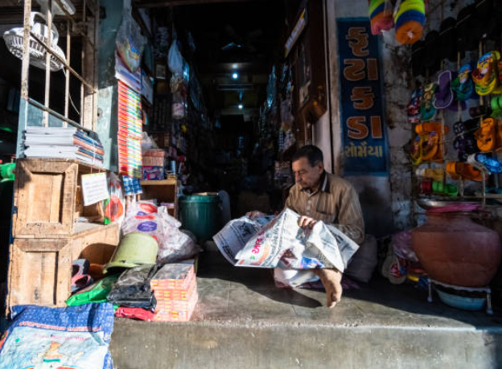

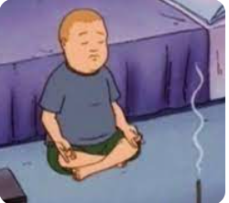
Business Model , Go-to Market Strategy and Funding Ask
Market Strategy door to door sales (sampling campaign) contacting shopkeepers using social media and influencers contacting wellness centers
START-A-THON : IDEATION Come with Ideas, Leave with Funded Startups

