Slide 1
CampusGuide AI
Your whole campus, one AI away.
An AI-powered campus companion for departments, hostels, clubs, contacts and nearby essentials.
MY
Ask your campus anything.
ITER • SOA University • Bhubaneswar
CampusGuide AI • Hackathon MVP

Slide 2
SOLUTION OVERVIEW
02
Brief about the solution
CampusGuide AI brings fragmented campus information into one student-first interface.
The MVP combines structured ITER information with an authenticated AI assistant and an interactive map, so students can find the right
information without switching between multiple sources.
▣
Campus information
★
Student life
⌖
Nearby essentials
AI
AI assistant
Departments, HOD emails,
key offices and important
contacts.
Hostel information plus a
categorized directory of
20 student clubs.
Map-based discovery for
useful places around campus.
Authenticated chat that
answers from the campus
data and guides students.
CampusGuide AI • Hackathon MVP

Slide 3
WHY CAMPUSGUIDE AI?
03
Opportunities
01
A. Different from existing ideas
02
B. How it solves the problem
03
C. USP
Instead of being only a campus directory,
CampusGuide AI combines:
• Structured campus information
• Student clubs & hostel discovery
• Nearby-place map
• AI-powered natural-language assistance
The result is a single conversational entry
point to campus life.
Students can directly browse
departments, contacts, hostels
and clubs, or ask the AI assistant for
help. The map section handles
location-based needs such as cafés,
pharmacies, ATMs, stationery and
other essentials.
“Everything a student needs — from
campus information to nearby essentials
— in one AI-powered platform.”
The strongest differentiator is the
combination of campus knowledge +
AI guidance + location discovery in one
lightweight MVP.
CampusGuide AI • Hackathon MVP

Slide 4
CORE FEATURES
04
Features offered by the solution
01
Departments & Contacts
02
Hostels
Department directory with HOD emails and key institute offices.
Boys’ and girls’ hostel information, facilities and a dedicated
rules/wardens section.
03
Student Clubs
04
Campus & Nearby Map
20 clubs grouped by Coding, Automation, Art, Cultural, Research,
Communities and more.
Interactive map for campus and useful nearby places such as cafés,
ATMs, pharmacies and stationery shops.
05
AI Campus Assistant
Authenticated Gemini-powered chat that answers using the available
campus dataset and points users to the Map section for nearby places.
CampusGuide AI • Hackathon MVP

Slide 5
STUDENT JOURNEY
05
Process flow / Use case
A simple flow from sign-in to information discovery or AI guidance.
1
2
3
4
5
Open CampusGuide AI
Sign in / Register
Choose a need
Get the answer
Take action
Student reaches the campus
companion.
Authentication unlocks
personalized access and AI chat.
Departments • Hostels • Club
s • Map • AI Assistant
Browse structured data,
discover places, or ask the AI.
Email a department, follow a
club, or navigate to a nearby place.
Example: “Where can I contact the CSIT department?” → Department directory → HOD email → action.
CampusGuide AI • Hackathon MVP

Slide 6
CONCEPTUAL UI
06
Wireframes / Mock diagrams
Low-fidelity layout sketches — these are design diagrams, not screenshots.
LOGO
Home
Departments
Hostels
Clubs
Map
AI
PAGE TITLE
search / filter
Hero / campus search
item / department / club
details →
Visual / AI
Ask your campus anything…
campus
illustration
item / department / club
details →
Departments
Clubs
Map
item / department / club
details →
Dashboard / Home
Directory / category page
CampusGuide AI • Hackathon MVP

Slide 7
TECHNICAL ARCHITECTURE
07
Architecture of the proposed solution
FRONTEND • index.html
Dashboard • Departments • Hostels • Clubs • Map • AI Assistant
BACKEND • Flask / Gunicorn
REST APIs • auth tokens • campus data • chat orchestration • health check
DATABASE • Neon PostgreSQL
EXTERNAL SERVICES
users table
name • email • password hash • created_at
Gemini API • OpenStreetMap / Leaflet / Overpass
Flow: Student UI → Flask APIs → Neon / Gemini / map services → response back to UI
CampusGuide AI • Hackathon MVP

Slide 8
TECHNOLOGY STACK
08
Technologies used in the solution
HTML + CSS + JavaScript
Python + Flask
Responsive single-page frontend and interactive UI.
Backend routes, APIs, authentication and application logic.
PostgreSQL / Neon
Google Gemini
Persistent user accounts and authentication data.
AI Campus Assistant with campus-aware system instructions.
Leaflet + OpenStreetMap
Overpass API
Interactive campus and nearby-place map.
Queries map data for useful nearby categories.
Werkzeug + itsdangerous
Gunicorn + Render
Password hashing and signed, time-limited auth tokens.
Production WSGI server and cloud deployment.
CampusGuide AI • Hackathon MVP

Slide 9
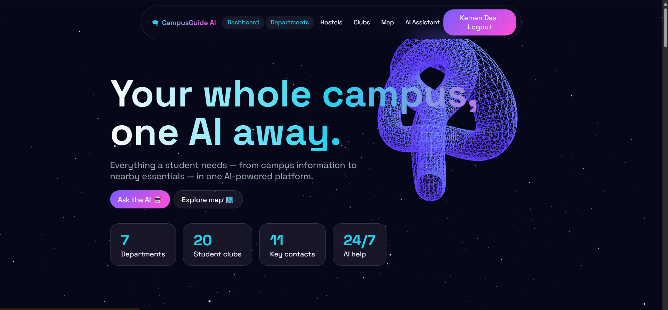
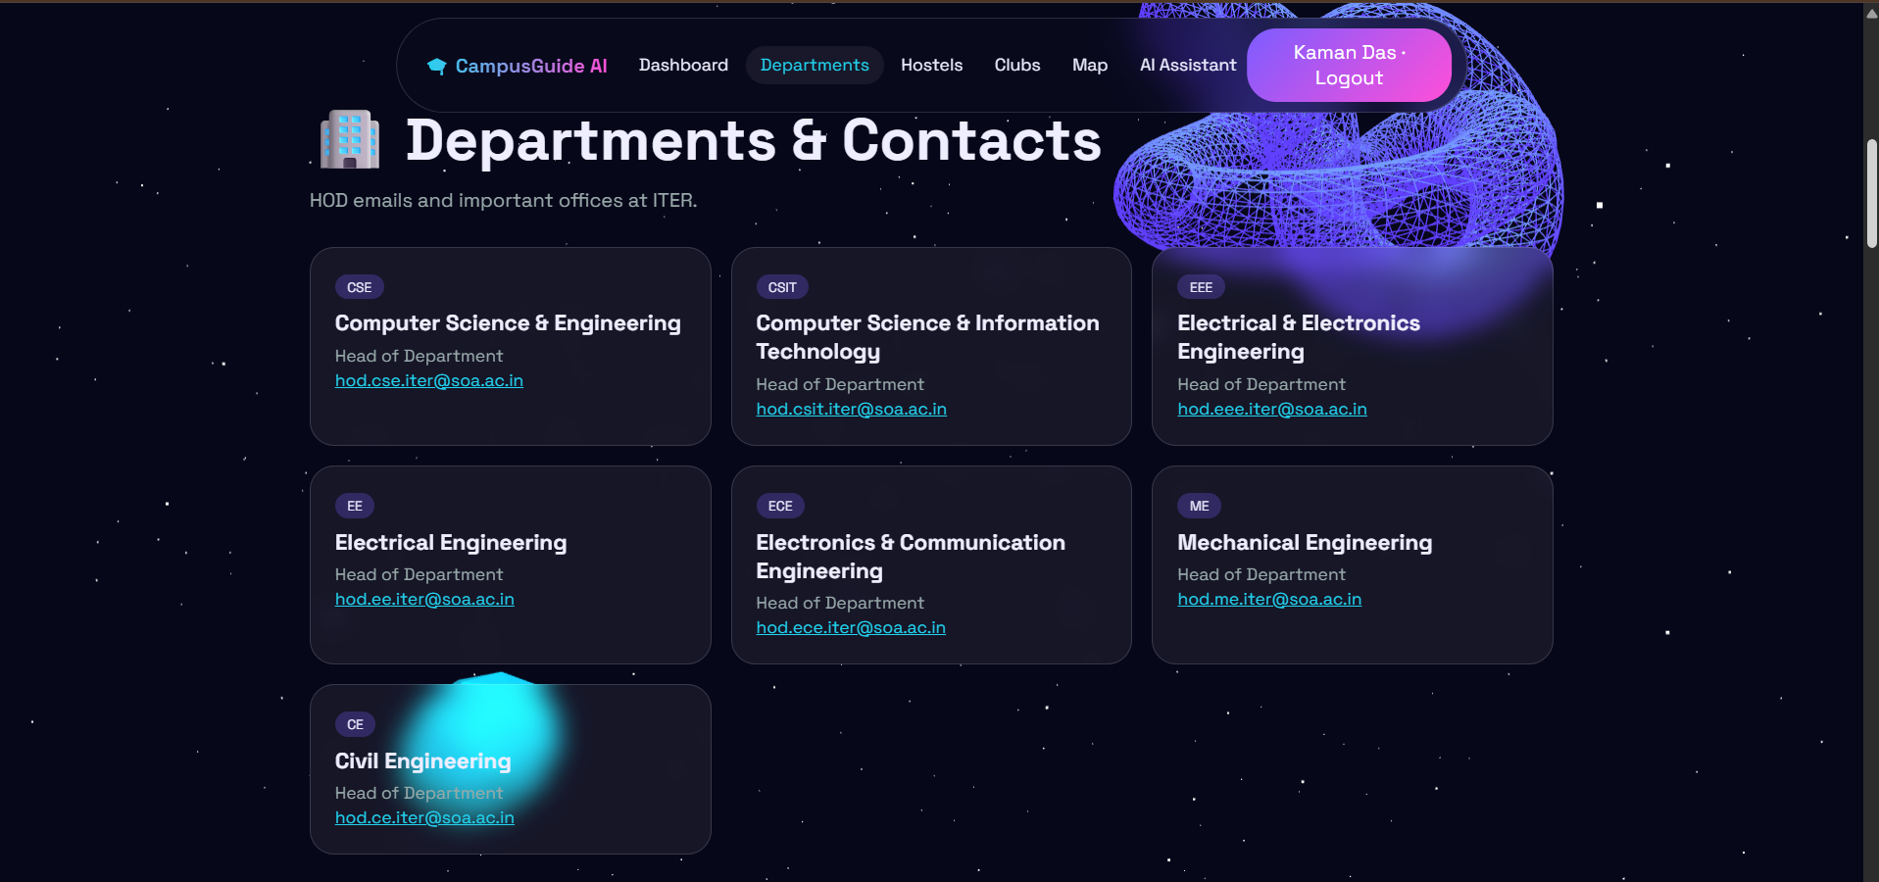
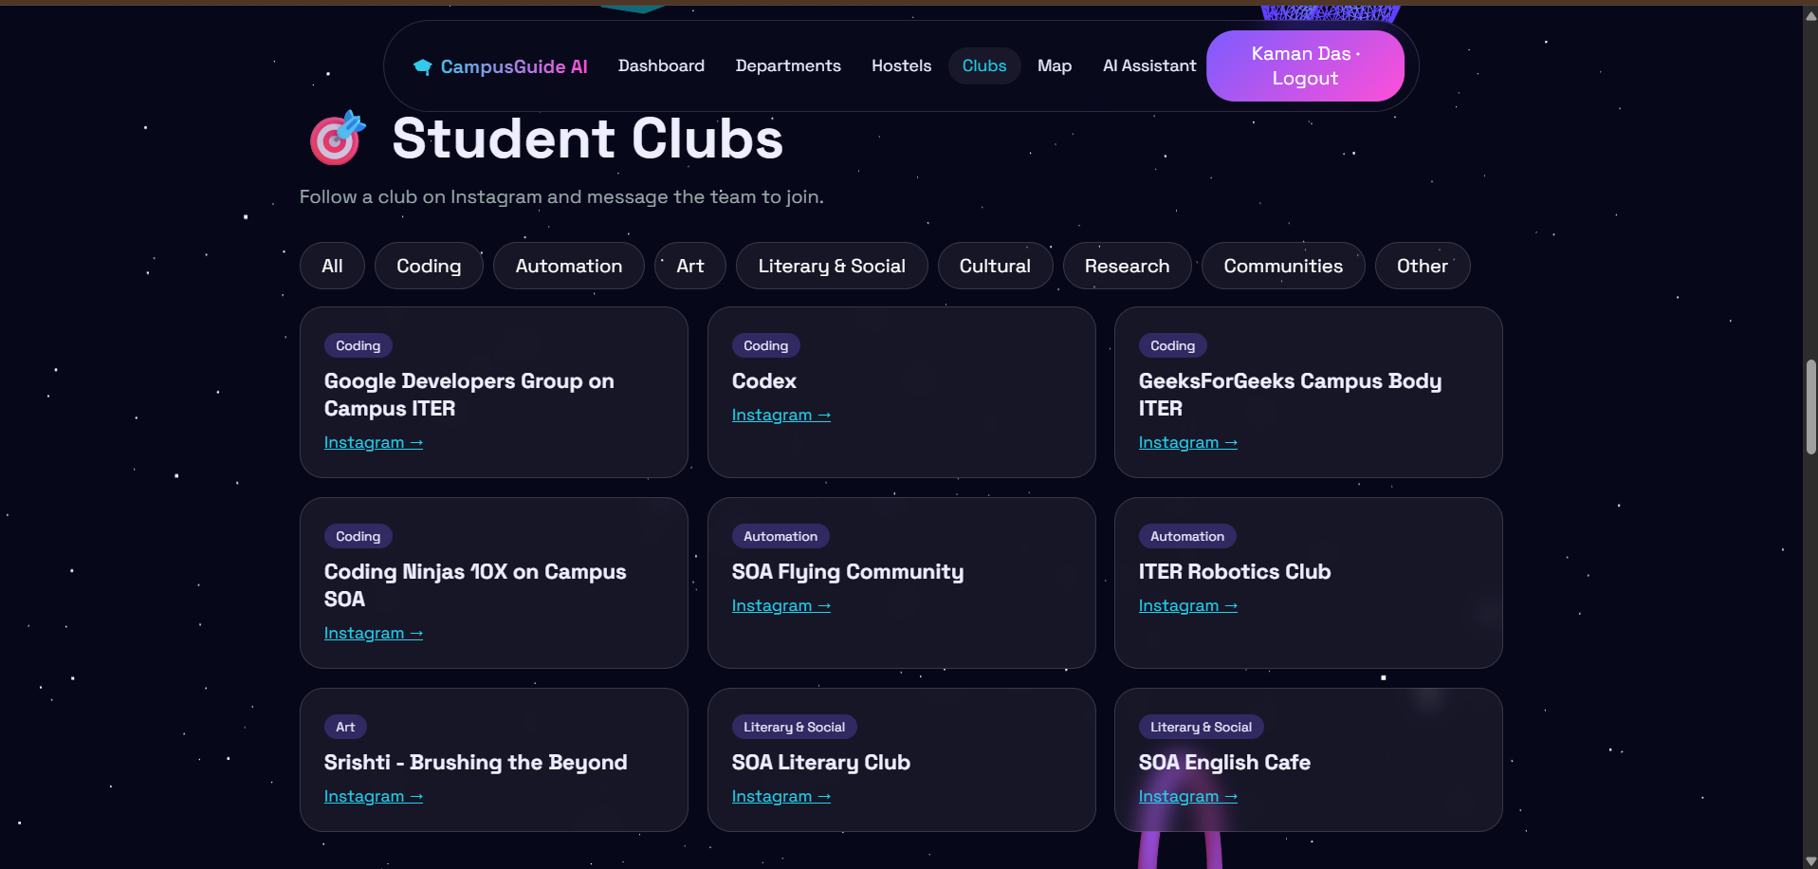
ORIGINAL WEBSITE SCREENSHOTS
09
Snapshots of the MVP
The following visuals are the original screenshots provided for the presentation.
CampusGuide AI • Hackathon MVP

Slide 10
ROADMAP
10
Additional details & future development
01
Live campus directory
02
Richer contacts & hostel data
03
Smarter campus search
Move more information from static MVP data
into an admin-managed database so updates
can happen without code changes.
Add verified phone numbers, wardens, timings,
hostel rules and office hours as authoritative
data becomes available.
Add semantic search and retrieval so the
assistant can answer from a larger, continuously
updated campus knowledge base.
04
Personalized student tools
05
Navigation & accessibility
06
Admin analytics
Saved places, favorite clubs, event reminders a
nd personalized campus shortcuts.
Improve route guidance, mobile UX, voice
interaction and accessibility for faster
on-campus use.
Usage insights for frequently searched
departments, clubs and locations while
keeping student data protected.
CampusGuide AI • Hackathon MVP

Slide 11
EXPLORE THE MVP
11
Project links
1. GitHub Public Repository
https://github.com/kamandas-108/CampusGuide-AI/
2. Working Prototype
https://campusguide-ai-ui78.onrender.com/
Scan, click or copy the links to inspect the code and try the deployed MVP.
CampusGuide AI • Hackathon MVP

Slide 12
Thank You
CampusGuide AI
Your whole campus, one AI away.
Ask your campus anything.
CampusGuide AI • Hackathon MVP

