Slide 1
Carbon Coach AI
AI-Powered Personal Carbon Footprint & Sustainability Assistant Kaman Das

Slide 2
Problem & Solution
• Tracks emissions from travel, electricity and shopping. • Uses Gemini AI to provide personalized reduction tips. • Helps users build sustainable habits.

Slide 3
Opportunity / Impact
• Encourages sustainable living • Personalized AI guidance • Goal-based progress tracking • Daily eco challenges

Slide 4
Key Features
1. Carbon Calculator 2. AI Coach + Voice Input 3. Progress Dashboard 4. AI Eco Challenges

Slide 5
Process Flow
User → Calculator → Carbon Score → Gemini AI → Personalized Tips → Dashboard

Slide 6
Wireframes
Home | Calculator | AI Coach | Dashboard (Simple wireframe placeholders)

Slide 7
System Architecture
Frontend (HTML/Tailwind/JS) ↓ Flask Backend ↓ Gemini AI + Neon PostgreSQL

Slide 8
Technology Stack
HTML • Tailwind CSS • JavaScript Flask • Gemini 2.5 Flash Neon PostgreSQL • Web Speech API • Render

Slide 9
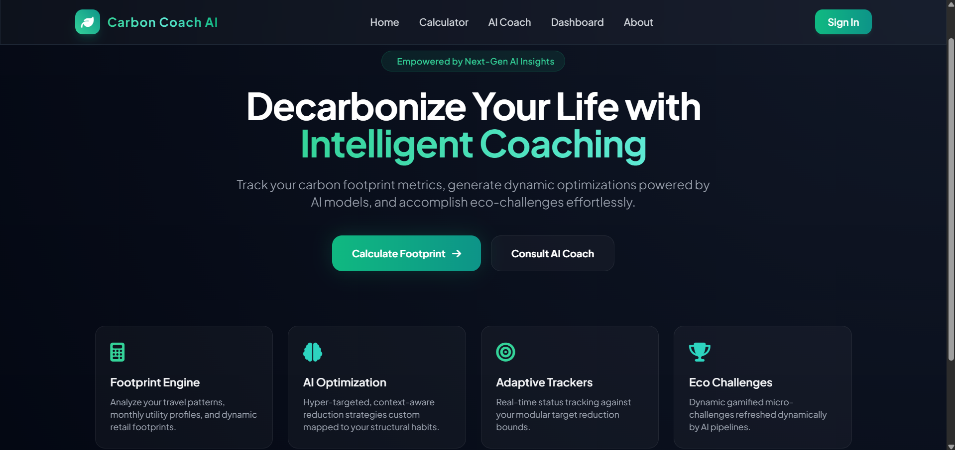
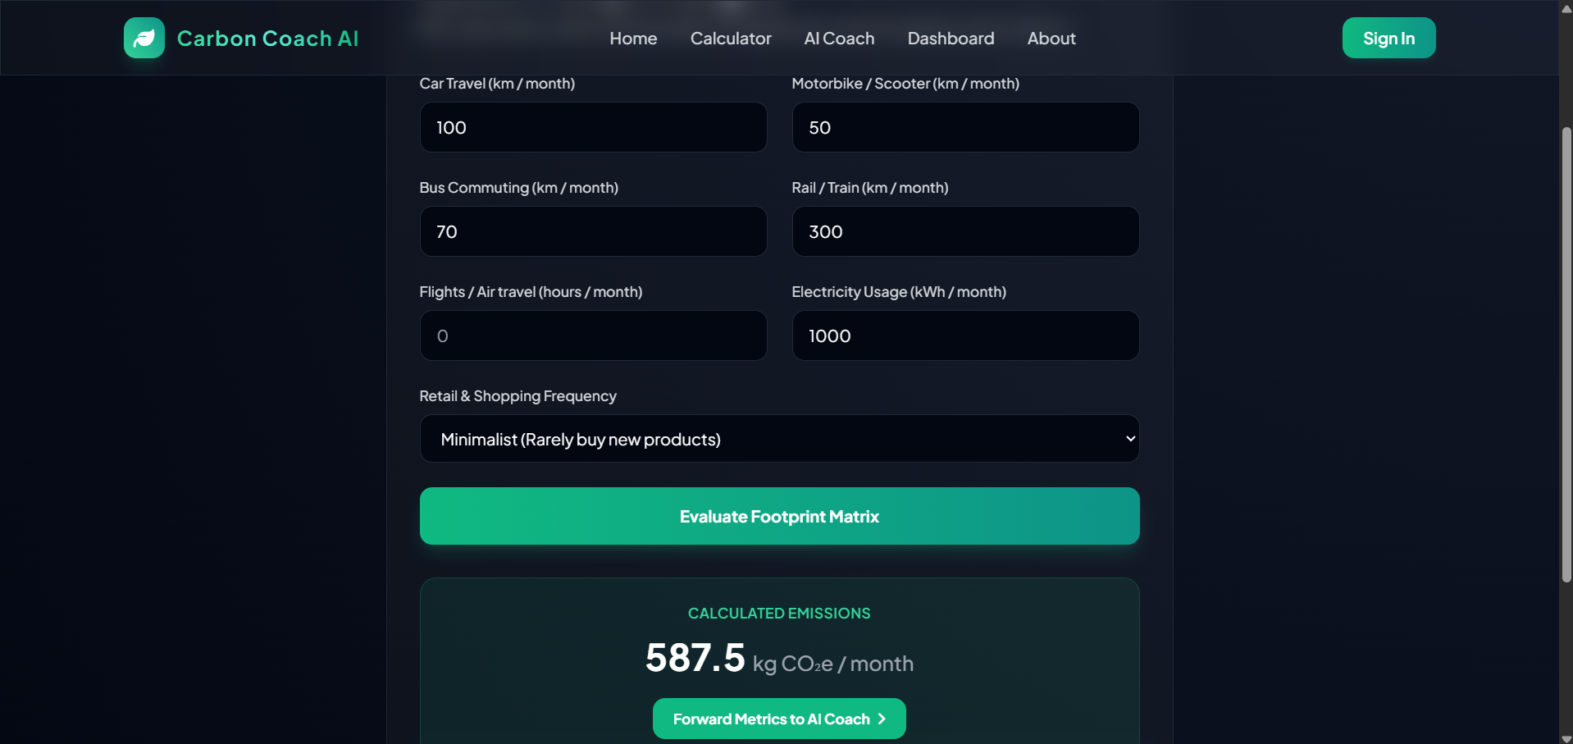
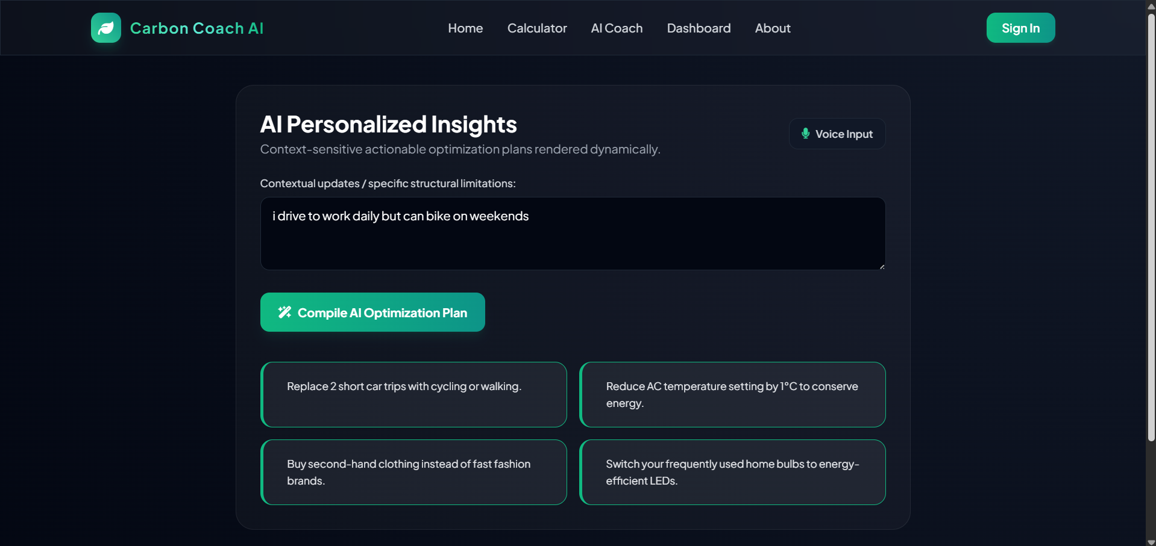
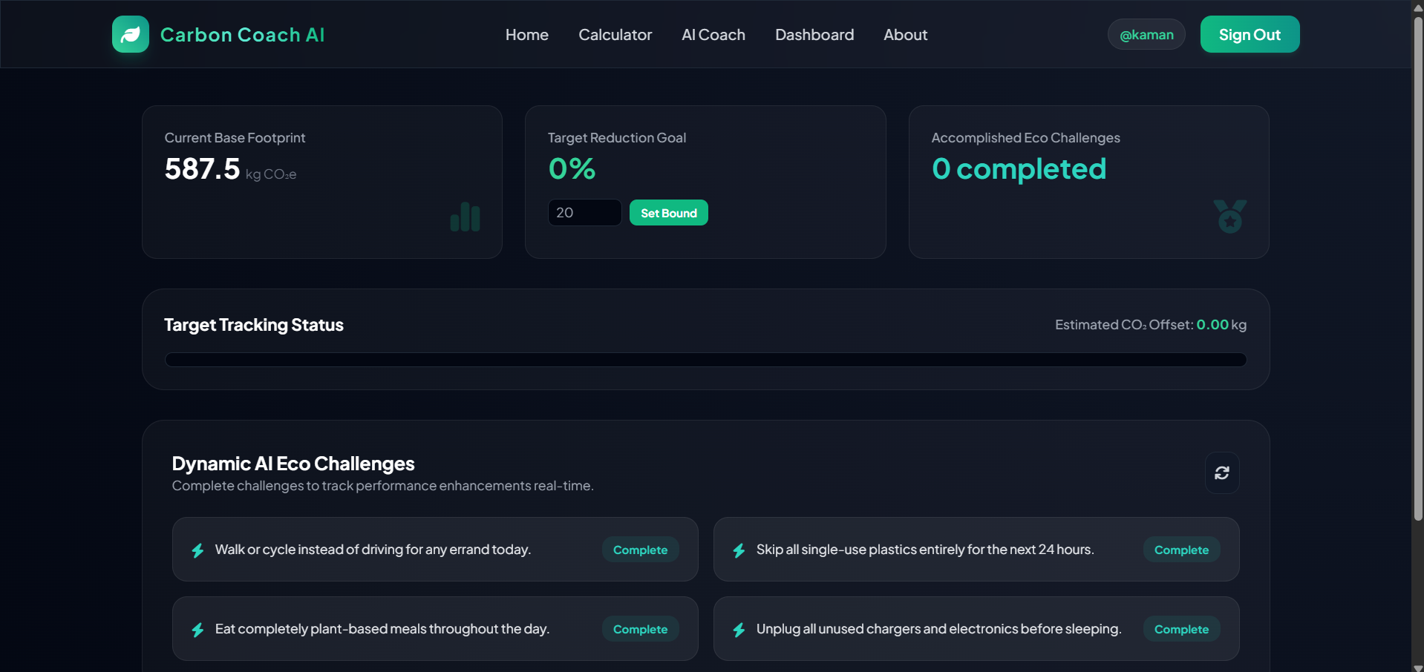
MVP Screenshots

Slide 10
Future Scope
• Mobile App • Smart device integration • Community leaderboard • Carbon offset marketplace

Slide 11
GitHub & Live Demo
GitHub: https://github.com/kamandas-108/Carbon-Coach-AI/ Live: https://carbon-coach-ai-1.onrender.com/

Slide 12
Thank You
Questions? Kaman Das

