Slide 1
CarePath AI
Symptom-to-Care Navigator
Presented by: Kaman Das

Slide 2
Brief About the Solution
CarePath AI is an AI-powered healthcare assistant that helps users understand possible causes of symptoms, assess risk levels, receive healthcare recommendations, and access health education. It also supports voice input, multilingual interaction, health tracking, reminders, and nearby healthcare facility discovery.

Slide 3
Opportunities
a. Combines AI analysis, health tracking, voice input, and location-based healthcare guidance.
b. Helps users make informed healthcare decisions quickly.
c. USP: Multilingual support, symptom trend analysis, reminders, and nearby healthcare finder in one platform.

Slide 4
Features
• AI Symptom Analysis
• Risk Classification
• Health Education Insights
• Emergency Warning Detection
• Voice Symptom Input
• Multi-language Support
• User Authentication
• Health Journey Tracker
• Reminders
• Nearby Healthcare Finder

Slide 5
Process Flow Diagram
User Input → AI Analysis (Gemini) → Risk Assessment → Recommendation → Health Education → Database Storage → Tracker & Reminders

Slide 6
Wireframes / Mock Diagrams
Dashboard
AI Assessment
Journey Tracker
Reminders
Nearby Finder

Slide 7
Architecture Diagram
Frontend (HTML/CSS/JS) ↔ Flask Backend ↔ Gemini AI
↕
Neon PostgreSQL
↕
OpenStreetMap / Geolocation

Slide 8
Technologies Used
Frontend: HTML, Tailwind CSS, JavaScript
Backend: Flask (Python)
AI: Gemini 2.5 Flash
Database: Neon PostgreSQL
Maps: OpenStreetMap + Leaflet
Speech: Web Speech API
Deployment: Render

Slide 9
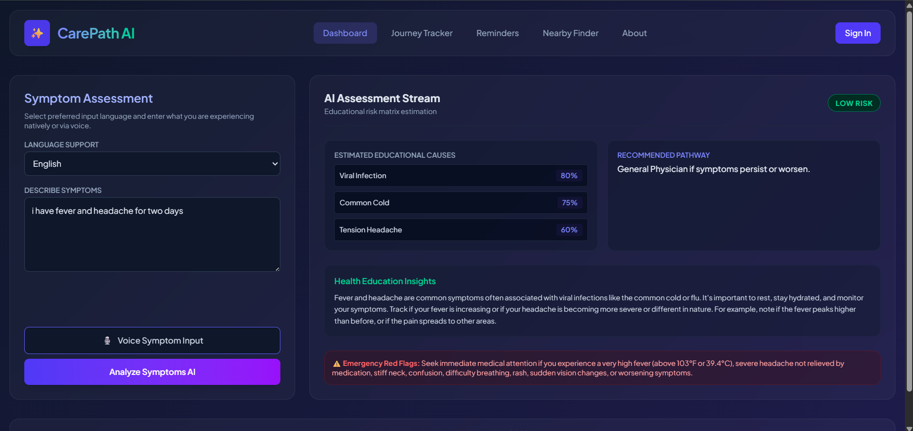
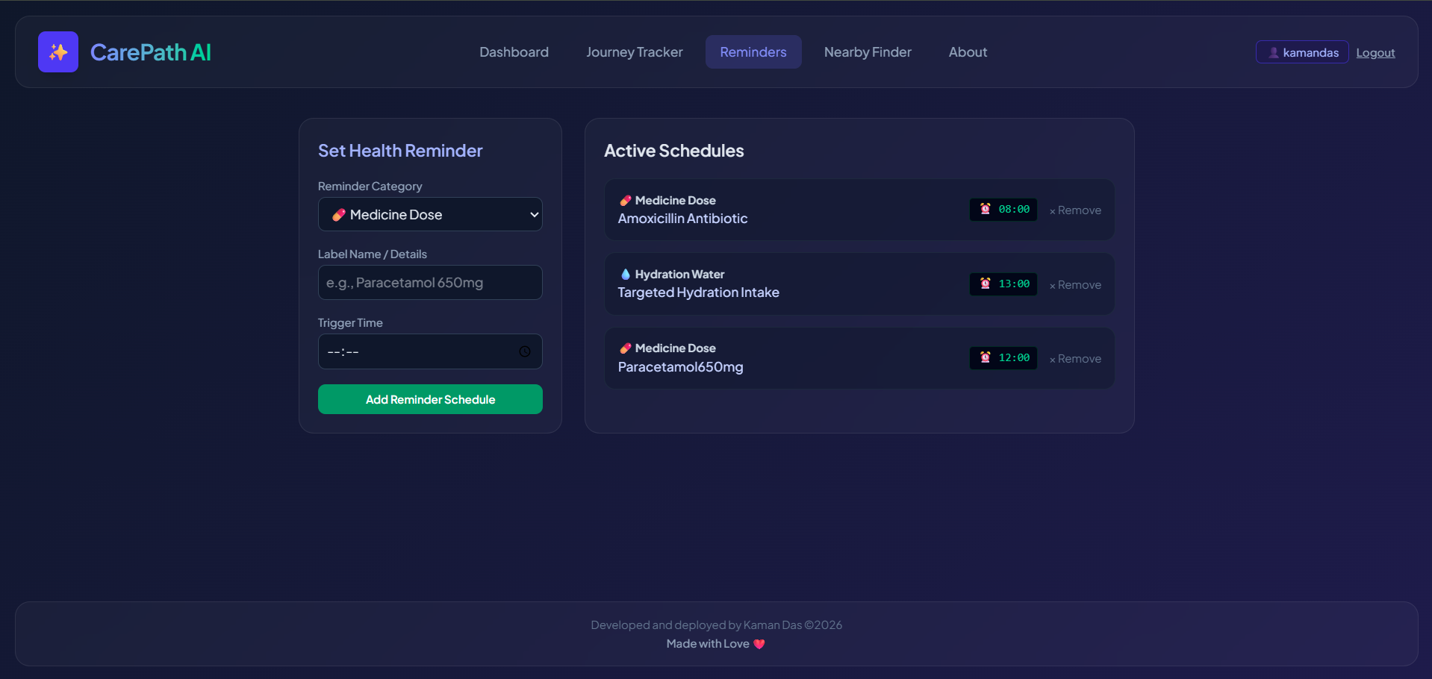
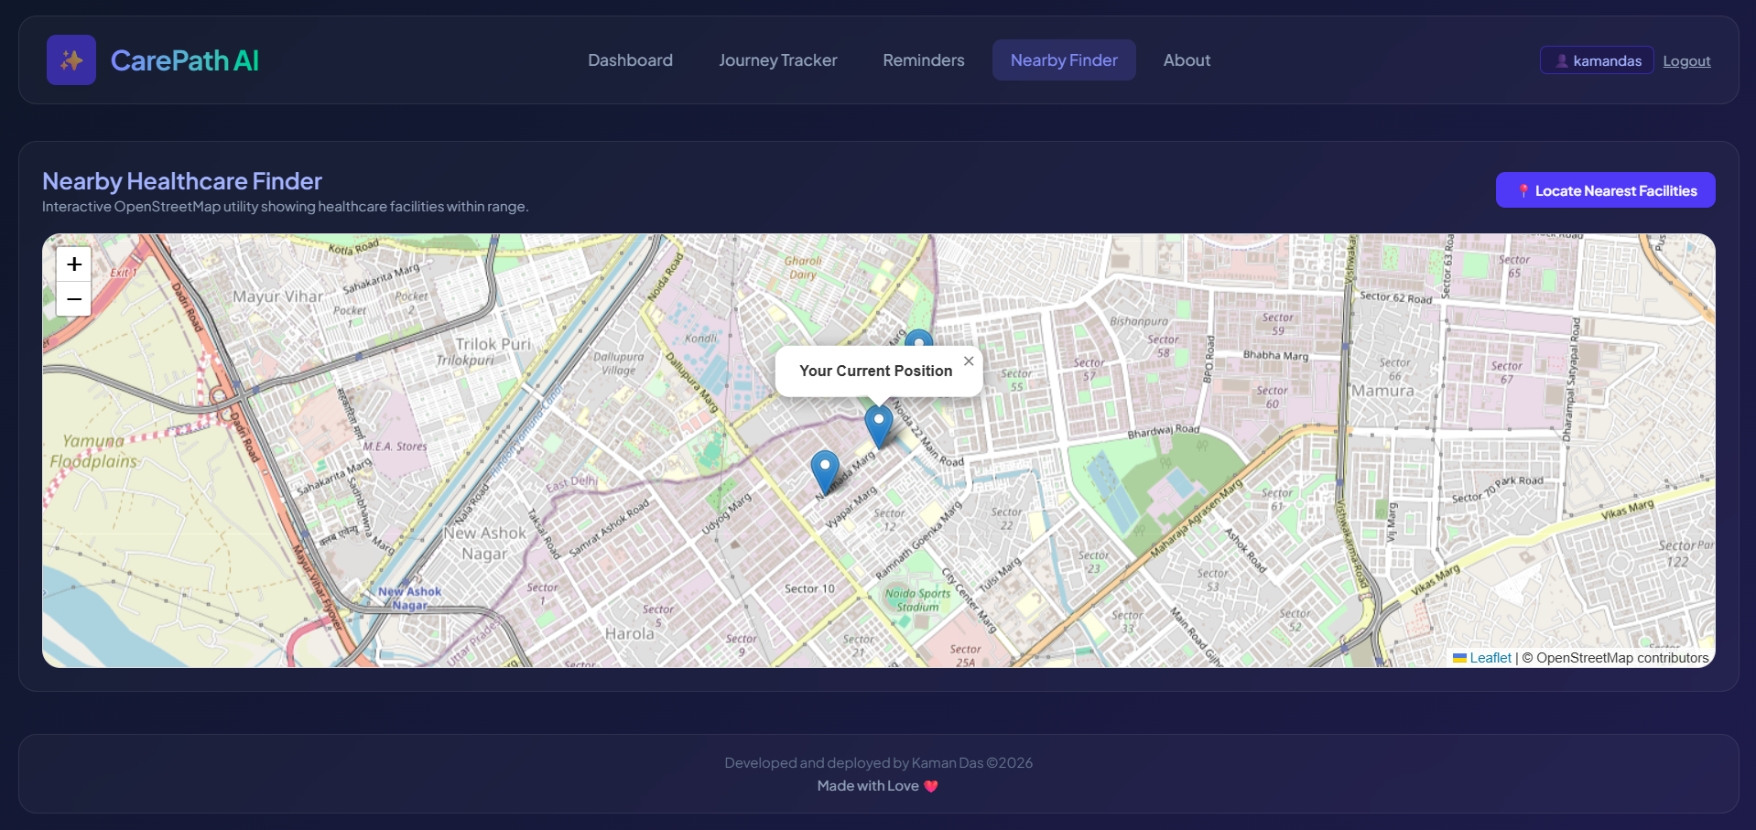
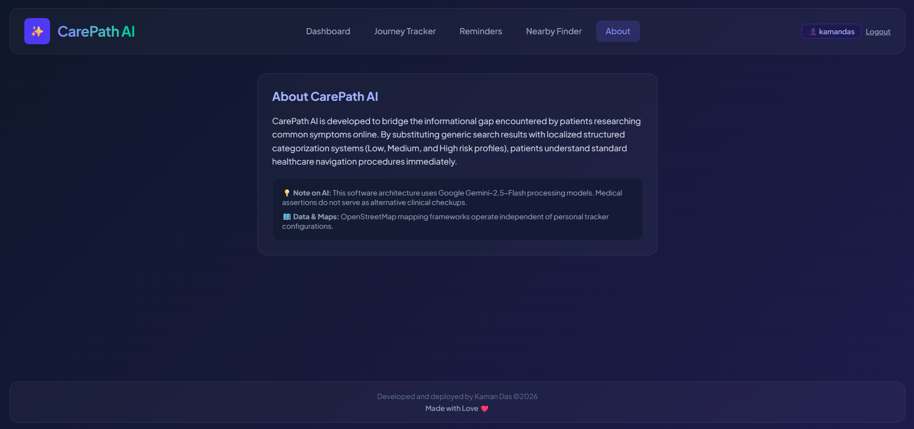
Snapshots of the MVP

Slide 10
Future Development
• Real-time hospital database integration
• Doctor appointment booking
• Advanced AI health trend prediction
• Mobile application
• Wearable device integration

Slide 11
Repository & Prototype Links
GitHub: https://github.com/kamandas-108/CarePath-AI/
Live Prototype: https://carepath-ai-2.onrender.com/

Slide 12
Thank You
Thank You
Questions & Feedback

