Slide 1
CareerCompass AI
Kaman Das
Smart Career Guidance Platform

Slide 2
Brief About the Solution
CareerCompass AI is an AI-powered platform that analyzes interests, skills, subjects, and personality traits to provide personalized career recommendations, roadmaps, learning resources, and project ideas.

Slide 3
Opportunities
a. Personalized guidance unlike generic portals.
b. Reduces career confusion using AI analysis.
c. USP: Complete roadmap + resources + projects + demand insights.

Slide 4
Features
• Career Recommendations
• Suitability Scores
• Salary Estimation
• Future Demand Analysis
• Learning Roadmaps
• Courses & Certifications
• YouTube Resources
• Project Recommendations

Slide 5
Process Flow Diagram
User Input → Frontend → Flask API → Gemini AI → Analysis Engine → Career Roadmap

Slide 6
Wireframes / Mock Diagrams
User Profile Form
→ Analyze Profile Button
→ AI Career Cards
→ Project Recommendations

Slide 7
Architecture Diagram
Frontend (HTML/CSS/JS)
↓
Flask Backend
↓
Gemini 2.5 Flash
↓
Career Recommendation Engine

Slide 8
Technologies Used
HTML, CSS, JavaScript
Flask (Python)
Gemini 2.5 Flash
Neon PostgreSQL
Render
GitHub

Slide 9
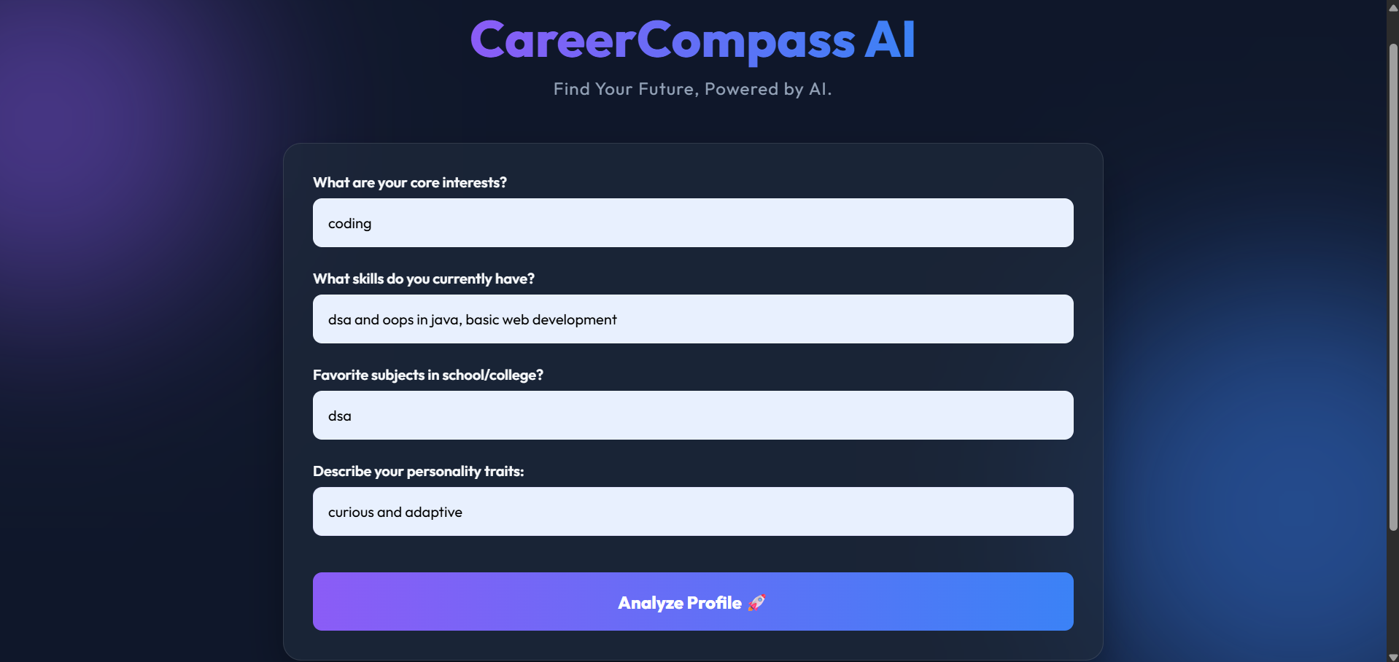
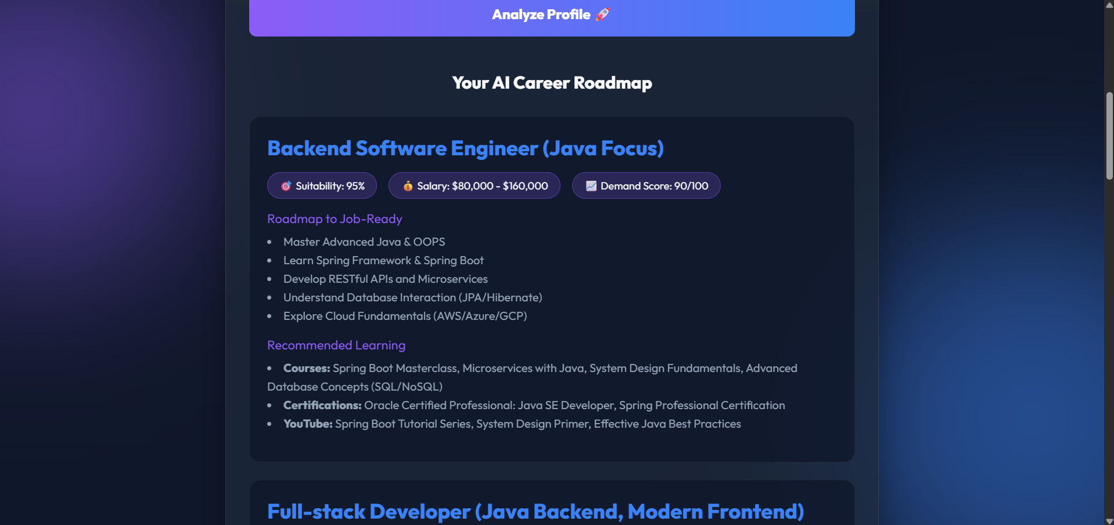
MVP Snapshots

Slide 10
Future Development
Resume Builder
Skill Gap Analysis
Internship Recommendations
Career Analytics
Industry Trends

Slide 11
Project Links
GitHub:
https://github.com/kamandas-108/CareerCompass-AI
Prototype:
https://kamandas-108.github.io/CareerCompass-AI/

Slide 12
Thank You

