Slide 1
EcoLens AI
Kaman Das
Snap Waste. Save the Planet.

Slide 2
Brief About the Solution
EcoLens AI identifies waste using Gemini Vision AI, determines recyclability, provides disposal guidance, reuse ideas, environmental impact, and nearby recycling centers.

Slide 3
Opportunities
• AI-powered waste identification
• Proper disposal guidance
• Nearby recycling centers
• Eco dashboard and chatbot

Slide 4
Features
• AI Waste Detection
• Disposal Guide
• Reuse Ideas
• AI Chatbot
• Voice Input
• Dashboard
• Authentication

Slide 5
Process Flow
User → Upload Image → Flask Backend → Gemini AI → Waste Analysis → Results → Dashboard

Slide 6
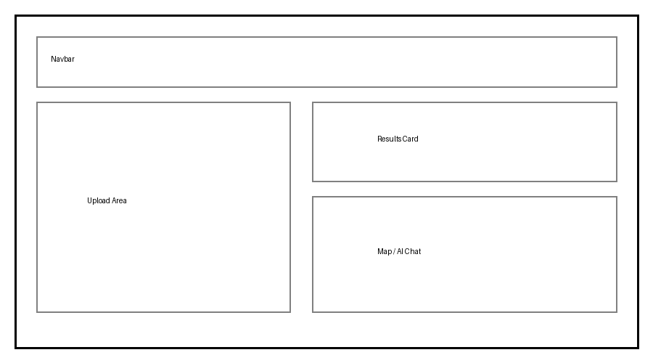
Wireframes / Mock Diagrams
Conceptual wireframe of the proposed interface.

Slide 7
Architecture
Frontend (HTML/Tailwind/JS)
↓
Flask Backend
↓
Gemini API + Neon PostgreSQL

Slide 8
Technologies
HTML
Tailwind CSS
JavaScript
Python
Flask
Gemini 2.5 Flash
Neon PostgreSQL
Leaflet

Slide 9
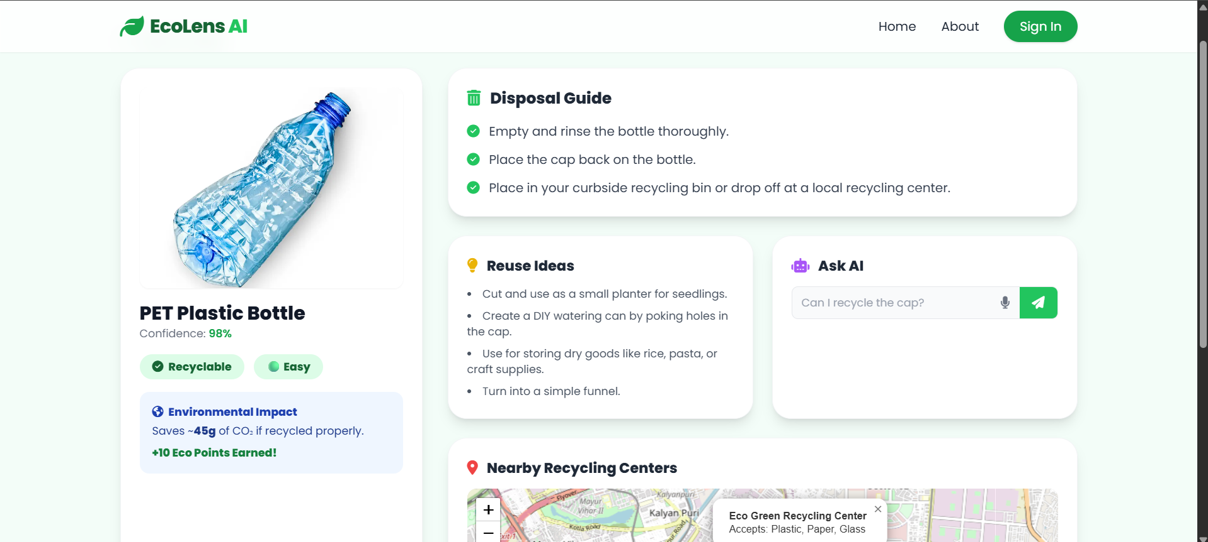
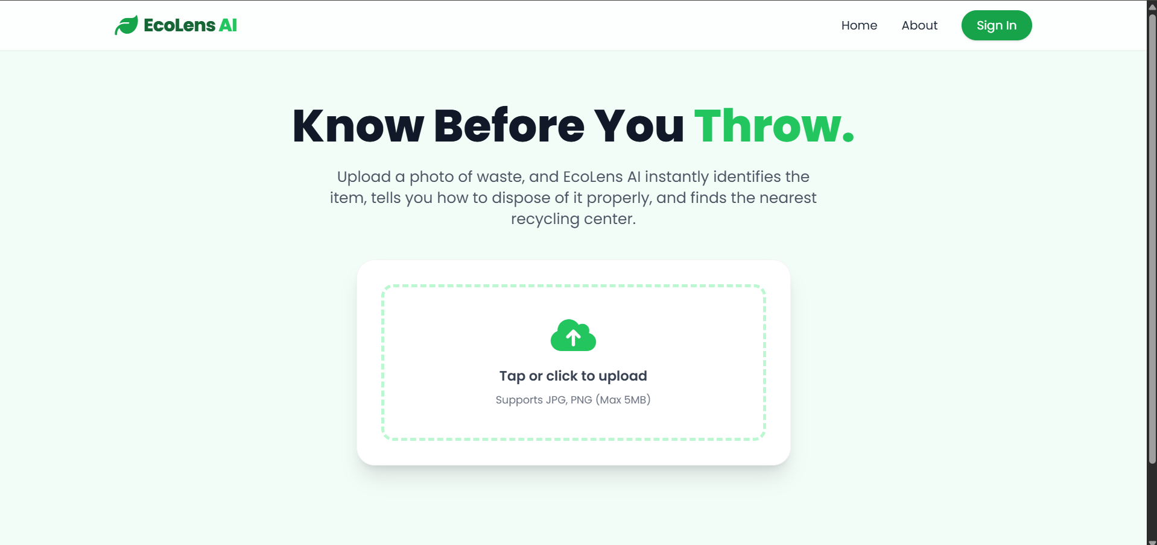
Snapshots of MVP

Slide 10
Future Development
• Mobile App
• Barcode Scanner
• Smart Bin
• Multi-language
• Better recycling APIs

Slide 11
Links
GitHub:
https://github.com/kamandas-108/EcoLens-AI/
Prototype:
https://kamandas-108.github.io/EcoLens-AI/

Slide 12
Thank You
Thank You!

