Slide 1
RescueVision AI Disaster Response Assistant Kaman Das

Slide 2
Problem Statement
• Slow disaster assessment
• Delayed rescue prioritization
• Manual resource allocation
• Need AI-assisted decision support

Slide 3
Solution Overview
AI analyzes uploaded satellite/drone images and incident reports using Gemini AI to identify affected regions, estimate severity, recommend rescue resources, and visualize priority locations on an interactive map.

Slide 4
Key Features
• AI Disaster Analysis
• Incident Report Analysis
• Rescue Priority Map
• AI Resource Allocation

Slide 5
Process Flow
Image + Report/Voice → Flask → Gemini AI → Damage Detection → Priority → Resource Allocation → Map

Slide 6
Wireframes
Low-fidelity screens:
Login → Dashboard → Analysis → Map

Slide 7
System Architecture
User → Frontend → Flask → Gemini + Neon DB → Leaflet Map → Results

Slide 8
Technology Stack
HTML, Tailwind CSS, JavaScript
Flask
Gemini 2.5 Flash
Neon PostgreSQL
Leaflet.js
OpenStreetMap
Web Speech API
Render

Slide 9
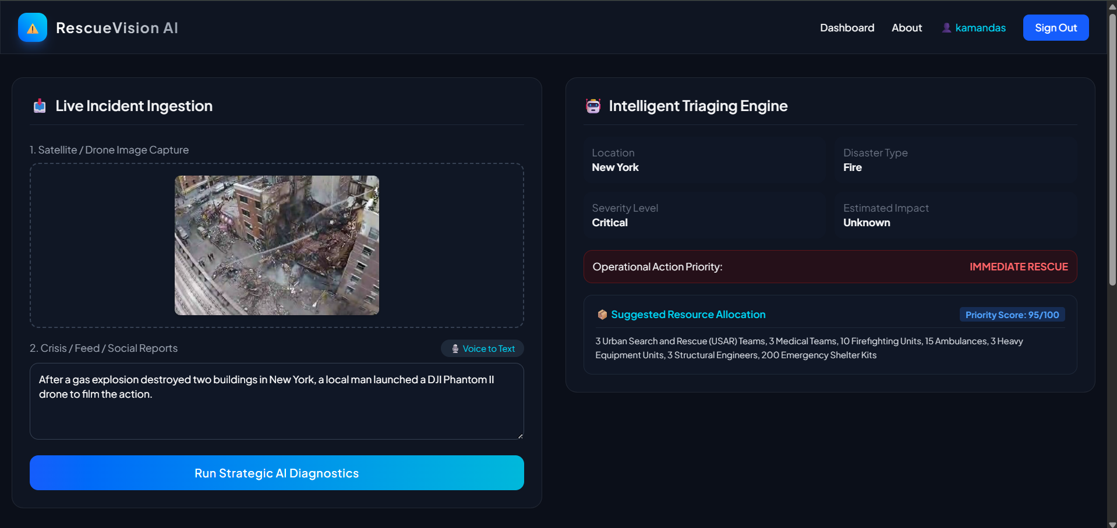
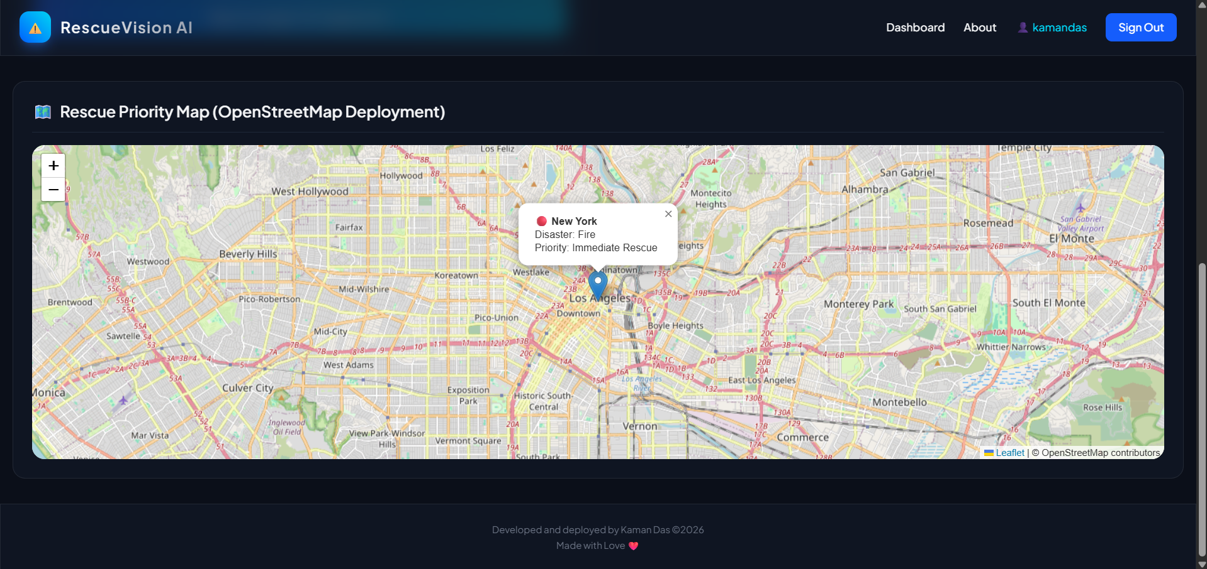
MVP Screenshots

Slide 10
Future Scope
• Live satellite feeds
• Social media APIs
• Predictive analytics
• Mobile app
• Offline mode

Slide 11
GitHub & Live Demo
GitHub:
https://github.com/kamandas-108/RescueVision-AI
Live:
https://rescuevision-ai.onrender.com/

Slide 12
Thank You
Thank You!
Questions?

