Slide 1



ABS Store Performance Analysis
Arash Nateghian
Data 205
Prof. Perine
Notes:
“Hello, my name is Arash Nateghian.
(pause)
Today I’m presenting my analysis of Alcohol Beverage Services store performance.
My goal in this project was to understand why stores perform differently, not only in total revenue, but in efficiency, traffic patterns, basket behavior, and category mix.
(slight pause)
Using transaction-level sales data, store attributes, and statistical modeling, I evaluated which stores perform above expectations and which ones fall short.
(pause)
This analysis supports more informed operational, inventory, and merchandising decisions for ABS.”
“ABS operates under a unique dual mission: to protect public safety and to generate revenue for the county. (slow)
To achieve that, it’s essential to understand why stores perform differently,whether the drivers are traffic, product mix, or basket behavior. These differences directly affect inventory planning, staffing, and assortment strategy.
(pause)

Slide 2
Data Overview & Cleaning Strategy
3 datasets: transactions, designation, demographics
Major cleaning: normalize store names, pack sizes, remove noise
Result: analytics-ready dataset
Notes:
“My analysis is built on three core datasets: line-level transactions, store square footage, and demographic attributes.
I performed extensive cleaning, standardizing classification labels, correcting pack and size units, removing non-retail items, flagging refunds, and validating all date and quantity fields. (pause)

Slide 3
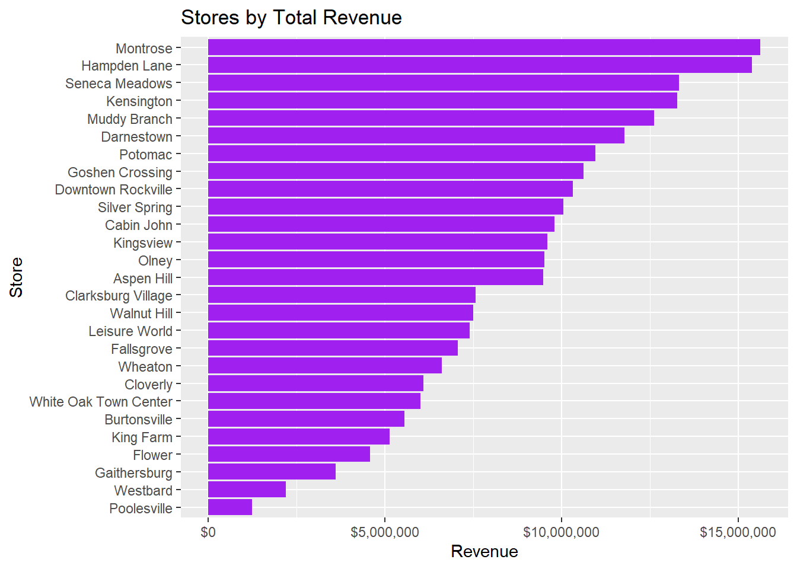
High-revenue ≠ high efficiency
Montrose, Hampden Lane
Notes:
“This chart ranks stores by total revenue, But raw revenue by itself can be misleading, because it doesn’t account for store size or how much traffic each location receives. (pause)
That’s why later in the presentation I shift to evaluating performance per square foot, which gives a much more accurate picture of true efficiency.”

Slide 4
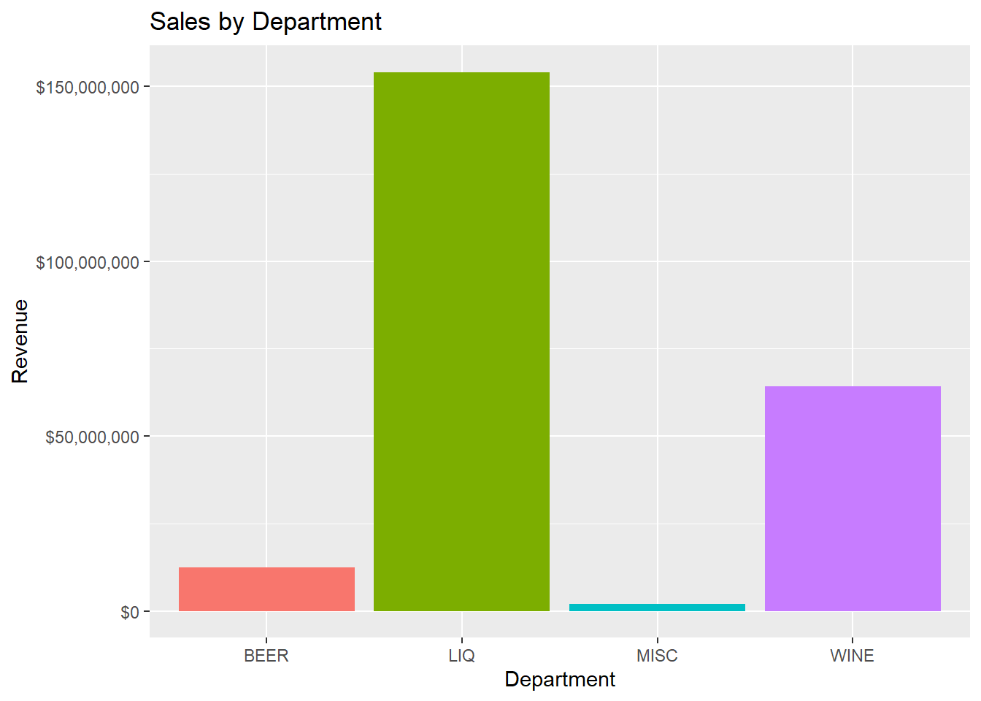
Liquor drives revenue
Beer = volume machine
Wine moderate
Notes:
“Liquor drives the majority of system revenue, Decisions around liquor shelving, facings, and replenishment have the biggest impact on overall performance.”

Slide 5
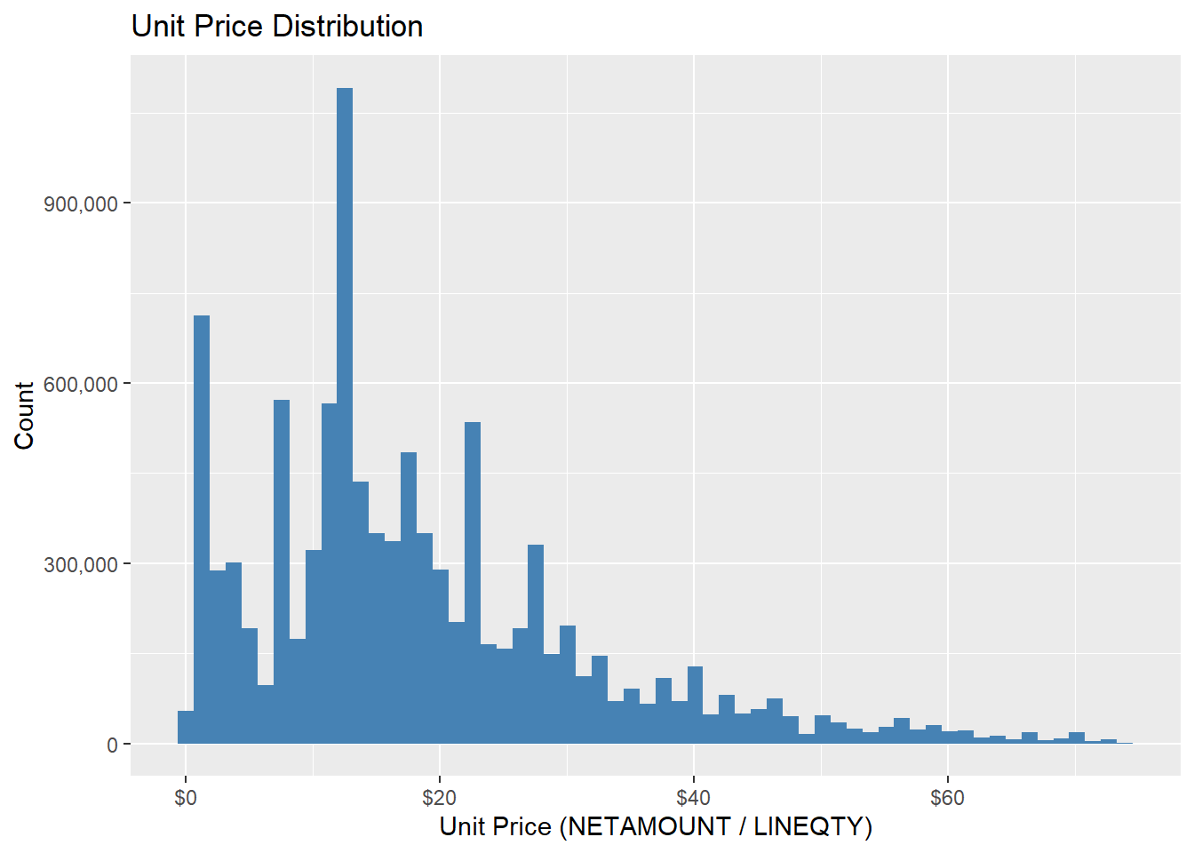
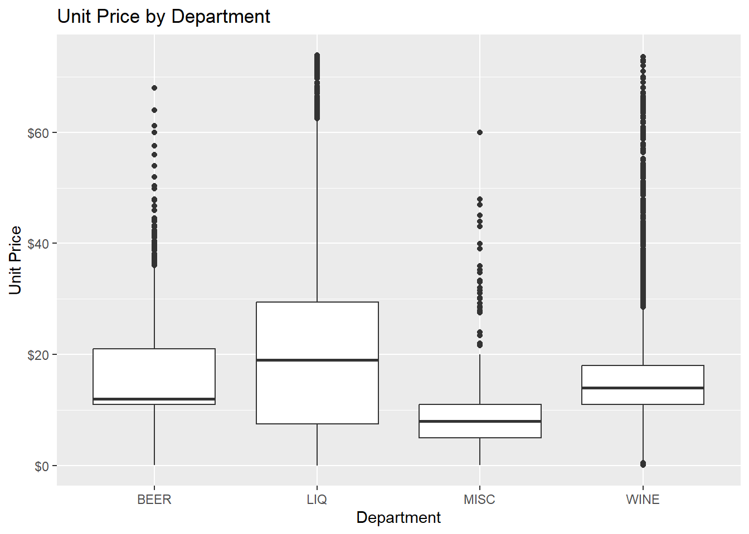
Strong right-skew with premium items
Liquor & wine have widest price ranges
Beer & misc cluster at lower prices
Premium pricing concentrated in spirits/wine
Notes:
“This slide looks at unit prices from two perspectives.
(pause)
On the left, the histogram shows the overall price distribution. Most transactions fall in the low-to-moderate price range, with a long tail of premium items on the right.
(pause)
On the right, the boxplots break this out by department. Liquor and wine show much wider price ranges, while beer item stay tightly clustered at lower price points.
(pause)

Slide 6
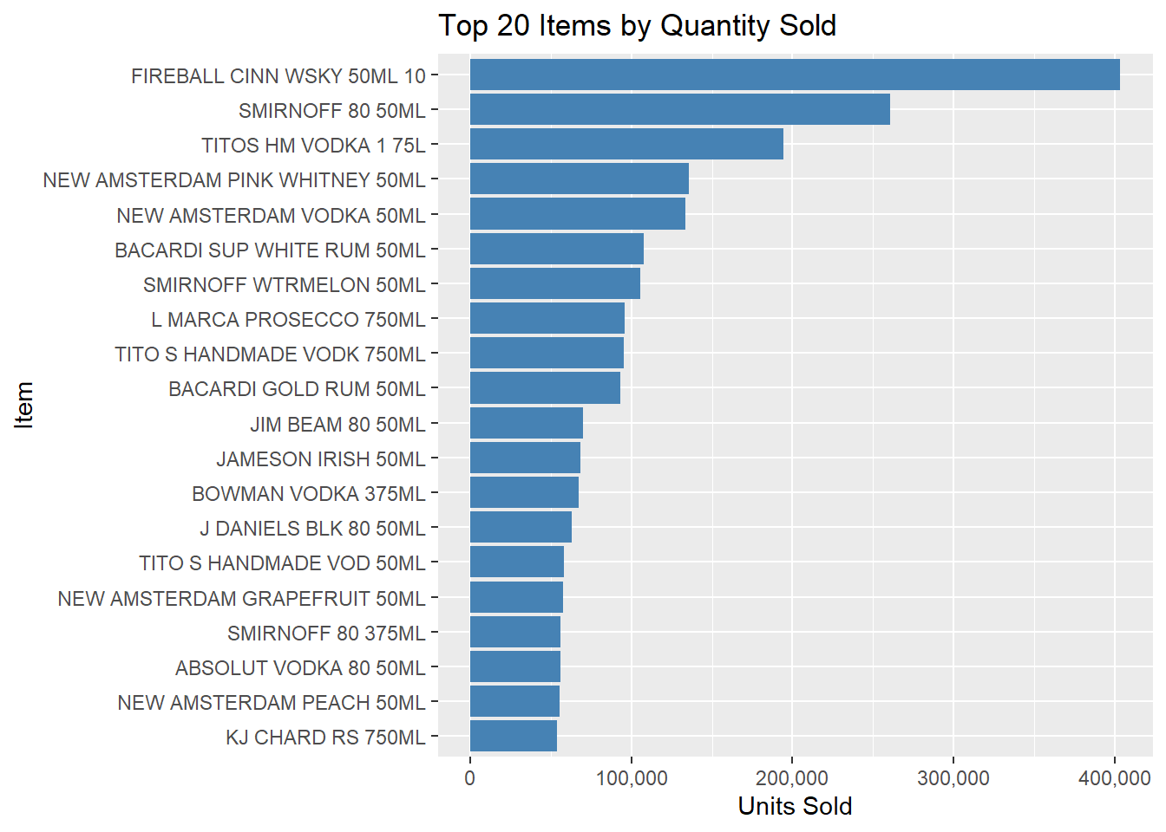
Small bottles, beer packs
Drives foot traffic
Low individual revenue
Continue improving
Seek feedback
Reflect on performance
Explore new techniques
Set personal goals
Iterate and adapt
Notes:
“When we look at volume, the top items by quantity are mostly small bottles especially 50 mL minis.
These items aren’t high-value individually, but they drive a huge share of store traffic. (pause)
Minis in particular influence several operational factors:
• they increase transaction count,
• they create foot-traffic pressure,
• they add shrink risk,
• and they increase checkout workload.

Slide 7
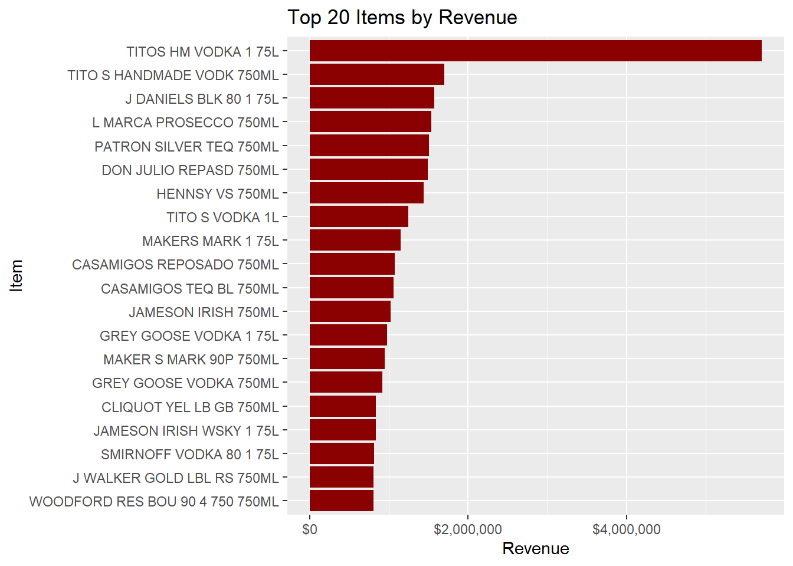
Premium spirits dominate
Big impact on revenue
Fewer SKUs drive most dollars
Notes:
“When we shift from volume to revenue, the story reverses. Premium spirits dominate.
The top contributors are large-format liqures essentially the higher-end spirits that generate most of the money. (pause)
So the pattern is clear:
• minis drive traffic,
• large bottles drive revenue.
Both segments are essential, but they play very different roles in store performance.”

Slide 8
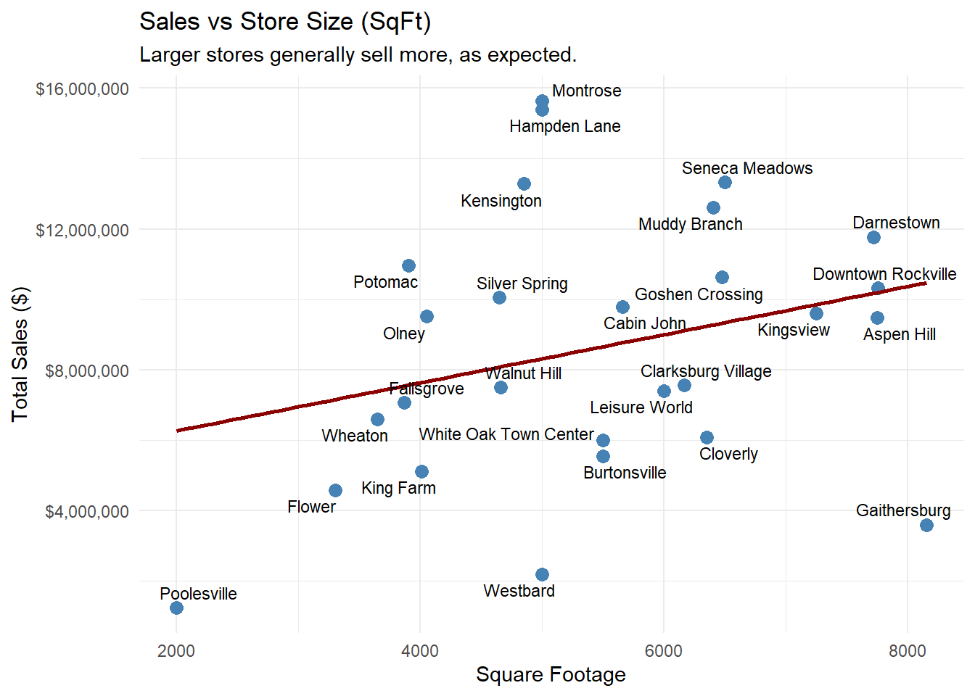
Weak correlation
Bigger store ≠ better store
Correlation = 0.2813958
Notes:
“When I compare sales to square footage, the relationship is surprisingly weak.
Yes, larger stores tend to sell more overall, but the spread is huge. (pause)
Some small stores outperform much larger ones, and some large stores underperform.
So store size alone does not explain performance, which is why the behavioral KPIs become so important later in the analysis.”

Slide 9
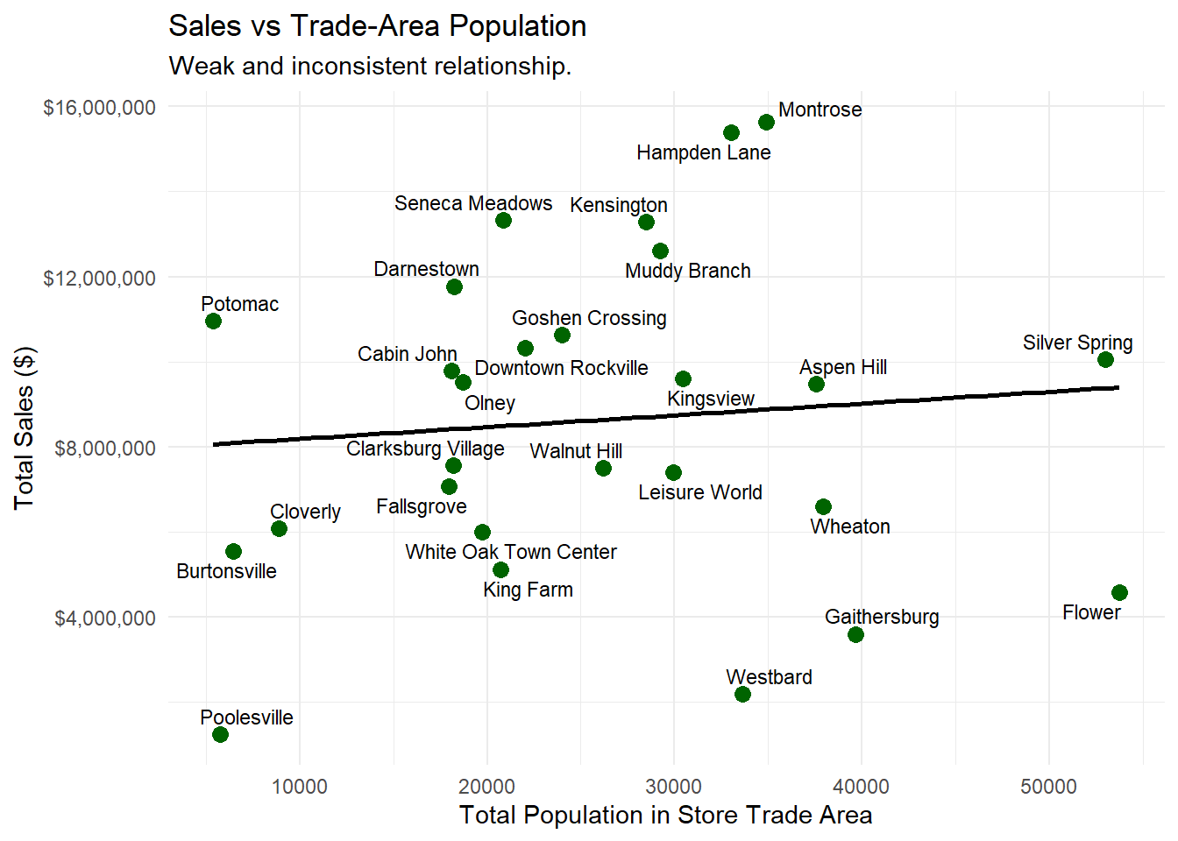
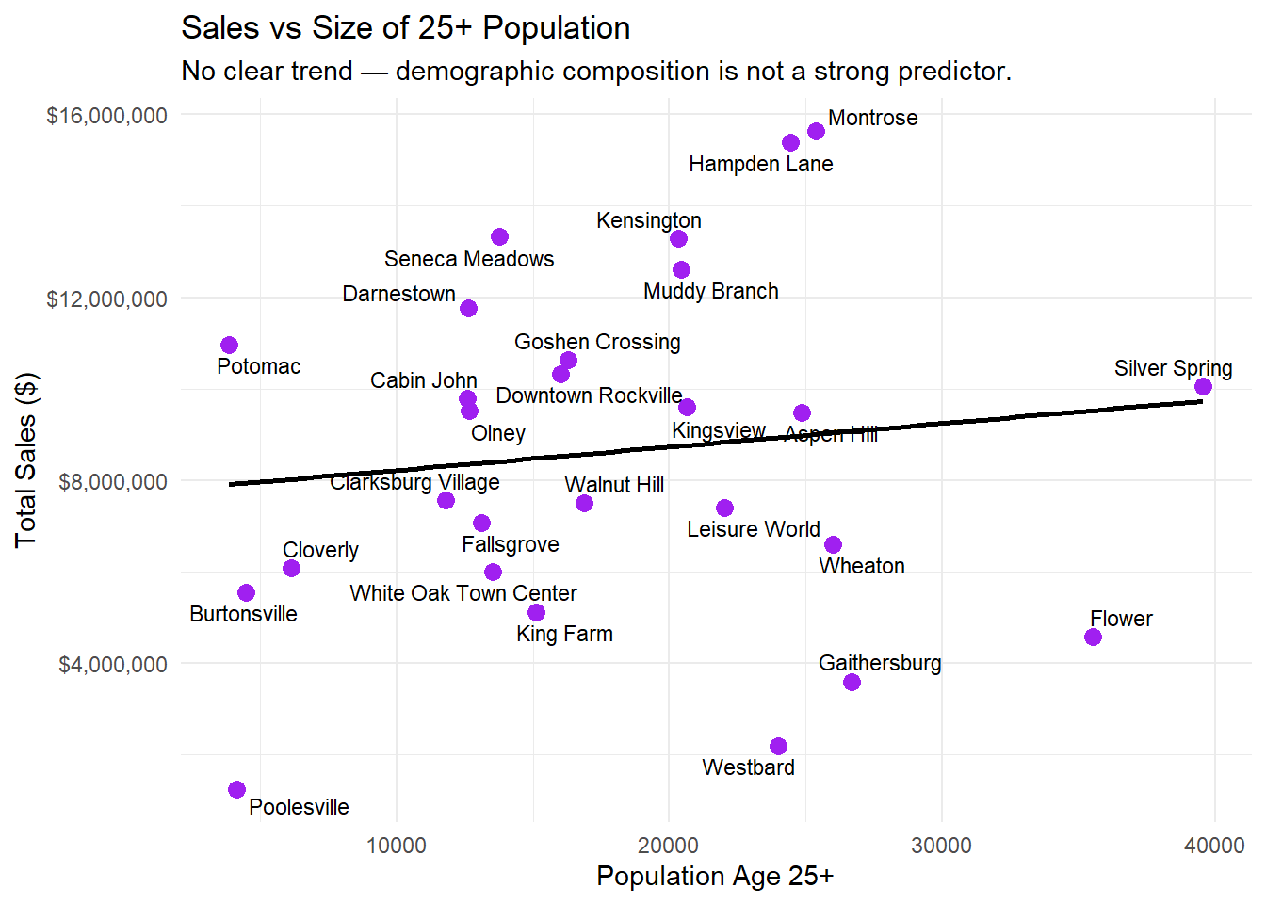
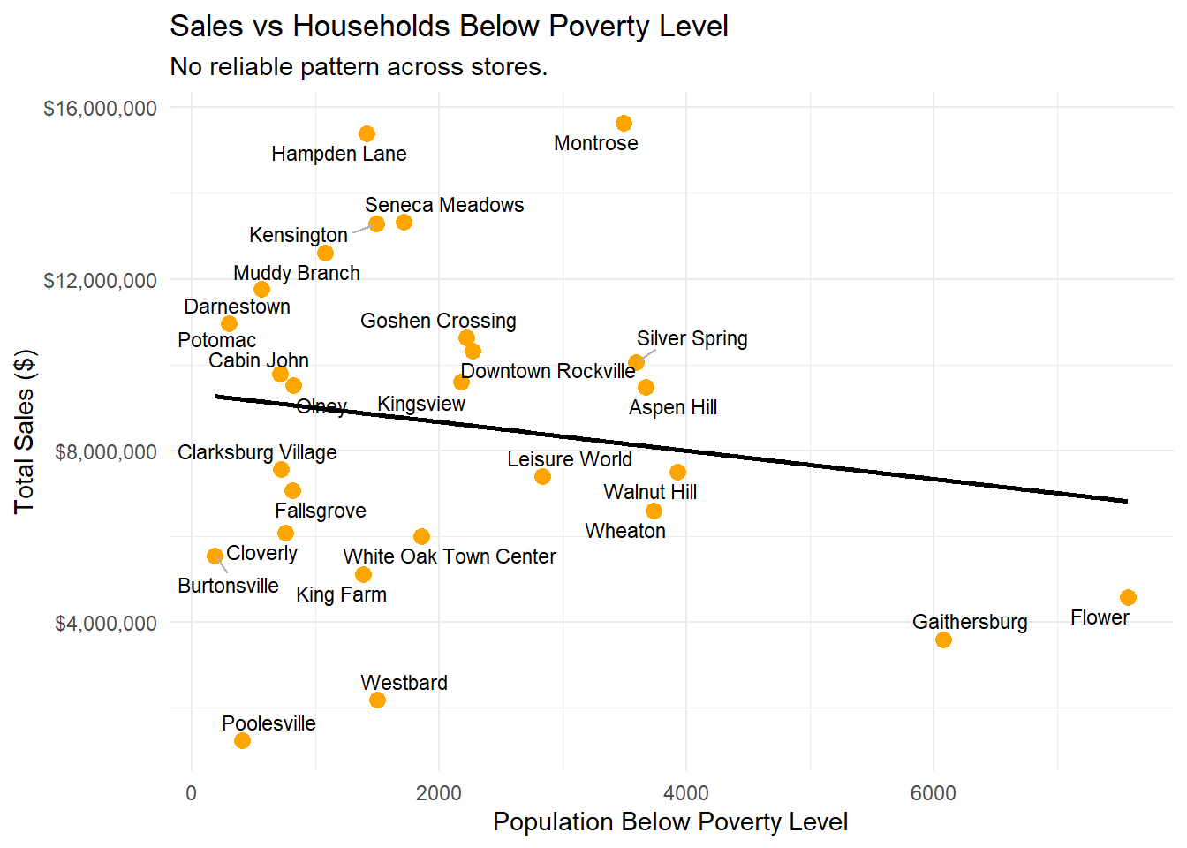
Demographics vs Sales
Demographics show weak predictive power
Performance differences arise from in-store behavior, not population
Reinforces the need for operational and assortment strategies
Correlation = 0.0928748
Correlation = 0.1209889
Correlation = -0.1579369
Notes:
“These charts test a simple question: do demographics explain why some stores perform better than others?
And the answer is no. (pause)
The relationships are weak and inconsistent across all major demographic variables.
Population, Poverty, +25Years
(pause)
This is important, because it means store outcomes are shaped far more by operations than by external demographic conditions.”

Slide 10
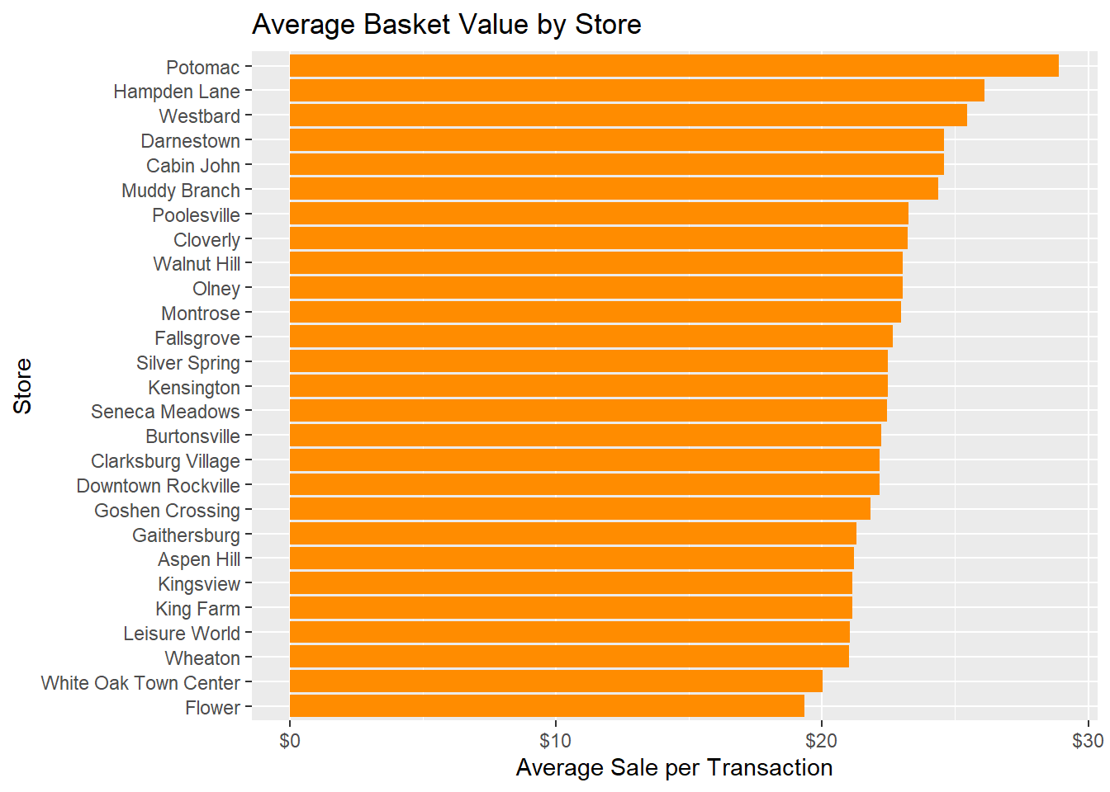
Very wide variation
Customer behavior differs by location
Notes:
“Basket values vary a lot across the system. some stores average in the low twenties, while others approach thirty dollars. (pause)
This variation is important because it explains why stores with similar traffic sometimes produce very different revenue outcomes.

Slide 11
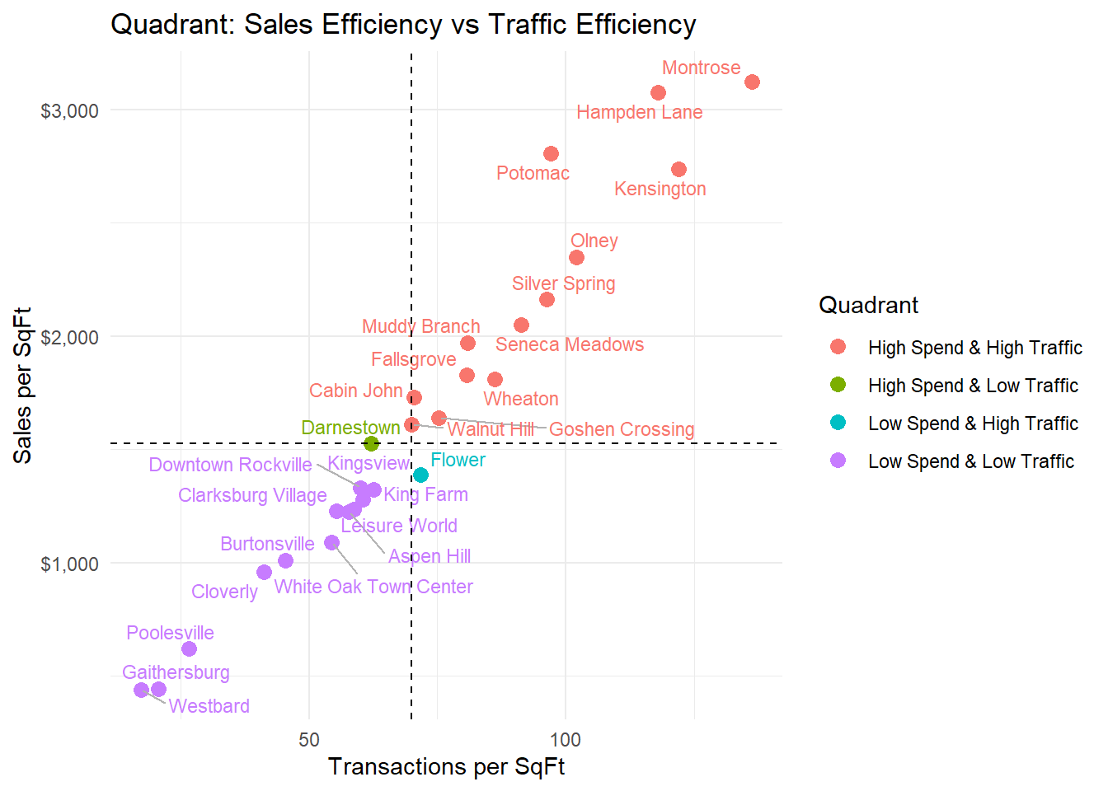
Four-quadrant segmentation based on medians
Reveals structural positions across stores
Top performers: Montrose, Kensington, Hampden Lane
Underperformers: Westbard, Poolesville, Gaithersburg
Traffic is influential, but not sufficient → operational gaps remain
Notes:
“This is one of the most important visuals in my entire project. (slow)
By using the medians of Sales per SqFt and Transactions per SqFt, I classify every store into four behavioral quadrants:
• High Spend / High Traffic
• High Spend / Low Traffic
• Low Spend / High Traffic
• Low Spend / Low Traffic
This segmentation shows each store’s structural position in the system. (pause)
At the top, stores like Montrose, Kensington, Hampden Lane, Potomac, and Olney deliver strong traffic and strong spend.
At the bottom, locations such as Westbard, Poolesville, Gaithersburg, and Burtonsville fall behind on both dimensions.
The key insight is that traffic alone is not enough. (pause)
Several stores with similar traffic levels generate very different sales per square foot.

Slide 12
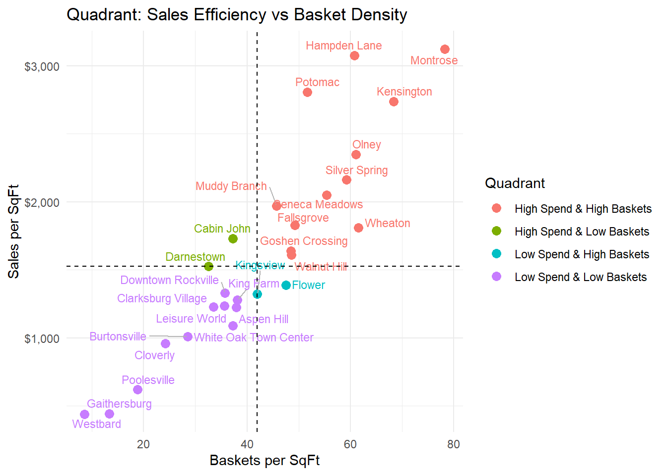
Reveals stores with high traffic but weak buying behavior
Highlights stores with low traffic but strong, consistent baskets
Shows basket density as a critical driver of sales productivity
Notes:
“This second quadrant swaps traffic for basket density, baskets per square foot. (pause)
What it shows is that stores with similar traffic begin to separate quickly once we look at how much customers actually buy.
Some locations bring in a steady stream of shoppers, but those shoppers leave with very small baskets.
Others attract fewer customers overall but generate consistently strong baskets, which usually reflects a small but highly committed customer base. (pause)
The key point is that basket density is a major differentiator.
It explains why two stores with similar foot traffic can produce very different revenue outcomes.”

Slide 13
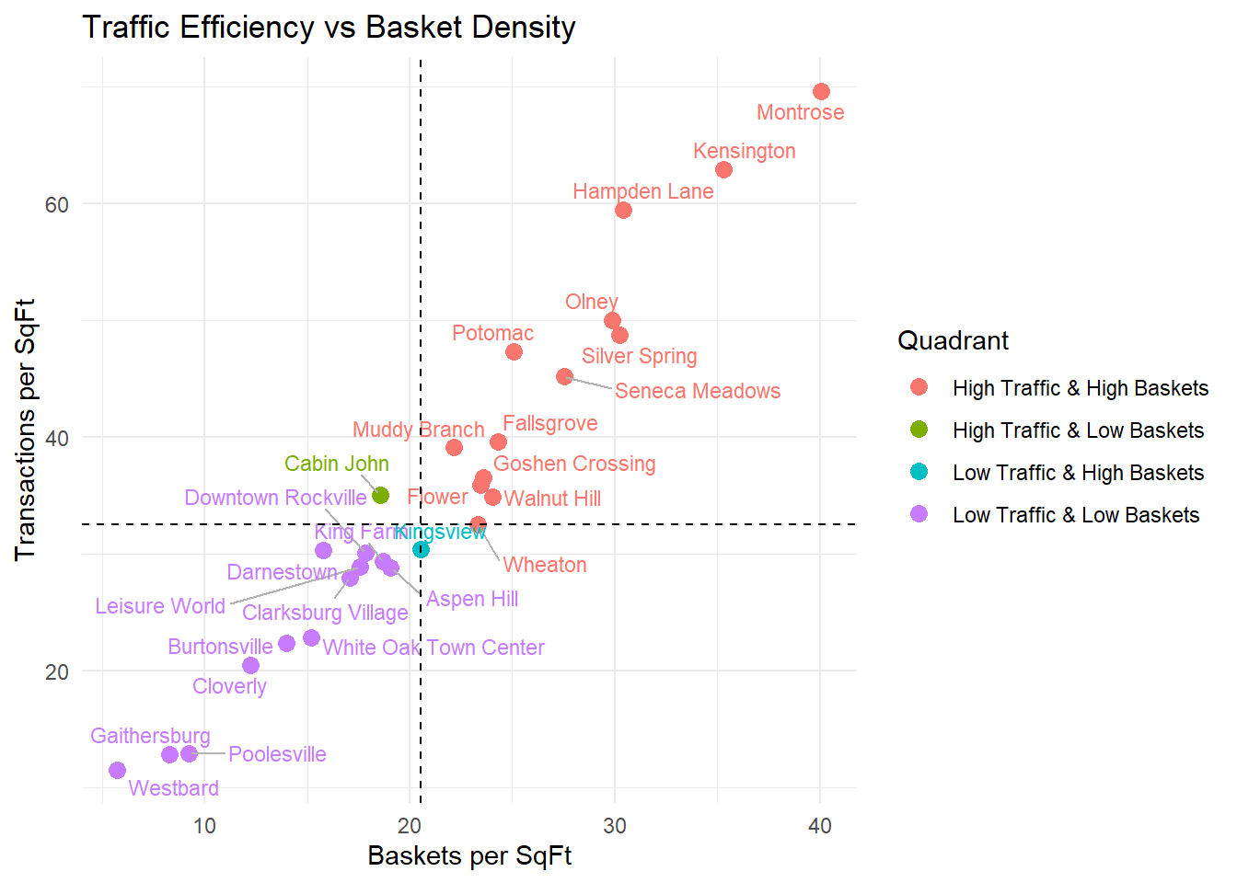
Combines traffic and basket density into four store archetypes
Distinguishes conversion problems from demand problems
Identifies where traffic, basket value, or both need intervention
Provides the framework for targeted operational strategy
Notes:
“This final quadrant brings traffic and basket density together, creating four clear operational archetypes. (pause)
High-traffic, high-basket stores perform well across both dimensions.
High-traffic but low-basket stores draw customers in, but fail to convert that traffic into meaningful spend.
Low-traffic but high-basket stores sell well to the customers they do have, but their reach is limited.
And low–low stores show structural weaknesses in both demand and buying behavior. (pause)

Slide 14
OLS Coefficient Significance Table (α = 0.05)
Predictor | Estimate | Std. Error | t-value | p-value | Significance
TotalTransactionsPerSqFt | 0.01607 | 0.000915 | 17.565 | 6.2e-11 | Strong*
Share_BEER | 56.82 | 19.14 | 2.97 | 0.0102 | Significant
Share_LIQ | 55.69 | 18.45 | 3.02 | 0.0092 | Significant
Share_WINE | 55.66 | 18.08 | 3.08 | 0.0082 | Significant
Share_Weekday | –76.74 | 35.65 | –2.15 | 0.0493 | Significant
Share_Weekend | –80.51 | 36.00 | –2.24 | 0.0421 | Significant
Avg_BasketValue | 0.0204 | 0.0101 | 2.02 | 0.0634 | Borderline
AvgItemsPerBasket | –0.2195 | 0.2440 | –0.90 | 0.3835 | NS
SquareFootage | 0.0000163 | 0.0000199 | 0.82 | 0.4250 | NS
TotalPopulation | 0.0000241 | 0.0000300 | 0.80 | 0.4358 | NS
Older25Years | –0.000031 | 0.0000392 | –0.79 | 0.4421 | NS
PovertyLevel | –0.000016 | 0.0000316 | –0.51 | 0.6163 | NS
Notes:
“Now I’ll explain briefly how the statistical modeling was structured.
I modeled log of SalesPerSqFt as the response for all 27 stores, using a set of 12 predictors covering store size, demographics, basket metrics, traffic intensity, and category mix. Those predictors were included because they’re the operational levers I expect could influence store performance.
The main analytical model is an OLS regression, and throughout the analysis I use the standard significance threshold α = 0.05 zero point zero five.. That means a predictor with a p-value below 0.05 zero point zero five is considered statistically significant in this sample; a predictor slightly above 0.05 zero point zero five is treated as suggestive but not definitive.
I used an Ordinary Least Squares regression OLS, which is a statistical method that estimates how different factors combine to explain store performance.
“OLS looks at all 27 stores and asks: based on size, traffic, basket behavior, and mix, what sales per square foot should each store achieve?
The OLS results reflect this:
• Traffic intensity has by far the strongest signal, with an extremely small p-value, so traffic per square foot is the main driver of sales productivity.
• The category mix shares for beer, liquor, and wine also show strong significance, meaning stores that sell proportionally more core alcohol categories outperform others.
• Avg_BasketValue has a borderline p-value around 0.06 zero point zero six. so directionally positive but weaker.
• Metrics like store size and the basic demographics have large p-values, and act mainly as controls rather than active drivers in this dataset.

Slide 15
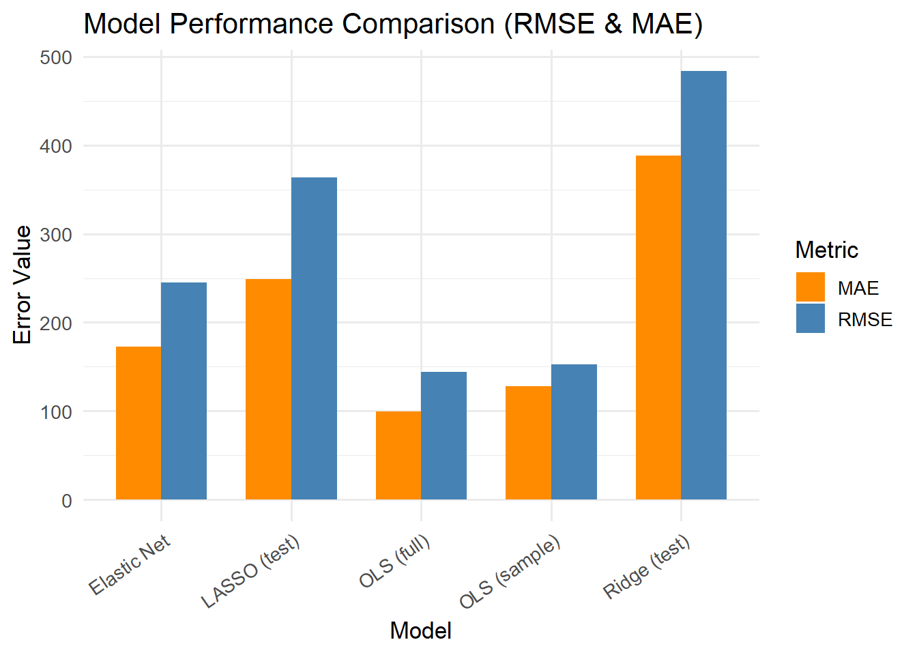
Model Comparison Table (Fit Metrics)
Model | RMSE | MAE
OLS (Full Model) | 144.11 | 99.46
OLS (Sampled Train/Test) | 152.52 | 127.68
Elastic Net | 245.04 | 172.54
Ridge (Test) | 483.30 | 388.38
LASSO (Test) | 363.41 | 248.77
Notes:
“To validate the models, I used two approaches: leave-one-out cross-validation for Elastic Net, and an 18/9 train–test split for OLS, Ridge, and LASSO. The results are clear.
OLS is the strongest model.
The full OLS model has an RMSE of about 144, and the test RMSE rises only slightly to 153, showing strong stability even with a small dataset.
The penalized models perform far worse.
When these models are penalized, they collapse toward one dominant driver, traffic intensity which is exactly what the OLS significance tests also highlight.
The bootstrapping analysis confirms this pattern: high-traffic, high-spend stores average nearly double the SalesPerSqFt of low-traffic, low-spend stores, with no overlap in confidence intervals. These are real structural differences, not random noise.
Given the sample size, these models are descriptive rather than predictive, and together they make the same point: traffic is the system’s primary performance driver, and OLS captures this relationship most effectively.”
The MAE is a linear score which means that all the individual differences are weighted equally in the average. The RMSE is a quadratic scoring rule which measures the average magnitude of the error. The equation for the RMSE is given in both of the references.

Slide 16
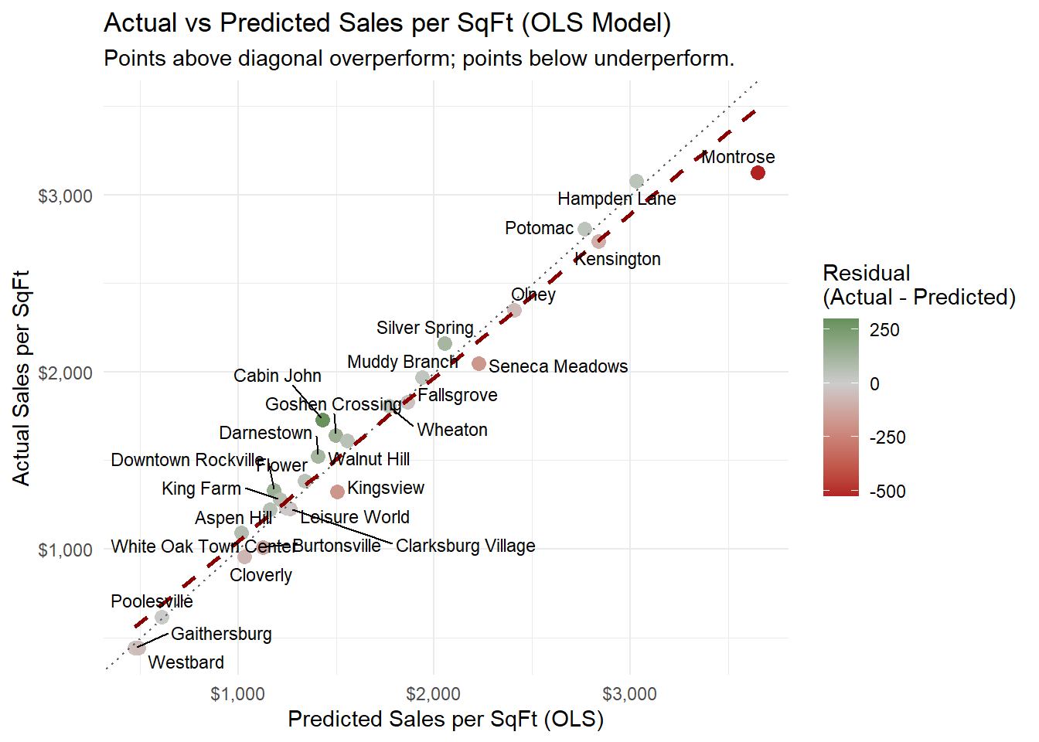
Model explains ≈97% of variation in sales per SqFt
Above the line → outperforming expectations
Below the line → underperforming expectations
Establishes an objective performance benchmark
Notes:
“The OLS model fits extremely well, it captures roughly 97% of the variation in sales per square foot. (pause)
Each point represents a store.
Stores above the diagonal deliver more sales than the model predicts; those below fall short relative to their size, traffic, basket behavior, and category mix. (pause)
This makes the chart a defensible, data-driven benchmark for judging whether a store is performing at, above, or below its potential.”

Slide 17
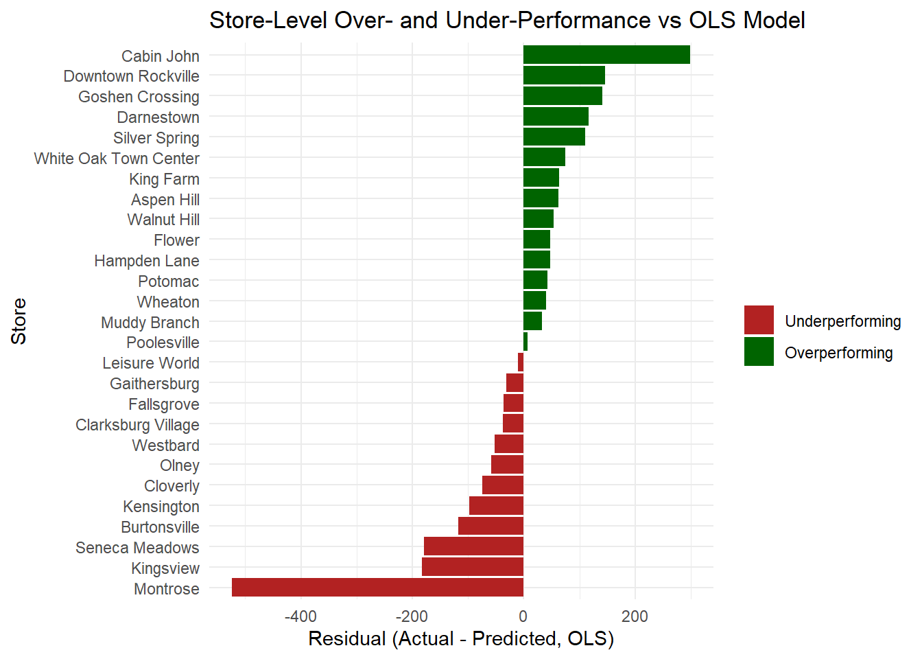
Clear separation of true over- and under-performance
Montrose: high revenue ≠ high efficiency
Significant unrealized value in several top stores
Notes:
“This ranking shows which stores truly outperform or underperform after controlling for size, traffic, basket behavior, and category mix. (pause)
On the overperforming side, stores like Cabin John, Goshen Crossing, and Silver Spring consistently exceed expectations, they convert their demand and product mix more effectively than the model predicts. (pause)
On the underperforming side, Montrose, Kingsview, Burtonsville, and Hampden Lane fall well short of expected performance.
And the critical point is this: Montrose, despite being the system’s top-revenue store, is one of the largest underperformers.
That means a substantial portion of its potential is not being realized.” (pause)

Slide 18
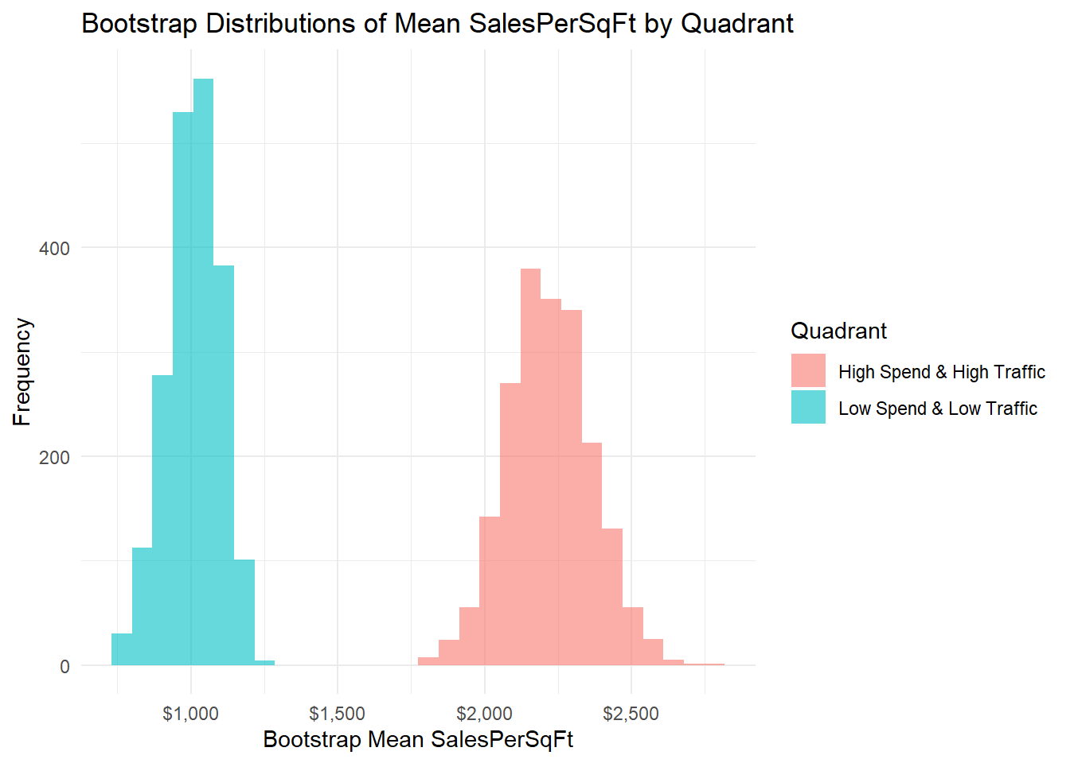
Bootstrapped means: ~$2,200 vs ~$900
Confidence intervals do not overlap
High/High stores are genuinely stronger
Confirms quadrant segmentation is statistically robust
Notes:
“To confirm that these quadrant patterns are real and not just random variation, I used bootstrapping to estimate the average SalesPerSqFt for each group. (pause)
Bootstrapping is a resampling technique that tests whether the performance differences we see between store groups are real or just random noise.
We repeatedly resample the stores hundreds or thousands of times and estimate the average SalesPerSqFt for each quadrant each time.
High-Spend, High-Traffic stores center around $2,200 per square foot, while Low-Spend, Low-Traffic stores average around $900.
And importantly, the confidence intervals for these distributions do not overlap. (pause)
That means the performance gap between these two groups is statistically meaningful, these are real structural differences in how stores operate, not noise in the data.”

Slide 19
Key Insights
Traffic intensity is the strongest driver of performance
Basket density + category mix determine revenue efficiency
Demographics provide little explanatory power
Quadrants reveal stable behavioral patterns across stores
OLS residuals expose hidden underperformance
Bootstrapping confirms differences are statistically significant
Foundation for targeted, store-specific operational improvements
Notes:
“I’d like to share the key insights from this analysis. (pause)
First, traffic intensity is the single strongest driver of store performance. (pause)
Second, basket density and category mix explain how effectively a store converts its traffic into revenue.
Third, demographics contribute almost nothing in this dataset.
Fourth, the quadrant analysis reveals stable structural patterns, showing which stores have strong demand, strong buyers, or weaknesses in both.
Fifth, the OLS residuals expose hidden underperformance, especially in high-revenue stores that look strong on the surface but fall below their modeled potential.
And finally, bootstrapping confirms that these performance gaps are statistically real, not random variation.

Slide 20
Recommendation
Boost traffic where it is weak; raise basket value where it underperforms
Use quadrant positions to target the highest-impact lever at each store
Tighten replenishment and align ordering with observed buying patterns
Reduce long-tail SKUs to increase efficiency and improve shopper navigation
Tailor promotions to quadrant type: premium pushes for high-traffic stores, traffic builders for low-traffic stores
Use the KPI monitoring framework for continuous, data-driven oversight
Notes:
“My recommendations follow directly from the performance patterns revealed in the analysis.
I focus first on the two strongest operational levers: traffic and basket value.
Where traffic is weak, the priority is bringing more customers through the door. Where basket value is low, the focus shifts to improving mix, facings, and promotion strategy. (pause)
Each store’s quadrant position makes these decisions straightforward, it identifies the lever with the highest expected return.
I also recommend tightening store-level replenishment and reducing long-tail SKU clutter. (pause)
Promotions and advertising should be matched to quadrant type, high-traffic stores respond to premium mix and trade-up strategies, while low-traffic stores need traffic-building campaigns and localized outreach.

Slide 21
acknowledgment
The ABS team for meeting with me weekly, helping me understand the dataset, and making sure I stayed on the right analytical path.
The Data Montgomery team for coordinating meetings, supporting communication, and helping identify supplementary datasets—even the ones we ultimately didn’t need.
Prof. Lori Perine for her guidance on how to advance and refine my modeling approach.
My teammate Andre, whose thoughtful input consistently sharpened my reasoning and guided my analytical decisions.
Notes:
Special Thanks to

Slide 22
Thank you

Slide 23
ABS Mission & Why This Analysis Matters
Dual mandate: public safety + profit
Store variation influences county revenue
Better decisions require accurate metrics
Notes:
“ABS operates under a unique dual mission: to protect public safety and to generate revenue for the county. (slow)
Even small improvements in store efficiency can create meaningful financial impact across the system. (pause)
To achieve that, it’s essential to understand why stores perform differently — whether the drivers are traffic, product mix, or basket behavior. These differences directly affect inventory planning, staffing, and assortment strategy.
(pause)
The goal of my project wasn’t simply to make visualizations.
It was to uncover the operational and behavioral reasons why certain stores consistently outperform expectations… and why others fall short of their potential.”

Slide 24
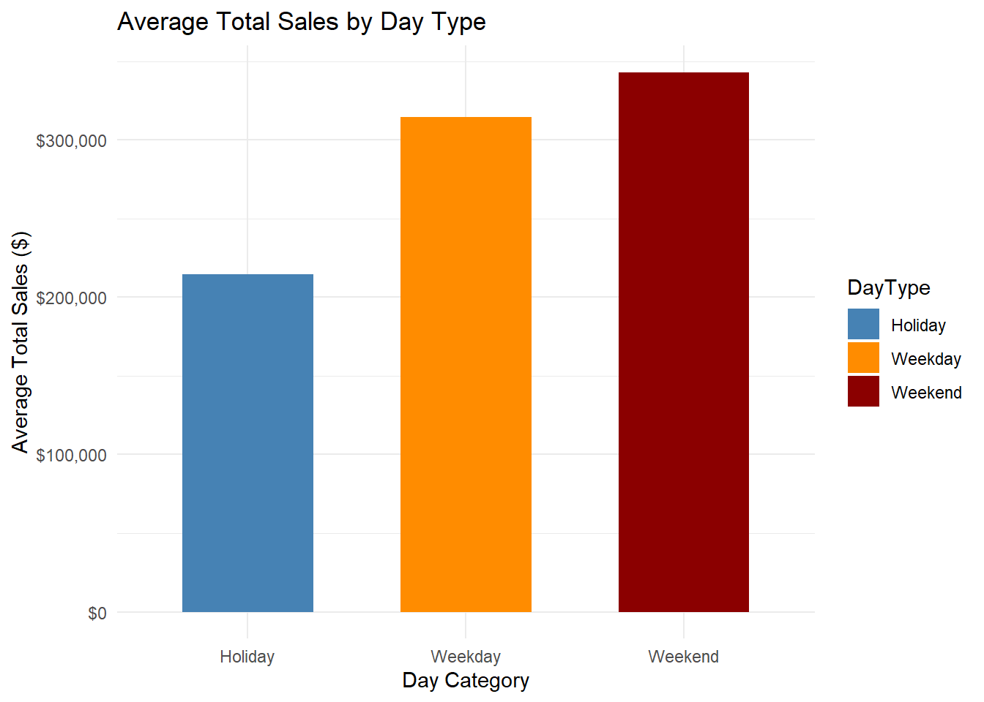
Weekends generate the highest total daily sales
Holidays also produce elevated revenue levels
Weekdays remain steady but lower than peak periods
Notes:
“This chart shows how average total daily sales differ across Holidays, Weekends, and Weekdays. (pause) Weekends consistently generate the highest revenue per day, followed by Holidays, while Weekdays are steadier and noticeably lower. (pause) What matters is the stability. this pattern repeats across fiscal years, which means ABS demand follows a very predictable weekly rhythm. (pause) That consistency gives us confidence that differences between stores are driven by store operations and customer behavior, not by randomness in the calendar.”

Slide 25
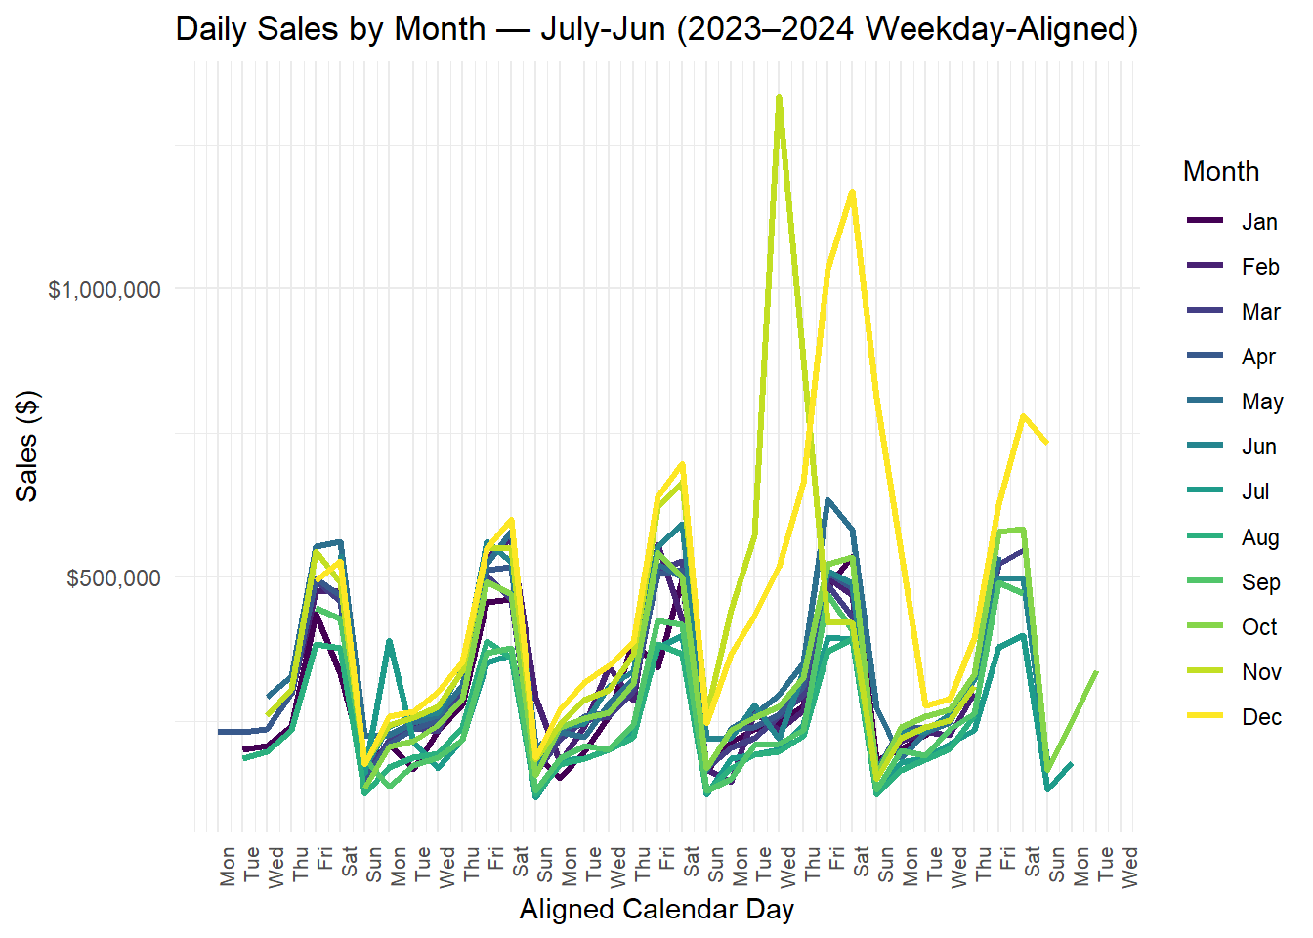
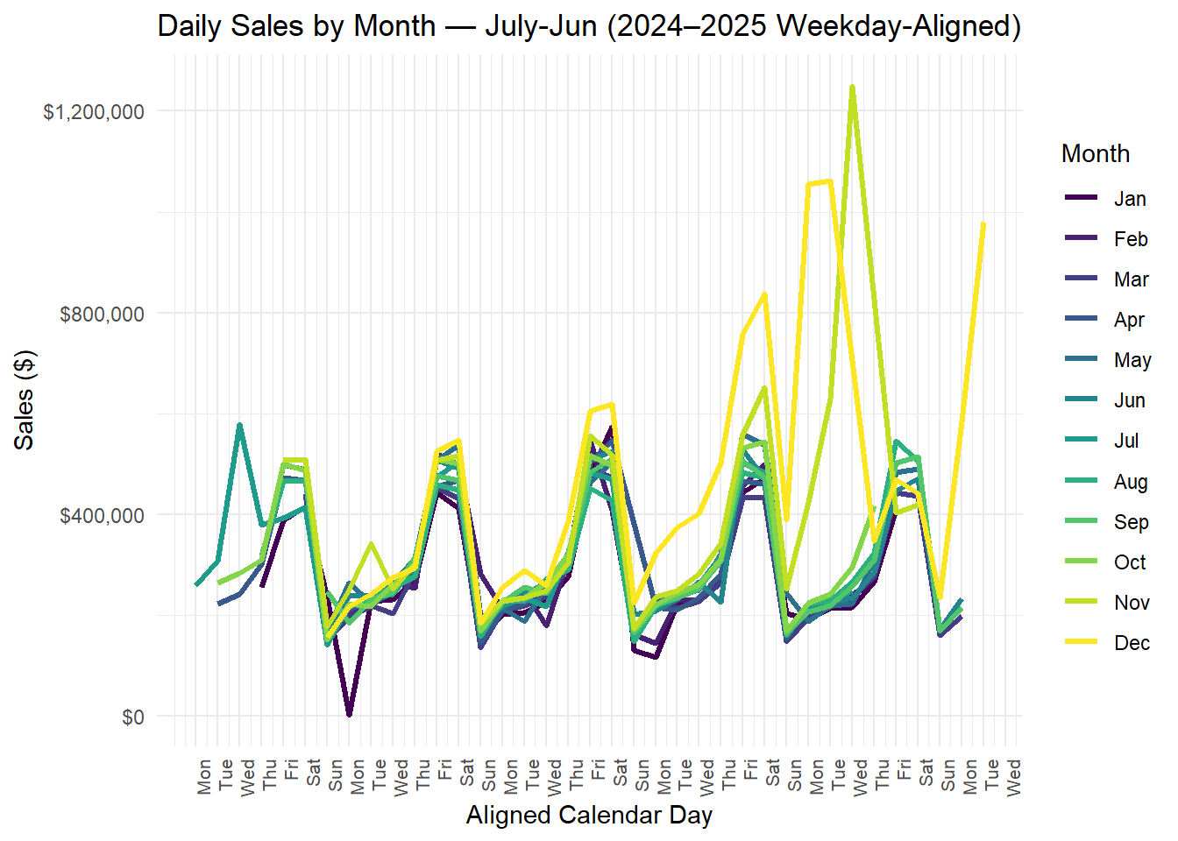
Consistent Friday–Saturday peaks
Stable weekly rhythm
Clendar alignment removes date bias
Notes:
“By aligning each month by weekday, I can isolate the true weekly rhythm of customer behavior. (pause)
Across both fiscal years, the pattern is the same: sales rise sharply on Fridays and Saturdays, and they dip on Mondays and Tuesdays.
This tells me ABS demand isn’t driven by specific calendar dates,

Slide 26
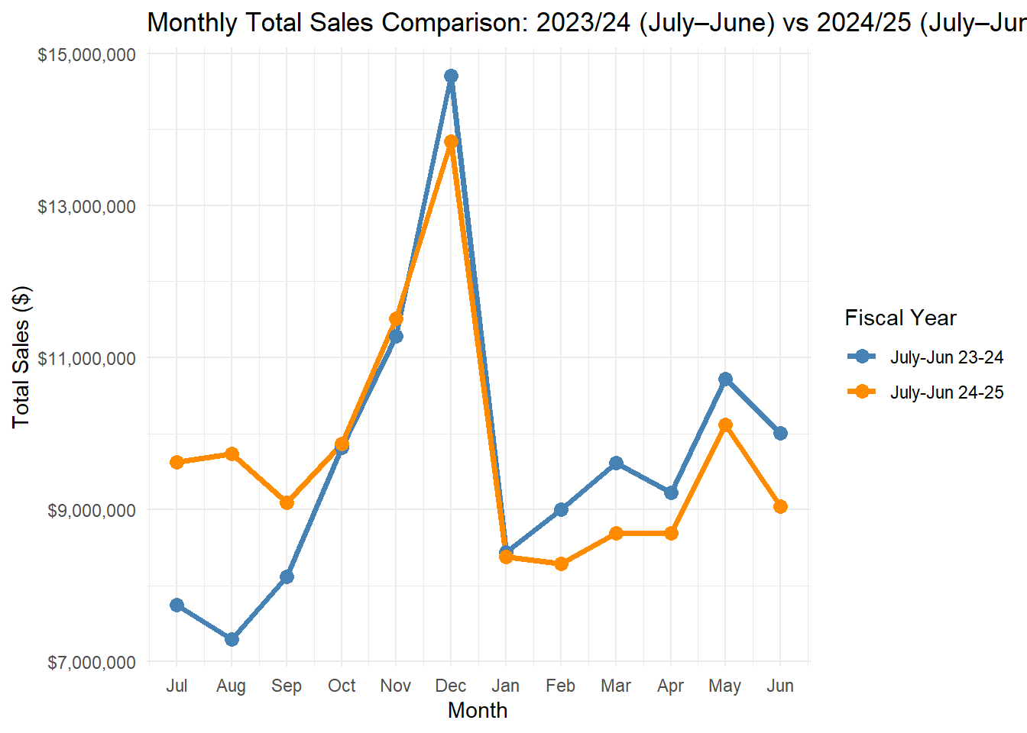
December is consistently the peak month
January drops sharply
Spring recovery follows the same pattern
Notes:
“This comparison shows monthly total sales for FY23–24 and FY24–25. (pause)
Both years follow almost the exact same seasonal pattern: sales build through the fall, peak sharply in December, drop in January, and then climb gradually through the spring.

Slide 27
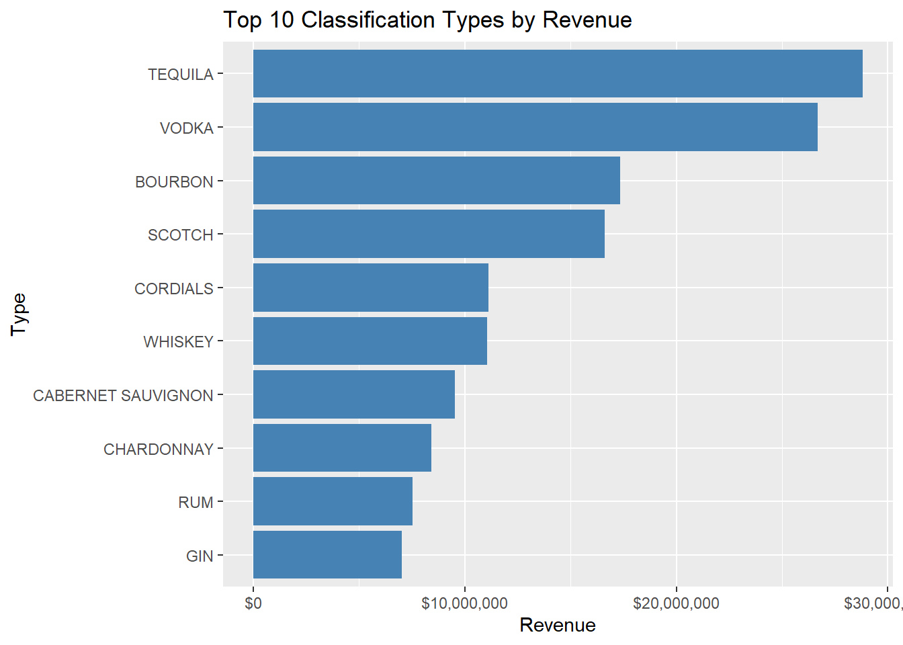
Tequila, vodka, bourbon high impact
Key categories for assortment and forecasting
Notes:
“This breakdown shows that tequila, vodka, bourbon, and scotch alone represent a massive share of system revenue.
This provides the backbone for category-level strategy.”

Slide 28
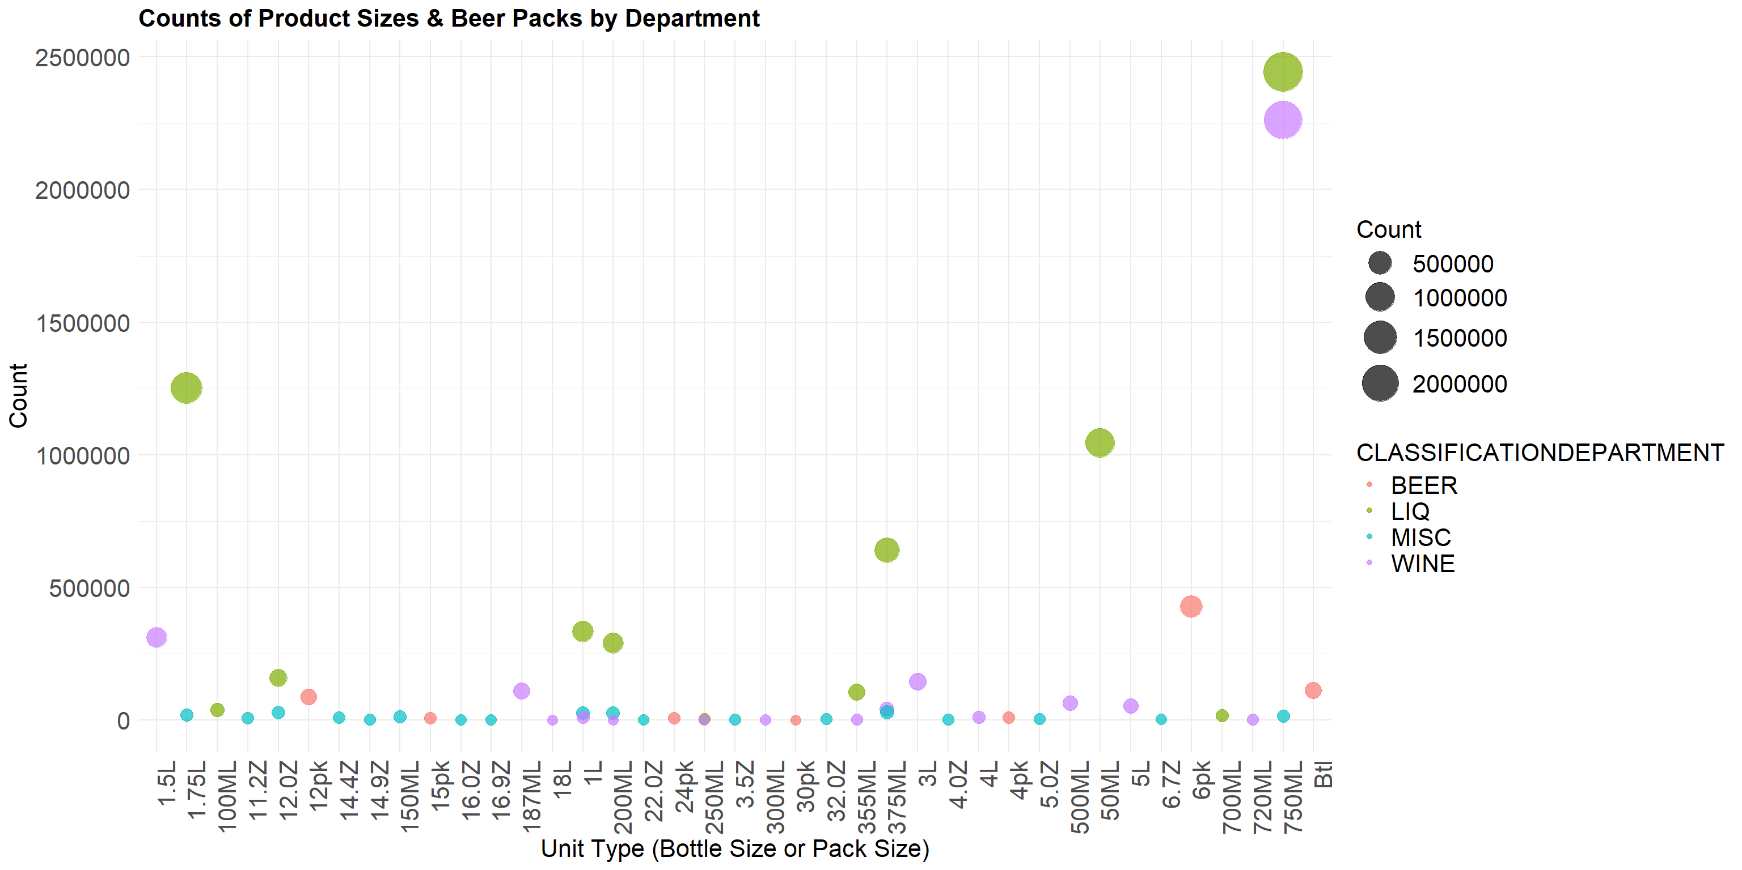
Core sizes dominate
Fringe formats low impact
Notes:
“The system is built around a few dominant pack sizes.
For beer, most of the volume comes from 6-packs, 12-packs, and singles.
For spirits and wine, the core formats are 750 mL, 1.75 L, and 50 mL minis. (pause)
Everything outside these formats contributes only marginally.

Slide 29
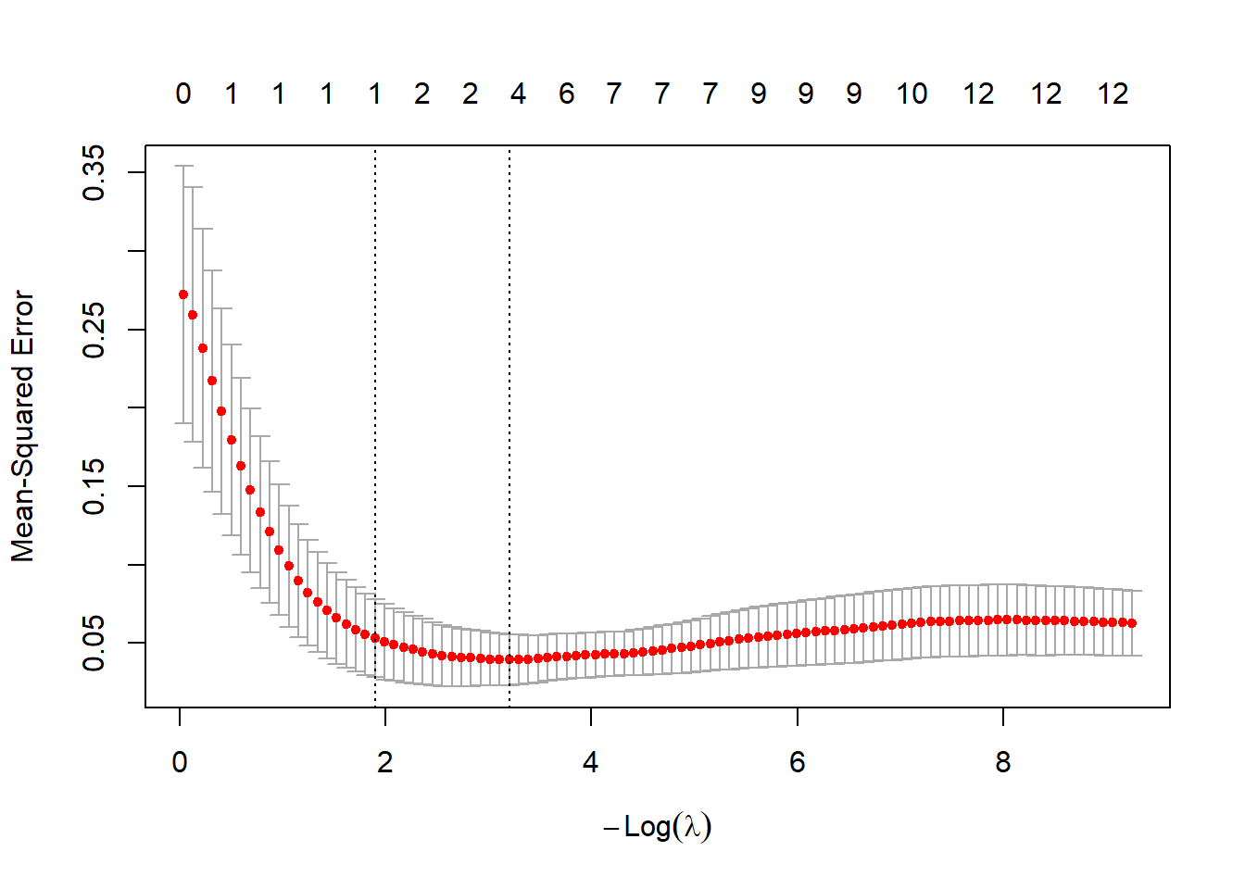
Elastic Net Cross-Validation
Elastic Net used to test stability under correlated predictors
Strong penalty quickly removes weaker variables
Traffic intensity is the only predictor that consistently survives
Basket metrics and category mix shrink to zero under regularization
ENET confirms traffic’s dominance but fits worse than OLS
Best used for variable screening, not for final prediction
Notes:
⭐ Transition
“To quantify performance expectations, I built statistical models.”
“To understand which factors remain important when we penalize correlated predictors, I tested an Elastic Net model. (pause) Elastic Net is useful in this dataset because category shares and basket metrics are correlated. But with only 27 stores, the penalty becomes strong very quickly. (pause) The result was very clear: the Elastic Net model shrinks almost every variable to zero except traffic intensity. (slow) In other words, when we use regularization, traffic is the only predictor consistently strong enough to survive the penalty.
(pause) This reinforces how dominant traffic is as a performance driver. But Elastic Net does not fit as well as the OLS model, so for interpretation and diagnostics, OLS remains the better choice.”

Slide 30
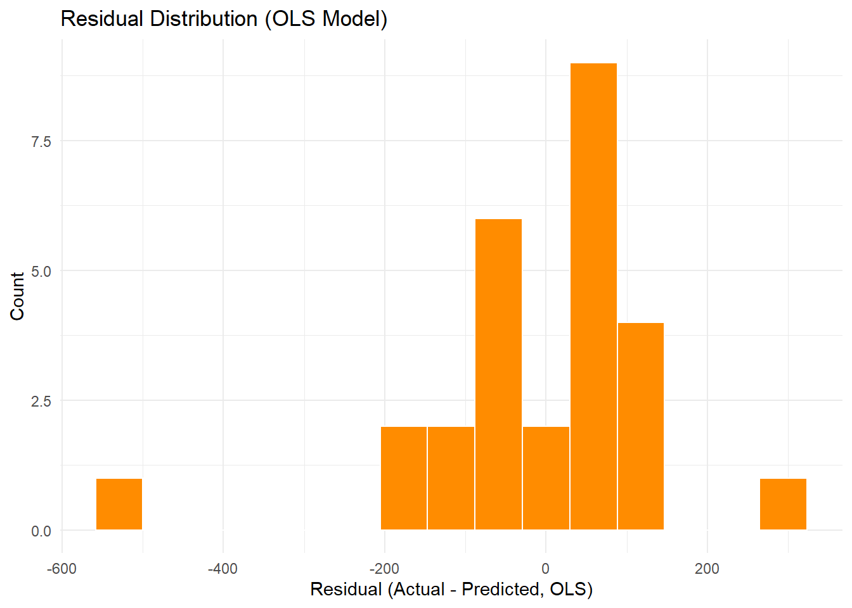
OLS fits on the log scale:
log (SalesPerSqFt) ~ sim SquareFootage + TotalPopulation + Older25Years + PovertyLevel + Avg_BasketValue + AvgItemsPerBasket + TotalTransactionsPerSqFt + Share_BEER + Share_LIQ + Share_WINE + Share_Weekday + Share_Weekend
Notes:
“This plot shows the distribution of residuals from the OLS model. (pause) Most stores cluster tightly around zero, which means their actual SalesPerSqFt is very close to what the model predicts once we account for size, traffic, basket behavior, and category mix. (pause) The small number of stores far to the left or far to the right represent meaningful deviations — true over-performance or under-performance relative to their expected potential. (pause) This confirms that the model is both stable and well-behaved. The residuals give us a clean way to identify stores that are truly outperforming or underperforming after leveling the playing field.”

Slide 31
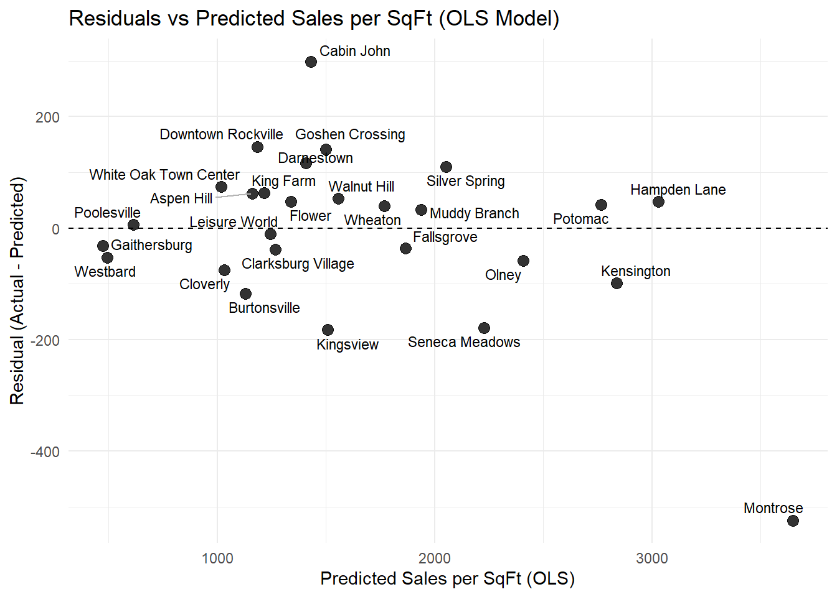
Below the line → underperformance
Above the line → overperformance
Underperformance appears at all predicted sales levels
Reveals operational gaps hidden by revenue totals
Notes:
“This chart isolates true operational performance.
Every point below the line is a store that delivers less than the model expects, even after accounting for traffic, basket behavior, and category mix.
Every point above the line is outperforming relative to its fundamentals. (pause)
What matters here is that underperformance shows up across the entire range of predicted sales — even among the system’s top sellers.
High revenue does not guarantee high efficiency.
This view exposes performance gaps that raw sales alone simply cannot reveal.”

