Slide 1

Movie Rental Analytic Dashboard
Prepared by: Kamaraj E

Slide 2
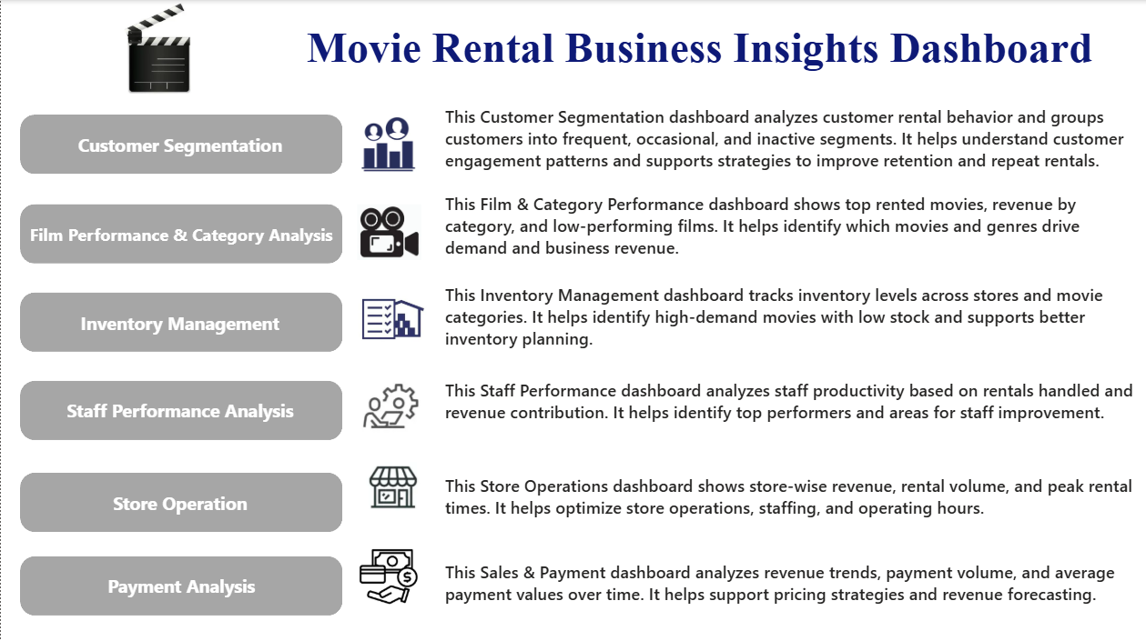

Slide 3
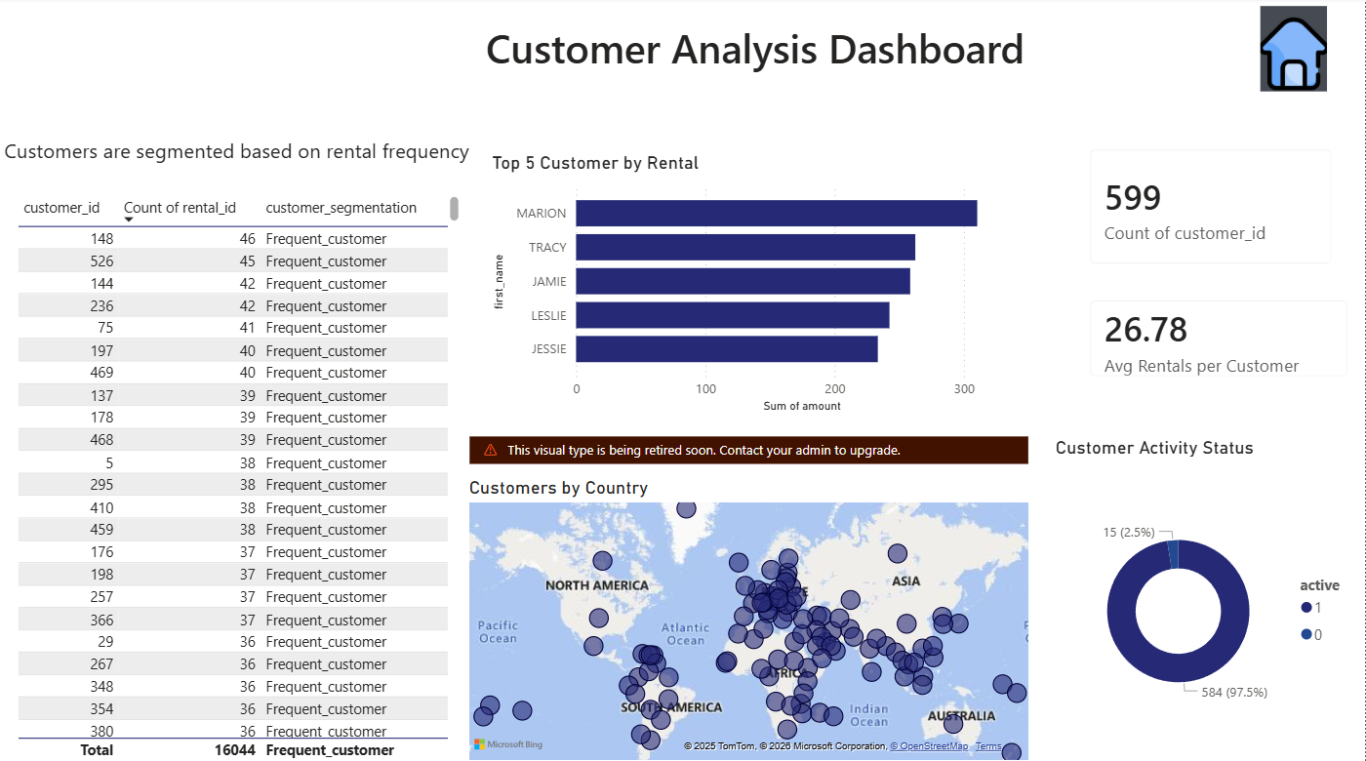

Slide 4
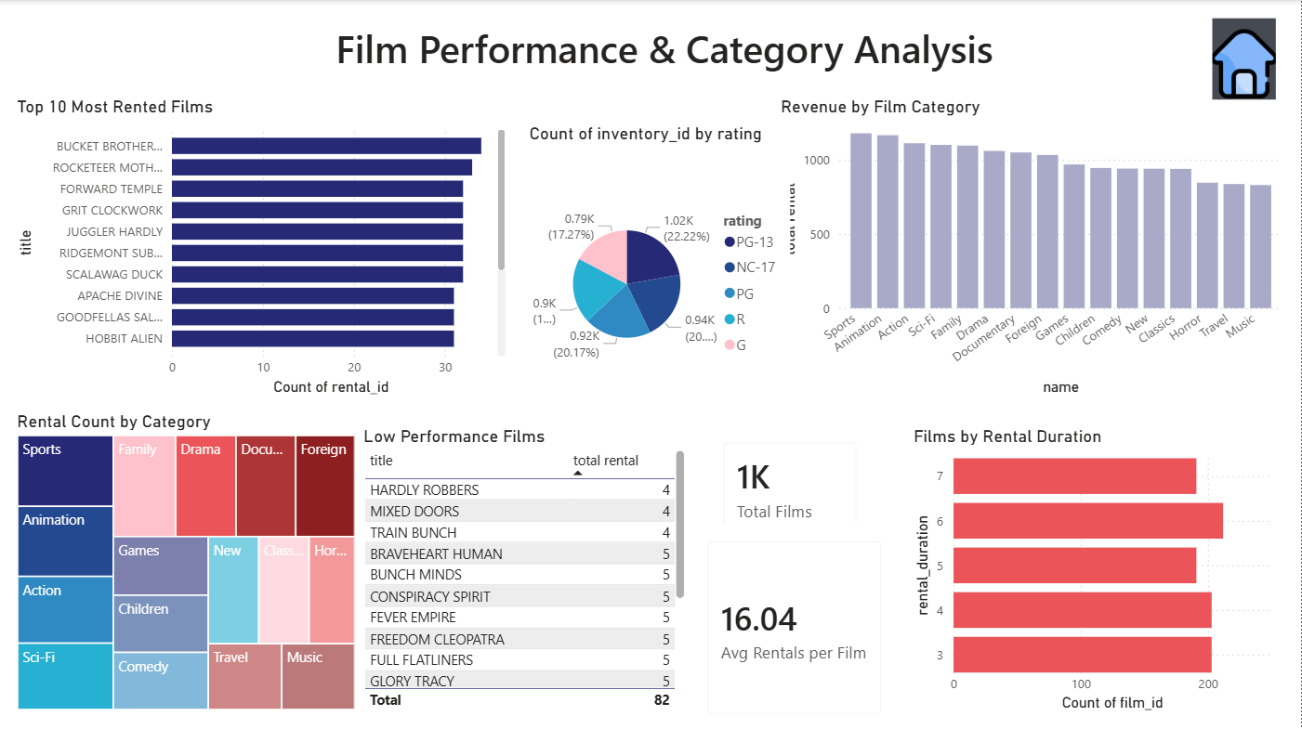


Slide 5
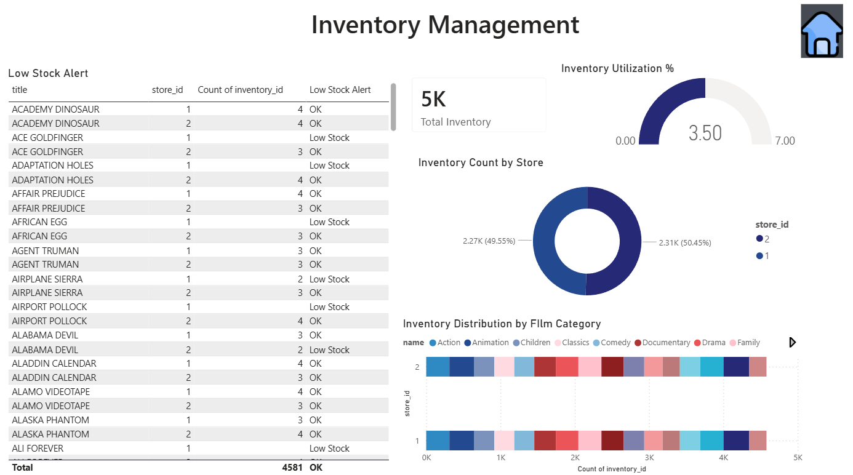
0

Slide 6
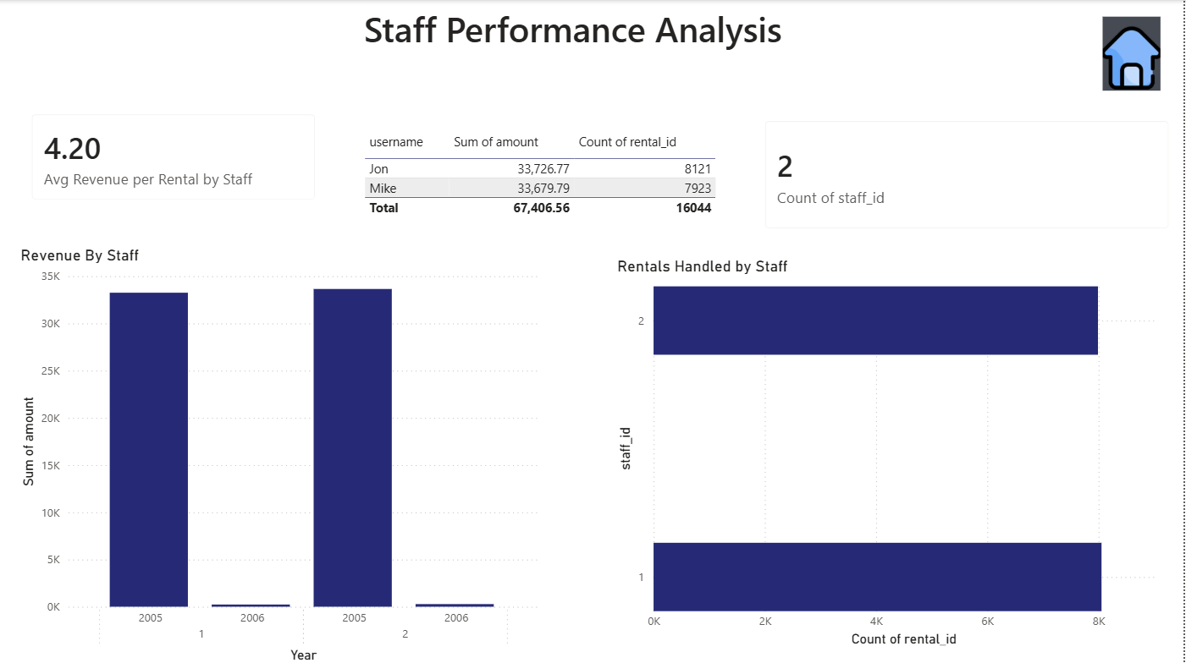

Slide 7
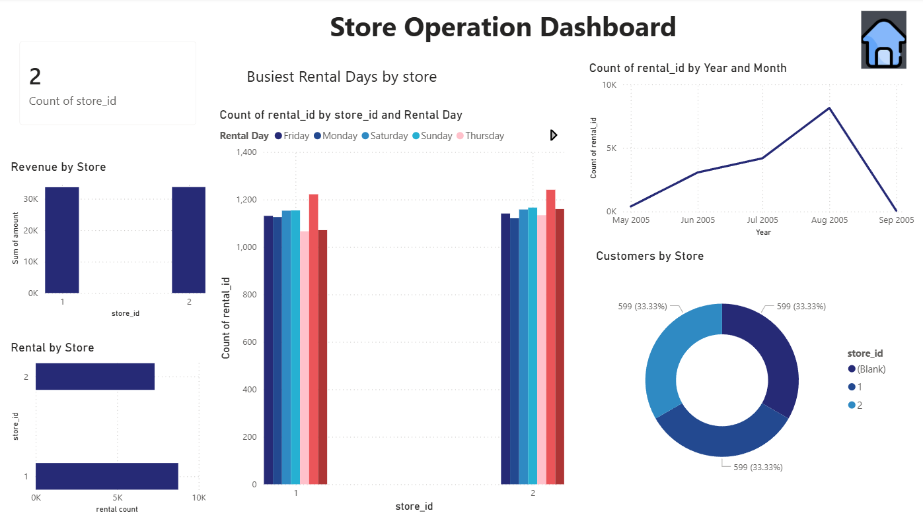


Slide 8
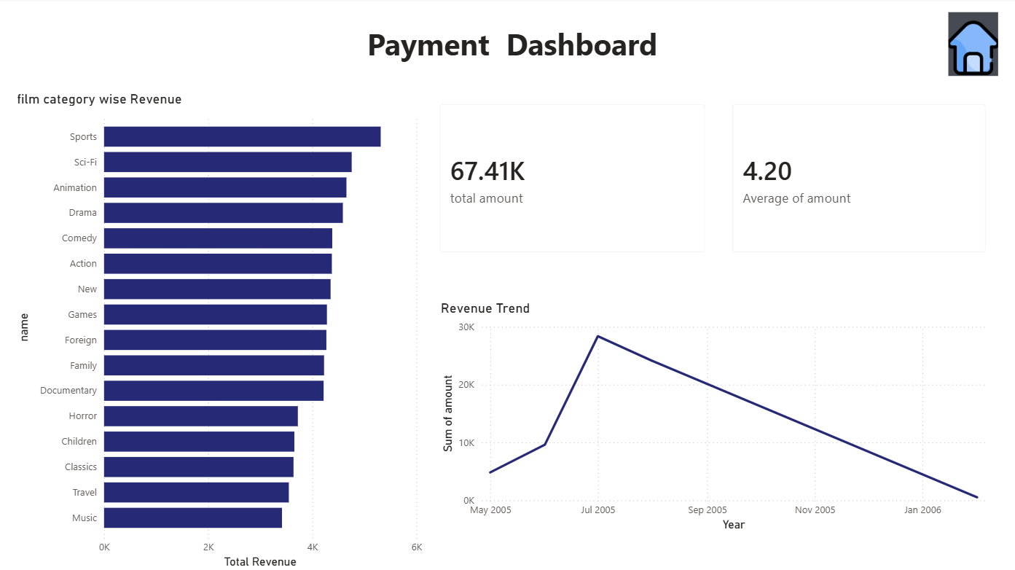

Slide 9
Business Recommendations
Customer Analysis
Introduce a loyalty program for frequent customers to encourage repeat rentals.
Provide discount offers or reminders to inactive customers.
Suggest movies to customers based on their past rental history
Film Performance & Category
Increase promotion for high-performing movie categories.
Offer discounts or bundles for low-performing movies.
Replace consistently low-performing movies with popular or trending titles
Inventory Management
Increase the number of copies for high-demand movies.
Move excess inventory from low-demand stores to high-demand stores.
Reduce storage of movies that are rarely rented

Slide 10
Thank You

