Slide 1
Northwind Traders Analytic Dashboard
Interactive Power BI Report for Business Insights
Prepared by: Kamaraj E

Slide 2
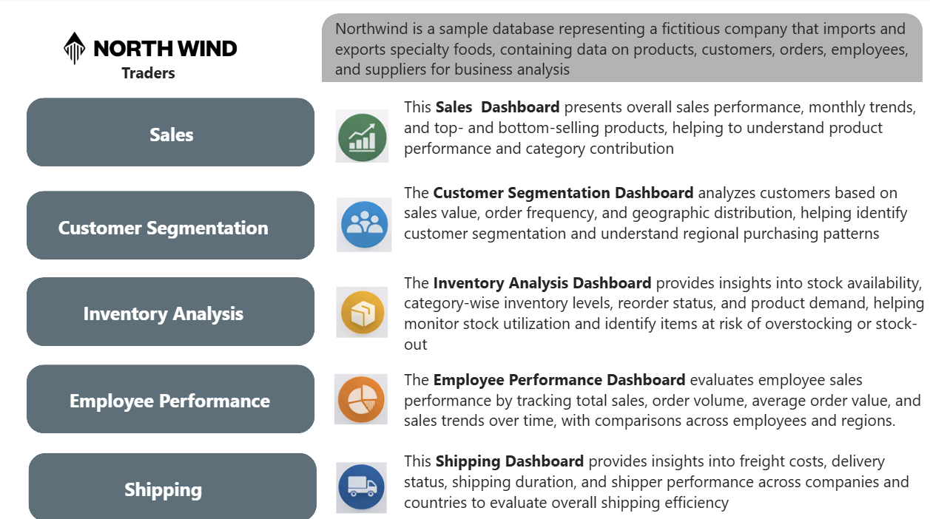

Slide 3
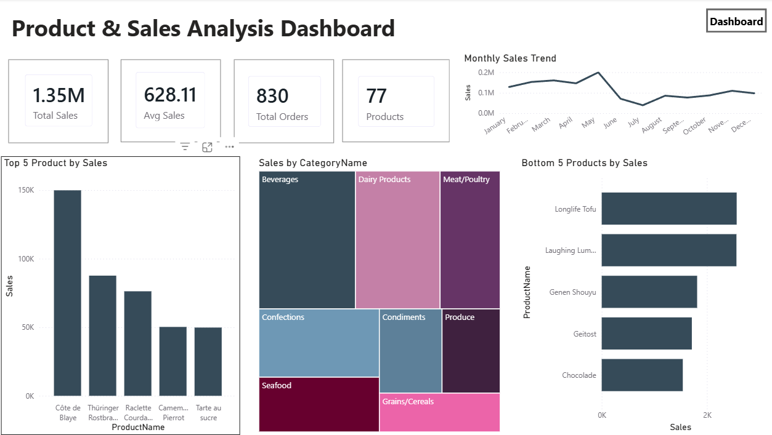

Slide 4
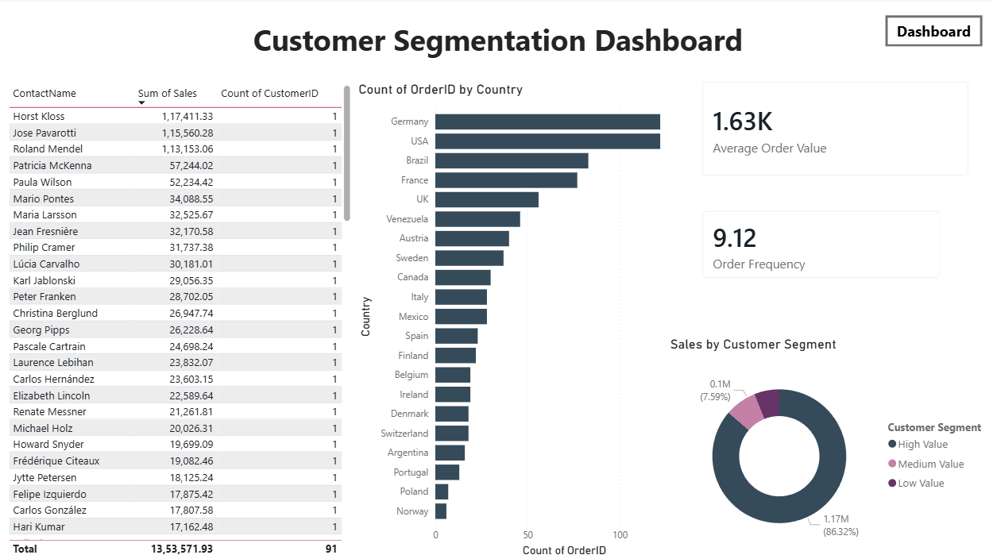

Slide 5
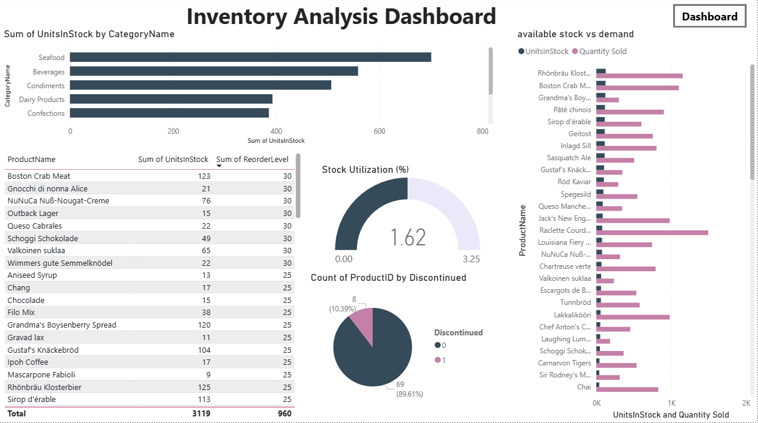

Slide 6
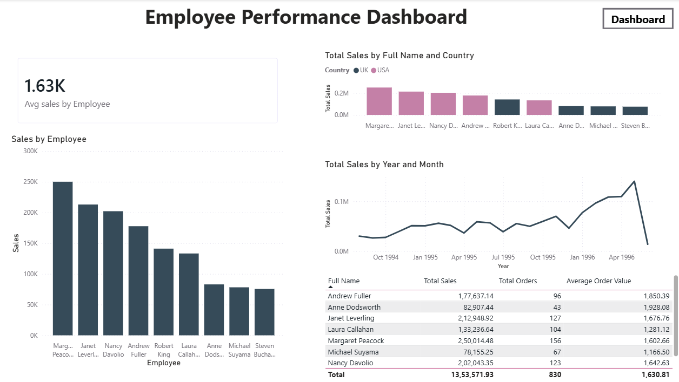

Slide 7
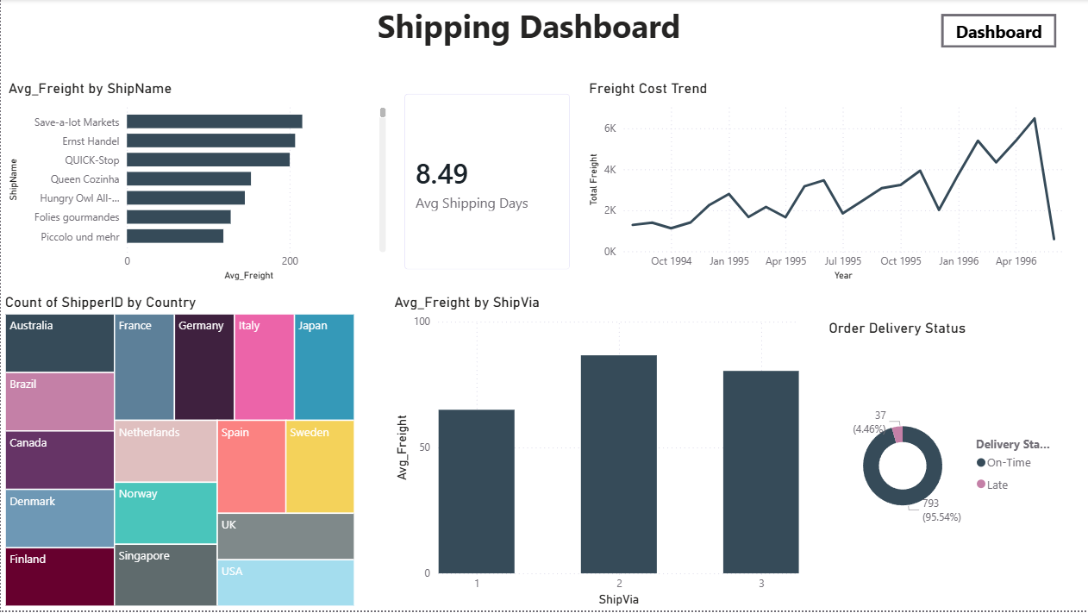

Slide 8
Sales Analysis Dashboard Insights
The sales dashboard shows the overall sales performance of the company. It displays total sales and average sales to understand how much revenue is generated. Total product orders and product count help understand how many products are being sold.
The dashboard shows the top 5 products by sales to identify the best-selling products and the bottom 5 products by sales to find products with low performance. Sales by product category helps understand which categories contribute more to sales. The monthly sales trend shows how sales change over time and helps identify high and low sales months.
Sales dashboard helps track sales performance and supports better business decisions.
Customer Segmentation Dashboard Insights
This dashboard shows customer buying behavior. Average order value shows how much a customer spends per order. Order frequency shows how often customers place orders.
Sales by customer segment (low, medium, and high value) shows which group of customers contributes more to sales. Order count by country shows which countries place more orders.
The customer table shows the customer contact name, total sales made by each customer. This helps identify important customers and understand their contribution to overall sales

Slide 9
Inventory Analysis Dashboard Insights
This dashboard shows how much stock is available for different products and categories. It helps see which categories have more stock.
The stock and sales comparison shows which products are selling well and which have low demand.
The product table shows stock quantity and reorder levels, helping to know when products need to be reordered.
The dashboard also shows how many products are discontinued and how well the stock is being used.
Employee Performance Dashboard Insights
This dashboard shows how much sales each employee makes. Average sales by employee shows the typical sales value. Sales by employee helps identify top-performing and low-performing employees. Sales by country shows how employees contribute in different regions.
The sales trend shows how employee sales change over time. The employee table shows each employee’s total sales, number of orders, and average order value.
Shipping Dashboard Insights
This dashboard shows shipping cost and delivery time. Average shipping days shows how long delivery usually takes.
Average freight by ship name and ship mode shows which shipping options cost more. The freight trend shows how shipping cost changes over time.
Shipments by country show where orders are being delivered. Delivery status shows that most orders are delivered on time.

Slide 10
Thank You

