Slide 1
Digital Portfolio
NAME
: kamaraj
REGISTER NO: 32724U18035
NMID NO : astvu32724022
COLLEGE : SSS COLLEGE ARTS & SCIENCE UNIVERSITY : THIRUVULLUVAR UNIVERSITY
1

Slide 2


DIGITAL PORTFOLIO USING
HTML , CSS , JAVASCRIPT
G
2

Slide 3



AGENDA
Problem Statement
Project Overview
End Users
Tools and Technologies
Portfolio design and Layout
Features and Functionality
Results and Screenshots
Conclusion
Github Link
3/21/2024 Annual Review
3

Slide 4
PROBLEM STATEMENT
Intoday’sdigital-firstworld,individualsoftenstruggletopresenttheirskills,achievements, and creative work in a structured and accessible way.
Traditionalresumes,paperportfolios,orstaticdocumentsfailtoshowcaseinteractiveprojects, design aesthetics, and multimedia elements effectively.
Thiscreatesagapbetweentalentandopportunities,asemployers,clients,oraudiencesfinditdifficult toevaluate the complete potentialof an individual.
Adigitalportfoliosolvesthisproblembyprovidingadynamic,user-friendlyplatform
where a person can highlight their skills, experiences, and projects in an engaging and professional manner.
However,creating sucha portfolio often faces challenges like: Lack of technical knowledge todesign and develop one. Difficulty in organizing and curating content to reflect true strengths. Limited accessibility and poor compatibility across devices. Absence of personalization that differentiates the individual from others.
4

Slide 5
PROJECT OVERVIEW
The goal of this project is to create a professional, visually appealing, and interactive digital portfolio that highlights personal skills, achievements, and creative work.
It serves as both a self-promotion tool and a platform to showcase academic, professional, and personal projects.
5

Slide 6

WHO ARE THE END USERS?
To showcase skills,projects, and achievements.
To highlightwork samples, casestudies, and career growth. To track teaching methods, lesson plans, and achievements To present services, products, and success stories. End users: Recruiters, HR managers, admission committees, teachers, or internship providers Clients, employers, collaborators, or agencies. School administrators, students, parents, or education boards.Customers, investors, business partners.
6

Slide 7


TOOLS AND TECHNIQUES
◻ Techniques
1. Responsive Design
Tools (on Mobile with CodePen)
Use @media queries so your portfolio looks good on mobile & desktop.
1. CodePen App / Mobile Browser
Use codepen.io on Chrome or Safari.
2. Navigation Menu (Hamburger)
Login to save and edit your portfolio.
Simple mobile-friendly navigation at the top.
2. HTML (Structure)
3. Sections
For content like your name, about section, skills, projects, contact details.
Header – Name & tagline.
3. CSS (Styling)
About Me – Short bio with photo.
To design your portfolio with colors, fonts, layouts.
Skills – List with icons or progress bars.
Mobile-friendly design with Flexbox or Grid.
Projects – Grid or card layout with images/links.
Contact – Email or form.
4. JavaScript (Interactivity)
Add animations, sliders, form validation, or project filters.
4. Animations
CSS transitions (:hover) or small JavaScript scroll effects.
5. External Libraries/Frameworks (Optional)
Example: fade-in sections while scrolling.
Bootstrap / TailwindCSS – for responsive design quickly.
FontAwesome – for icons.
5. CodePen Embeds
Google Fonts – for stylish text.
If you build mini projects in CodePen, you can embed them inside your portfolio.
7

Slide 8







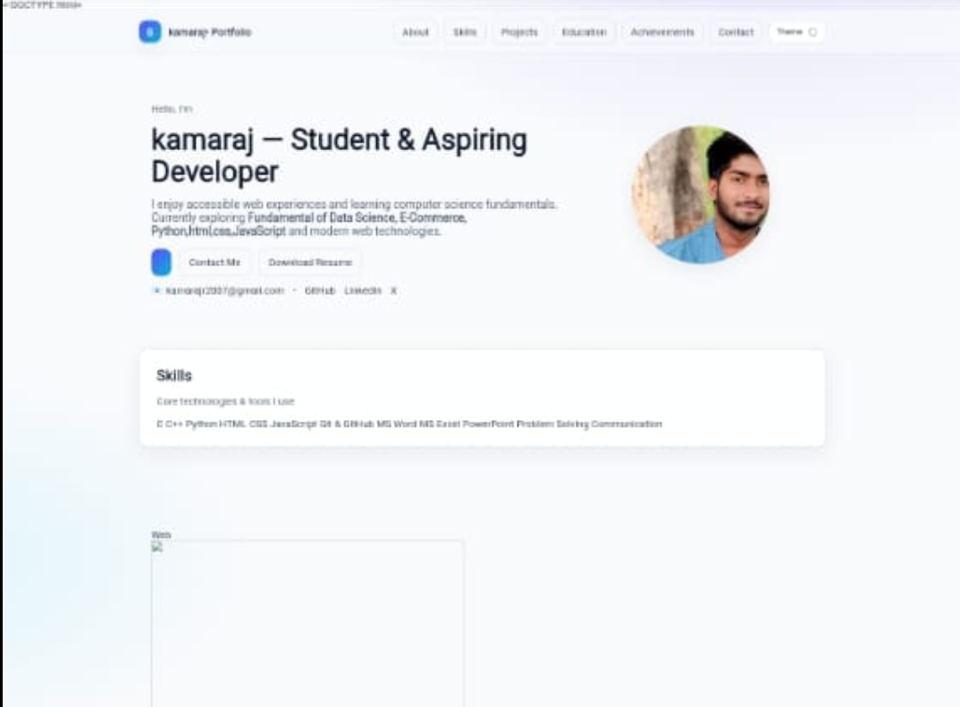
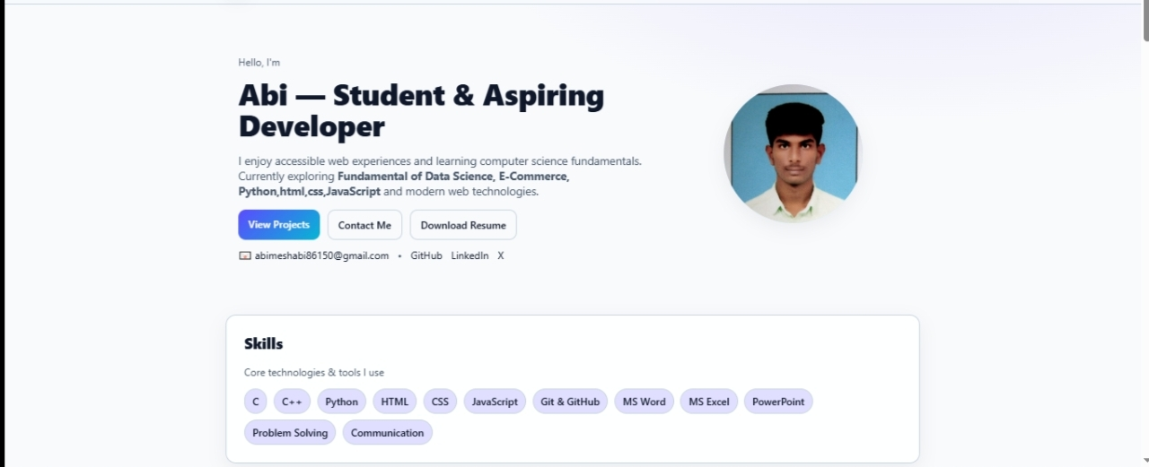
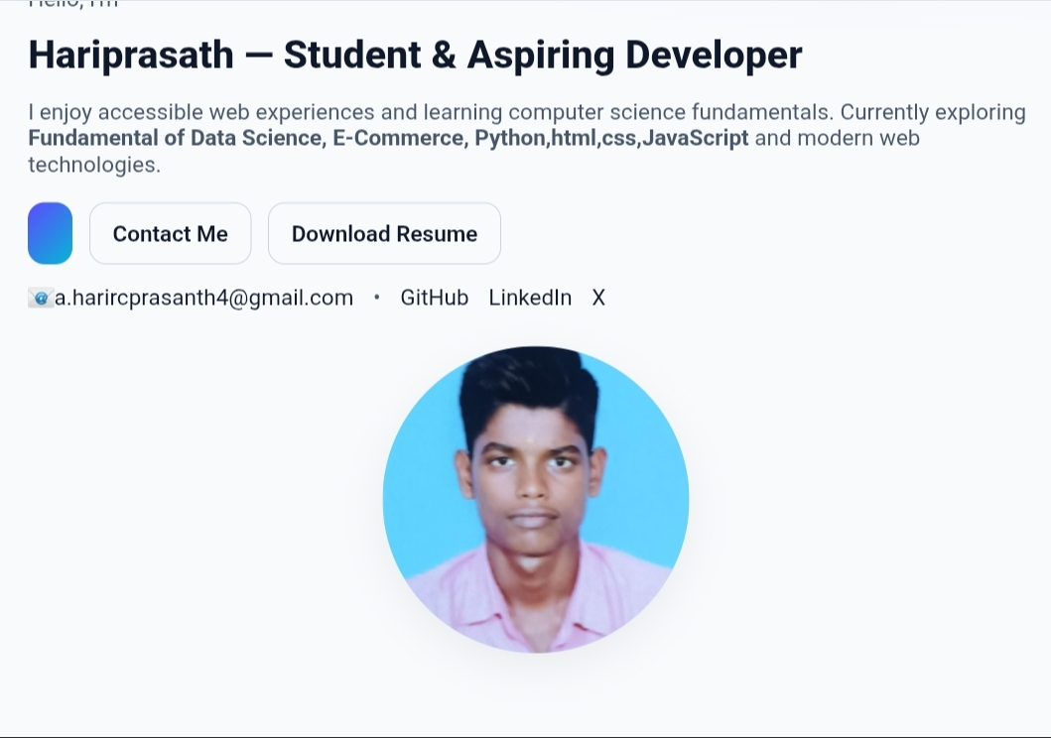
ESI AN LAYOUT
POTFO

Slide 9

FEATURES AND FUNCTIONALITY
1. Interactive Animations
Features of a Digital Portfolio
Smooth scroll to sections.
1. Personal Branding
Fade-in or slide-up animations when scrolling.
Name, tagline, professional role, and profile photo.
A personal logo or unique color theme.
2. Search or Filter Projects
Filter projects by category (e.g., Web, Mobile, Design).
2. About Section
3. Embedded Media
Short bio or career summary.
CodePen, GitHub repos, YouTube videos, or Behance designs.
Background, education, and interests.
4. Theme Toggle
3. Skills Showcase
Dark mode / light mode switch.
Technical and soft skills (with icons, progress bars, or charts).
Categorized (e.g., Web Development, Design, Tools).
5. Analytics (Optional)
Google Analytics to track views.

Slide 10
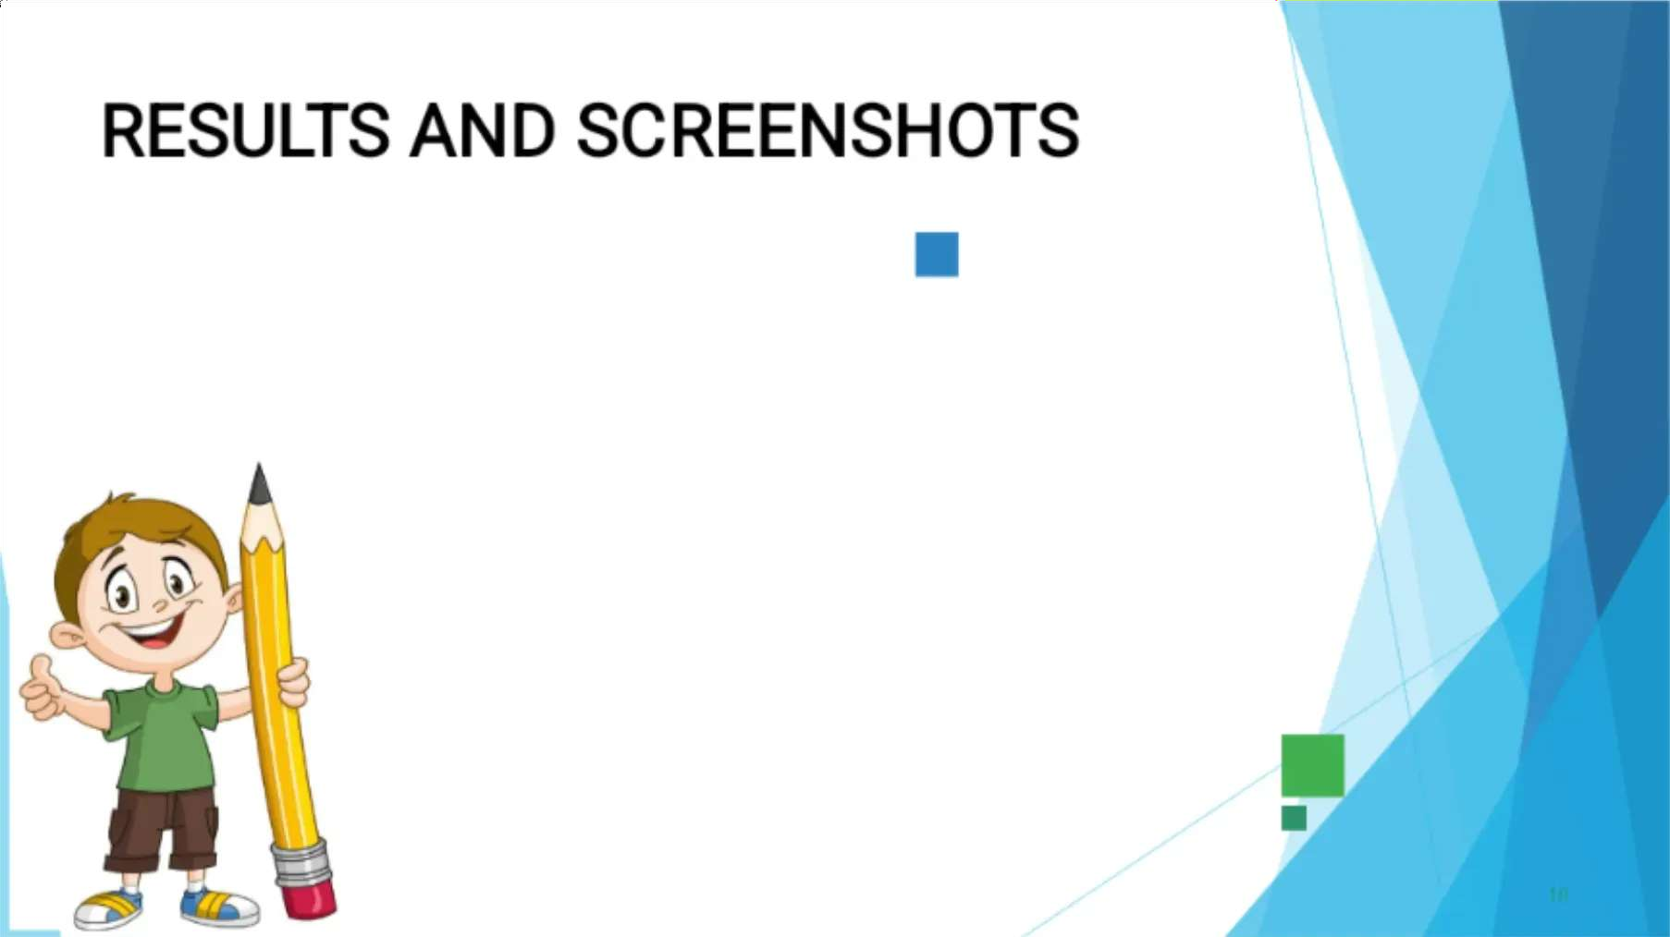

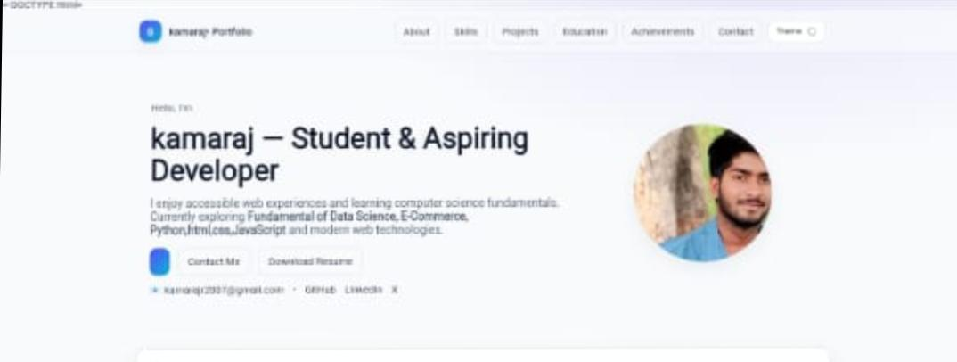
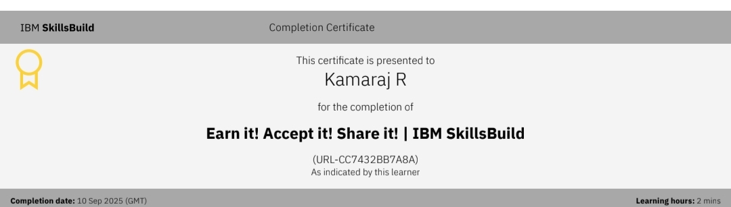
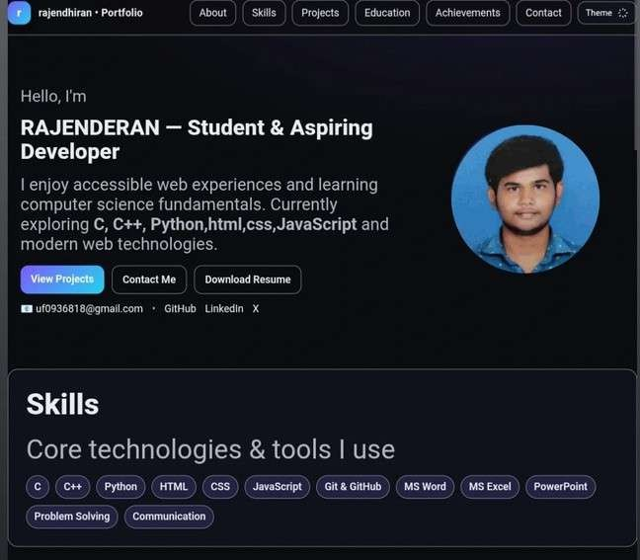
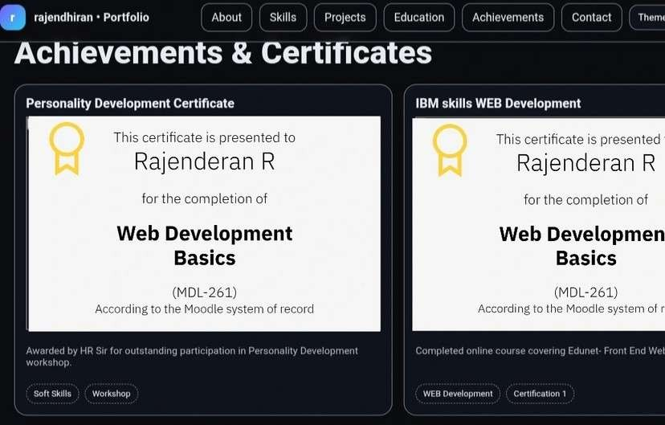
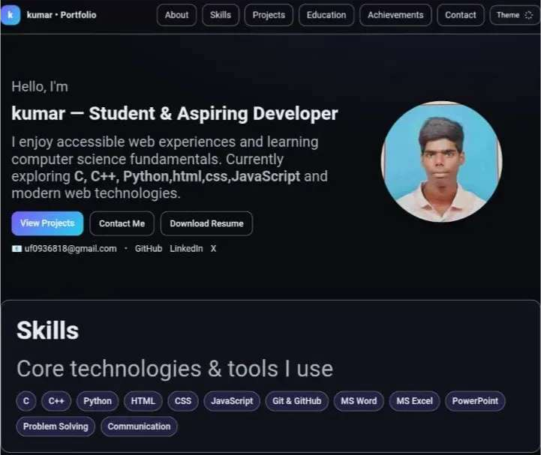
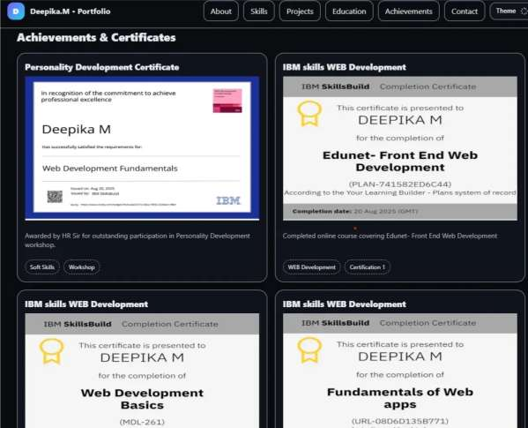
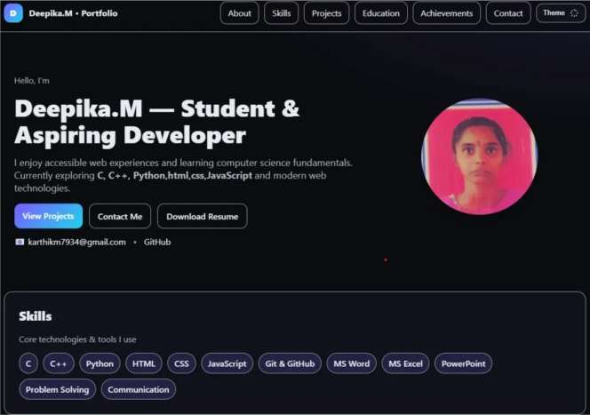
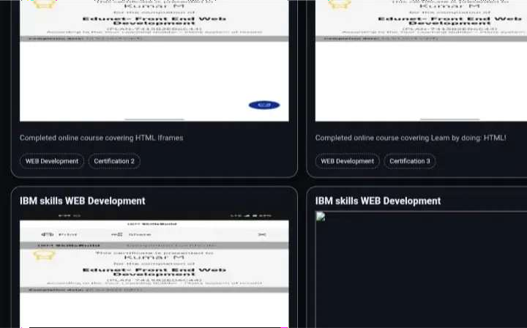
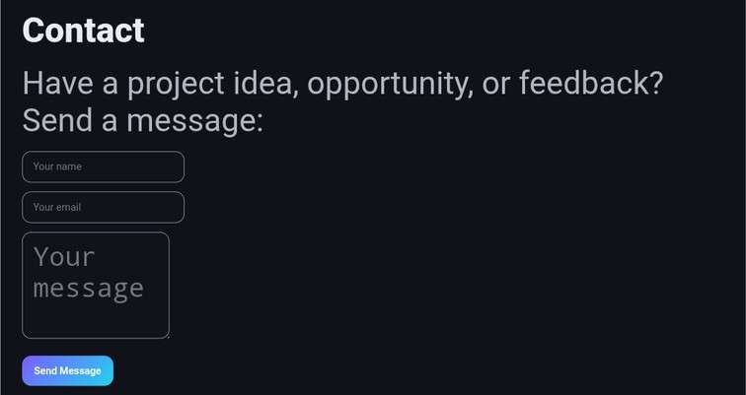

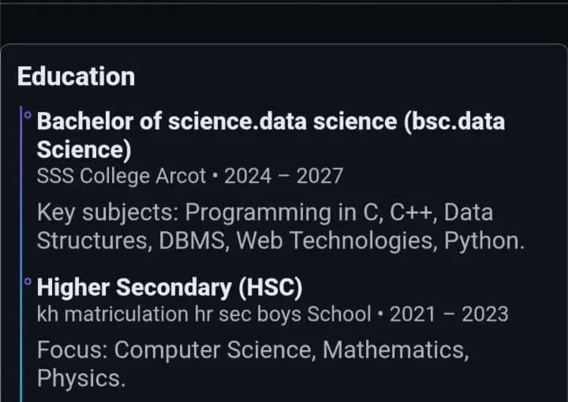
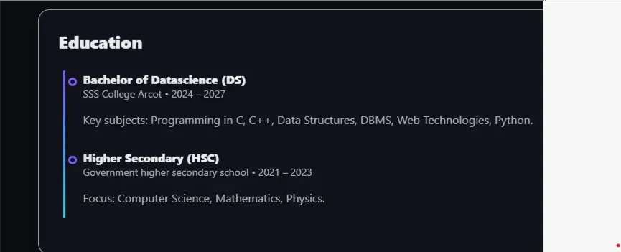
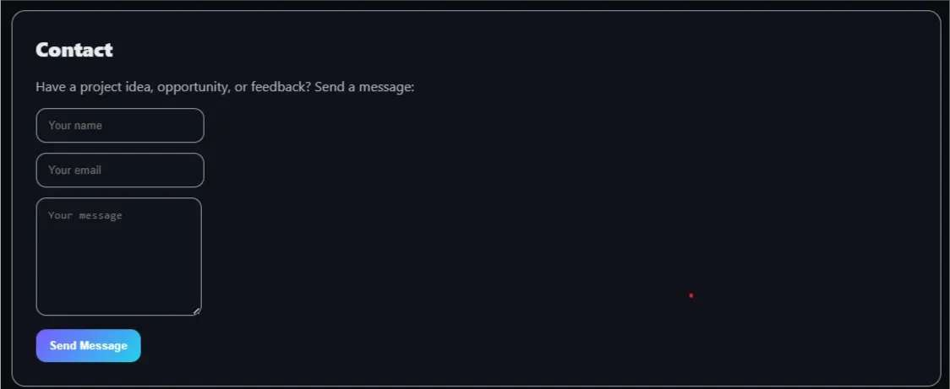
RESULTS AND SCREENSHOTS
10

Slide 11
CONCLUSION
The Employee Salary Prediction System successfully demonstrates the end-to-end application of machine learning in solving a real-world HR analytics challenge. By simulating realistic salary data and applying advanced modeling techniques, the system achieved high prediction accuracy and practical insights into salary dynamics.
The use of SHAP for model explainability added transparency, enabling users to understand key salary drivers.
The Streamlit-based deployment ensured accessibility through a user-friendly web interface.
This project highlights the effectiveness of combining data science, domain knowledge, and cloud deployment to deliver a scalable, production-ready solution for compensation intelligence.
11

