Slide 1

15ECC18 – SENSORS AND ACTUATORS

Slide 2
UNIT V – RADIATION SENSORS , MEMS AND SMART SENSORS
Radiation Sensors
Microwave Radiation
Antennas as Sensors and Actuators
MEMS Sensors and Actuators
Smart Sensors and Actuators
Sensor Networks

Slide 3
INTRODUCTION
low-frequency radiation ‘‘electromagnetic’’ (electromagnetic waves, electromagnetic energy, etc.) and high frequency radiation simply ‘‘radiation’’ (as in X-rays, α, β, γ or cosmic radiation).
The higher the frequency, the higher the photon energy. At high frequencies the photon energy is sufficient to strip electrons from atoms—this is called ionization, and the radiation is said to be ionizing radiation. At low frequencies ionization does not happen, and hence these waves are said to be nonionizing and the radiation nonionizing radiation.

Slide 4
UNITS
Units:
The basic unit of activity is the becquerel (Bq), which is defined as one transition (disintegration) per second.
It indicates the rate of decay of a radionuclide.
The basic unit of exposure is the coulomb per kilogram (C/kg), which is equivalent to the ampere second per kilogram (As/kg).
Absorbed dose is measured in grays (Gy). The gray is energy per kilogram, that is, 1 Gy = 1 J/kg.
The unit for dose equivalence is the sievert (Sv), which is measured in joules per kilogram (J/kg) as well.

Slide 5
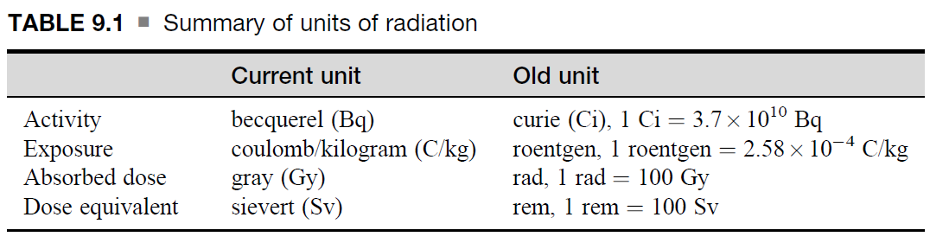
UNITS
Units:

Slide 6
RADIATION SENSORS
Types:
Ionization Sensors (Detectors)
Ionization Chambers
Proportional Chamber
Geiger–Muller Counters
Scintillation Sensors
Semiconductor Radiation Detectors
Bulk Semiconductor Radiation Sensor
Semiconducting Junction Radiation Sensors

Slide 7
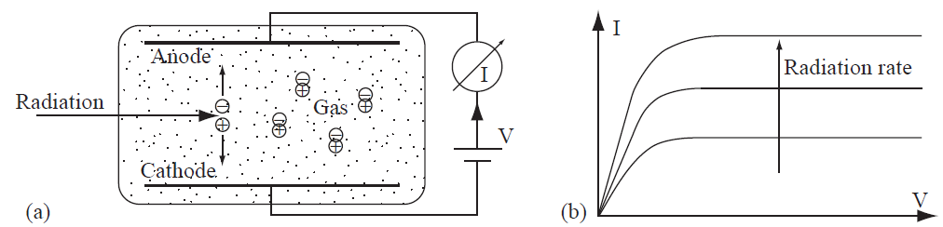
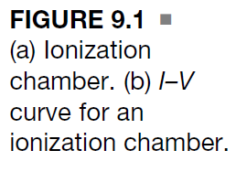
Ionization Sensors (Detectors)
Ionization Chambers

Slide 8
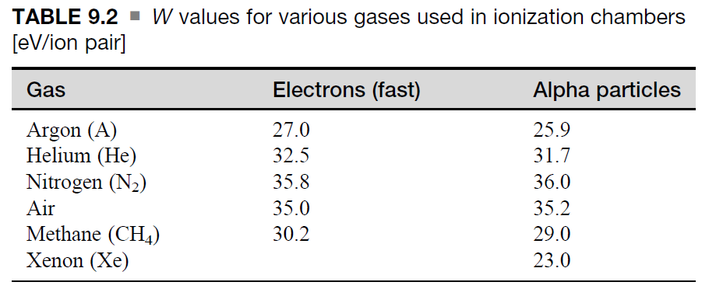
Ionization Sensors (Detectors)
Ionization Chambers
The simplest and oldest type of radiation sensor is the ionization chamber. The chamber is a gas-filled chamber, usually at low pressure, with predictable response to radiation.
In most gases the ionization energy for the outer electrons is rather small, 10–20 eV. Nevertheless, a somewhat higher energy is required since some energy may be absorbed without releasing charged pairs.
For the purpose of sensing, the important quantity is the W value. It is an average energy transferred per ion pair generated.

Slide 9

Ionization Sensors (Detectors)
Ionization Chambers
The principle is shown in Figure 9.1. When no ionization occurs, there is no current, as the gas has negligible resistance.
The voltage across the cell is relatively high and attracts the charges, reducing recombination.
Under these conditions the steady-state current is a good measure of the ionization rate. The chamber operates in the saturation region of the I–V curve.
The saturation current in an ion chamber can be calculated from the ionizing energy of the radiation that produces the ionization and their activity.
Given a source of particles with energy Es and activity A, the current in a chamber is

Slide 10
Ionization Sensors (Detectors)
Ionization Chambers
Clearly, the higher the particle energy, the higher the current across the chamber.
Alternatively, looking at it as an electromagnetic radiation, the higher the radiation frequency and the higher the voltage across the electrodes, the higher the current across the chamber.

Slide 11
Ionization Sensors (Detectors)
Ionization Chambers – Application 1 (smoke detectors)
The chamber is open to the air and ionization occurs in air. A small radioactive source (usually americum-241) ionizes the air at a constant rate causing a small, constant ionization current between the anode and cathode of the chamber.
The source emits mostly α particles. These are heavy particles and are easily blocked. In air they only propagate a few centimeters, but that is sufficient to establish an ionization current (called the saturation current) in the chamber.
Combustion products such as smoke that enter the chamber are much larger and heavier than air molecules and form centers around which positive and negative charges recombine (some particles become positive, some negative through collisions with charged air molecules).
This reduces the ionization current and triggers an alarm.

Slide 12
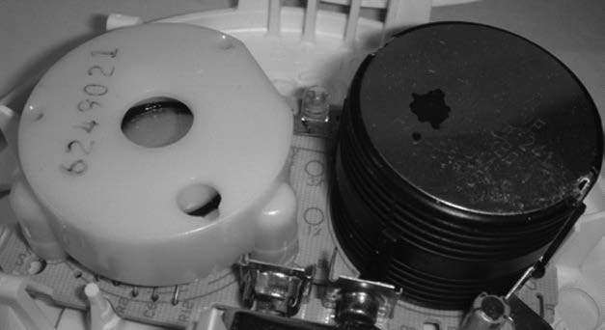
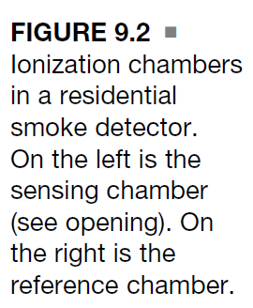
Ionization Sensors (Detectors)
Ionization Chambers – Application 1 (smoke detectors)
The trigger is now based on the difference between these two currents. Figure 9.2 shows the ionization chambers of a residential smoke detector. The black chamber is the reference chamber and the white chamber is the sensing chamber.

Slide 13
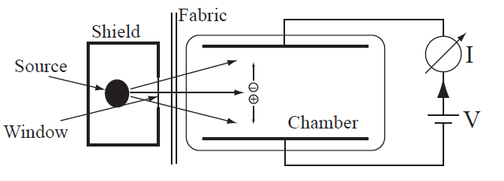
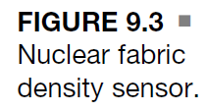
Ionization Sensors (Detectors)
Ionization Chambers – Application 2 (fabric density sensor)
It is made of two sections with the fabric between them. One part contains a low-energy radioactive isotope (typically krypton-85) while the second part is an ionization chamber.
The ionization current established in the chamber is reduced by the fabric. The denser the fabric, the lower the ionization current. The ionization current is calibrated in terms of density (i.e., weight per unit area).

Slide 14
Ionization Sensors (Detectors)
Proportional Chamber
A proportional chamber is essentially a gas ionization chamber, but the potential across the electrodes is high enough to produce an electric field in excess of 10⁶ V/m.
Under these conditions, the electrons are accelerated and in the process they collide with atoms, releasing additional electrons (and protons) in a process called the Townsend avalanche. These charges are collected at the anode, and because of this multiplication effect they can be used to detect lower intensity radiation.
The device is also called a proportional counter or multiplier.
If the electric field is increased further, the output becomes nonlinear due to the increased number of protons, which, being heavier than electrons, cannot move as fast, causing accumulation of a space charge.
The operation now is in what is called the limited proportional zone or region.

Slide 15
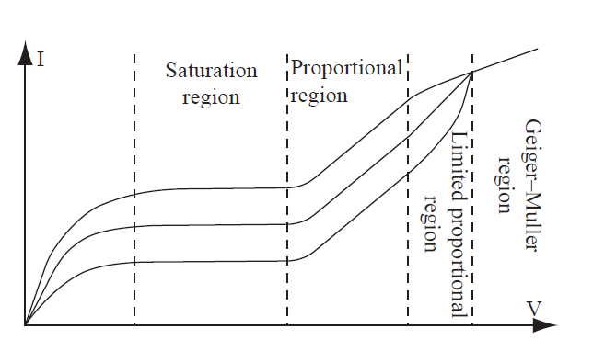
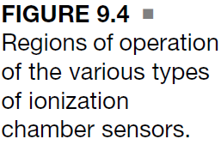
Ionization Sensors (Detectors)
Proportional Chamber

Slide 16
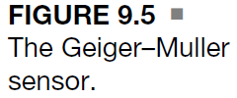
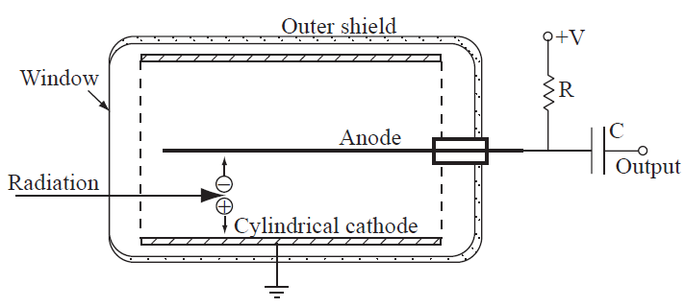
Ionization Sensors (Detectors)
Geiger–Muller Counters
When the voltage across an ionization chamber is sufficiently high, the output is not dependent on the ionization energy, but rather is a function of the electric field in the chamber. Because of this, the chamber can ‘‘count’’ single particles, whereas this would be insufficient to trigger a proportional chamber.
This device is called a Geiger–Muller (G–M) counter.

Slide 17
Ionization Sensors (Detectors)
Geiger–Muller Counters
The G–M counter is made as a tube, about 10–15 cm long and about 3 cm in diameter. A window (transparent to radiation) is provided to allow penetration of radiation. The tube is filled with argon or helium with about 5%–10% ethyl alcohol to quench triggering.
The operation relies heavily on the avalanche effect and in the process UV radiation is released, which adds to the avalanche process. These processes result in an output that is about the same no matter what the ionization energy of the input radiation is (as long as it is sufficient to produce ionization).
Because of the very high voltage, a single particle can release 10⁹–10¹⁰ ion pairs.
This means that a G–M counter is essentially guaranteed to detect any ionizing radiation through it.
The efficiency of all ionization chambers, including G–M counters, depends on the type of radiation.
The cathodes also greatly influence this efficiency.

Slide 18
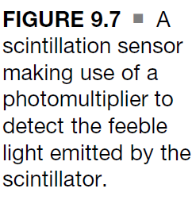
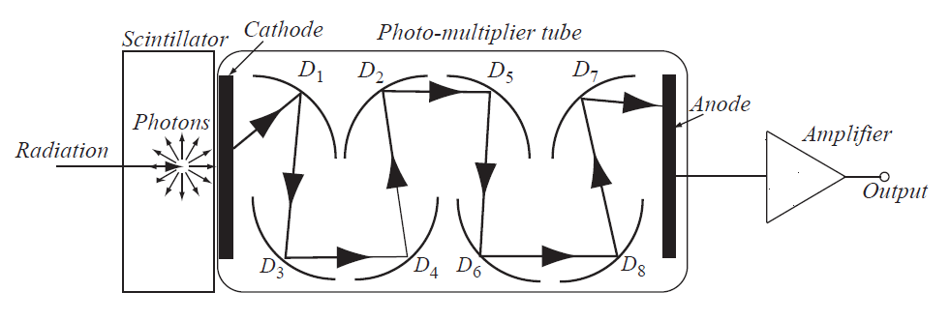
Scintillation Sensors
Scintillation Sensors

Slide 19
Scintillation Sensors
Scintillation Sensors
A relatively simple method of sensing radiation is to take advantage of the radiation to light conversion (scintillation) that occurs in certain materials.
The light intensity generated is then a measure of the radiation’s kinetic energy.
Some scintillation sensors are used as detectors in which the exact relationship to radiation is not critical.
The most common material used for this purpose is sodium iodine, but there are also organic materials and plastics that can be used for this purpose.
Many of these have faster responses than the inorganic crystals.
Light conversion is fairly weak because it involves inefficient processes. Therefore the light obtained in these scintillating materials is of low intensity and requires ‘‘amplification’’ to be detectable.
To increase the sensitivity, a photomultiplier or a charge-coupled device (CCD) can be used as the detector mechanism.
The large gain of photomultipliers is critical in the success of these devices.
The reading is a function of many parameters.
First, the energy of the particles and the efficiency of conversion
Then the cathode of the photomultiplier has a quantum efficiency

