Slide 1

15ECC18 – SENSORS AND ACTUATORS

Slide 2
15ECC18 – SENSORS AND ACTUATORS
Animal | Sense/Concept | Sensor
bats | echolocate | Ultrasonic Sensor
sharks and fish | Variations in electric fields
Birds | detect magnetic Fields (for orientation and navigation) | Compass
spider’s | vibration | Vibration sensor
chameleon | move each eye independently | Optical Sensor
Tongue | Taste | Chemical Sensor

Slide 3
DEFINITIONS
Confusing Terms
sensor, transducer, probe, gauge, detector, pickup, receptor, perceptron, transmitter, and transponder
actuator, driver, and operating element
Examples
motor, valve, solenoid, etc.

Slide 4
sensors that double as actuators and devices that perform both functions.
Example 1:
a bimetallic switch is a temperature sensor that activates a switch or creates a direct contact (cooking thermometer, thermostat)
it is a sensor-actuator
Example 2:
common fuse

Slide 5
SENSOR
A device that responds to a physical stimulus and transmits a resulting impulse.
A device, such as a photoelectric cell, that receives and responds to a signal or stimulus.
TRANSDUCER
A device that is actuated by power from one system and supplies power usually in another form to a second system.
A substance or device, such as a piezoelectric crystal, that converts input energy of one form into output energy of another

Slide 6
ACTUATOR
A mechanism for moving or controlling something indirectly instead of by hand.
One that actuates; a mechanical device for moving or controlling something.

Slide 7
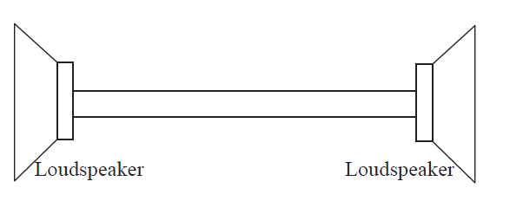
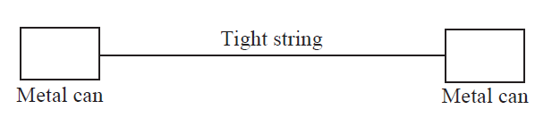
Confusing Terms
“transducer’’ → sensor or an actuator
Example,
loudspeaker is clearly an actuator—it converts electrical energy into acoustic energy.
A magnetic loudspeaker
use it as a microphone, the motion of the loudspeaker cone moves a coil in a magnetic field and this generates a voltage across the coil. When connected in a circuit, a measurable current appears in the circuit.
(a direct connection between a sensor and an actuator).

Slide 8
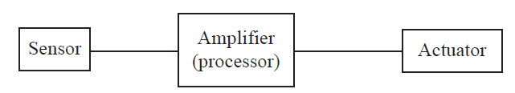
sensors and actuators operate
The three elements of a sensor-actuator system. The amplifier is the ‘‘processor’’ or ‘‘controller’’ in the system.

Slide 9
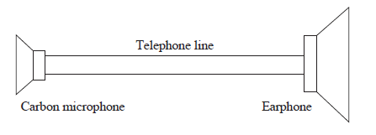
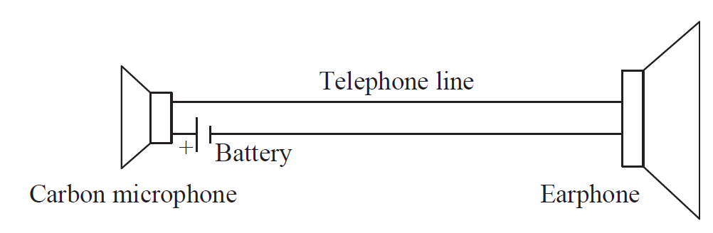
Power and Transduction
A telephone link that cannot work. The microphone now is an active sensor and requires power for transduction.
A ‘‘proper’’ telephone link based on an active (carbon) microphone.
microphone and the battery as a transducer or sensor
loudspeaker as the actuator

Slide 10
DEFINITIONS
Sensor
A device that responds to a physical stimulus.
Transducer
A device or mechanism that converts power of one form into power of another form.
Actuator
A device or mechanism capable of performing a physical action or effect.
sensor to be the input to a system, whereas an actuator is an output.

Slide 11
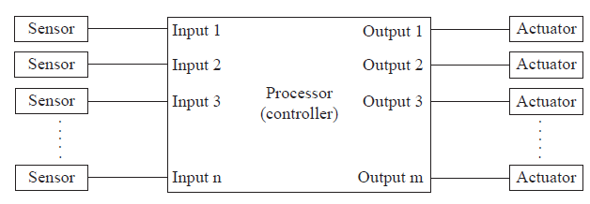
A GENERIC SYSTEM
A generic system with sensors as inputs and actuators as outputs. The processor or controller interfaces between the sensors and actuators.
Assignment 1:
List any Five Sensors and actuators in the car

Slide 12
CLASSIFICATION OF SENSORS AND ACTUATORS

Slide 13
1. Active and Passive sensors
An active sensor requires an external power source
Ex.:
strain gauges (resistance changes as a function of strain)
Thermistors (resistance changes as a function of temperature)
capacitive or inductive proximity sensors (capacitance or inductance is a function of position)
The sensing function is a change in the device properties

Slide 14
1. Active and Passive sensors
Passive sensors operate by changing one or more of their own properties to generate an electric signal.
Do not require external power sources; Also called Self-generating sensors.
Ex.:
Thermoelectric sensors
Solar cells
Magnetic microphones
Piezoelectric sensors

Slide 15
2. Contact and Noncontact sensors
Distinction is based on certain applications.
Ex.:
strain gauges arecontact sensors, but a proximity sensor is not.
Sometimes be used in either mode
Ex.: thermistor measuring the temperature of an engine is a contact sensor, but when measuring ambient temperature in the car it is not.
how a sensor may be mounted
Ex.: a Geiger tube cannot be a contact sensor since radiation must penetrate into the tube from the outside

Slide 16
3. Absolute or Relative Sensors
An absolute sensor reacts to a stimulus in reference to an absolute scale.
Ex.: Thermistor. Capacitance proximity sensor
A relative sensor’s output depends on a relative scale
Ex.:
Thermocouple (temperature difference between two junctions).
Pressure sensor

Slide 17
Other Classifications
Low or High temperature
Low or High frequency
Low or High accuracy
Semiconductor and biological sensors
Physical size based

Slide 18
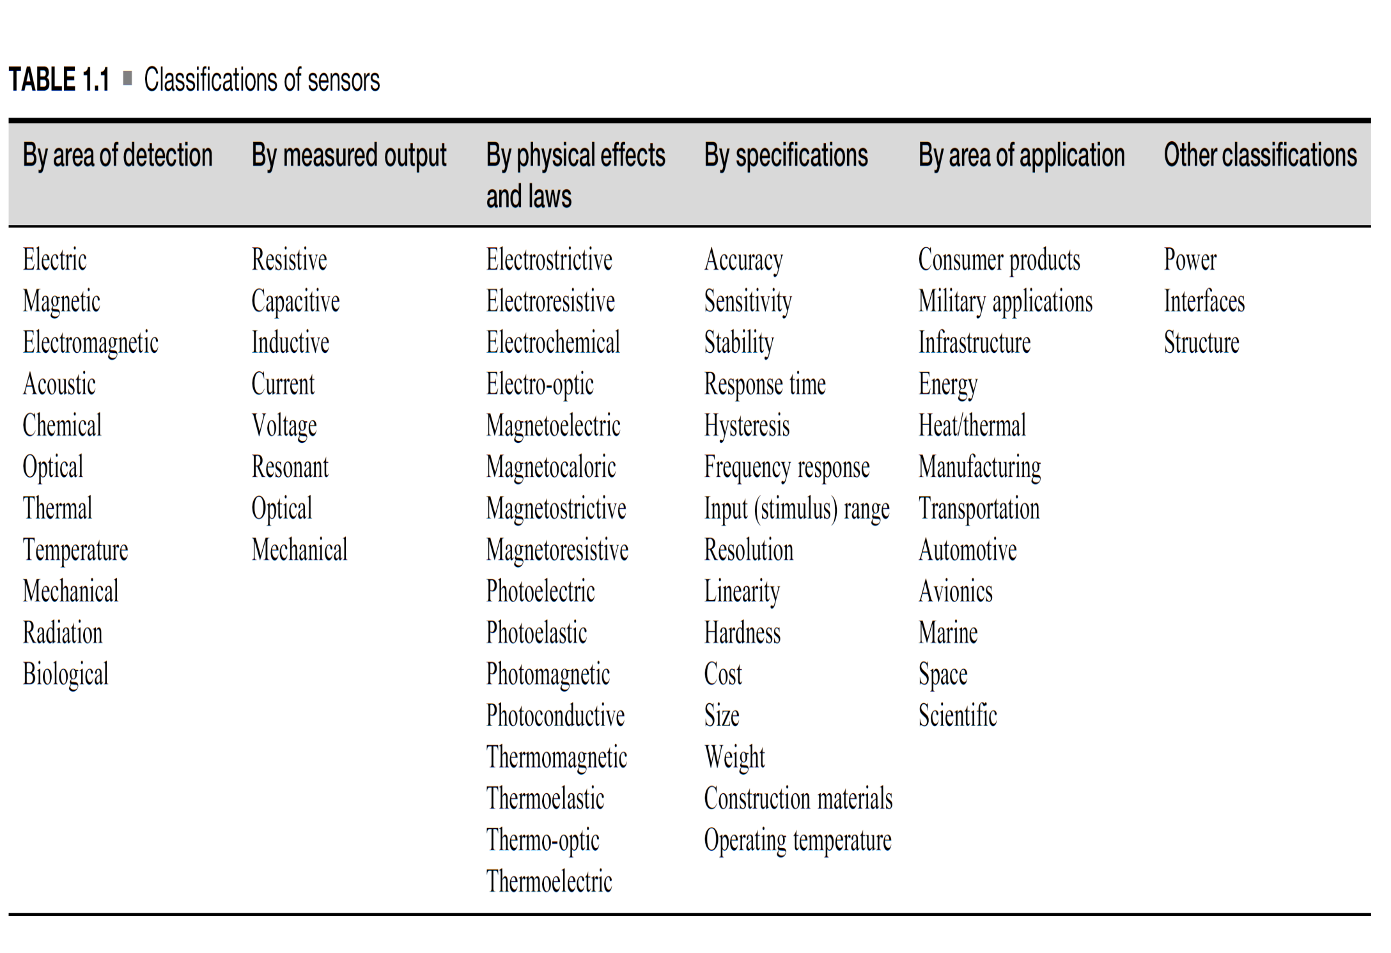

Slide 19
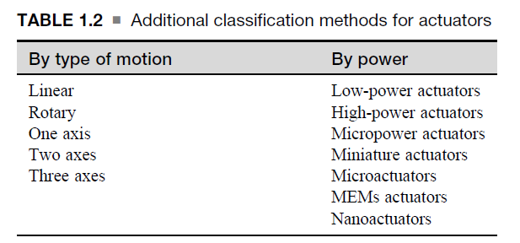

Slide 20
GENERAL REQUIREMENTS FOR
INTERFACING

Slide 21
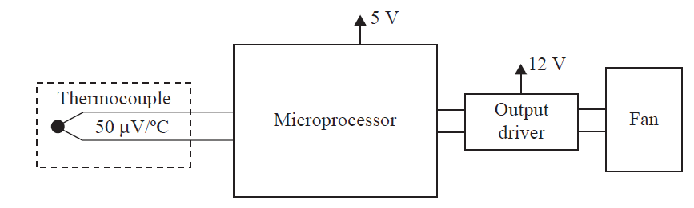
Sensors and actuators almost never operate by themselves.
The specifications of sensors or actuators match the needs of the system. Else need to be interfaced with the system.
Ex.:
A system comprising a sensor, a processor, and an actuator.s

Slide 22
Sensor is a thermocouple
Actuator is a motor whose speed is proportional to temperature
A thermocouple is a passive sensor
it does not require a power source to operate
its output is very low—on the order of 10–50 µV/C
The motor operates at 12 V DC.
Controller is a small microprocessor operates at 5 V DC
Power to operate the processor and the controller
Provide interfacing circuits between the sensor and the microprocessor and between the microprocessor and the actuator

Slide 23
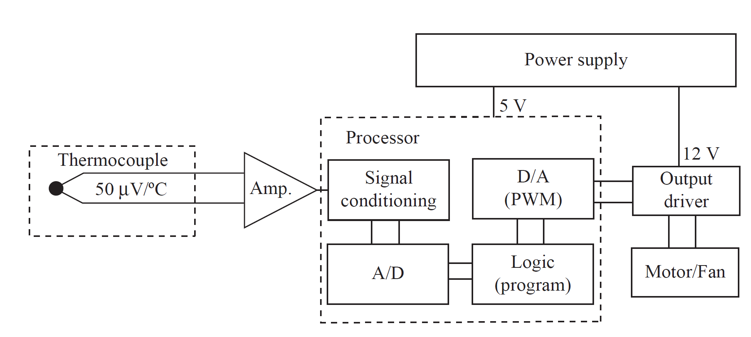
A complete system for sensing of temperature and activation of a fan to cool a device.

Slide 24
Additionally,
Need to isolate the actuator from the microprocessor for safety or functional Reasons (true if the actuator operates at grid voltages (usually 120– 480 V AC))
Alternatives…
Temperature sensors with digital outputs are available, and if used instead of the thermocouple, the system is simplified.
Choose to use a 5 V motor instead of a 12 V motor to simplify power management
Microprocessors included ADCs internally (elimination of the DAC and power amplifier).

Slide 25
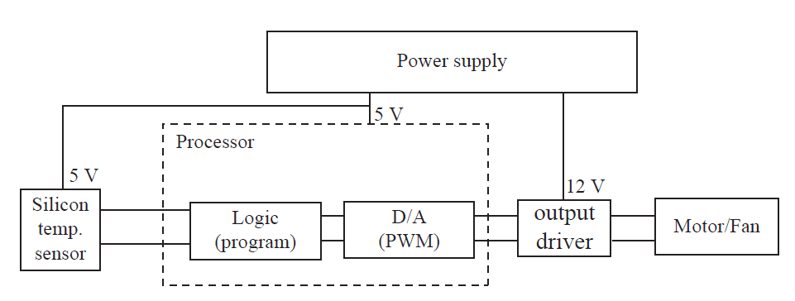
An alternative design to the temperature controller
Adv.:
Simpler because many of the requirements of interfacing have been integrated into the sensor and the microprocessor.
Disadv.:
Operate at up to about 100ᵒC, whereas thermocouples can operate at well over 2000C

Slide 26
Issues:
Conversion of voltages, currents, and impedances are very common, but sometimes interfacing may involve conversions in other parameters, such as frequency.
Ex.:
Piezoelectric sensor may generate a few hundred volts; impedance of the sensor is practically infinite.
A magnetic sensor usually includes a coil that has very low impedance
Conclusion:
Interfacing circuits vary from one application to another and cover the whole spectrum of electronic circuits.

Slide 27
UNITS

Slide 28
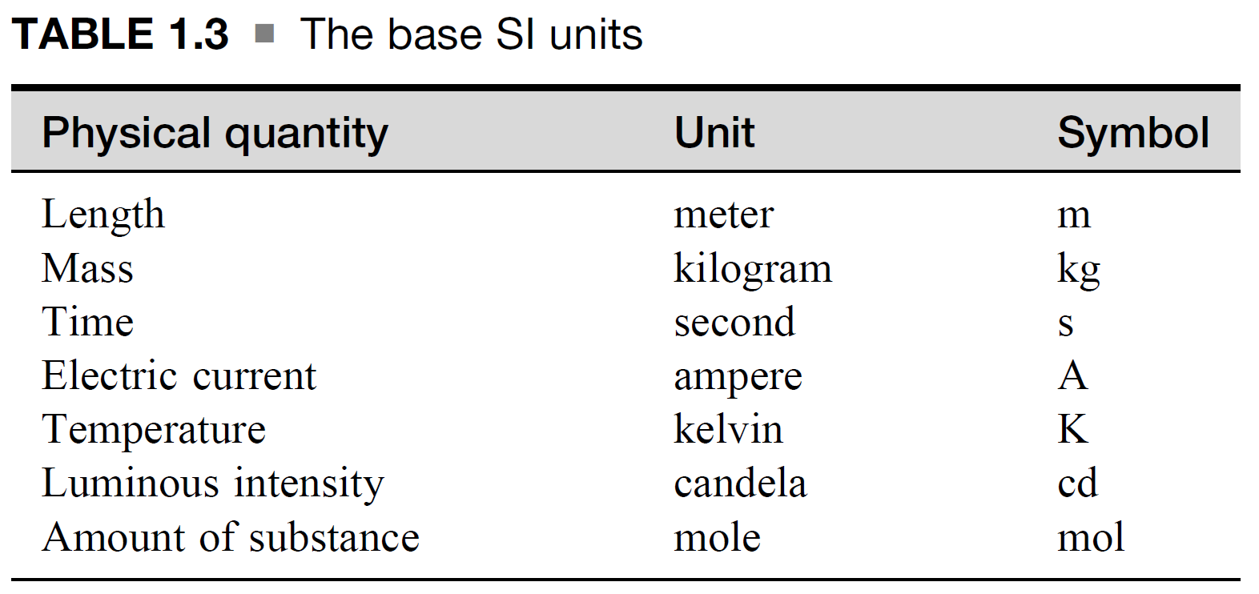
Base SI Units

Slide 29
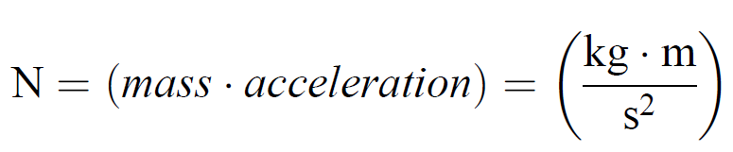
Derived Units
Other metric units in common use are derived from the base units
Example: 1
Unit of force is the newton (N)
Newton’s law of force as F = ma
The unit of mass is the kg.
Unit of acceleration is (m/s²).

Slide 30
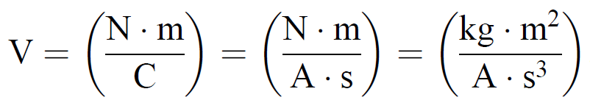
Derived Units
Example: 2
Unit of electric potential is the volt (V).
E = F/q (force F and charge q (Coulomb’s law))
So, units are Newtons/Coulomb (N/C).
The coulomb is the unit of charge and it Unit is ampere seconds (A.s).

Slide 31
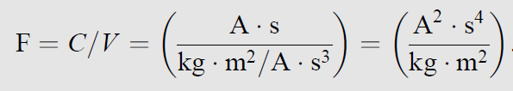
Derived Units
Example: 3
The unit of capacitance, the farad (F)

Slide 32
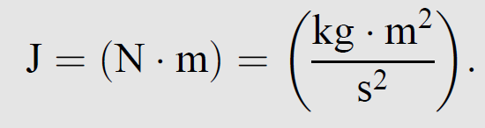
Derived Units
Example: 4
The unit of energy, the joule (J)

Slide 33
Supplementary Units
The system of units, which are derived non-dimensional units, also termed ‘‘supplementary units.’’
Ex.:
unit for the plane angle, the radian (rad).
unit for the solid angle, the steradian (sr).
Ref.:
https://www.youtube.com/watch?v=RMJucQJ1NGo

Slide 34
Customary Units
Used in Region wise are termed as Customary Units.
Some are existing and Some are vanished.
Ex.:
calorie (cal) or the kilowatt-hour (kWh)
foot, mile, gallon, psi (pounds per square inch),
astronomical unit (AU) ((1 AU = 149,597,870.7 km)

Slide 35
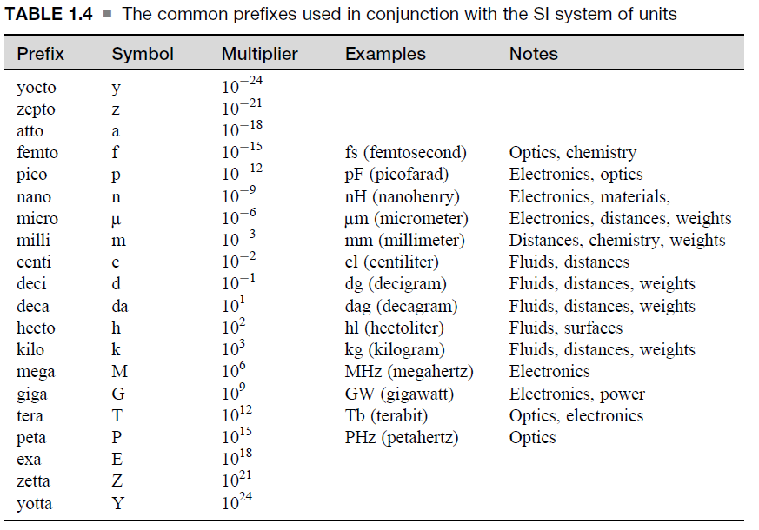
Prefixes
The SI also defines the proper prefixes that provide standard notation of very small or very large units

Slide 36
Other Units and Measures
Ex.:
‘‘dozen’’ or a ‘‘gross’’ (1 gross = 12 dozen or 144)
In Electronics base 2, base 8, or base 16 counting
100 Gb = 107.4 * 10⁹ bytes =

Slide 37
Other Units and Measures
When a physical quantity spans a very large range of numbers, it is difficult to properly grasp the magnitude of the quantity.
Ex.:
Richter magnitude scale (0-10). But, from 0 to infinity is the fact.

Slide 38
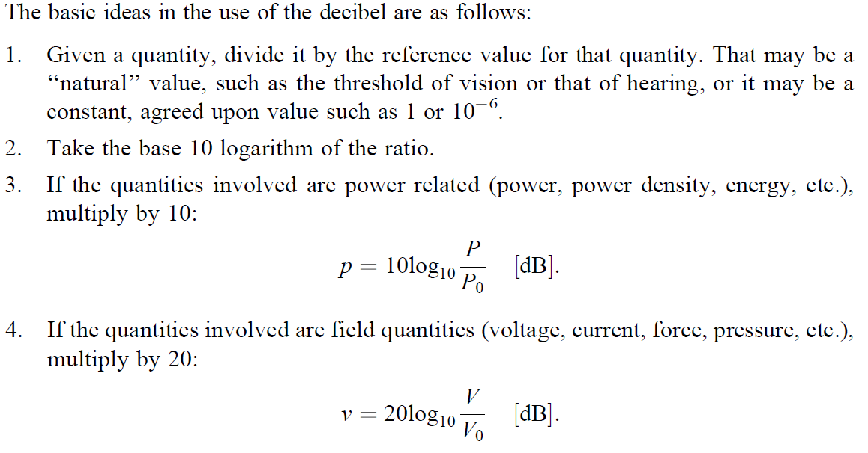
Other Units and Measures
The Decibel (dB) and Its Use

Slide 39
Other Units and Measures
The Decibel (dB) and Its Use
1 mW
dBm
µV
dBµV
Example,
a power sensor may be said to operate in the range - 30 dBm and 20 dBm.
This means it can detect power from 0.001 mW and 100 mW.
Advantages,
A very large range reduces to a short, easily comprehensible scale.
The logarithmic scale means that a product of ratios becomes a sum in decibels.
In many cases, such as acoustics, the dB scale is closer to the way devices (such as loudspeakers) produce output and organs (such as the eye or the ear) perceive physical quantities such as light, power, or pressure.
REFERENCES
T. Wildi, ‘‘Units and Conversion Charts,’’ IEEE Press, New York, NY, 1991.

Slide 40
Performance Characteristics of Sensors and Actuators

Slide 41
Two set of Applications,
Medical Field – Human Health support
X-ray
MRI
CT
Space Research – Human Knowledge Expansion
Radiation
effects of solar flares
catastrophic collisions with meteorites,

Slide 42
Should answer the following questions to choose the Sensors and Actuators,
What kind of sensor?
What range can it sense?
How ‘‘accurate’’ does it need to be?
Is it important that it be a linear measurement?
How critical is the repeatability of the sensor?
Does it need to respond quickly or can we use a slow responding sensor?

Slide 43
Basic performance characteristics,
Transfer Function
Frequency Response
Accuracy
Repeatability
Sensitivity
Linearity
Reliability
Resolution and others…

Slide 44
INPUT AND OUTPUT CHARACTERISTICS
For a sensor,
Input => stimulus or the measured quantity
Output => voltage, current, charge, frequency, phase, or a mechanical quantity
For an actuator,
Input => electric (voltage or current)
Output => electrical or mechanical (displacement, force, a dial gauge, a light indication, a display).
Additionally,
input and output properties such as impedance, temperature, and environmental conditions

Slide 45
Transfer Function
Definition
The input/output characteristic function or response of a device is a relationship between the output and input of the device.
It defines the response of a sensor or actuator to a given input or set of inputs and is one of the main parameters used in design.
Mathematical equation or descriptive curve or graphical representation.
The function may be linear or nonlinear, single valued or multivalued, and may at times be very complex.
A one-dimensional relation or multidimensional.

Slide 46
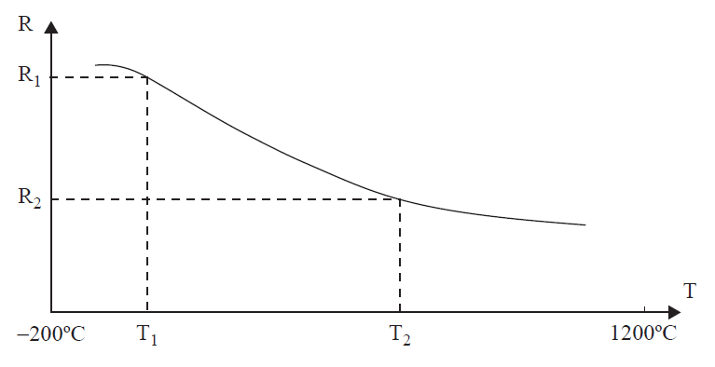

Transfer Function
Example: 1
S = f(x)
where x is the input, S is the output.
Output S on x indicates that this function can be (and often is) nonlinear.
Example: 2
Sensor is,
Linear in T1<T<T2
Nonlinear in other ranges.
Additional data about the sensor is,
saturation,
sensitivity, and
range,
Resistance-temperature relationship in a hypothetical temperature sensor.

Slide 47
Transfer Function
The output signal of a sensor may be voltage or current or it may be frequency, phase, or any other measurable quantity.
The output of actuators is usually mechanical, manifest in motion or force, light or electromagnetic waves.
Thermocouple =>10–50 µV/C
piezoelectric sensor =>300 V
magnetic actuator may require 20 A at 12 V,
electrostatic actuator may operate at 500 V

Slide 48
2. Impedance and Impedance Matching
An internal impedance that may be real or complex.
Consider, both sensors and actuators as two-port devices.
output impedance of sensors and the input impedance of actuators are considered.
Input impedance
The ratio of the rated voltage and the resulting current through the input port of the device with the output port open (no load).
Output impedance
The ratio of the rated output voltage and the short circuit current of the port’’ (i.e., the current when the output is shorted).

Slide 49
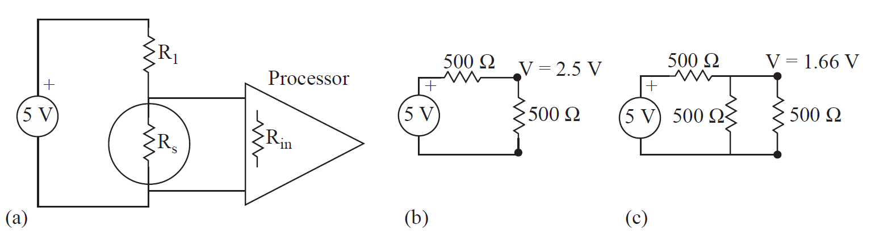
2. Impedance and Impedance Matching
A strain sensor connected to a processor. (a) The sensor and connections. (b) Equivalent circuit of a sensor alone. (c) Equivalent circuit of a sensor and processor.
At no strain, this voltage is 2.5 V (corresponding to 500Ω) and at the measured strain it is 3 V (corresponding to 750Ω).
The connection is made, the voltage across the sensor goes down to 1.666 V at no strain and rises to 1.875 V at the measured strain
Solution: Impedance matching circuit

Slide 50
3. Range, Span, Input and Output Full Scale, Resolution, and Dynamic Range
Range
The lower and upper limit operating values of the stimulus, that is, the minimum and maximum input for which a valid output is obtained
Example
A temperature sensor may operate between -45°C and +110°C.

Slide 51
3. Range, Span, Input and Output Full Scale, Resolution, and Dynamic Range
Span
The arithmetic difference between the highest and lowest values of the stimulus that can be sensed within acceptable errors.
i.e., the difference between the range values.
This may also be called the input full scale (IFS) of the sensor. The output full scale (OFS).
Example,
A sensor measures temperature between -30°C and +80 ° C and produces an output between 2.5 V and 1.2 V.
The span (IFS) is 80°C - (-30C) = 110 ° C
The OFS is 2.5 V - 1.2 V = 1.3 V.

Slide 52
3. Range, Span, Input and Output Full Scale, Resolution, and Dynamic Range
Resolution
The minimum increment in stimulus to which it can respond.
It is the magnitude of the input change that results in the smallest discernible output.

Slide 53
Resolution
Example,
A sensor may be said to have a resolution of 0.01°C, meaning that an increment in temperature of 0.01°C produces a readily measurable.
A sensor producing an output of 0–10 V for a temperature range of 0°C–100°C must be connected to an instrument to monitor. If this instrument is analog, the resolution is 0.01 V (1000 graduations on the voltmeter’s scale) or 0.001 V (10,000 graduations).
Resolution may be specified in the units of the stimulus (e.g., 0.5°C for a temperature sensor, 1 mT for a magnetic field sensor, 0.1 mm for a proximity sensor, etc.) or may be specified as a percentage of the span (0.1%, for example).
Stepper motor may have 200 steps/revolution for a resolution is 1.8°.
In digital systems, in A/D, 12-bit resolution means the device can resolve 2¹² = 4096 steps
This is not sensitivity. Sensitivity is the ratio of change in output to the change in input.

Slide 54
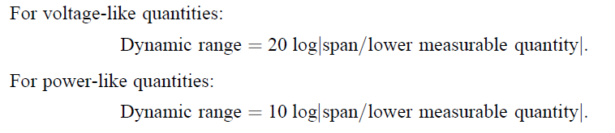
3. Range, Span, Input and Output Full Scale, Resolution, and Dynamic Range
Dynamic range of a device
The ratio of the span of the device and the minimum discernible quantity the device is capable of (resolution).
Dynamic range is particularly useful in devices with large spans.

Slide 55
Example,
A 4-digit digital voltmeter capable of measuring between 0 and 20 V. The total span is 19.99 V and the resolution (smallest increment) is 0.01 V. The dynamic range is thus
For Voltage,
For Power,
Note:
Span, IFS, and OFS are usually measured in the respective quantity at the input and output of the device (pressure and voltage), but in some cases, where the dynamic range is very large, these may also be given in Decibels.

Slide 56
4. Accuracy, Errors, and Repeatability
The errors involved in sensing and actuating define the accuracy of the device.
The definition of error is rather simple and can be represented as the difference between the measured and actual value.
Inaccuracies in the output due to ,
Materials, construction tolerances, aging, operational errors, calibration errors, matching (impedance) or loading errors,

Slide 57
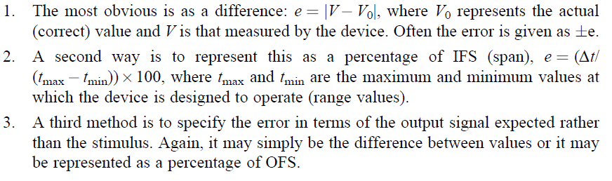
4. Accuracy, Errors, and Repeatability
Example,

Slide 58
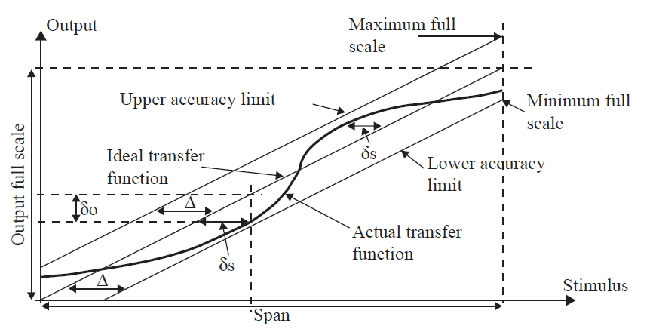
4. Accuracy, Errors, and Repeatability
Example,
Error and accuracy limits in nonlinear transfer functions.

Slide 59
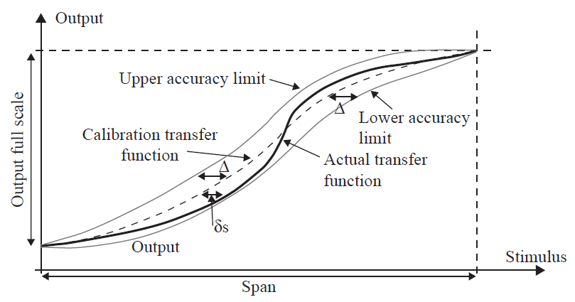
4. Accuracy, Errors, and Repeatability
Example,
Error in nonlinear transfer functions may be taken around the calibration transfer function rather than the ideal transfer function.

Slide 60
4. Accuracy, Errors, and Repeatability
Note:
Errors can also be dynamic or time dependent, but the calculation and meaning of errors is the same as for static errors.
Some errors are random, whereas others are constant or systemic.
A particular device exhibits different error values each time it is operated, these errors are said to be random. If the errors are constant, they are said to be systemic.

Slide 61
4. Accuracy, Errors, and Repeatability
Repeatability,
The failure of the sensor or actuator to represent the same value (i.e., stimulus for sensors or output for actuators) under identical conditions when measured at different times.
It is given as the maximum difference between two readings taken at different times under identical input conditions.
Usually the error will be given as a percentage of IFS

Slide 62
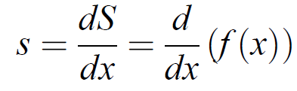
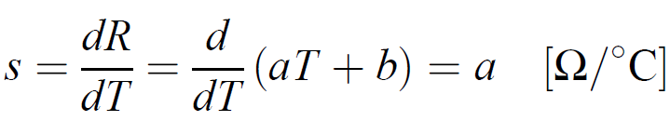
5. Sensitivity and Sensitivity Analysis
The sensitivity of a sensor or actuator is defined as the change in output for a given change in input, usually a unit change in input.
S = f(x)
Example: 1
Example: 2
the sensitivity is given in ohms per degree Celsius (Ω/°C).

Slide 63
5. Sensitivity and Sensitivity Analysis
Sensitivity may be constant throughout the span (linear transfer function), it may be different in different regions, or it may be different at every point in the span
Usually sensitivity is associated with sensors.
A transfer function can be defined for an actuator, then it is extended to actuators.
Example:
A speaker as dP/dI, where P is the pressure (output) the speaker generates per unit current I (input) into the speaker, (or)
The sensitivity of a linear positioner as dl/dV, where l is linear distance and V is the voltage (input) to the positioner.

Slide 64
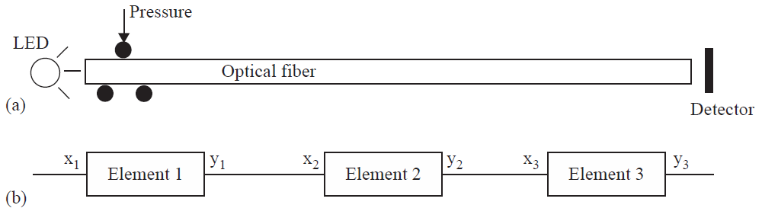
5. Sensitivity and Sensitivity Analysis
Issues:
Sources of Noise, nonlinearities, accuracy, errors.
Sensitivity analysis may also provide clues as to how the effects of noise and errors can be minimized by proper choice of sensors, their connections, and other steps that can be taken to improve performance (amplifiers, feedback, etc.)
Example: 1
A sensing system made of a source, optical fiber pressure sensor, and processor. (a) The sensor. (b) Equivalent configuration showing the transducing elements

Slide 65
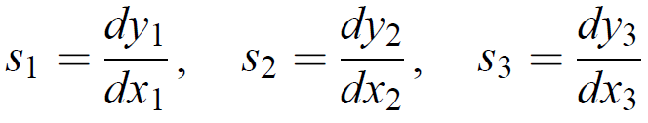
5. Sensitivity and Sensitivity Analysis
The optical fiber transmits light generated by a laser or LED to a detector and the phase of this signal is calibrated to read pressure.
When pressure is applied on the optical fiber, it is tensioned.
This means the light travels a longer distance in the fiber and its phase at the detector will be larger.
This is a complex sensor that includes three transduction steps.
First, an electric signal is converted into light and is coupled into the fiber.
Then pressure is converted to displacement and,
In the detector, light is converted into an electric signal.
Each one of these transduction steps has its own errors, its own transfer function, and its own sensitivity.
The three transducers are connected in series and their errors are additive.

Slide 66
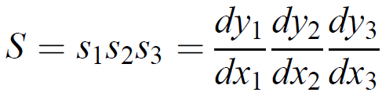
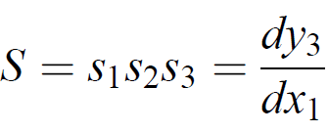
5. Sensitivity and Sensitivity Analysis
Suppose first that there are no errors in the system.
But x2 = y1 (the output of transducer 1 is the input to transducer 2) and x3 = y2.
No errors in the system

Slide 67

5. Sensitivity and Sensitivity Analysis
If errors or noise are present, and assuming each transducer element has different errors,
The output of transducer element 1 as,
The output of element 2 as,
This becomes the input to element 3, The output of element 3 as,

Slide 68
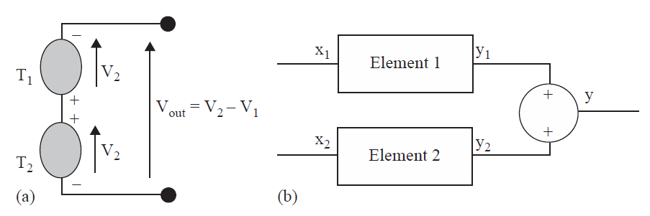
5. Sensitivity and Sensitivity Analysis
Example: 2
A differential sensor.
The two sensors measure temperatures at different locations connected in opposition.
Equivalent configuration showing the transducer elements

Slide 69


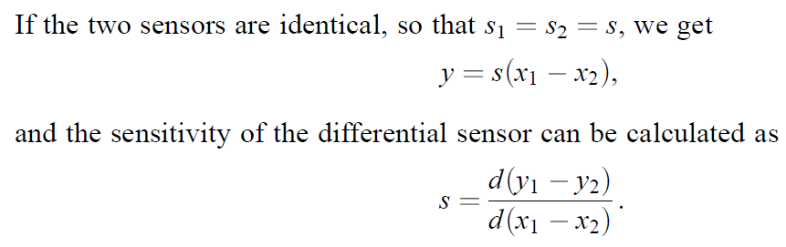
5. Sensitivity and Sensitivity Analysis
Assuming first that there are no errors and that each transducer has a different transfer function, the sensitivity of each sensor is,
The outputs of the two sensors are y1 = s1x1 and y2 = s2x2 and the overall output is,

Slide 70
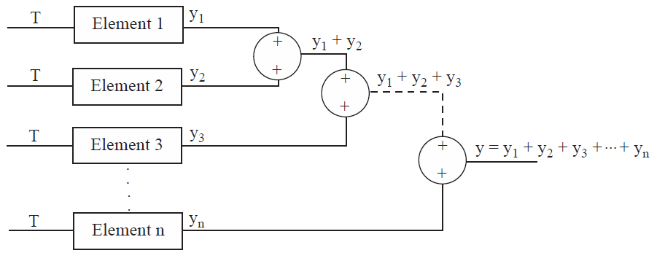

5. Sensitivity and Sensitivity Analysis
Example: 3
A thermopile (‘‘a pile of thermocouples’’) is a sensor made of n thermocouples electrically connected in series to increase the electrical output, whereas the input (temperature) to all thermocouples is the same (they are said to be connected in parallel thermally)

Slide 71
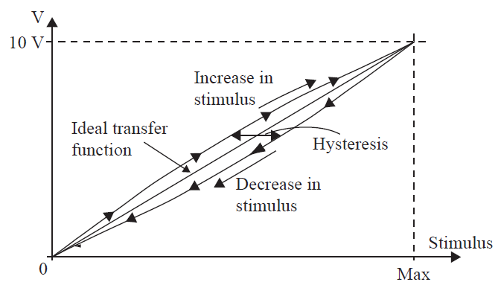
6. Hysteresis, Nonlinearity, and Saturation
Hysteresis
The deviation of the sensor’s output at any given point when approached from two different directions
Hysteresis in a sensor.

Slide 72
6. Hysteresis, Nonlinearity, and Saturation
Example
If temperature is measured, at a rated temperature of 50C, the output might be 4.95 V when the temperature increases, but 5.05 V when the temperature decreases. This is an error of 0.5%
The sources of hysteresis are either
mechanical (friction, slack in moving members),
electrical (such as due to magnetic hysteresis in ferromagnetic materials), or
due to circuit elements with inherent hysteresis

Slide 73
6. Hysteresis, Nonlinearity, and Saturation
Nonlinearity
A property of a sensor or an error due to deviation of a device’s ideal, linear transfer function.
A nonlinear transfer function is a property of the device and, as such, is neither good nor bad.
A nonlinearity error is a quantity that influences the accuracy of the device.
Method
If the transfer function is nonlinear, the maximum deviation from linearity across the span is stated as the nonlinearity of the device.

Slide 74
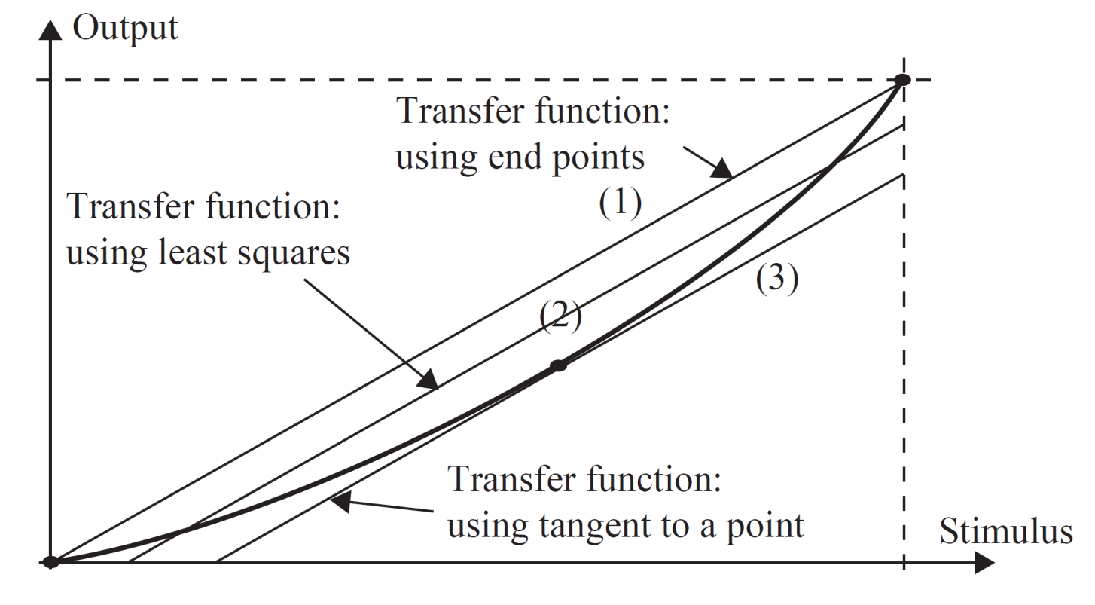
6. Hysteresis, Nonlinearity, and Saturation
Methods
If the transfer function is close to linear, an approximate line may be drawn and used as the reference linear function.
Sometimes this is done simply by connecting the end points (range values) of the transfer function (line 1).
Another method is to draw a least squares line through the actual curve (line 2).
Another method that is sometimes employed is to take a midpoint in this reduced range and draw a tangent to the transfer function through the selected point and use this tangent as the ‘‘linear’’ transfer function for purposes of defining nonlinearity (line 3)

Slide 75
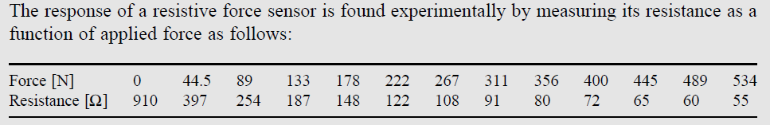
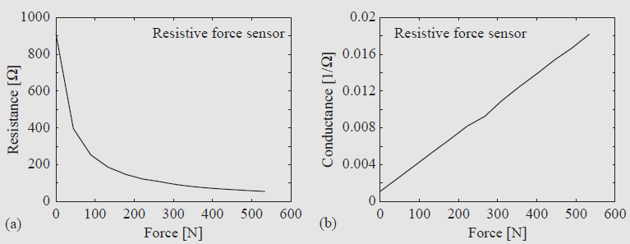
6. Hysteresis, Nonlinearity, and Saturation
Non Linearity is Good…
There are instances in which a nonlinear response is superior to a linear response and there are sensors and actuators that are intentionally and carefully designed to be nonlinear.
Example: 1
Potentiometer used as a volume control, especially in audio systems.
Example: 2

Slide 76
6. Hysteresis, Nonlinearity, and Saturation
Saturation
The behavior of sensors or actuators when they no longer respond to the input or, more likely, their response is reduced.
This usually occurs at or near the ends of their span and indicates that the output is no longer a function of the input or, more likely, is a highly reduced function of the input.
Sensor is,
Linear in T1<T<T2
Nonlinear in other ranges or saturation.

Slide 77
6. Hysteresis, Nonlinearity, and Saturation
Saturation
should avoid saturation for two reasons,
First, sensing is inaccurate at best and the sensitivity, and often the response, is reduced.
Second, saturation may, in some cases, damage the device
In actuators any additional power supplied does not produce an increase in the output power of the device (i.e., sensitivity is reduced), leading to internal heating and possible damage.

Slide 78
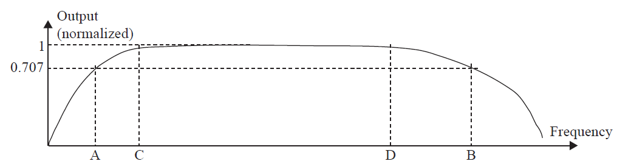
7. Frequency Response, Response Time, and Bandwidth
Frequency response (frequency transfer function)
A device indicates the ability of the device to respond to a harmonic (sinusoidal) input.
Typically the frequency response shows the output (as a magnitude of the output or gain) of a device as a function of the frequency at the input.
The frequency response is important in that it indicates the range of frequencies of the stimulus for which the output is adequate

Slide 79
7. Frequency Response, Response Time, and Bandwidth
The frequency response provides three important design parameters,
Bandwidth - frequency range between the two pre-agreed upon points A and B. The gain (magnitude) at the half-power points is 1/√2 of the gain in the flat region, or 70.7%.
Useful frequency range or flat frequency range (or static range) - portion of the bandwidth that is flat. Therefore the useful frequency range may be considerably smaller than the bandwidth or it may be a compromise between flatness and width

Slide 80
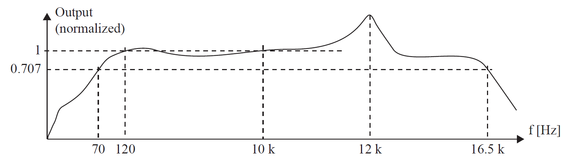
7. Frequency Response, Response Time, and Bandwidth
Example
In a Loud Speaker the Frequency response is,
The bandwidth extends between 70 Hz and 16.5 kHz and most often is indicated as 16.5 kHz - 70 Hz = 16,430 Hz.
At 12 kHz is said to be resonant.
Flat region is 120 Hz and 10 kHz - ‘‘FLAT.’’

Slide 81
7. Frequency Response, Response Time, and Bandwidth
Response time
The time needed for the output to reach steady state for a step change in input.
This is often specified for slow-responding devices such as temperature sensors or thermal actuators.
The response time will be given as the time needed to reach 90% of steady-state output upon exposure to a unit step change in input.
Example
In temperature sensor, - time needed for the sensor’s body to reach the temperature it is trying to measure.
The higher the response time, the less the sensor can follow rapid changes in the stimulus, and consequently the narrower its frequency response (bandwidth).
Response time is most often specified with devices that respond slowly. Fast-acting devices will be specified in terms of frequency response.

Slide 82
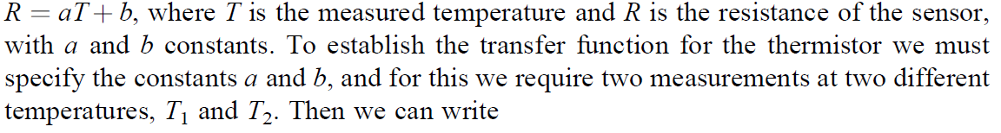

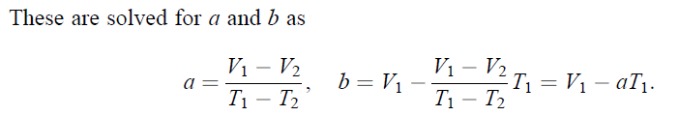
8. Calibration
Calibration is the experimental determination of the transfer function of a sensor or actuator.
Calibration of a device will be needed when the transfer function is not known or when the device must be operated at tolerances below those specified by the manufacturer
Example
A thermistor with a 5% tolerance on a full scale from 0°C to 100°C
There are two ways, the transfer function of the sensor can be established,
Method: 1

Slide 83
8. Calibration
Method: 2
Assume no knowledge of the transfer function and determine it by a series of experiments.
A number of measurements will be needed measuring Ti and reading the resulting resistance Ri.
The points are plotted and a curve.
Note:
Calibration is a critical step in the use of sensors or actuators and should be undertaken with the utmost care.
Measurements must be meticulous, instruments as accurate as possible, and conditions as close as possible to those under which the sensor or actuator will operate.

Slide 84
9. Excitation
Excitation refers to the electrical supply required for operation of a sensor or actuator.
Specify the range of voltages, current, power dissipation and frequency under which the device should operate.
The normal operating conditions of the sensor also defined.
10. Deadband
Deadband is the lack of response or insensitivity of a device over a specific range of the input.
In this range, which may be small, the output remains constant.
A device should not operate in this range unless this insensitivity is acceptable.
For example, an actuator that is not responding to inputs in a small range around zero may be acceptable.

Slide 85
11. Reliability
Reliability is a statistical measure of a device that indicates the ability of the device to perform its stated function, under normal operating conditions without failure, for a stated period of time or number of cycles.
Reliability may be specified in hours or years of operation or as number of cycles or number of failures in a sample.
Elevated temperatures, higher voltages and currents, as well as environmental conditions (such as humidity) reduce reliability
Examples
Failure rate
Mean time between failures (MTBF)
Failure in time (FIT)

Slide 86
Problems

Slide 87
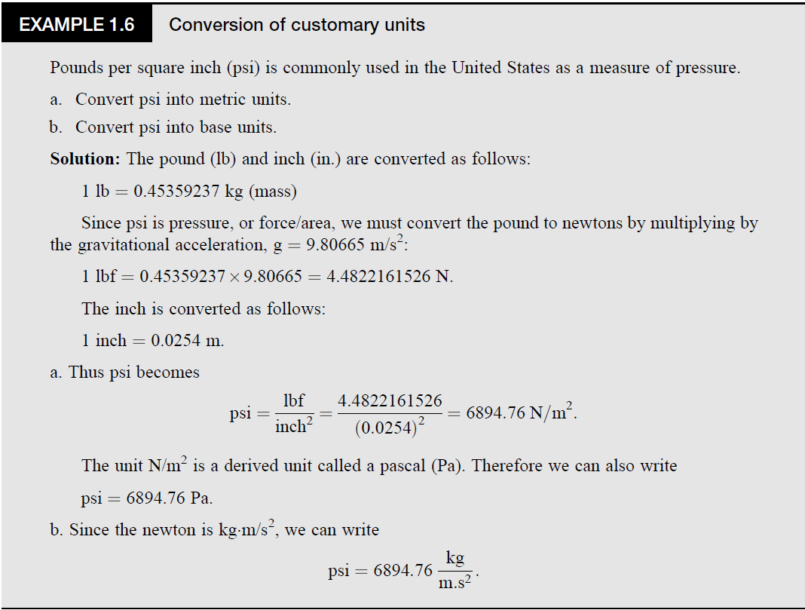

Slide 88
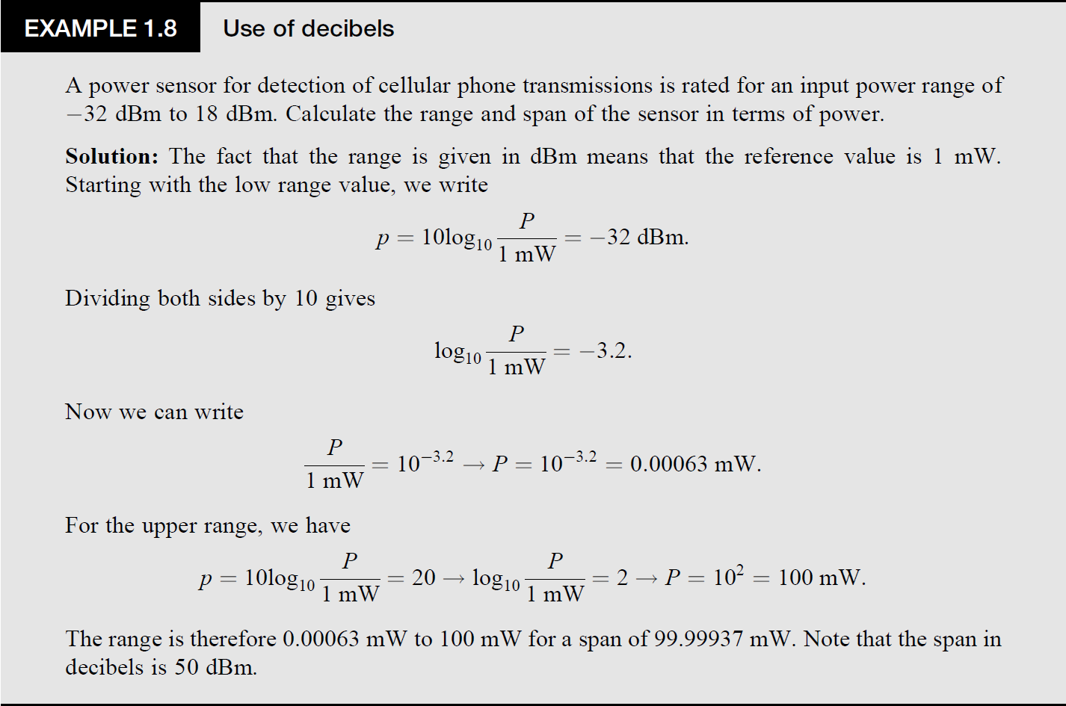

Slide 89
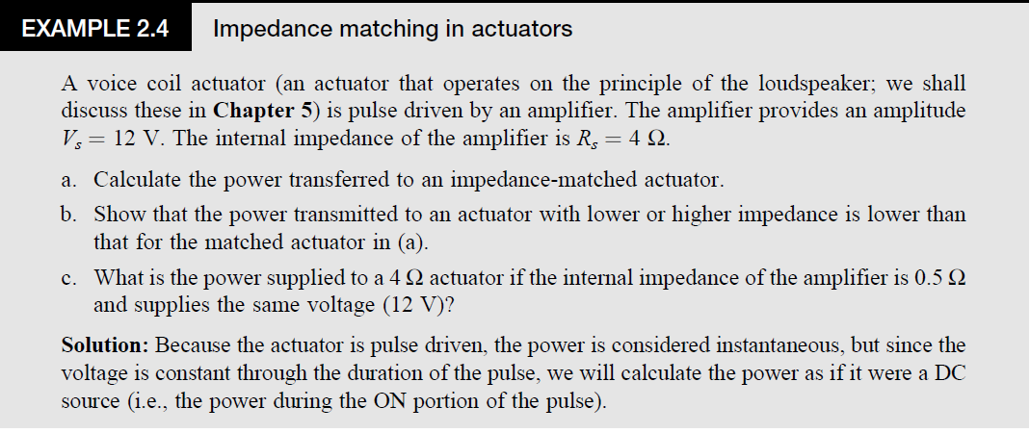
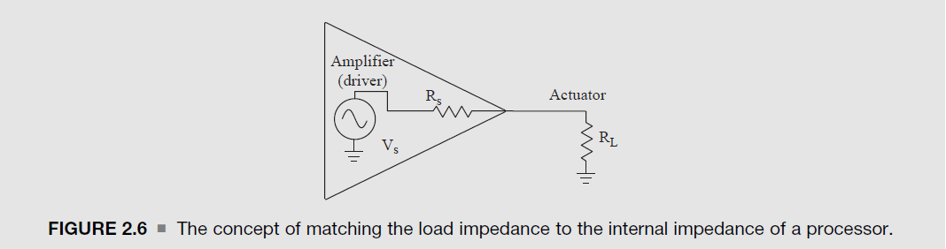

Slide 90
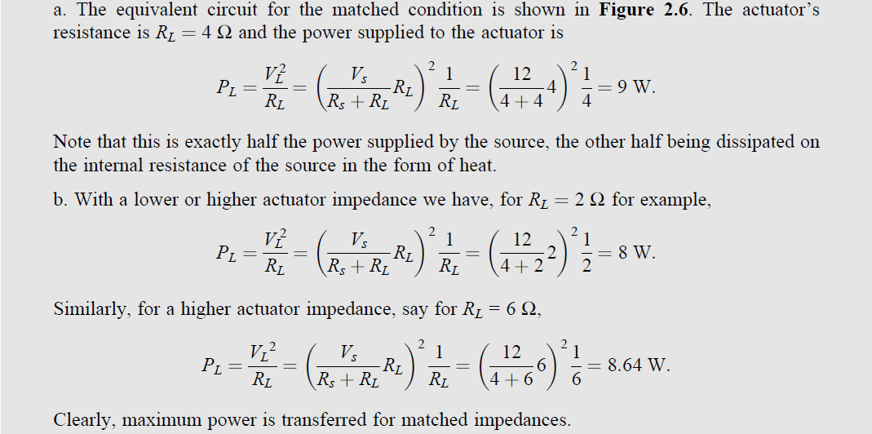

Slide 91
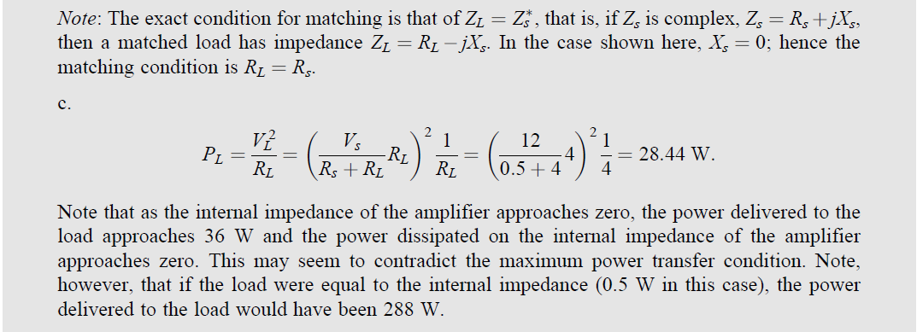

Slide 92
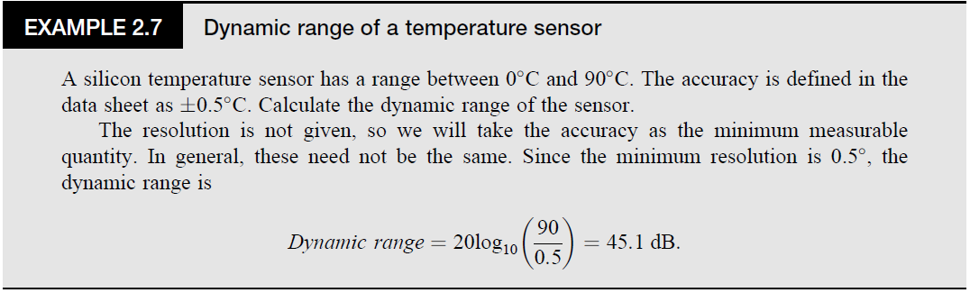
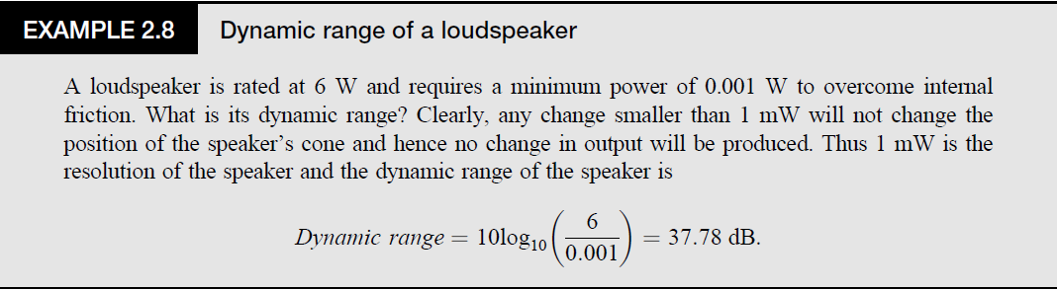

Slide 93
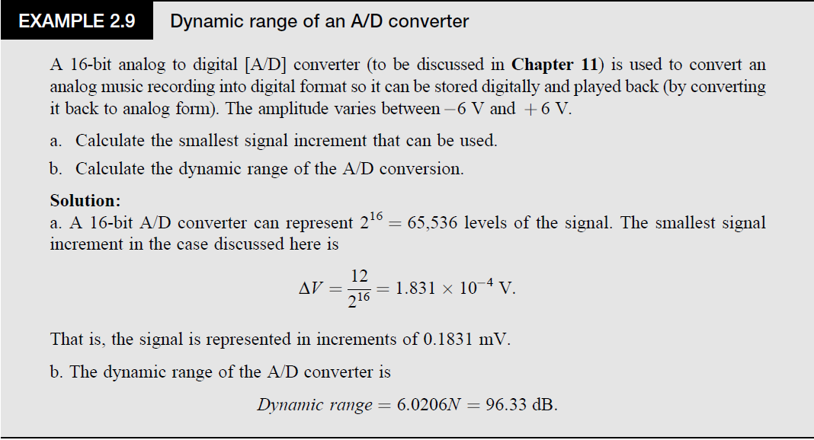
Note:

Slide 94


Slide 95


