Slide 1

15ECC18 – SENSORS AND ACTUATORS

Slide 2
UNIT II – OPTICAL SENSORS AND ACTUATORS
Optical Units and materials
Effects of Optical Radiation
Quantum-Based Optical Sensors
Photoelectric Sensors
Coupled Charge (CCD) Sensors and Detectors
Thermal-Based Optical Sensors
Active Far Infrared (AFIR) Sensors and
Optical Actuators.

Slide 3
INTRODUCTION
Optics is the science of light and light is an electromagnetic radiation that manifests itself either as an electromagnetic wave or as photons (particles with quanta of energy.
The visible spectrum of electromagnetic radiation as perceived by the human eye both below and above this spectrum the behavior of radiation is similar, the term light is normally extended to include a much wider spectrum that includes infrared (IR) radiation (below the frequency of visible light or ‘‘below red’’) and ultraviolet (UV) radiation (above the visible range or ‘‘above violet’’).
In characterizing light it is more common to use wavelength, defined as the distance in meters the light wave propagates in one cycle or λ= c/f, where c is the speed of light and f is its frequency. The range of wavelengths in the visible light region is between 700 nm (deep red) and 400 nm (violet).

Slide 4
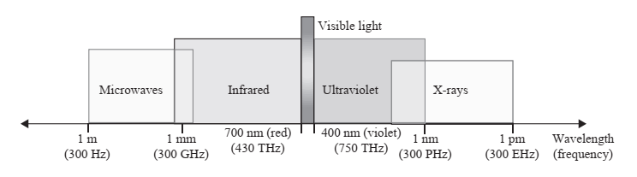
INTRODUCTION
Optical sensors are those sensors that detect electromagnetic radiation in what is generally understood as the broad optical range—from far IR to UV.
The sensing methods may rely on direct methods of transduction from light to electrical quantities such as in photovoltaic or photoconducting sensors or indirect methods such a conversion first into temperature variation and then into electrical quantities such as in passive IR (PIR) sensors and bolometers.

Slide 5
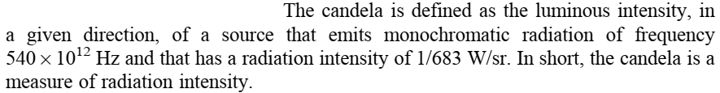
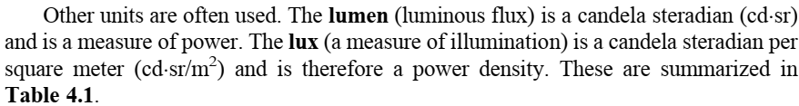
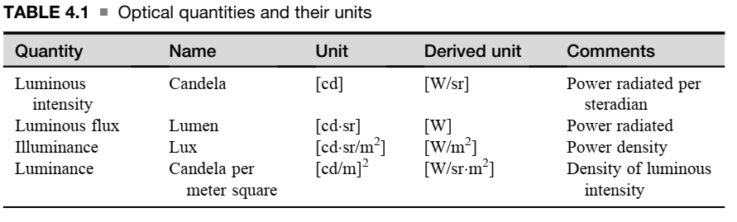
OPTICAL UNITS

Slide 6
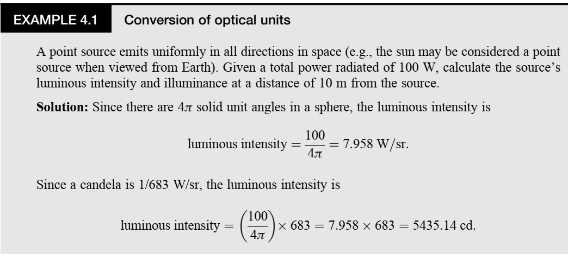
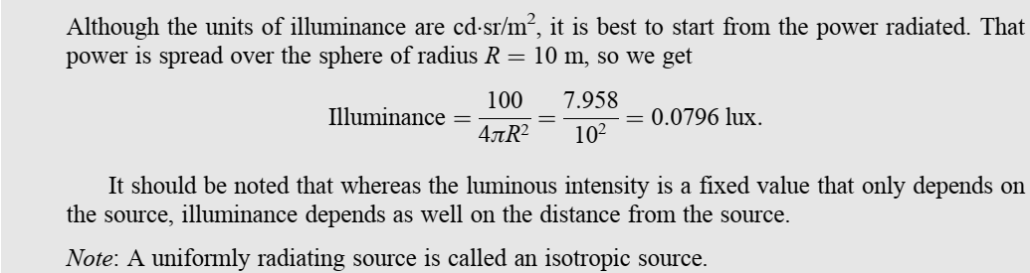
OPTICAL UNITS

Slide 7
MATERIALS
Many of the properties of materials are not specific to a single element, but rather belong to a group (often a column in the table of elements), and one can expect that if an element in a specific column is used for a given purpose, other elements from the same column may have similar properties and be equally useful.
For example, if potassium (alkali column I) is useful in the production of cathodes for photoelectric cells, then lithium, sodium, rubidium, and cesium should also be useful. But there are clear limits.
The elements in the VIII column—nickel, palladium, and platinum are used for various types of thermocouples together with elements from the I-B and II-B columns.
We shall refer to the periodic table often, but will also refer to many simple or complex compounds with specific properties that have been found to be useful in sensors and actuators.

Slide 8
EFFECTS OF OPTICAL RADIATION
Thermal Effects
The interaction of light (radiation) with matter results in absorption of energy in two distinct ways. One is thermal and is usually viewed as absorption of electromagnetic waves.
The other is a quantum effect. The thermal effect is based on electromagnetic energy absorbed by the medium and converted into heat through the increased motion of atoms. This heat is sensed and translated into a measure of the incident radiation.
The electrons gain kinetic energy and may be released given sufficient energy and, of course, that this interaction can be used for sensing.

Slide 9

EFFECTS OF OPTICAL RADIATION
Quantum Effects
1. The Photoelectric Effect
The second effect is a quantum effect and is governed by photons, the particle-like manifestation of radiation. In this representation of light, and in general radiation, energy travels in bundles (photons) whose energy is given by Plank’s equation

Slide 10

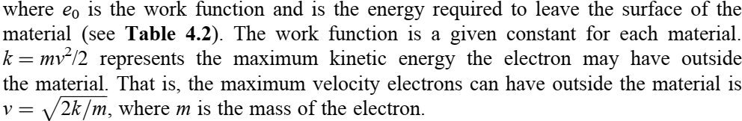
EFFECTS OF OPTICAL RADIATION
Quantum Effects
1. The Photoelectric Effect
The higher the frequency (the shorter the wavelength), the higher the photon energy.
In the quantum mode, energy is imparted to materials by elastic collision of photons and electrons.
The electrons acquire energy and this energy allows the electron to release itself from the surface of the material by overcoming the work function of the substance. Any excess energy imparts the electron kinetic energy.
This theory was first postulated by Albert Einstein in his photon theory, which he used to explain the photoelectric effect in 1905 (and for which he received the Nobel Prize). This is expressed as

Slide 11
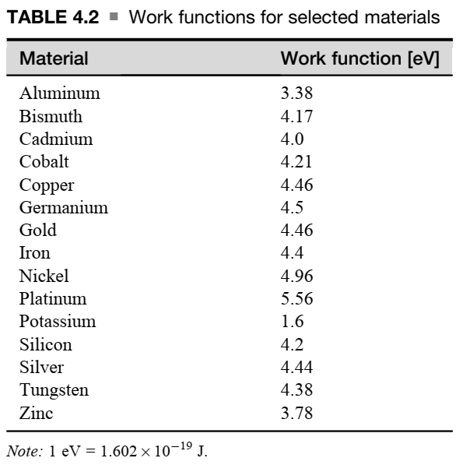
EFFECTS OF OPTICAL RADIATION
Quantum Effects
1. The Photoelectric Effect

Slide 12

EFFECTS OF OPTICAL RADIATION
Quantum Effects
1. The Photoelectric Effect
A photon with energy higher than the work function will, in principle, release an electron and impart a kinetic energy.
But does in fact each photon release an electron?
That depends on the quantum efficiency of the process. Quantum efficiency is the ratio of the number of electrons released (N_{e}) to number of photons absorbed (N_{ph})
Clearly, for electrons to be released, the photon energy must be higher than the work function of the material. Since this energy depends on frequency alone, the frequency at which the photon energy equals the work function is called a cutoff frequency.
Below it quantum effects do not exist (except for tunneling effects) and only thermal effects are observed. Above it, thermal and quantum effects are present.
For this reason, low-frequency radiation (IR in particular) can only give rise to thermal effects, whereas at high frequencies (UV radiation and above) the quantum effect dominates.
In all of these methods, surface electrons are released.

Slide 13
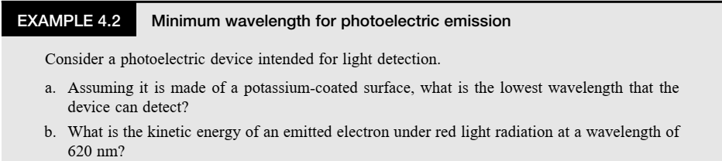
EFFECTS OF OPTICAL RADIATION
Quantum Effects
1. The Photoelectric Effect

Slide 14
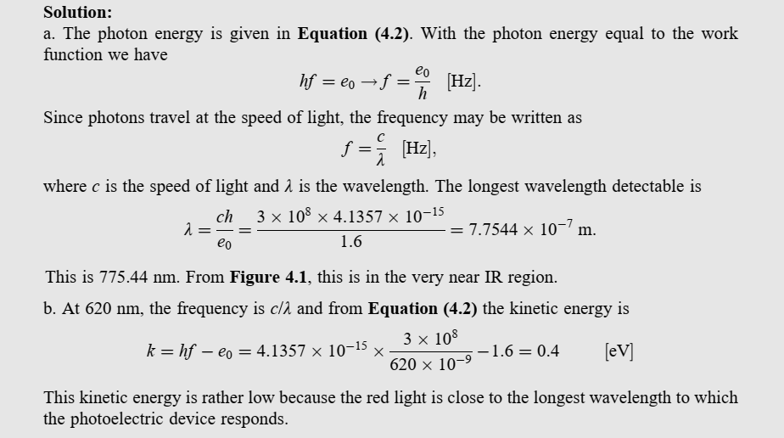
EFFECTS OF OPTICAL RADIATION
Quantum Effects
1. The Photoelectric Effect

Slide 15
EFFECTS OF OPTICAL RADIATION
Quantum Effects
2. Quantum Effects: The Photoconducting Effect
Many modern sensors are based on quantum effects in the solid state, and particularly in semiconductors. Although some electrons may still leave the surface based on the photoelectric effect, when a semiconductor material is subjected to photons they can transfer the energy to electrons.
If this energy is sufficiently high, the electrons become mobile, resulting in an increase in the conductivity of the material and, as a result, in an increase in current through the material.
This current or its effects become a measure of the radiation intensity (visible light, UV radiation, and, to a lesser extent, IR radiation) that strikes the material.
The model for this effect is shown in Figure 4.2a.

Slide 16
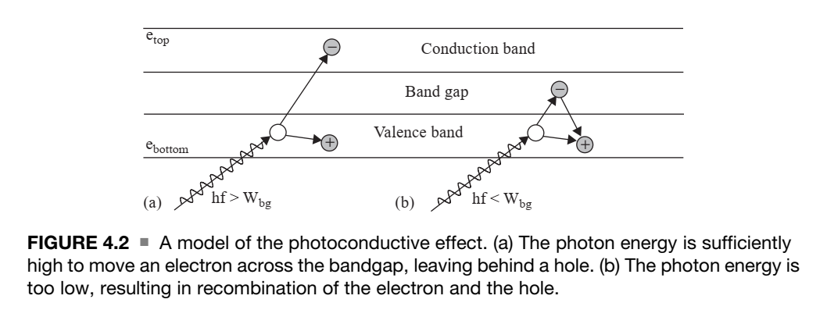
EFFECTS OF OPTICAL RADIATION
Quantum Effects
2. Quantum Effects: The Photoconducting Effect

Slide 17
EFFECTS OF OPTICAL RADIATION
Quantum Effects
2. Quantum Effects: The Photoconducting Effect
Electrons are normally in the valence band—they are bound to lattice sites within the crystal (i.e., bound to the atoms that make up the crystal) and have specific densities and momentum.
Valent electrons are those that are bound to an individual atom. Covalent electrons are also bound, but are shared between two neighboring atoms in the crystal.
An electron can only move into the conduction band if its energy is larger than the energy gap (bandgap energy, W_{bg}) specific to the material and if the momentum of the site in the conducting band is the same as the momentum of the electron in the valence band (law of conservation of momentum).
This energy may be supplied thermally, but here we are interested in energy absorbed from photons. If the radiation is of sufficiently high frequency (sufficiently energetic photons), valence or covalence electrons may be released from their sites and moved across the bandgap into the conduction band.

Slide 18
EFFECTS OF OPTICAL RADIATION
Quantum Effects
2. Quantum Effects: The Photoconducting Effect
There are two mechanisms for this transition to occur
In direct bandgap materials, the momentum in the top of the valence band and in the bottom of the conduction band are the same and an electron can transit without the need for a change in momentum, provided it acquires sufficient energy from the photon interaction.
In indirect bandgap materials, the electron must interact with the crystal lattice to either gain or lose momentum before it can occupy a site in the conduction band.
This process is characterized by a lattice vibration called a phonon and is a less efficient process than that in direct bandgap materials.
When in the conduction band, electrons are mobile and free to move as a current.
When electrons leave their sites, they leave behind a ‘‘hole,’’ which is simply a positive charge carrier. This hole may be taken by a neighboring electron with little additional energy and therefore, in semiconductors, the current is due to the net concentrations of electrons and holes.

Slide 19

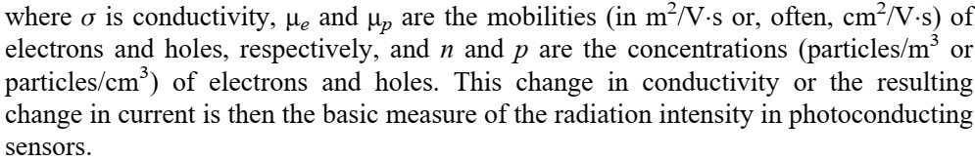
EFFECTS OF OPTICAL RADIATION
Quantum Effects
2. Quantum Effects: The Photoconducting Effect
The release of electrons is manifested as a change in the concentration of electrons in the conduction band and of holes in the valence band.
The conductivity of the medium is due to the concentrations of both carriers and their mobilities:
Therefore semiconductors are the obvious choice for sensors based on the photoconducting effect, whereas conductors will most often be used in sensors based on the photoelectric effect.

Slide 20
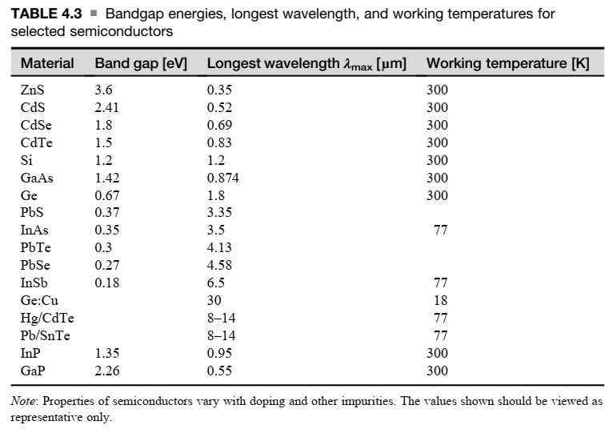
EFFECTS OF OPTICAL RADIATION
Quantum Effects
2. Quantum Effects: The Photoconducting Effect

Slide 21
EFFECTS OF OPTICAL RADIATION
Quantum Effects
2. Quantum Effects: The Photoconducting Effect
From Table 4.3, it is clear that some semiconductors are better suited for low frequency radiation whereas others are better at high-frequency radiation.
The lower the bandgap, the more effective the semiconductor will be at detection at low frequencies (long wavelength, hence lower photon energies).
The longest wavelength specified for the material is called the maximum useful wavelength, above which the effect is negligible.
For example, InSb (indium antimony) has a maximum wavelength of 5.5 μm making it useful in the near IR range. Its bandgap is very low, which also makes it very sensitive.
It is often necessary to cool these long-wavelength sensors to make them useful by reducing the thermal noise. The third column in Table 4.3 shows the (highest) working temperature of the material.

Slide 22
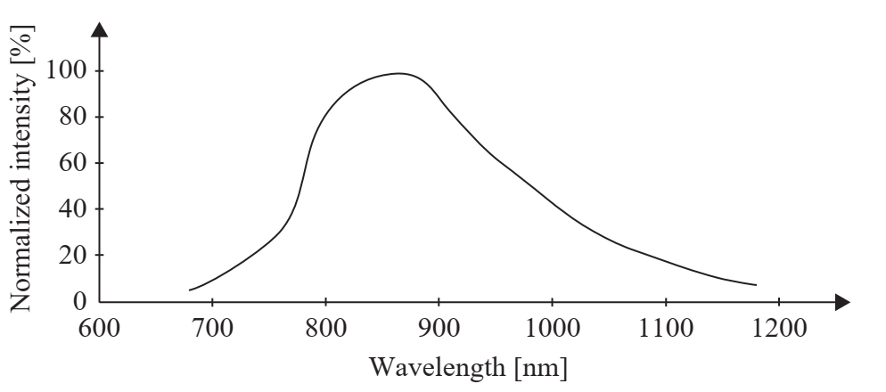
EFFECTS OF OPTICAL RADIATION
Quantum Effects
3. Spectral Sensitivity
Each semiconducting material has a range of the spectrum in which it is sensitive, given as a function of frequency or wavelength.
The upper range (longest wavelength or minimum energy) is defined by the bandgap Above the bandgap, the response of a material increases steadily to a maximum and then decreases.
The reason for the increase and decrease in response is that electron density and momentum are highest in the middle of the valence band and taper off to zero at its boundaries.
Spectral sensitivity of a semiconductor

Slide 23
EFFECTS OF OPTICAL RADIATION
Quantum Effects
4. Tunnelling Effect
Another important quantum effect is the tunneling effect in semiconductor devices. A simple explanation of this curious effect is that although carriers may not have sufficient energy to go ‘‘over’’ the gap, they can tunnel ‘‘through’’ the gap.
The tunneling effect explains behavior on the microscopic level that cannot be explained through classical physics.
Semiconductor devices based on this effect, particularly tunnel diodes, are common, and the effect is used extensively in optical sensors.

Slide 24
QUANTUM-BASED OPTICAL SENSORS
Sensors
Optical sensors are divided into two broad classes:
quantum sensors (or detectors) and thermal sensors (or detectors).
A quantum optical sensor is any sensor based on the quantum effects that include photoelectric and photoconductive sensors as well as photodiodes and phototransistors
Thermal optical sensors are mostly encountered in the IR region and come in many variations, including passive infrared (PIR) sensors, active far infrared (AFIR) sensor bolometers, and others

Slide 25
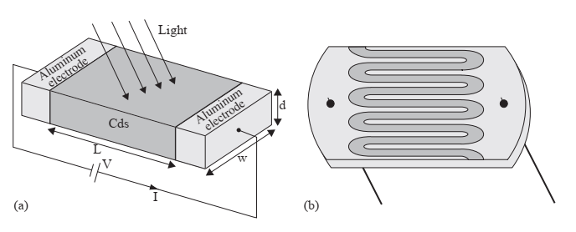
QUANTUM-BASED OPTICAL SENSORS
Photoconducting Sensors
Photoconducting sensors, or as they are sometimes called, photoresistive sensors or photoresistive cells, are possibly the simplest optical sensors.
They are made from a semiconducting material connected to two conducting electrodes and are exposed to light through a transparent window. A schematic view of the sensor is shown in Figure 4.4a.
Materials used for these sensors are cadmium sulfide (CdS), cadmium selenide (CdSe), lead sulfide (PbS), indium antimonide (InSb), and others, depending on the range of wavelengths for which the sensor is designed to operate and other requisite properties of the sensor.
CdS is the most common material.
Figure 4.4a
Structure of a photoconductive sensor. (a) Simple electrodes. (b) Schematic of a sensor showing the connections

Slide 26
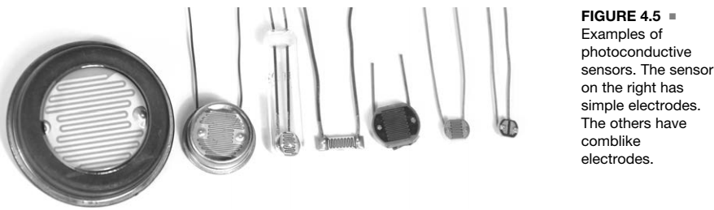
QUANTUM-BASED OPTICAL SENSORS
Photoconducting Sensors
In terms of construction, the electrodes are typically set on top of the photoconductive layer, which in turn is placed on top of a substrate layer.
The electrodes may be very simple (Figure 4.4a) or may resemble a meandering or comblike shape (Figure 4.4b), depending on requirements.
In either case, the area exposed between the electrodes is the sensitive area.
Figure 4.5 shows a few sensors of various sizes and construction.
The photoconductor is an active sensor that must be connected to a source.
The current through or the voltage on the sensors is taken as the output, but what changes with light intensity is the conductivity of the semiconductor and hence its resistance .

Slide 27
QUANTUM-BASED OPTICAL SENSORS
Photoconducting Sensors
The conductivity of the device, given in Equation (4.4), results from the charge of electrons e, the mobilities of electrons and holes (μe and μp), and the concentrations of electrons n and holes p from whatever source.
In the absence of light, the material exhibits what is called dark conductivity, which in turn results in a dark current. Depending on the construction and materials, the resistance of the device may be very high (a few megaohms) or may be in the range of a few kilo-ohms.
When the sensor is illuminated, its conductivity changes (the conductivity increases and hence the resistance decreases) depending on the change in carrier concentrations (excess carrier concentrations). This change in conductivity is,

Slide 28
QUANTUM-BASED OPTICAL SENSORS
Photoconducting Sensors
The carriers are generated by the radiation at a certain generation rate (the number of electrons or holes per second per unit volume), but they also recombine at a set recombination rate.
The generation and recombination rates depend on a variety of properties, including the absorption coefficient of the material, dimensions, incident power density (of the radiation) wavelength, and the carrier lifetime.
Under this condition, the change in conductivity may be written as
Although carrier generation is in pairs, if the preexisting carrier density of one type dominates, the excess carrier density of the second type will be negligible with respect to the density of the dominant carrier.
If electrons dominate, the material is said to be an n-type semiconductor, whereas if the dominant carriers are holes, the semiconductor is said to be p-type semiconductor.

Slide 29


QUANTUM-BASED OPTICAL SENSORS
Photoconducting Sensors
An important property of a photoresistor is its sensitivity to radiation. Sensitivity, also called gain, is given as
Sensitivity gives the ratio of carriers generated per photon of the input radiation.
To increase sensitivity, one should select materials with high carrier lifetimes, but one must also keep the length of the photoresistor as small as possible.
It can be achieved through the meander construction. The meander shape ensures the distance between two electrodes is reduced for a given exposure area. It also reduces the resistance of the sensor that,

Slide 30


QUANTUM-BASED OPTICAL SENSORS
Photoconducting Sensors
The excess carrier density depends on the power absorbed by the photoconductor. Since the photons have an energy hf, we can write the total number of excess carrier pairs released per unit time as,
power density P
a fraction T of this power penetrates into the photoconductor
Assuming carrier generation is uniform throughout the volume of the photoconductor (an assumption only valid for thin photoconductors), we can calculate the rate at which carriers are generated per unit volume per second:

Slide 31

QUANTUM-BASED OPTICAL SENSORS
Photoconducting Sensors
As mentioned before, the recombination rate influences the net excess carrier density. The carrier density (concentration) is then obtained by multiplying the rate of generation by the lifetime of the carriers, t:
Some of the various terms in Equation (4.11) are not necessarily constant with concentrations and some may only be estimates as well as being temperature dependent.
However, the equation shows the link between light intensity and excess carrier concentration and hence the dependence of conductivity on light intensity.
Other parameters to consider are the response time of the sensor, its dark resistance the range of resistance for the span of the sensor, and the spectral response of the sensor.
Noise in photoconducting sensors is another important factor. Much of the noise is thermally induced and becomes worse at longer wavelengths. Hence many IR sensors must be cooled for proper operation.

Slide 32
QUANTUM-BASED OPTICAL SENSORS
Photoconducting Sensors
From a sensor production point of view, photoresistive sensors are made either as a single crystal semiconductor, by deposition of the material on a substrate, or by sintering.
Usually sensors made by deposition are the least expensive, whereas single crystal sensors are the most expensive, but with better properties.
Special Sensors
The most common materials for inexpensive sensors are CdS and CdSe.
CdS and CdSe can also be sintered.
CdS tends to respond better at shorter wavelengths (violet) while CdSe responds better at longer wavelengths (red)
Single crystal sensors are those made from indium antimonide (InSb)
In the far IR, mercury cadmium telluride (HgCdTe) and germanium boronide (GeB) materials may be used.

Slide 33
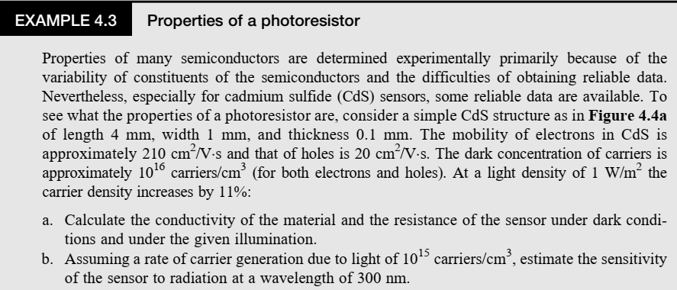
QUANTUM-BASED OPTICAL SENSORS
Photoconducting Sensors

Slide 34
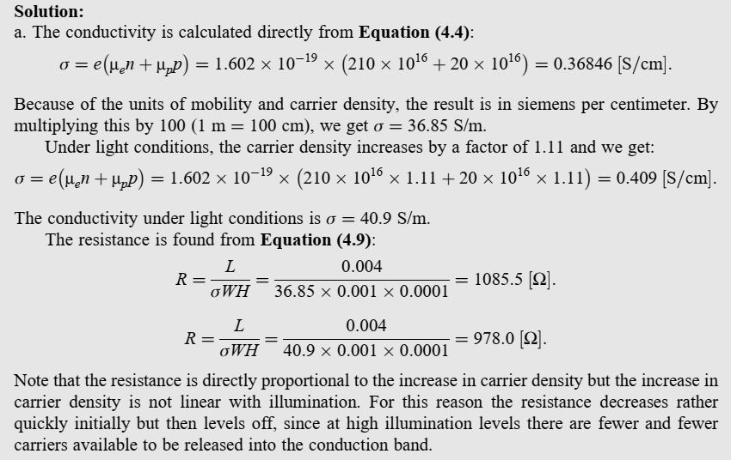
QUANTUM-BASED OPTICAL SENSORS
Photoconducting Sensors

Slide 35
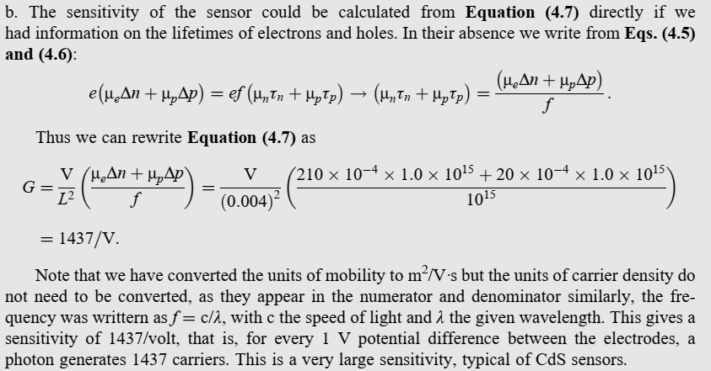
QUANTUM-BASED OPTICAL SENSORS
Photoconducting Sensors

Slide 36
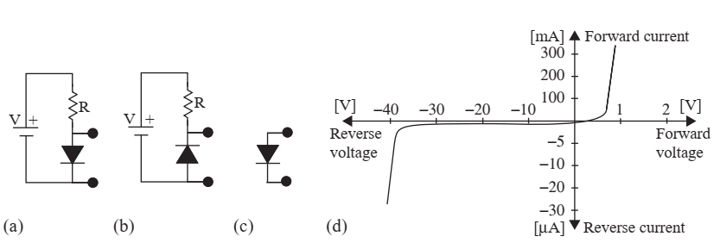
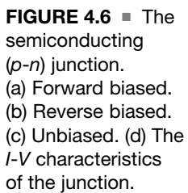
QUANTUM-BASED OPTICAL SENSORS
Photodiodes

Slide 37
QUANTUM-BASED OPTICAL SENSORS
Photodiodes
the junction of a semiconducting diode is exposed to light radiation, the generation of excess carriers due to photons adds to the existing charges in the conduction band exactly in the same fashion as for a pure semiconductor.
The diode itself may be reverse biased (Figure 4.6a), forward biased (Figure 4.6b), or unbiased (Figure 4.6c). Figure 4.6d shows the current–voltage (I-V) characteristics of the diode.
Of the three configurations in Figure 4.6, the forward-biased mode is not useful as a photosensor because in this mode the normal current (not due to photons) is large in comparison to the current generated by photons.
In the reverse-biased mode, the diode carries a minute current (i.e., a ‘‘dark’’ current) and the increase in current due to photons is large in comparison. In this mode the diode operates in a manner similar to the photoconducting sensor and is therefore called the photoconducting mode of the diode. If the diode is not biased it operates as a sensor in the photovoltaic mode (Figure 4.6c)

Slide 38
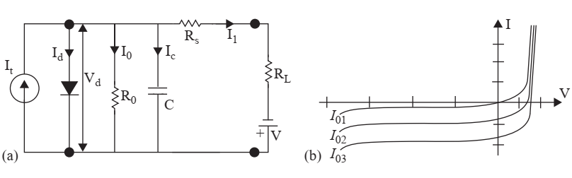
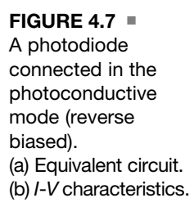
QUANTUM-BASED OPTICAL SENSORS
Photodiodes

Slide 39
QUANTUM-BASED OPTICAL SENSORS
Photodiodes
The equivalent circuit of a diode in the photoconductive mode (Figure 4.6b) is shown in Figure 4.7a.
In addition to the current that would exist in the ideal diode (Id) there is also a leakage current (I₀) defined by the ‘‘dark’’ resistance R₀ and a current through the capacitance (I_{c}) of the junction.
The series resistance R_{s} is due to conductors connecting the diode. The photons release electrons from the valence band either on the p or n side of the junction.
These electrons and the resulting holes flow toward the respective polarities (electrons toward the positive pole, holes toward the negative pole) generating a current, which in the absence of a bias current in the diode constitutes the only current (the diode is reverse biased).
In practice there will be a small leakage current, shown in the equivalent circuit as I₀. The attraction of electrons by the positive pole will tend to accelerate them and in the process they can collide with other electrons and release them across the bandgap, especially if the reverse voltage across the diode is high.
This is called an avalanche effect and results in multiplication of the carriers available. Sensors that operate in this mode are called photomultiplier sensors.

Slide 40
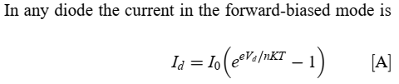
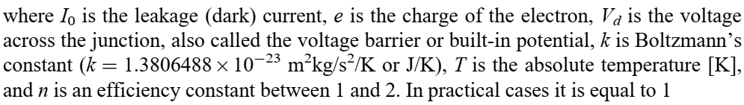
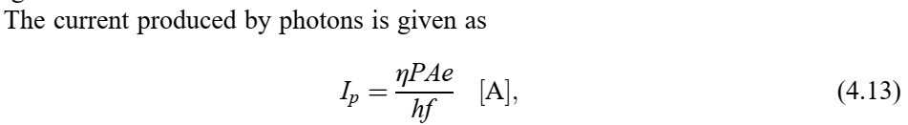
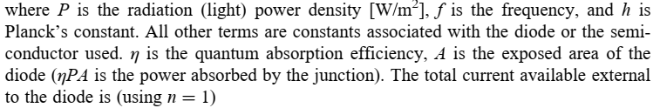
QUANTUM-BASED OPTICAL SENSORS
Photodiodes

Slide 41
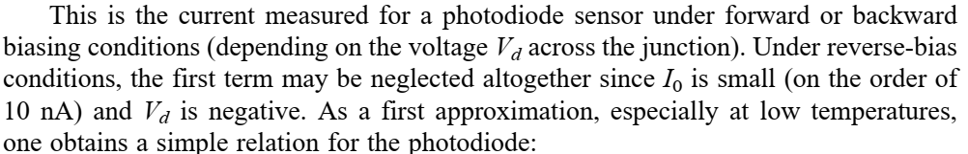

QUANTUM-BASED OPTICAL SENSORS
Photodiodes

Slide 42
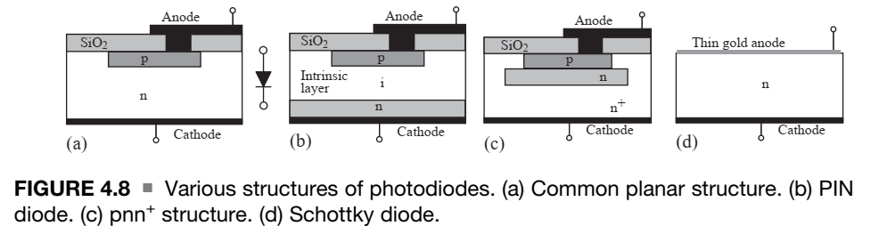
QUANTUM-BASED OPTICAL SENSORS
Photodiodes
Any diode can serve as a photodiode, provided that the n region, p region, or p-n junction are exposed to radiation.

Slide 43
QUANTUM-BASED OPTICAL SENSORS
Photodiodes
Taking as an example the planar diffusion type of diode shown in Figure 4.8, it consists of p and n layers and two contacts. The region immediately below the p layer is the so-called depletion region, which is characterized by an almost total absence of carriers. This is essentially a regular diode. To increase dark resistance (lower dark current), the p layer may be covered with a thin layer of silicon dioxide (SiO2) (Figure 4.8a).
The addition of an intrinsic layer of the semiconductor between the p and n layers produces the so-called PIN photodiode, which, because of the high resistance of the intrinsic layer, has lower dark current and lower junction capacitance (and hence better time response) (Figure 4.8b).
The exact opposite is true in the pnn þ construction in which a thin, highly conductive layer is placed at the bottom of the diode. This reduces the resistance of the diode and improves low-wavelength sensitivity (Figure 4.8c).
Another way of altering the response of a diode is through the use of a Schottky junction. In this diode, the junction is formed by use of a thin layer of sputtered conducting material (gold) on an n layer (the Schottky junction is a metal–semiconductor junction) (Figure 4.8d). This produces a diode with a very thin outer layer (metal) above the n layer, improving its long wavelength (IR) response.

Slide 44
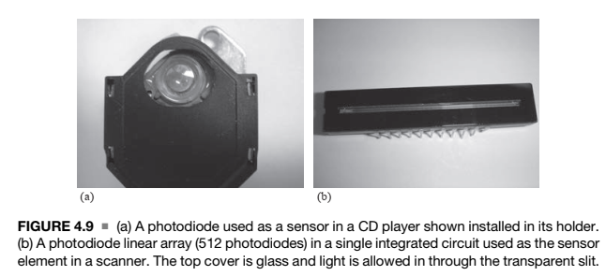
QUANTUM-BASED OPTICAL SENSORS
Photodiodes
A diode with high reverse bias may operate in avalanche mode, increasing the current and providing a gain or amplification (photomultiplier diode).
The main requirement needed to obtain avalanche is the establishment of a high reverse electric field across the junction (on the order of 107 V/m or higher) to provide sufficient acceleration of electrons.
In addition, low noise is essential. Avalanche photodiodes are available for high-sensitivity, low light level applications.

Slide 45
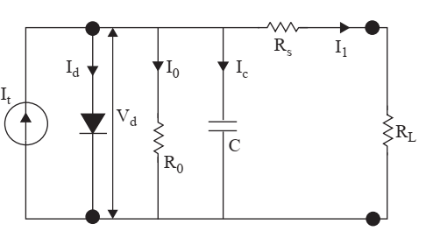
QUANTUM-BASED OPTICAL SENSORS
Photovoltaic diodes
Photodiodes may also operate in photovoltaic mode
Photodiode connected in the photovoltaic mode—equivalent circuit. The diode is unbiased

Slide 46
QUANTUM-BASED OPTICAL SENSORS
Photovoltaic diodes
In this mode the diode is viewed as a generator and requires no biasing. The best known structure for photovoltaic diodes is the solar cell, which is a photodiode with a particularly large exposed area.
All photodiodes can operate in this mode, but as a rule, the larger the surface area, the larger the junction capacitance. This capacitance is the main reason for the reduced time response of photovoltaic cells.
In most other respects photodiodes operating in photovoltaic mode have the same properties as photodiodes operating in photoconducting mode. There are differences as well.
For example, the avalanche effect cannot exist in this mode since there is no bias. Figure 4.11 shows the equivalent circuit for a photovoltaic cell.
Although typically used in photovoltaic arrays for solar power generation as well as smaller arrays used to power small appliances (such as calculators), the photovoltaic diode also makes an exceedingly simple light sensor that needs little more than a voltmeter to measure light power density or light intensity.

Slide 47


QUANTUM-BASED OPTICAL SENSORS
Photovoltaic diodes
Although the photovoltaic diode operates without a bias, under normal operation a voltage develops across the junction and the total current is described by Equation (4.14), where the first term is the normal diode current and the second is the photocurrent.
There are two important points in the operation of the diode. The first is the short-circuit current. If the diode is short-circuited, the voltage across the diode is zero and the only current that may exist is the photocurrent. Thus
The second term is the open circuit voltage, characterized by the fact that the normal diode current equals the photocurrent. The open circuit voltage, Voc, can then be evaluated from this balance
Clearly Voc is equal to the built-in potential or potential barrier, which depends on the material, doping, and, through carrier concentration, temperature.

Slide 48
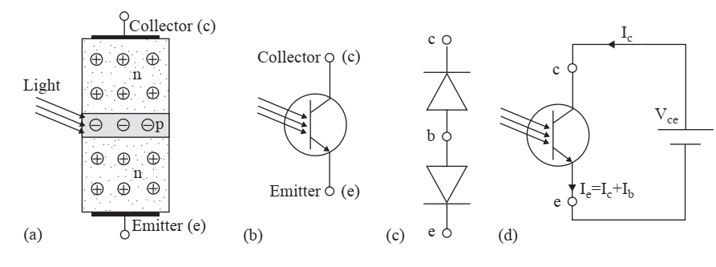
QUANTUM-BASED OPTICAL SENSORS
Phototransistors
FIGURE 4.15 An npn phototransistor.
Schematic structure and junctions.
The circuit schematic.
The two junctions form diodes as shown.
The biasing of a phototransistor

Slide 49


QUANTUM-BASED OPTICAL SENSORS
Phototransistors
The phototransistor can be viewed as two diodes connected back to back, as shown in Figure 4.15 for an npn transistor. With the bias shown, the upper diode (the collector– base junction) is reverse biased while the lower (base–emitter) junction is forward biased.
In a regular transistor, a current I_{b} injected into the base is amplified using the following simple relation:
The emitter current Ie is
The relations above apply to any transistor. When a transistor is made into a phototransistor, its base connection is usually eliminated and a provision is made for the radiation to reach the collector–base junction. The device operates as a regular transistor with its base current supplied by the photon interaction with the collector–base junction (which is reverse biased).

Slide 50



QUANTUM-BASED OPTICAL SENSORS
Phototransistors
Under dark conditions, the collector current is small and is almost entirely due to leakage currents, designated here as I₀. This causes a dark current in the collector and emitter as,
When the junction is illuminated, the diode current is the current due to photons obtained
The collector and emitter currents are then

Slide 51
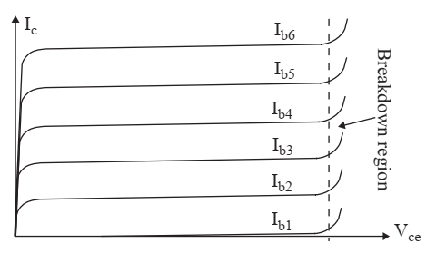
QUANTUM-BASED OPTICAL SENSORS
Phototransistors
Clearly then the operation of the phototransistor is identical to that of the photodiode except for the amplification, β, provided by the transistor structure. Since β, for even the simplest transistors, is on the order of 100 (and can be much higher), and the amplification is linear in most of the operation range (see Figure 4.16), the phototransistor is a very useful device and is commonly used for detection and sensing.
FIGURE 4.16
The I-V characteristics of a transistor as a function of base current. In a phototransistor the base current is supplied by photon interaction.

Slide 52
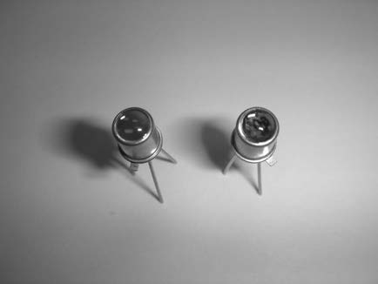
QUANTUM-BASED OPTICAL SENSORS
Phototransistors
A simple lens is also provided to concentrate the light on the junction, which for transistors is very small. A phototransistor equipped with a lens is shown in Figure.
Phototransistors equipped with lenses
Photoconducting sensors, photodiodes, and phototransistors can sense and measure directly the radiation power they absorb.
As such, they can be employed to sense position, distance, and dimensions, temperature, and color variations, in counting events, for quality control, and much more.

Slide 53
QUANTUM-BASED OPTICAL SENSORS
PHOTOELECTRIC SENSOR
The photoelectric effect relies on photons with energy hf impinging on the surface of a material.
The radiation is absorbed by giving this energy to electrons and these are emitted from the surface, provided the energy of the photon is higher than the work function of the material.
One can say that the collision between the photon and electron releases the electron if the energy exchanged is sufficiently high.
This effect has been applied directly to the development of photoelectric sensors

Slide 54
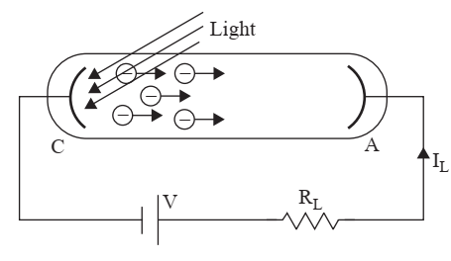
QUANTUM-BASED OPTICAL SENSORS
PHOTOELECTRIC SENSOR
Photoelectric sensor and biasing circuit

Slide 55
QUANTUM-BASED OPTICAL SENSORS
PHOTOELECTRIC SENSOR
The photocathode is made of a material with relatively low work function to allow efficient emission of electrons. These electrons are then accelerated toward the photoanode because of the potential difference between the anode and cathode. The current in the circuit is then proportional to radiation intensity.
The number of emitted electrons per photon is the quantum efficiency of the sensor and depends to a large extent on the material used for the photocathode.
More often, cesium-based materials are used because they have low work functions and fairly wide spectrum responses down to about 1000 nm (well into the IR region). Their response extends into the UV region as well.
In older devices, highly resistant cathodes were made of a metal such as tantalum or chromium and coated with alkali compounds (lithium, potassium, sodium, or cesium).
The electrodes are housed in an evacuated tube or in a tube with a noble gas (argon) at low pressure. The presence of gas increases the gain of the sensor by internal collisions between emitted electrons and the atoms of the gas through ionization of the gas.
Newer devices use so-called negative electron affinity (NEA) surfaces. These are constructed by evaporation of cesium or cesium oxide onto a semiconductor’s surface.
Classical photoelectric sensors require relatively high voltages for operation to supply useful sensing currents.
Negative electron afirity devices operate at much lower potentials

Slide 56
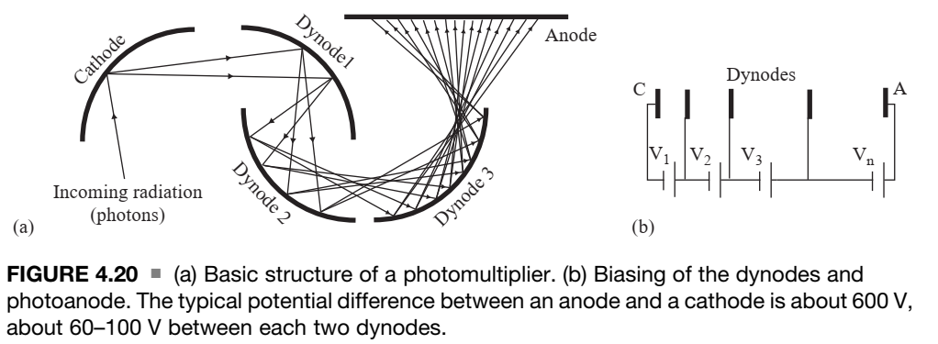
QUANTUM-BASED OPTICAL SENSORS
Photomultipliers

Slide 57
QUANTUM-BASED OPTICAL SENSORS
Photomultipliers
Photomultipliers are a development of the classical photoelectric sensor. Whereas in a photoelectric sensor the current is low (the number of electrons emitted is small), photomultipliers, as their names imply, multiply the available current, resulting in sensors that are considerably more sensitive than the simple photoelectric cell. The construction is shown schematically in Figure 4.20.
It consists of an evacuated tube (or a low-pressure gas-filled tube) made of metal, glass, or metal-coated glass with a window for the incoming radiation. The photocathode and photoanode of the basic photoelectric cell are maintained, but now there is a sequence of intermediate electrodes, as shown in Figure 4.20a.
The intermediate electrodes are called dynodes are made of materials with low work functions, such as beryllium copper (BeCu), and are placed at potential differences with respect to preceding dynodes, as shown in Figure 4.20b.

Slide 58

QUANTUM-BASED OPTICAL SENSORS
Photomultipliers - Operation
The operation is as follows:
The incident radiation impinges on the cathode and releases a number of electrons, say, n. These are accelerated toward the first dynode by the potential difference, V₁.
These electrons now have sufficient energy to release, say, n₁ electrons for each impinging electron. The number of electrons emitted from the first dynode is n × n₁.
These are again accelerated toward the second dynode, and so on, until they finally reach the photoanode.
The multiplication effect at each dynode results in a very large number of electrons reaching the photoanode for each photon impinging on the cathode.
Assuming there are k dynodes (10–14 is not unusual) and n is the average number of electrons emitted per dynode (secondary electrons), the gain may be written as
This gain is the current amplification of the photomultiplier and depends on the construction, the number of dynodes, and the accelerating interelectrode voltages.

Slide 59


QUANTUM-BASED OPTICAL SENSORS
Photomultipliers - Maximum Performance
First, electrons must be ‘‘forced’’ to transit between electrodes at about the same time to avoid distortions in the signal.
To do so the dynodes are often shaped as curved surfaces that also guide the electrons toward the next dynode.
Additional grids and slats are added for the same purpose, to decrease transit time and improve quality of the signal, especially when the photomultiplier is used for imaging.
Because of the multiplying effect, noise is particularly important in photomultipliers.
The dark current in a photomultiplier is given as

Slide 60
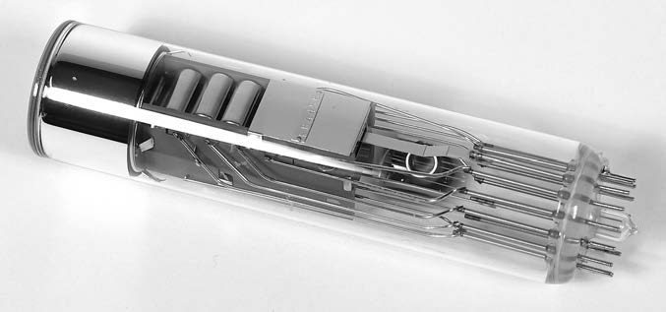
QUANTUM-BASED OPTICAL SENSORS
Photomultipliers - Performance considerations
Because of the multiplying effect, noise is particularly important in photomultipliers.
the shot noise due to fluctuations in the current of discrete electrons and multiplication noise due to the statistical spread of electrons limits the sensitivity of the device.
Photomultipliers is susceptibility to magnetic fields. Since magnetic fields apply a force on moving electrons, they can force electrons out of their normal paths reducing their gain and, more critically, distorting the signal.
Applications
With proper construction an exceedingly sensitive device can be made. These sensors are therefore used for very low light applications, such as in night vision systems. For example, a photomultiplier sensor may be placed at the focal point of a telescope to view extremely faint objects in space.
Photomultipliers are part of a broader class of devices called image intensifiers that use various methods to increase the current due to radiation. Because their output is sometimes the image itself, they are sometimes called light-to-light detectors.

Slide 61
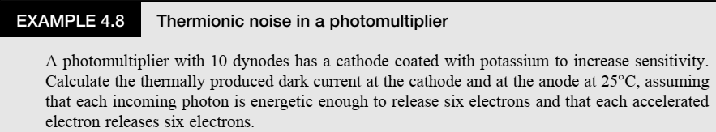
QUANTUM-BASED OPTICAL SENSORS
Photomultipliers - Problem

Slide 62
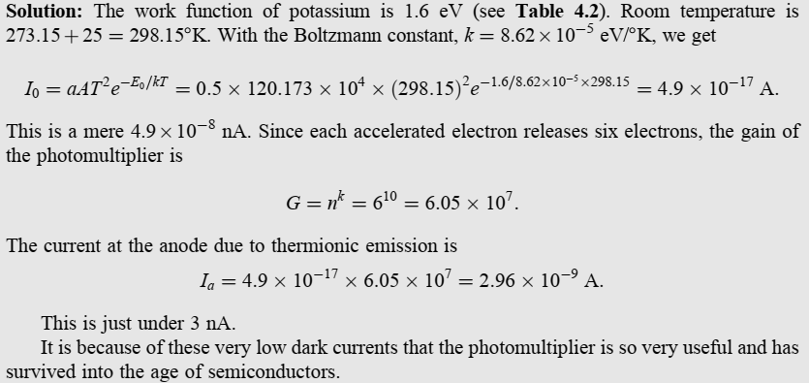
QUANTUM-BASED OPTICAL SENSORS
Photomultipliers - Problem

Slide 63
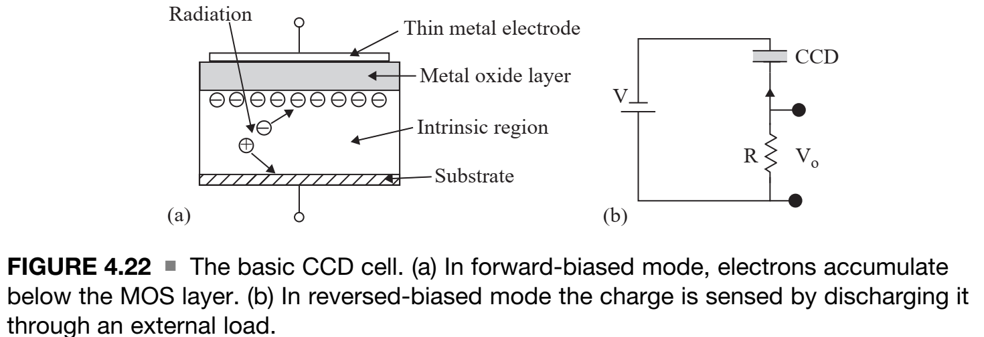
COUPLED CHARGE (CCD) SENSORS AND DETECTORS
Charge coupled devices (CCD) Cell

Slide 64
COUPLED CHARGE (CCD) SENSORS AND DETECTORS
Charge coupled devices (CCD) Operation
Charge coupled devices (CCD) are typically made of a conducting substrate on which a p- or –n type semiconductor layer is deposited. Above it lies a thin insulating layer made of silicon dioxide to insulate the silicon from a transparent conducting layer above it, as shown in Figure 4.22a.
The conductor (also called a gate) and the substrate form a capacitor.
The gate is biased positively with respect to the substrate (for an n-type semiconductor). This bias causes a depletion region in the semiconductor and, together with the silicon dioxide layer, makes this structure a very high resistance device.
When optical radiation impinges on the device it penetrates through the gate and oxide layer to release electrons in the depletion layer.
The charge density released is proportional to the incident radiation intensity. These charges are attracted toward the gate but cannot flow through the oxide layer and are trapped there.

Slide 65
COUPLED CHARGE (CCD) SENSORS AND DETECTORS
Charge coupled devices (CCD) Measurement
There are a number of methods to measure the charge (and hence the radiation intensity that produced it).
In its simplest form, one can reverse bias the MOS device to discharge the electrons through a resistor, as shown in Figure 4.22b. The current through the resistor is a direct measure of the light intensity on the device. However, the main value of CCDs is in building one-dimensional (linear array) or two-dimensional arrays of MOS devices for the purpose of imaging. In such cases it is not possible to use the method in Figure 4.22b directly.
Rather, the basic method is to move the charges of each cell to the next in a kind of ‘‘musical chairs’’ sequence by manipulating gate voltages.
In this method the transfer is one cell per step and the current in the resistor for each step corresponds to a particular cell. This is shown in Figure 4.23a for one row in the two dimensional array.
At the end of this scan, the array can be scanned again to read a new image. The scan for a two-dimensional array is shown schematically in Figure 4.23b.

Slide 66
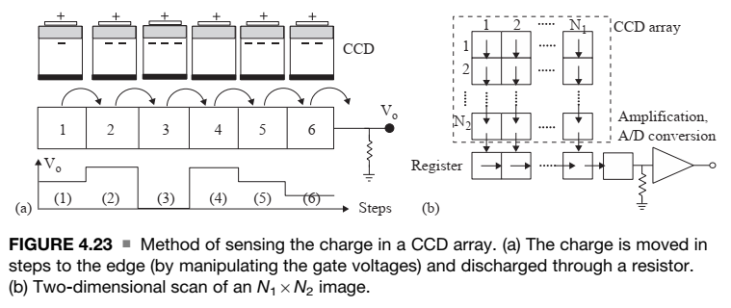
COUPLED CHARGE (CCD) SENSORS AND DETECTORS
Charge coupled devices (CCD) Measurement

Slide 67
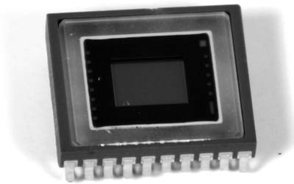
COUPLED CHARGE (CCD) SENSORS AND DETECTORS
Charge coupled devices (CCD) Measurement
The data are moved vertically one row at a time, that is, all cells move their data one row lower, whereas the lowest row moves it into a shift resister. The scan stops and the shift register is moved to the right to obtain the signal for one row (similar to that in Figure 4.23a). Then the next row is shifted until the whole array has been scanned.
In practice, each cell is equipped with three electrodes, each covering one-third of the cell and the time step described above is made of three pulses or phases.
All first electrodes in a row are connected to each other, all second electrodes in a row form a second phase, and all third electrodes in a row form the third phase. The phases are powered in sequence, moving all charge in each row downward one-third of the cell.
The signal obtained is typically amplified and digitized and used to produce the image signal, which can then be displayed on a display array such as a TV screen or a liquid crystal display.

Slide 68
THERMAL-BASED OPTICAL SENSORS
Introduction
The thermal effects of radiation, that is, conversion of radiation into heat, are most pronounced at lower frequencies (longer wavelengths) and are therefore most useful in the IR portion of the spectrum.
Almost any temperature sensor may be used to measure radiation as long as a mechanism can be found to transform radiation into heat.
In general, thermal radiation sensors are divided into two classes: PIR and AFIR.
In a passive sensor, radiation is absorbed and converted to heat. The temperature increase is measured by a sensing element to yield an indication of the radiative power.
In an active sensor, the device is heated from a power source and the variations in this power due to radiation (e.g., the current needed to keep the temperature of the device constant) give an indication of the radiation.

Slide 69
THERMAL-BASED OPTICAL SENSORS
Passive IR Sensors
A PIR sensor has two basic components:
An absorption section that converts radiation into heat and a proper temperature sensor that converts heat into an electrical signal.
The absorption section of the sensor must be able to both absorb as much of the incoming radiated power at the sensor’s surface as possible while at the same time quickly respond to changes in radiated power density.
Typically the absorber is made of a metal of good heat conductivity (gold is a common choice in high quality sensors) that is often blackened to increase absorption.
The volume of the absorber is kept small to improve response (quick heating/cooling) to changes in radiation and hence keep the response time reasonable.
Typically the absorber and the sensor are encapsulated or placed in a gas-filled or evacuated hermetic chamber to avoid variations in sensing signals due to the cooling effects of air motion.
The absorber is located behind a transparent (to IR radiation) window, often made of silicon, but other materials may be used (germanium, zinc selenide, etc.). The choice of the sensor materials and structure dictates to a large extent the sensitivity, spectral response, and physical construction of the device .

Slide 70
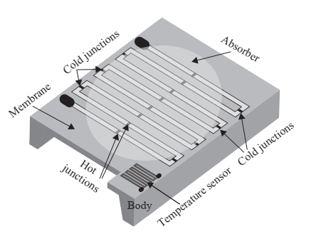
THERMAL-BASED OPTICAL SENSORS
Passive IR Sensors - Thermopile PIR
The structure of a PIR sensor showing the thermopile used to sense temperature (under an IR absorber).
A temperature sensor monitors the temperature of the cold junctions.

Slide 71
THERMAL-BASED OPTICAL SENSORS
Passive IR Sensors - Thermopile PIR
In this type of device, sensing is done by a thermopile. A thermopile is made of a number of thermocouples connected in series electrically but in parallel thermally (i.e., they are exposed to identical thermal conditions). Based on the thermoelectric effect, a thermocouple generates a small potential across a junction made of two different materials.
All ‘‘cold’’ junctions are held at a known (measured) lower temperature, while all ‘‘hot’’ junctions are held at the sensing temperature. In practical construction the cold junctions are placed on a relatively large frame that has a high thermal capacity and hence the temperature will fluctuate slowly while the hot junctions are in contact with the absorber, which is small and has a low heat capacity.
Although any pair of materials may be used, in most PIRs crystalline or polycrystalline silicon and aluminum are used because silicon has a very high thermoelectric coefficient and is compatible with other components of the sensor, whereas aluminum has a low temperature coefficient and can be easily deposited on silicon surfaces.
Other materials used (mostly in the past) are bismuth and antimony. The output of the thermocouple is the difference between the Seebeck coefficients of silicon and aluminum.
One of the most common applications of PIR sensors is in motion detection .

Slide 72
THERMAL-BASED OPTICAL SENSORS
Passive IR Sensors - Pyroelectric Sensors
The pyroelectric effect is an electric charge generated in response to heat flow through the body of a crystal. The charge is proportional to the change in temperature and hence the effect may be viewed as heat flow sensing rather than temperature sensing.
Pyroelectricity was formally named in 1824 by David Brewster, but its existence in tourmaline crystals was described in 1717 by Louis Lemery.
Pyroelectric sensorswere made of Rochelle salt (potassium sodium tartrate [KHC4H4O6]).
Currently there are many other materials used for this purpose, including barium titanate oxide (BaTiO3), lead titanate oxide (PbTiO3), as well as lead zirconium titanate (PZT) materials (PbZrO3), polyvinyl fluoride (PVF), and polyvinylidene fluoride (PVDF).

Slide 73

ACTIVE FAR INFRARED (AFIR) SENSORS
In its simplest form an active infrared (AFIR) sensor can be thought of as a power source that heats the sensing element to a temperature above ambient and keeps its temperature constant.
When used to sense radiation, additional heat is provided to the sensors through this radiation. The power necessary to keep the temperature constant is now reduced and the difference in power is a measure of the radiation power.
Assuming that the temperature of the sensing element is constant, the AFIR sensor can be viewed as being time independent.
Under these conditions the power supplied to the sensor through an electric circuit that heats it up to a constant temperature Ts is

Slide 74
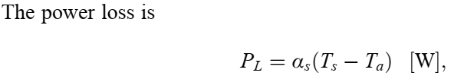
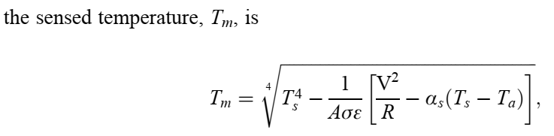
ACTIVE FAR INFRARED (AFIR) SENSORS
Although AFIR devices are much more complex than simple PIRs, including olometers, they have the advantage of a much higher sensitivity and an independence from thermal noise that other IR sensors do not possess.
Hence AFIR devices are used for low-contrast radiation measurements where PIRs are not suitable.

Slide 75
OPTICAL ACTUATORS
There are many optical actuators and they are quite common.
The use of a laser beam to perform eye surgery, to machine a material, or to record data in a magneto-optical hard drive are some examples.
Others are transmission of data on an optical fiber, transmission of a command using an IR remote control device, use of an LED or laser to illuminate a CD to read the data, scanning of an IPC code in a supermarket, or even turning on a light in a room.
Optical actuation can be low or high power. In an optical link such as in optical fiber communication or in an optical isolator, the transmitting element (the actuator) is a low-power LED in the IR or visible range (Figure 4.28). The power produced by the LED may only be a few milliwatts.
On the other hand, industrial lasers, such as carbon dioxide (CO2) lasers (in which CO2 gas is excited and produces a beam in the IR region around 100 mm), can produce hundreds of kilowatts of useful power for a variety of industrial processing purposes, including machining, surface treatment, and welding.
In between are lasers, mostly CO2 lasers of moderate power (a few watts to a few hundred watts) used for medical applications, including surgery, skin ablation, and suturing.
Other applications are for range finding, particularly in the military, and for speed detection and measurement. Laser actuation is also used for the production of electronic components, for trimming of devices, and even for recording of data on CD-ROMs, where they actually scribe the surface with the pattern representing the data.

Slide 76
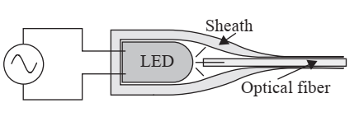
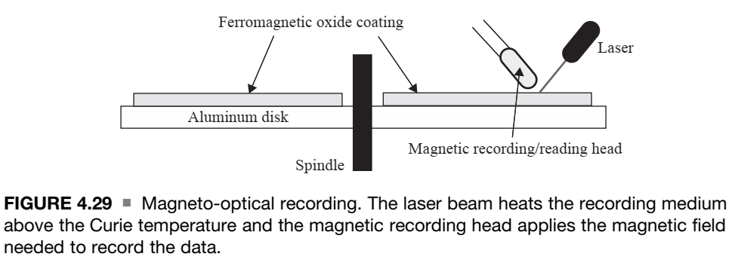
OPTICAL ACTUATORS
FIGURE 4.28
An optical link.
The fluctuations in the light intensity of the LED represent the data transmitted along the optical fiber

Slide 77
OPTICAL ACTUATORS
First, a laser beam, focused to a small point, can heat the surface of the disk to a high temperature in a few nanoseconds.
Second, when a ferromagnetic material such as iron or its oxides is heated above a certain temperature (about 650°C), the material loses its magnetic properties. This temperature is called the Curie temperature and is characteristic of the particular material used as the recording medium (mostly Fe2O3). When cooled, the material becomes magnetized with the field supplied by the recording head.
To record data, the laser is turned on to heat the point above the Curie temperature and the datum that needs to be recorded at that point is supplied in the form of a low intensity magnetic field by a magnetic recording head.
The beam is then switched off and the spot cools below the Curie temperature in the presence of the magnetic field, retaining the data permanently.
Erasure of data is done by heating the spot and cooling it off without a magnetic field. The data are read using the magnetic recording head alone
The advantage of this method is that the data density is much higher than purely magnetic recording, which requires larger magnetic fields that in turn extend over larger surfaces and hence is only practical at lower data densities.

Slide 78
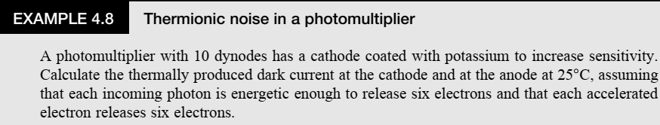

Slide 79
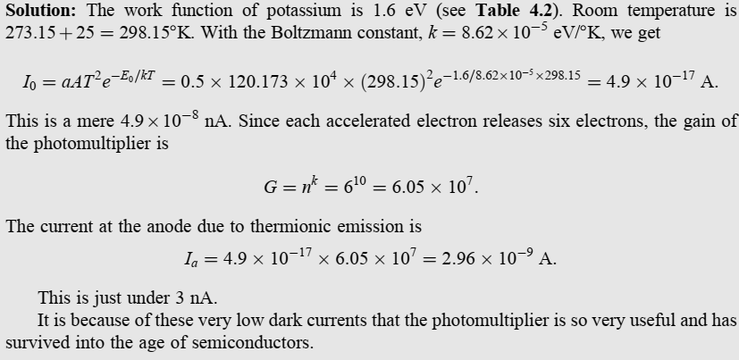

Slide 80
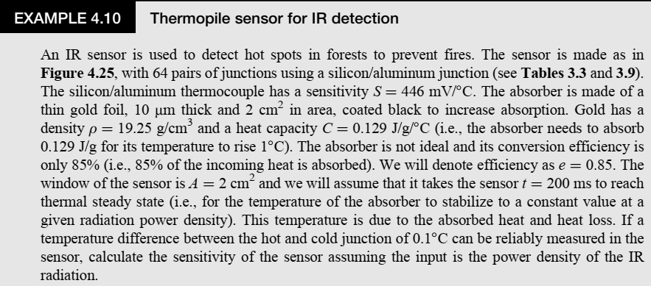

Slide 81


Slide 82


Slide 83



Slide 84


