Slide 1
GiftCompass
Understand the recipient first — then find the gift that fits them.
Jeddah · prices in SAR · consent-based, no scraping
Notes:
30s. GiftCompass recommends gifts by understanding the person receiving them. Jeddah first, prices in SAR. The headline of the week: we redesigned it so it never touches data the recipient has not shared.

Slide 2
The problem
Buying for someone you know well, and still guessing
1
2
3
Guesswork
Hours lost
Over budget
You do not know what they would genuinely like.
Searching store after store for generic ideas.
The one good idea costs more than you can spend.
And more choice makes the decision harder, not easier.
Notes:
30s. Three failure modes we all recognise. The last one matters most: showing someone two hundred options is not help.

Slide 3
What we found out this week
The original plan — read their TikTok reposts — is not available to us
1
Platform terms forbid automated collection
"It is public" is not permission (P4, Fiesler et al.)
2
TikTok's Research API is for academics
Approved non-profit researchers, not apps. Login Kit gives only a user's own posted videos — not likes or reposts.
3
Saudi PDPL requires consent and a stated purpose
Royal Decree M/19, enforced by SDAIA since September 2024.
So we designed around consent instead of collection — and the product got better, not worse.
Notes:
50s. This is the pivot of the week. We could not build what we originally drew, and the legal route turned out to give a cleaner design.

Slide 4
Consent, not collection
The recipient decides what we ever see
1
2
3
Quiz is primary
Gift Profile is optional
Preview, approve, delete
The sender answers a few short questions. Always available, no third party, works for everyone. This is the baseline everything else must beat.
The recipient opens a link and may donate their own platform export. It is parsed in their browser — we never receive messages, location or login data.
They see every interest we inferred and remove what does not fit. The raw file is deleted once the profile is built; only the profile is kept, and it expires.
The surprise problem: a reusable Gift Profile, built once and shared with family and friends, so a request is not a signal that a gift is coming.
Notes:
45s. Three ideas. The quiz is the primary source, donation is a bonus, and the recipient stays in control throughout. The reusable profile solves the obvious objection: asking ruins the surprise.

Slide 5
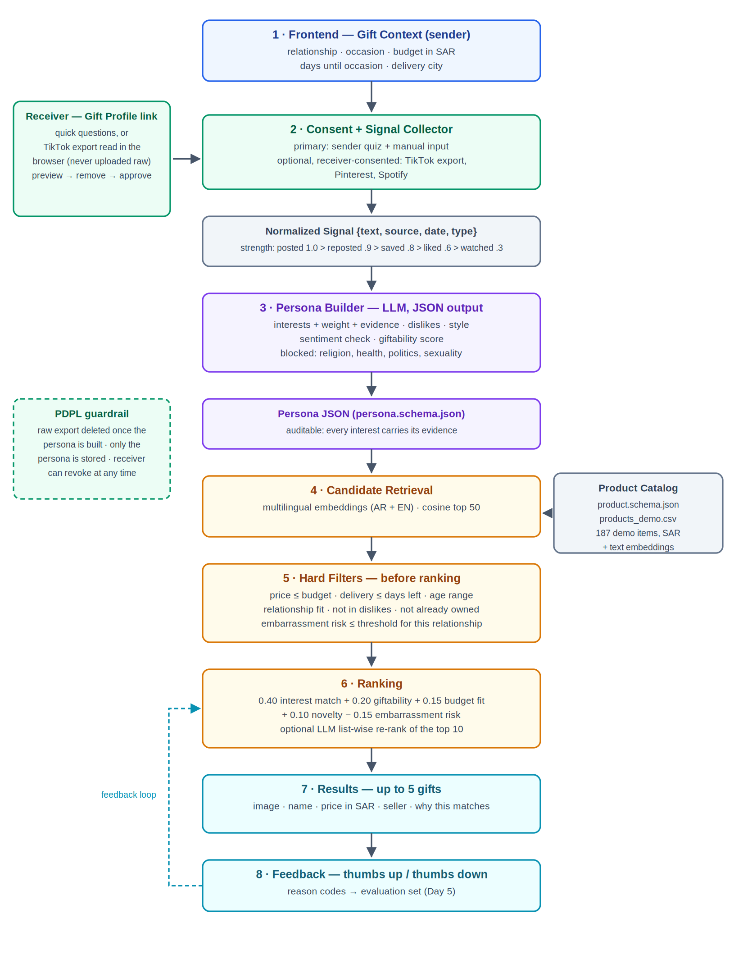
Architecture v2
1
Consent before signals
A collector and a persona builder now sit in front of the engine.
2
Filters before ranking
Budget, delivery, age and relationship fit remove candidates first, so nothing unaffordable is ever ranked.
3
Catalog wired in
187 demo products with embeddings feed retrieval.
4
Feedback loop
Thumbs up and down feed the evaluation set.
Notes:
45s. Four changes from our first diagram. The one to call out is filters before ranking — it is the difference between showing a perfect gift you cannot afford and showing one you can.

Slide 6
The persona is evidence, not a guess
Every interest carries the signals that produced it
Posted beats reposted beats liked beats watched.
Interests fade: a 180-day half-life.
One signal can never reach "strong" — only repetition does.
"I hate Twilight" mentions Twilight and is still a no.
Religion, health, politics, sexuality: never inferred.
7 x saved 43 days old -> 4.745
3 x reposted 58 days old -> 2.160
1 x quiz answer -> 0.850
raw = 7.755 weight = raw / (raw + 2) = 0.79
0.79
matcha · strong
Notes:
45s. This is the heart of it. A weight is computed from how strong each signal is and how recent, and it saturates, so a single repost is never an interest. Every number can be traced back to the evidence that made it.

Slide 7
It runs
Best friend · birthday · up to 500 SAR · 14 days
# | Gift | SAR | Why this matches
1 | Matcha and tea gift hamper | 260 | They show a strong interest in matcha (11 signals). It also touches cafe culture.
2 | Matcha and pastry tasting for two | 260 | They show a strong interest in matcha (11 signals). It also touches cafe culture. It is an experience rather than an object.
3 | Arabic coffee dallah with finjan set | 380 | They show an interest in coffee (3 signals). It also touches home & room decor.
4 | Personalised name neon sign | 420 | They show an interest in home & room decor (5 signals). It can be personalised, which suits a keepsake gift.
5 | English bestseller bundle, 3 paperbacks | 190 | They show a strong interest in reading & books (15 signals).
187 products → 50 retrieved → 46 pass the filters → 5 shown
The milk frother she already owns was filtered out. Three items over 500 SAR were removed before ranking.
Notes:
50s. A real run, not a mock-up. Five gifts, every one inside budget, every one with a reason the giver can read. Note the last line: it knows what she already has.

Slide 8
Does the extra data help?
Same catalog, same code — the only difference is how much we know about the person
25
What we can measure today
gifts confidently recommended
with quiz + donated signals
Every result inside budget, every run
Coverage of the top interests
Category spread
How much the two systems differ
19
with the quiz alone
What we have not done yet
Relevance, delight and embarrassment need human judgement. The harness produced a blind rating sheet — it does not say which system made which suggestion — and three of us will rate every item independently. Those numbers are not in this deck, because we have not collected them yet.
Notes:
55s. The measurable result: donated signals mostly do not change the ranking, they increase how many gifts the system is confident enough to show. Be explicit that the human ratings are not collected yet — the sheet is blind and ready.

Slide 9
Understand the person → then the gift
Verify catalog prices against live listings before anyone sees them
Swap the keyword persona builder for the LLM one, same schema
Swap TF-IDF for multilingual embeddings — most of our signals are Arabic
Build the receiver Gift Profile flow, then run the human evaluation
Catalog prices are demo data for development — realistic for Jeddah, but not quoted prices.
Notes:
25s. Close on the one line that describes the product, and be straight about what is still demo data. Then questions.

