Slide 1


Implementation of Competitive Programming Platform By: Omar Jaouadi
Supervisors
Ms. Wafa Chlagou
Ms. khaoula Braiki
Mr . Mouhieddine Belghuith
Notes:
hello to you, my name is omar jaouadi. before presenting my project, i want to thank you for agreeing to judge my work.

Slide 2
Plan
Introdution
Host company
Study of the existing
Requirement specification
Work methodology
Conception
Realization
General conclusion and perspectives

Slide 3
1.
General introduction

Slide 4
General introduction
What is competitive programming
The Impact of competitive programming on IT companies

Slide 5
2.
Host company

Slide 6
brandlab
Host company
Founded in 2020, the start-up Brandlab formed its name from the two words "branding" and "lab".
Brandlab is a full-service agency dedicated to designing and creating digital products

Slide 7
3.
Study of the existing
Analysis of the existing
Criticism of the existing
Proposed solution

Slide 8

Study of the existing
HackerRank
Analysis:
recruitment platform
coding challenges and contests
Criticsm:
Cannot create challenges
services cost a fee

Slide 9

Study of the existing
codewars
Analysis:
Challenges
Create challenges
criticsm:
Cannot create contest or an app test
Cannot have team or a group

Slide 10
Proposed solution
Proposed solution
Create a competitive platform meet certain requirements
Manage challenges
Manage contests
Manage teams & users

Slide 11
4.
Specification of the requirements
Actors identification
Non-functional needs

Slide 12

Specification of the requirements
actors identification
Admin
Manage users
Manage teams

Slide 13

Specification of the requirements
actors identification
Manager
Manage challenges
Manage contests
Manage team

Slide 14
Specification of the requirements
actors identification
Member
Solve challenges
Participate in team contests

Slide 15
Non-functional requirements
Specification of the requirements
maintainability
Ergonomics
Performance

Slide 16
5.
Work methodology

Slide 17
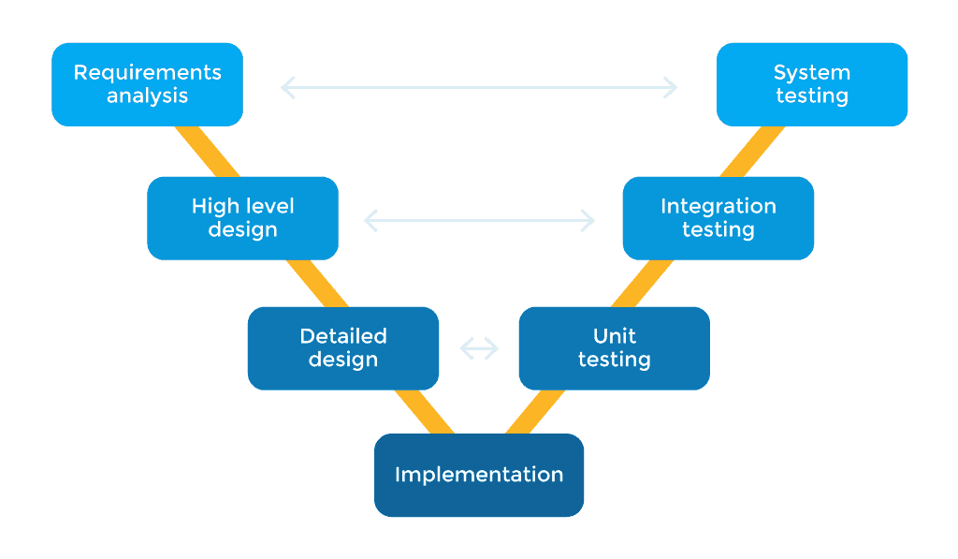
V-cycle
Work methodology

Slide 18
6.
conception
General use case Diagram
Class Diagram

Slide 19
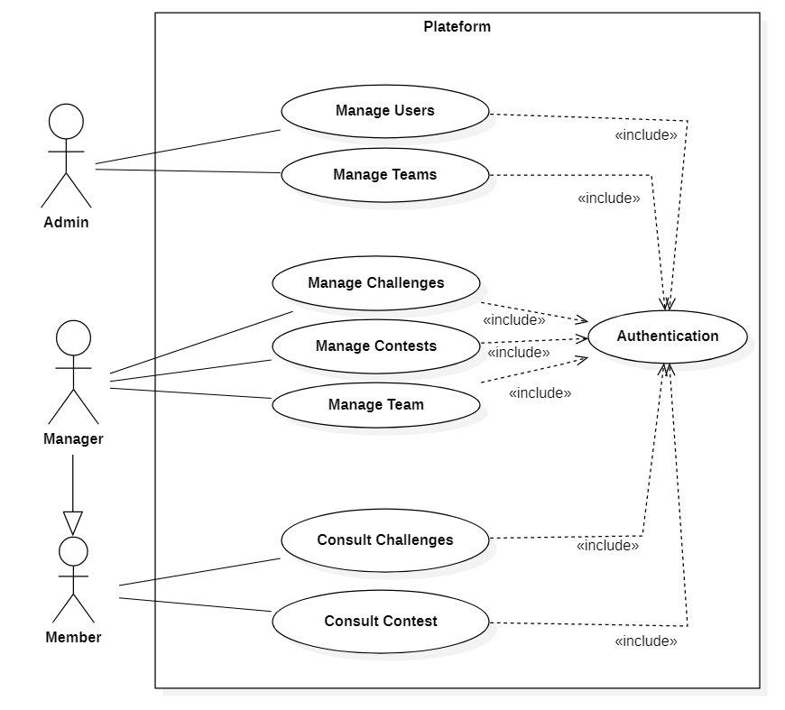
General use case Diagram
Conception

Slide 20
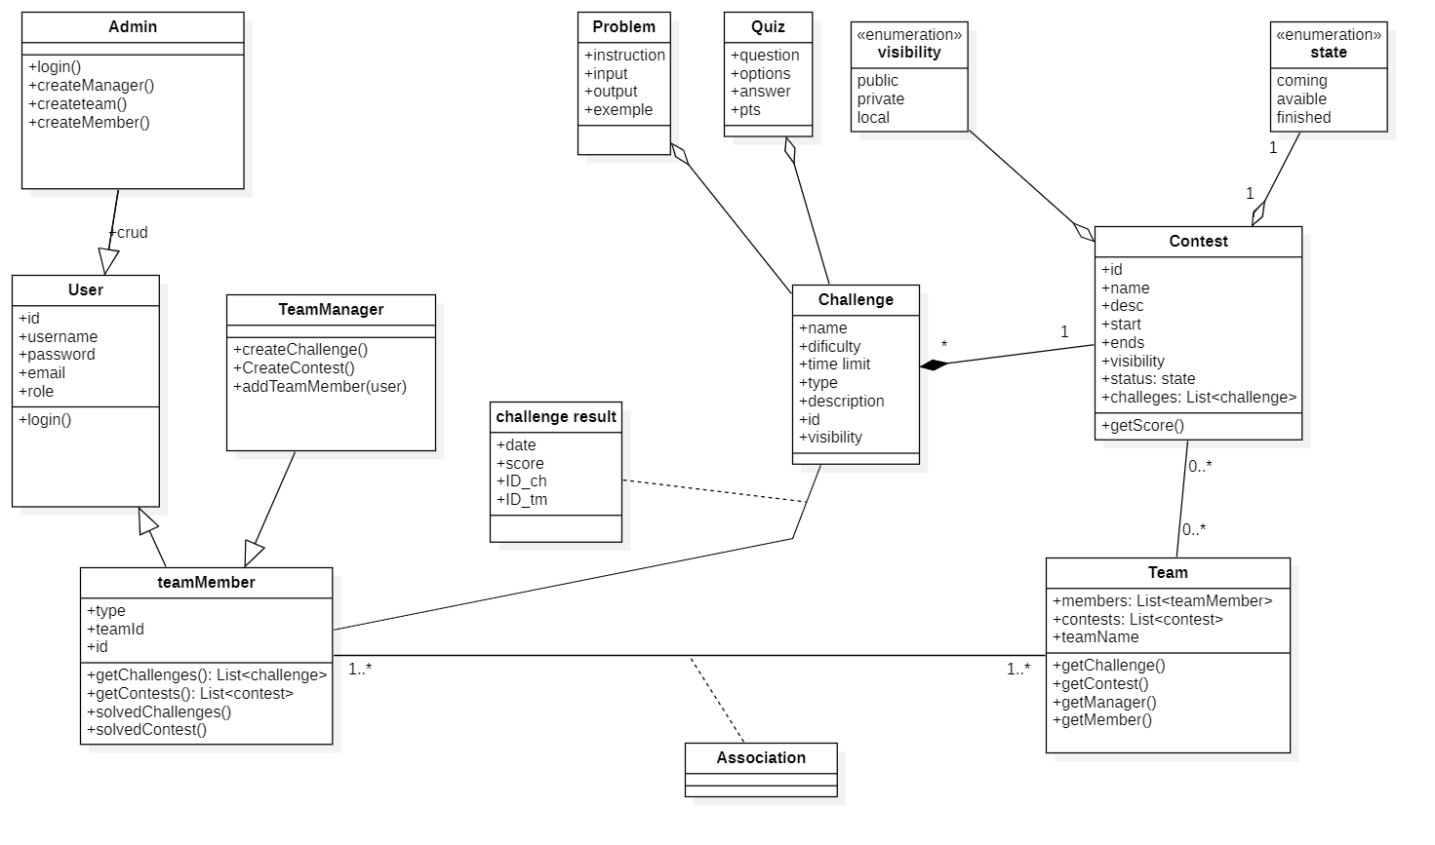
Class Diagram
Conception

Slide 21
7.
realization
Software environment and technology tools
Interface application

Slide 22

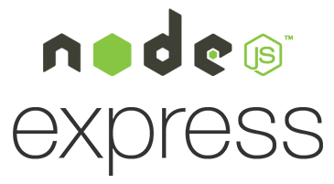

Realization
Software environment and technology tools

Slide 23






Realization
Software environment and technology tools
Vs studio code
Postman
Docker
Trello
Mongo DB Compass
Slack

Slide 24
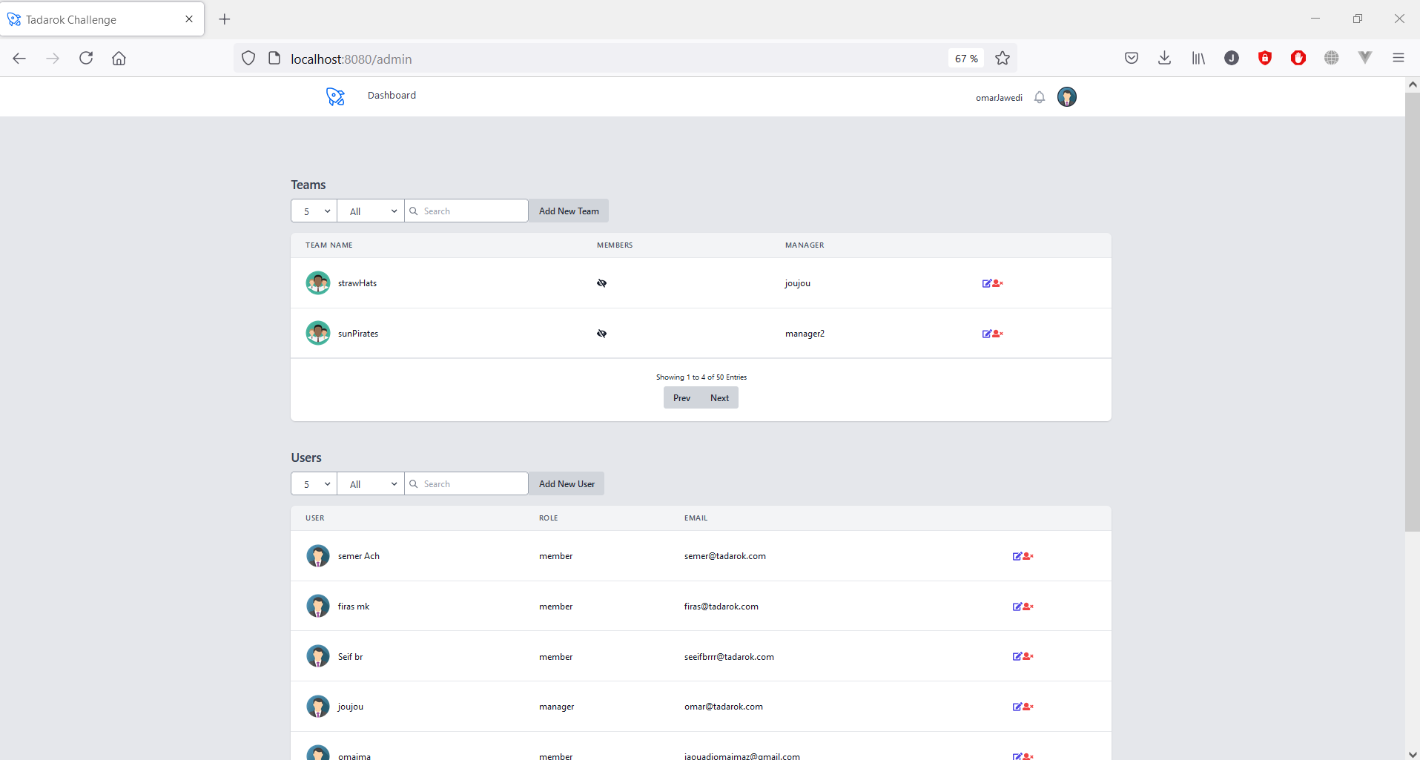
Admin homepage

Slide 25
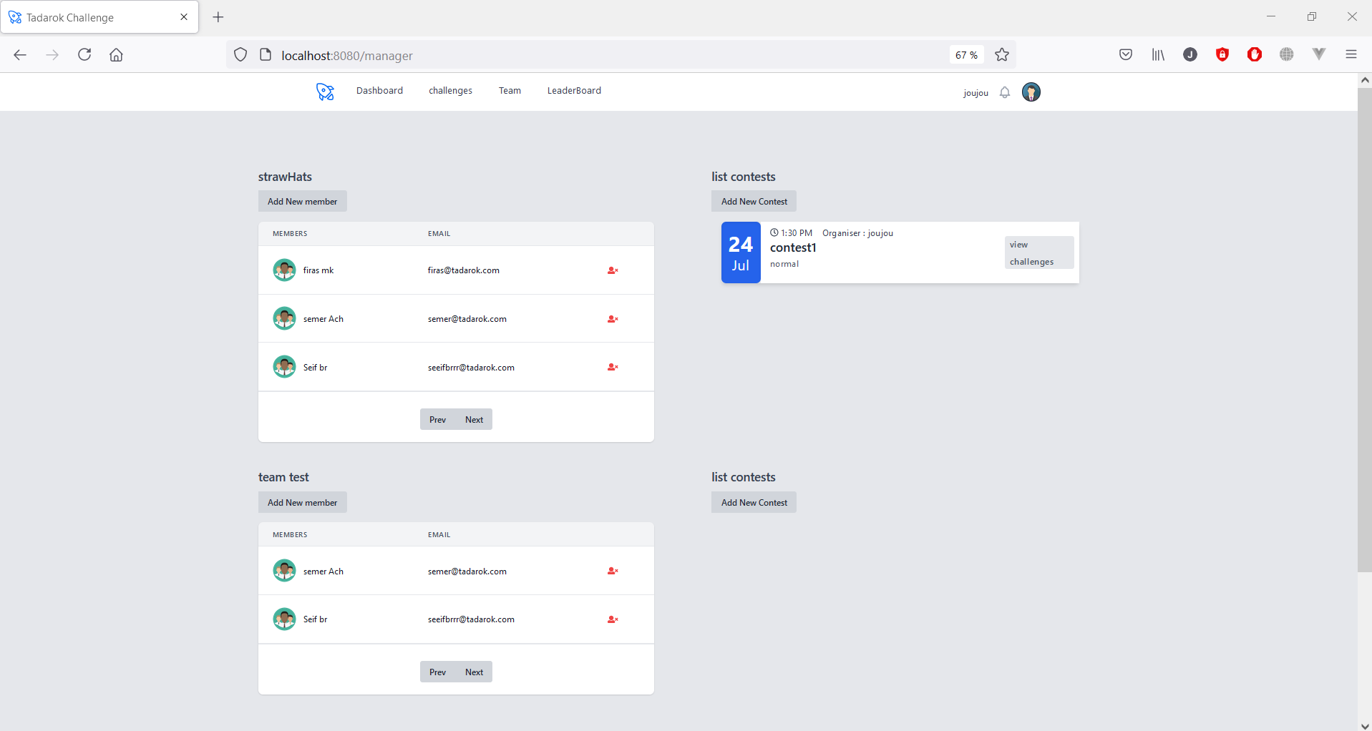
Manager homepage

Slide 26
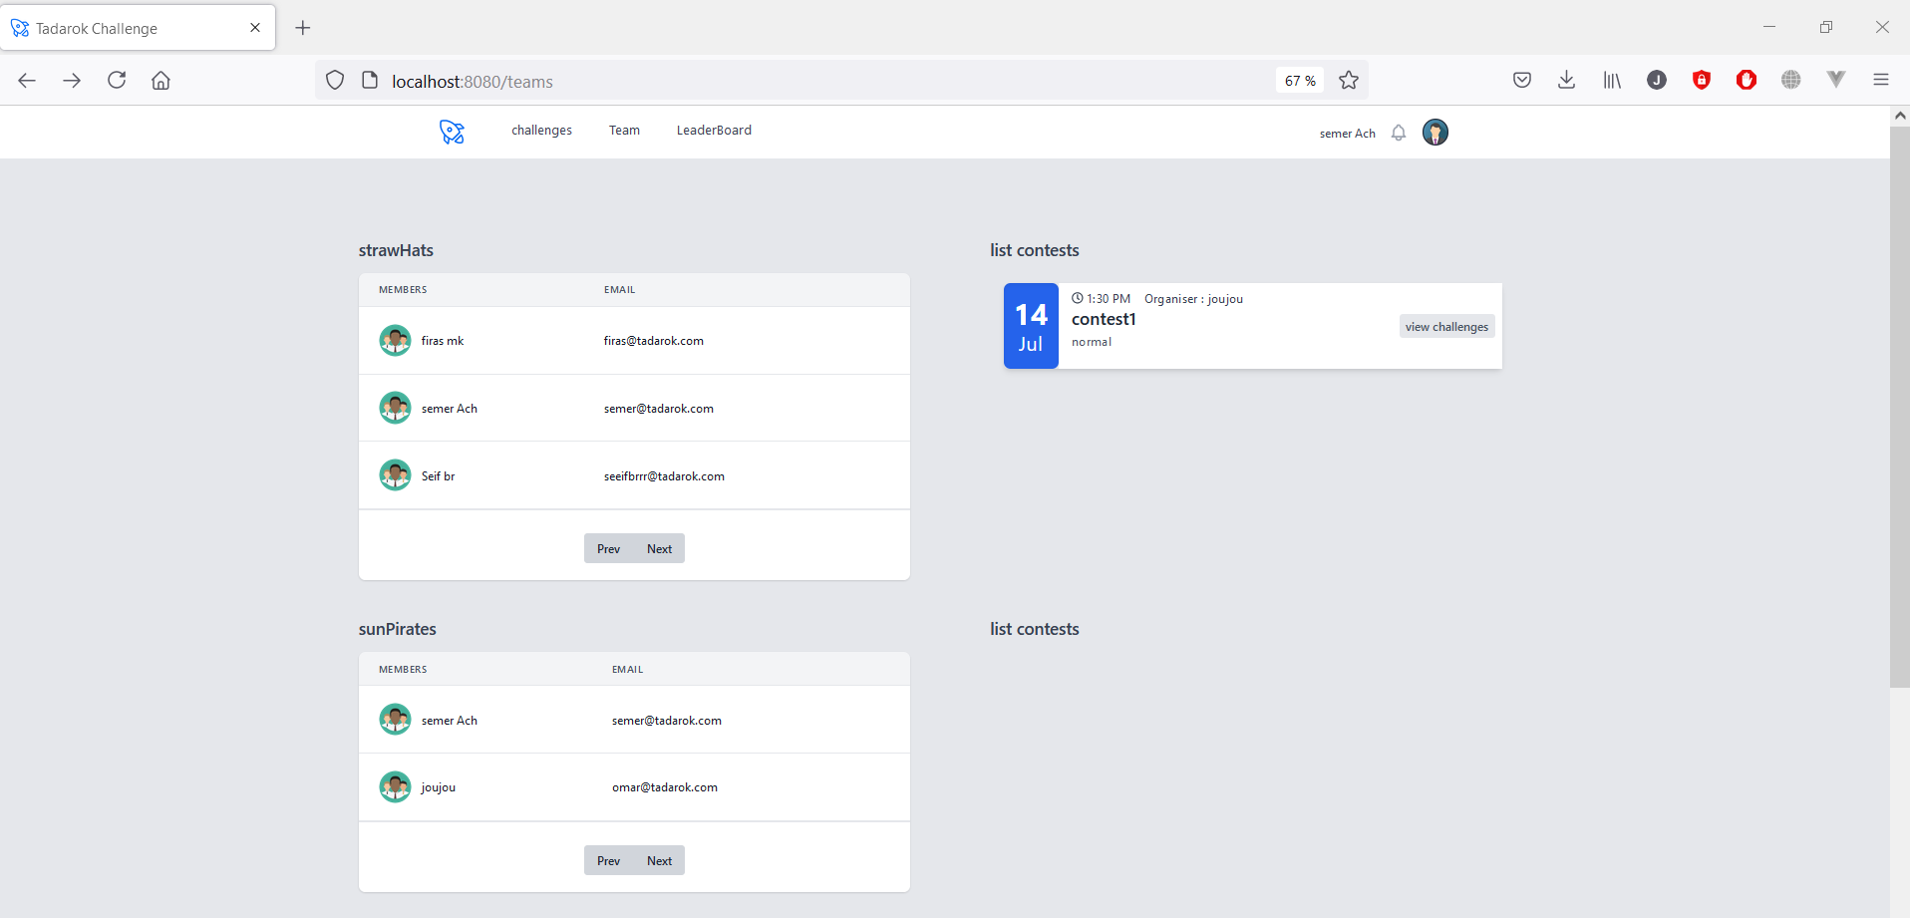
Member homepage

Slide 27
9.
General conclusion & perspectives

Slide 28
this project implement a competitive programming platform that offers the possibility to improve their colleagues skills by participating in contest and solving challenges
As a perspective we consider the implementation of the notification service ,as well supporting more additional languages beside JavaScript.

Slide 29

Thank you for your attention

