Slide 1
Exploratory Data Analysis
Netflix Movies and TV shows
Kamar Shahein
Data
Cleaning data
Information
Exploratory Data Analysis

Slide 2
Data
Liberaries
Describe

Slide 3


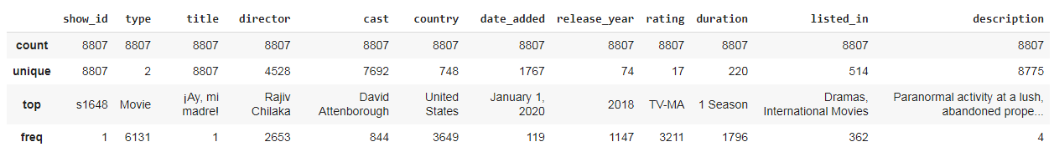
Describe the data >>
Frome 1925 to 2021
-This data showes the movies and tv showes at netflix website

Slide 4
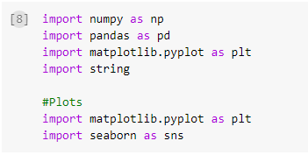
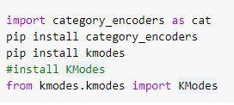
Liberaries

Slide 5
Exploratory Data Analysis
Netflix Movies and TV shows
Kamar Shahein
Data
Cleaning data
Information
Exploratory Data Analysis

Slide 6
Read data
Cleaning data
Cleaning data 1
Cleaning data 2
Cleaning data 3

Slide 7

Reading data

Slide 8
Read data
Cleaning data
Cleaning data 1
Cleaning data 2
Cleaning data 3

Slide 9
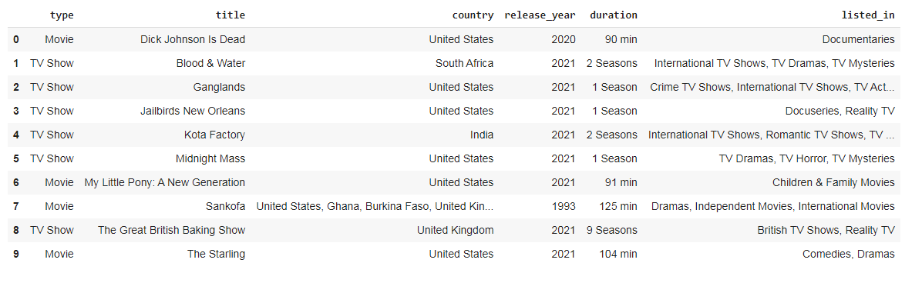
Cleaning data
-Drop columns that we don't need

Slide 10
Read data
Cleaning data
Cleaning data 1
Cleaning data 2
Cleaning data 3

Slide 11
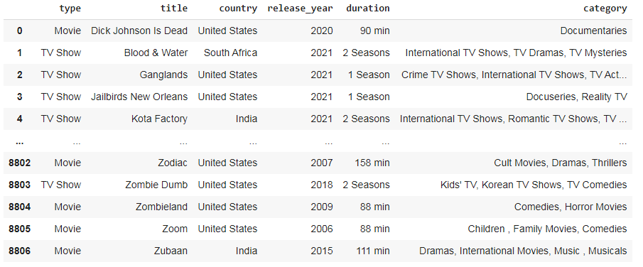
-Replace (&) with (,) in values of category
column (the last column)

Slide 12
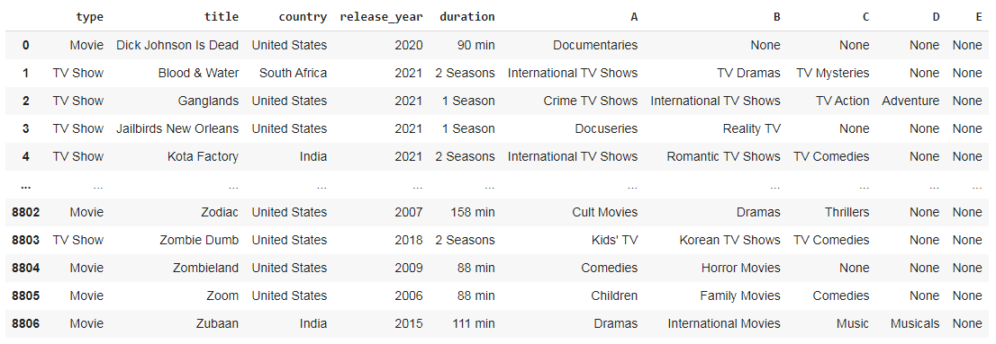
-Split category column to 6 columns

Slide 13
Read data
Cleaning data
Cleaning data 1
Cleaning data 2
Cleaning data 3

Slide 14
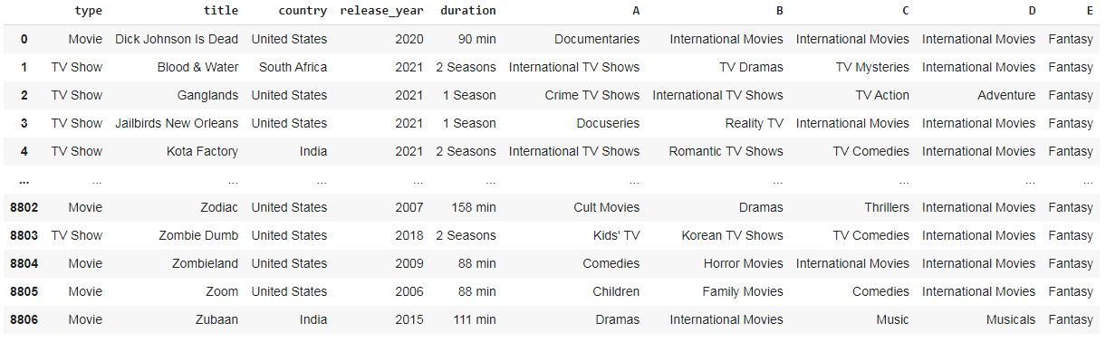
-Renaming the columns and replacing the (None) values with (most frequency) value to save the informations of the data

Slide 15
Exploratory Data Analysis
Netflix Movies and TV shows
Kamar Shahein
Data
Cleaning data
Information
Exploratory Data Analysis

Slide 16
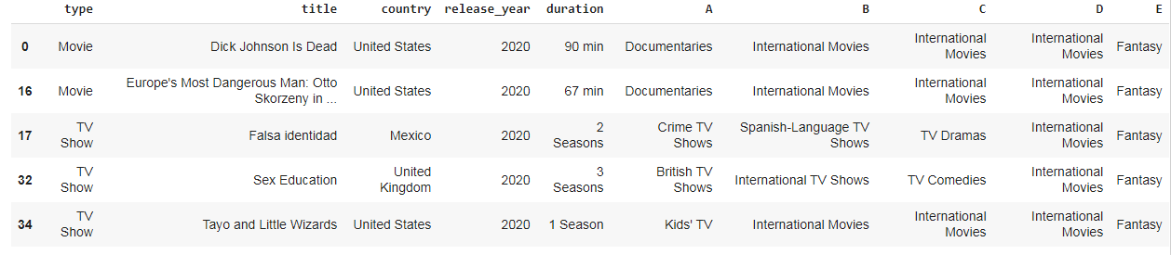
Informations of the data
-Numbers of Movies and TV Shows that released in 2020 = 953 and so on we do at columns (type and title)

Slide 17
-The informations of some TV shows and Movies

Slide 18
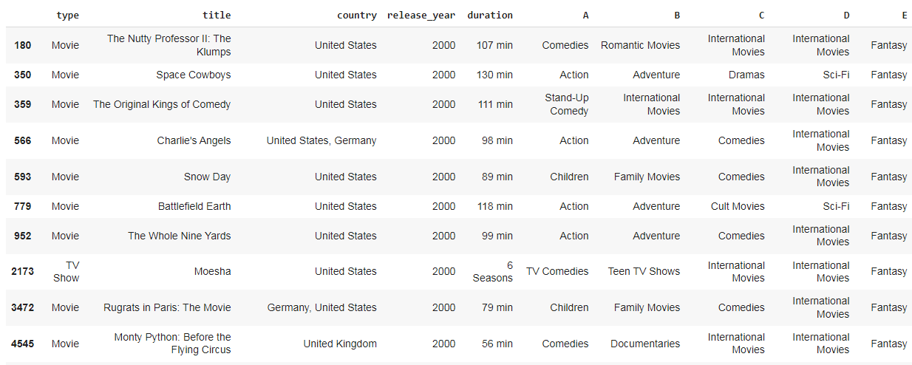

-The informations of some years

Slide 19
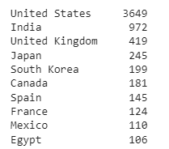
-Top 10 Countries in which shows are released

Slide 20
Exploratory Data Analysis
Netflix Movies and TV shows
Kamar Shahein
Data
Cleaning data
Information
Exploratory Data Analysis

Slide 21
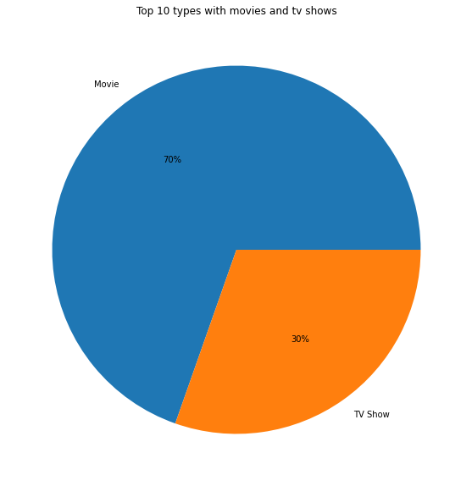
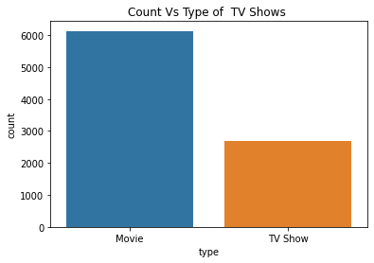

Slide 22
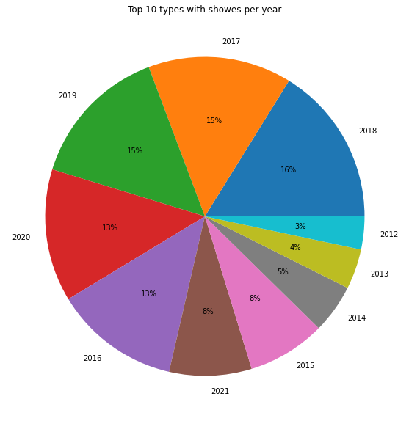
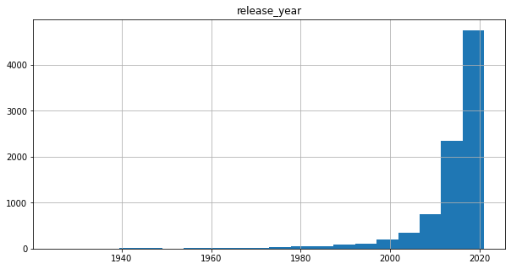
-Top 10 years of shows(TV shows & Movies) with percentage
-Number of shows per years

Slide 23
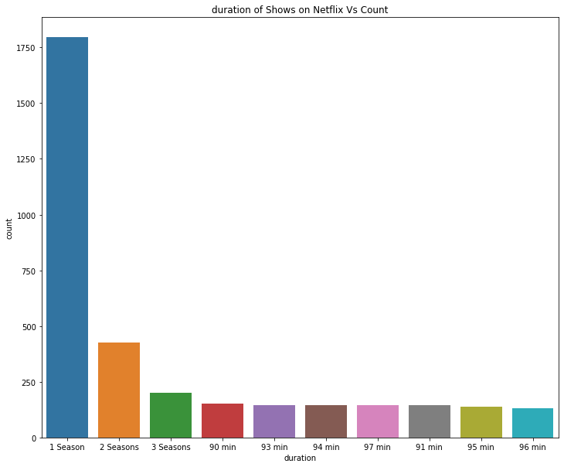
-Duration of Shows on Netflix Vs Count

Slide 24
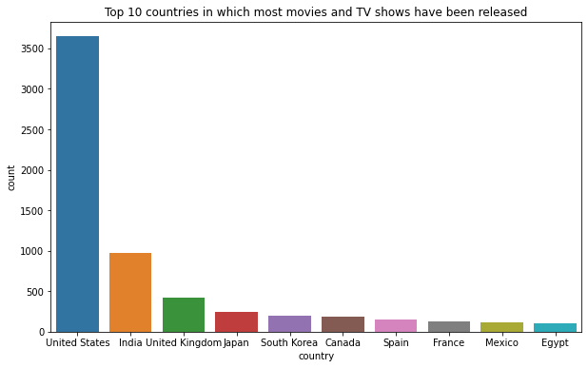
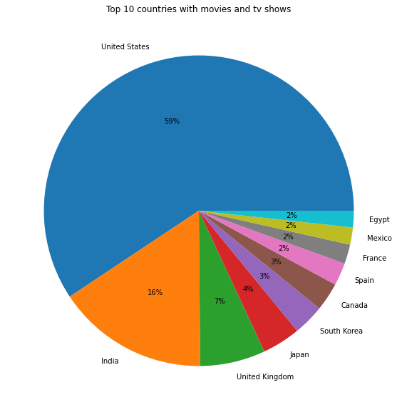
-Top 10 countries in which most movies and TV shows have been released with percentage

Slide 25
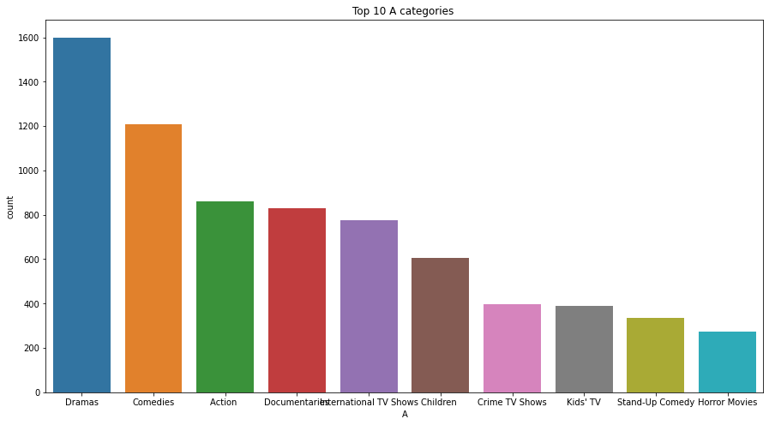
-Top 10 A categories of shows

Slide 26
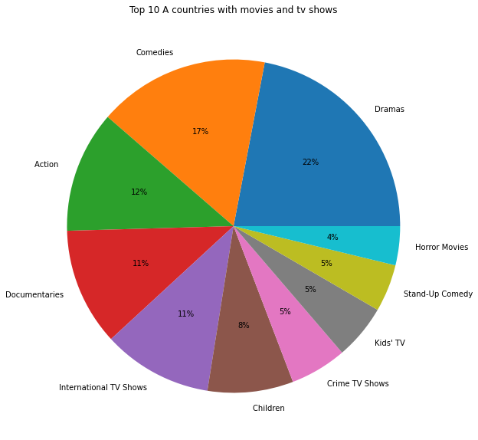
-Top 10 A categories of shows with percentage

Slide 27




