Slide 1


MyPlinko Simulation [Python]
Data 604 – Simulation and Modeling Techniques [ CUNY SPS – MSDS 2020 ]
Vinayak Kamath

Slide 2
MyPlinko Simulation – Problem Statement
Overview:
MyPlinko is a simple simulation of the popular game “Plinko” from the television series “The Price Is Right”. [http://www.priceisright.com/]
The game premise is simple; A flat disc is dropped onto a large board covered in small pegs. The disc bounces off these pegs as it drops down towards the bottom of the board. The bottom of the board catches the discs and different amount is won based on the bucket that the disc lands.
Problem Statement: How to Win with maximum Amount?
Dropping a ball into the right stationary bucket is way to earn cash in this game. They can earn you Ten, Hundred, or even Thousand dollars at a time, so if you land a ball in the correct one, you get a nice reward.
Plinko-gaming-strategy No. 1: Basically, if you're in it to win highest dollars, stick to the middle slots. Simple enough.
My attempt here is to run multiple simulation to see if this strategy holds true.

Slide 3
MyPlinko Simulation – Flow Chart
Run next Simulation ?
No
Yes
Stop Run
Basics:
Treated the Board has a matrix wall having columns as number of slots added by 1 and rows as number of slots multiplied by 2 and then added 1.
Treated each peg position as of 0.5 increments from left to right; left wall having score or 0.5 and right wall having score of number of slots + 0.5
Each drop lane indicated by a starting score of 1, 2, 3, so on till number of slots.
Each drop has a direction or Left or Right.
Each drop was given a score or +/- 0.5 based on drop on Right (+) or Left (-) side.
Simulation
Used random function to get direction for Left or Right
Kept score with each fall step based on above rules.
Final score would determine the bucket and there by the amount won.
Care taken when the disc was on near to the left or right wall and random function gave invalid direction. The direction was corrected and scored aligned.
Starting Score = Lane Number
Run next Drop?
No
Record Drop Direction and Final Score
Yes
Get Random Direction
Is Left ?
No
Yes
Score -= 0.5
Score +=0.5
Is Score < Left Wall ?
Yes
Move Right
Score += 1.0
Direction = “Right”
No
Is Score > Right Wall ?
Yes
Move Left
Score -= 1.0
Direction = “Left”
No
Record Current Direction and Current Score

Slide 4
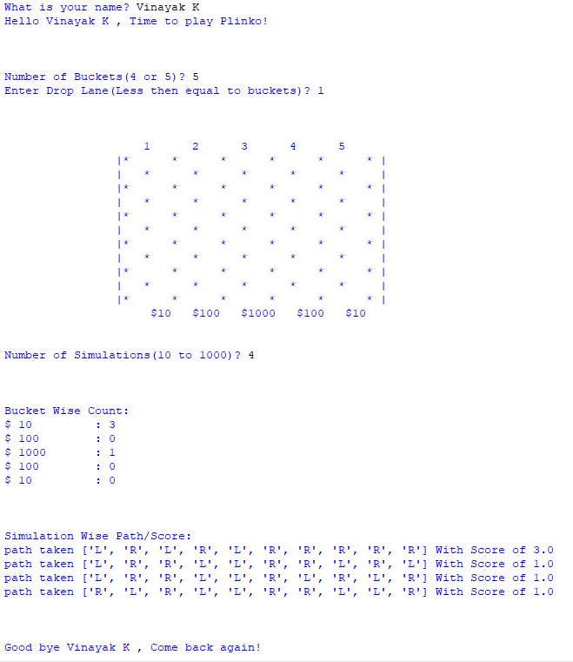
MyPlinko Simulation – Simulation
The program asks the user for his name and then the number of buckets and the drop lane.
The program draws a pictorial representation of the board depicting the lanes (1, 2, …), pegs (*) and money buckets ($) at bottom.
Number of simulations is also taken as input from the user.
The program then returns the bucket wise count for the simulations done.
The Program prints the path of Left (L) and Right (R) taken in each simulation and the score or the bucket the disc landed on.

Slide 5
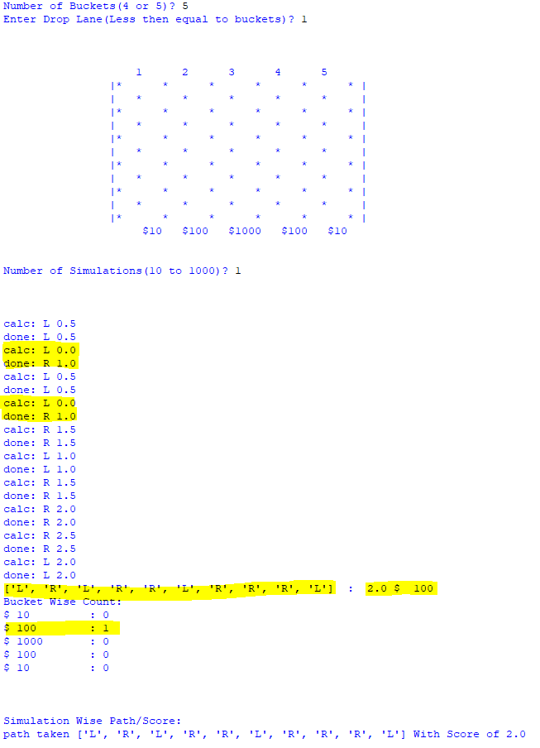
MyPlinko Simulation – Verification / Validation
Validation
This was done by manually running the game on a paper and validating for shorter runs with different combination of starting lane and number of buckets.
The path combination of left and right and handling of hitting walls was also validated in same manner using smaller runs and dropping the disc near from the lane near to either walls.
Verification
Multiple runs done to ensure the results were as expected with the final score being a integer and not float. And within the min and max values.
Prints [commented out finally] used in initial runs to get step by step output and verify the flow.

Slide 6
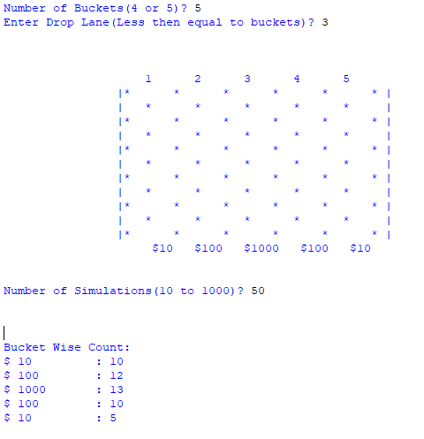
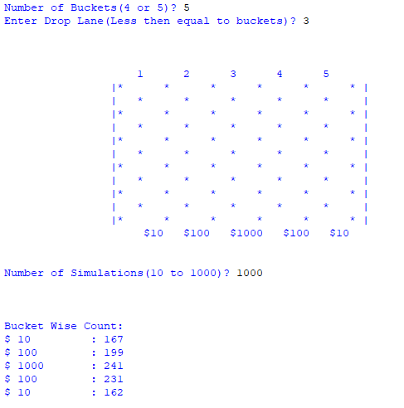
MyPlinko Simulation – Finding/Conclusion
On multiple Simulations we can see that the strategy holds true. Based on the drop position the disc did end up in near to if not exact to the bucket underneath to it.
With small number of simulations of 50 or less the result was not as expected. But with simulations of 100 or more the strategy seems to work.
As seen here with simulation of 1000 from the center drop lane of 3 we had largest number of drops in center bucket of $1000 compared to the count in other buckets.

Slide 7
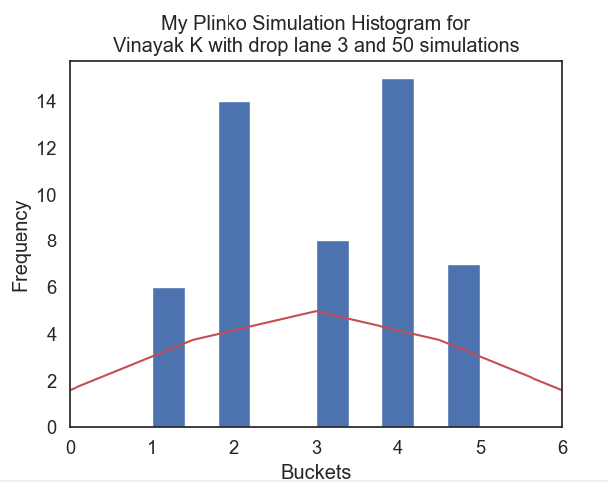
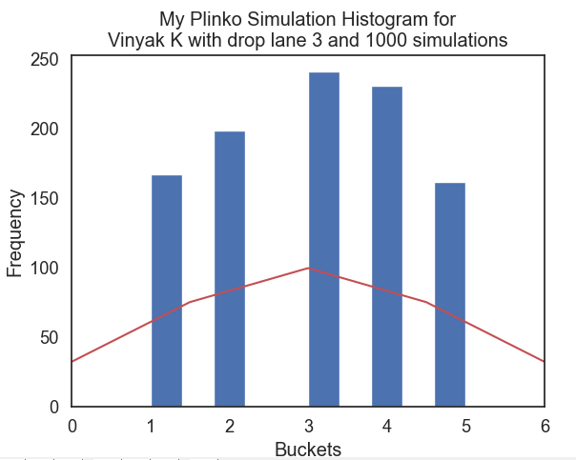
MyPlinko Simulation – Finding/Conclusion
Histogram:
The blue bar are the actual count for each bucket. And the red line is the expected distribution if the strategy did hold true.
On run of 50 simulation we can see the bar chart is not as expected compared to the distribution.
On run of 1000 simulation we can see the bar chart is very close to the distribution

Slide 8
MyPlinko Simulation – Next
For Future:
Use better graphic package to draw the board.
Better handling of return variable and follow python best practices.
Better error handling
Ability to run for more lanes/buckets.
Move to shiny app or flask.
Plinko-gaming-strategy No. 2
“Be Very Lucky”

