Slide 1

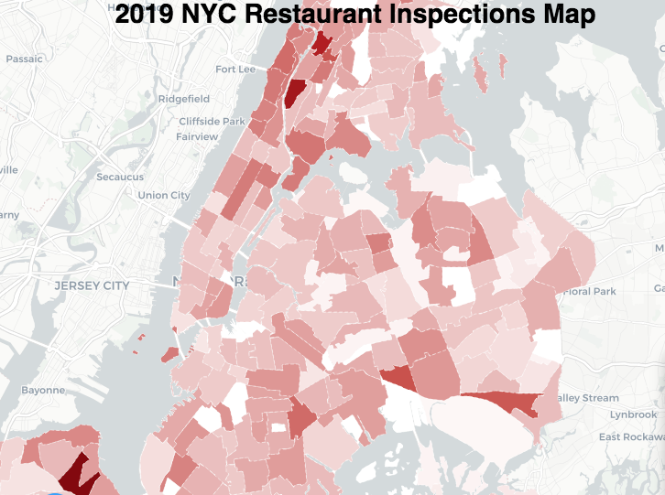
Visualization and Analysis for - New York City Restaurant Inspection Results
DATA 608 – Final Project –
Vinayak Kamath
https://kamathvk1982.shinyapps.io/MyNYCRestaurantInspectionResults/

Slide 2
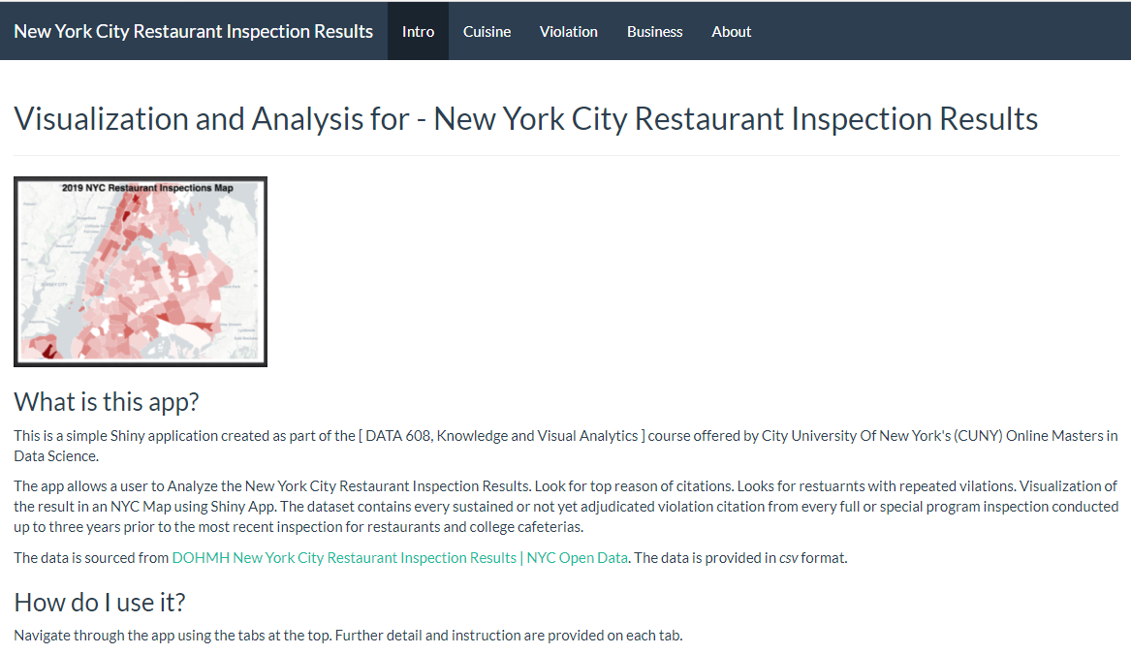
Introduction

Slide 3
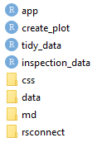
Code Structure / Walk through
Shiny App and Shiny theme was used for the coding for this App. The coding was done via multiple R scripts and Markdown files. The details on each is as given below:
inspection_data.R : the csv file is loaded via this R script. The file was loaded from local drive.
tidy_data.R : the data in the csv file was cleansed via this R script. Data list for lookups for the drop down were created in this R script. Individual Data store having required columns were created for the various charts.
create_plot.R : All plots and wordclouds used are written in this R script.
app.R : The main R script having the UI and SERVER codes. The required libraries and the R scripts are loaded in this R script.
5. The “Introduction” and the “About” tabs in the Shiny App are markdowns file and were manually created with the required details using the IDE Sublime Text. The markdowns files are stored in the “md” folder.
6. The csv file is located in the “data’ folder.
7. The css file for the styling of the Shiny App is in the “css” folder.

Slide 4
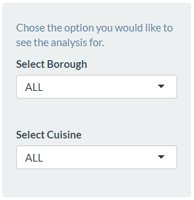
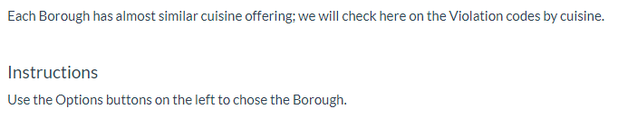
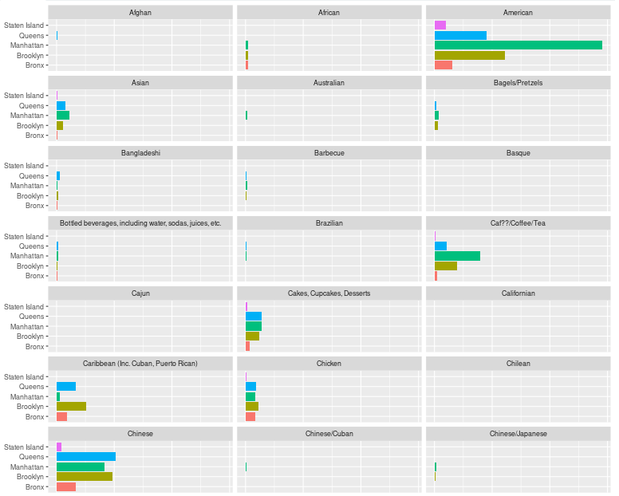
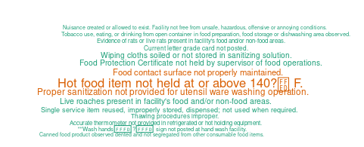
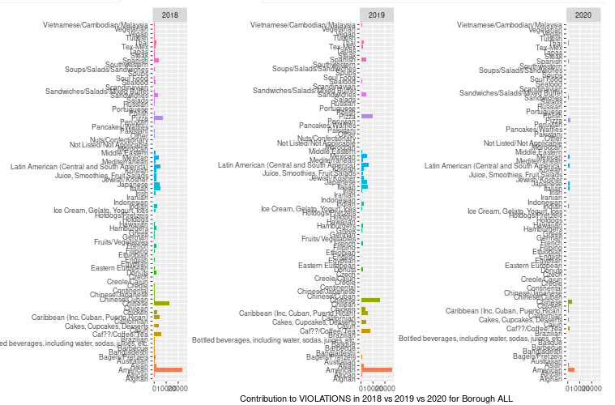
Borough - Cuisine Analysis
We investigate three charts here:
1. Looking at the trend of citations
for the cuisines across the boroughs.
2. A word cloud map of the citations
descriptions for the options selected.
3. A comparison of the counts across
three years and comparing the 2020
numbers for the pandemic year.

Slide 5
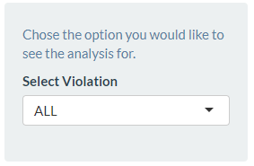
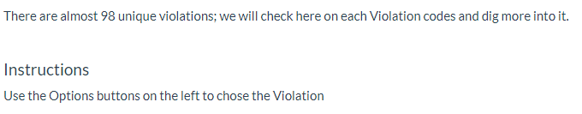
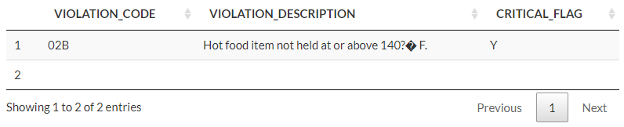
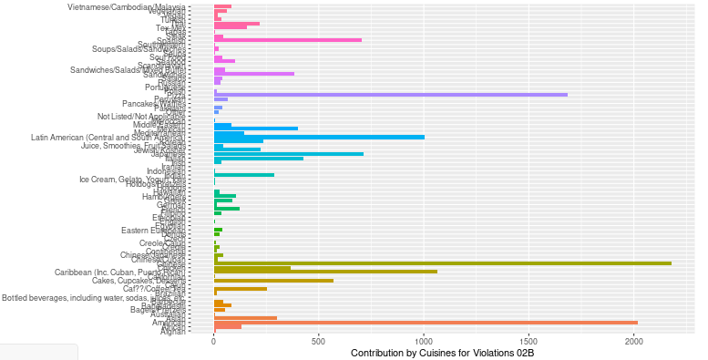
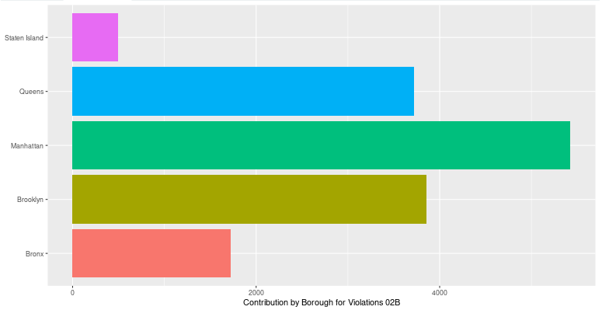
Violation Analysis
For the violation code selected, we
look into below details:
Violation description and its
criticality flag.
2. A chart of the count of citations by
cuisine.
3. A chart of the count of citations by
Borough.

Slide 6
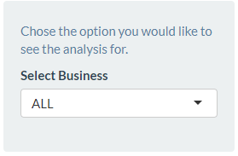
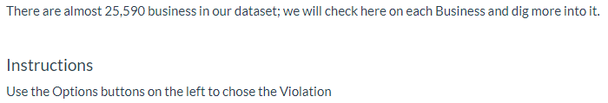
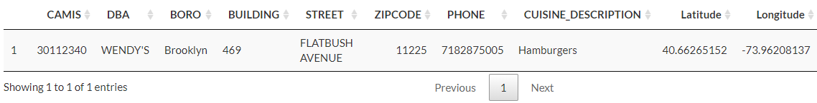
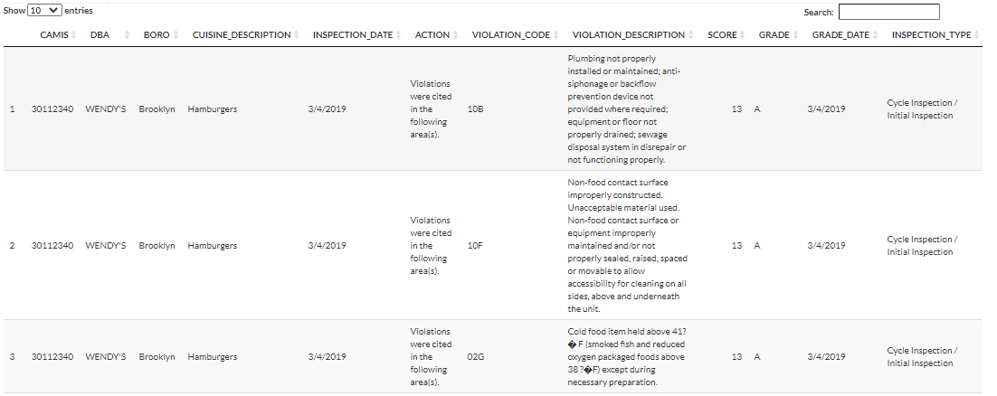
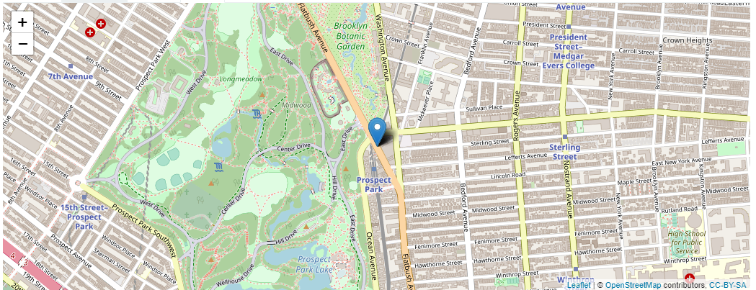
Business Analysis
For the business place selected, we
look into below details:
Details of the business, address,
contacts, cuisine it serves and its
location.
2. A chart of the citations.
3. A Map showing its location.

Slide 7
