Slide 1

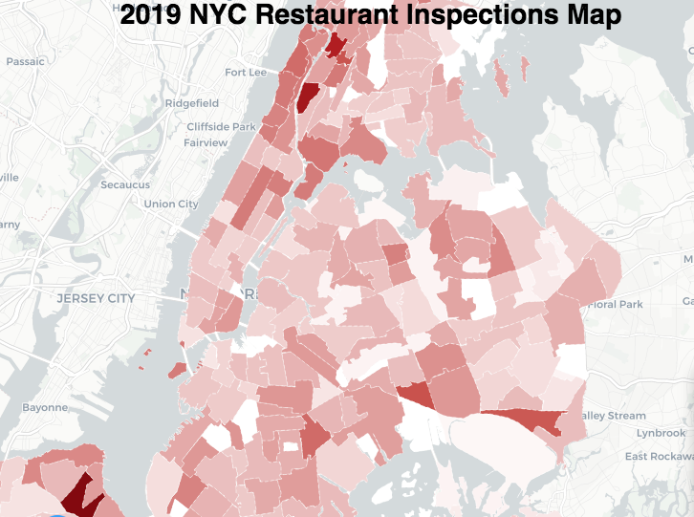
Visualization and Analysis for - New York City Restaurant Inspection Results
DATA 608 – Final Project –
Vinayak Kamath
https://kamathvk1982.shinyapps.io/

Slide 2
Proposal
Title | Visualization and Analysis for - New York City Restaurant Inspection Results
Data Source | DOHMH New York City Restaurant Inspection Results | NYC Open Data (cityofnewyork.us)
Synopsis | Analyze the New York City Restaurant Inspection Results. Look for top reason of citations. Looks for restuarnts with repeated vilations. Visualization of the result in an NYC Map using Shiny App. The dataset contains every sustained or not yet adjudicated violation citation from every full or special program inspection conducted up to three years prior to the most recent inspection for restaurants and college cafeterias. What’s in the Dataset? Rows 395K ; Columns26 ; Each row is a Restaurant Citations
Tech Stack | ‘R’ Shiny Apps

