Slide 1
DATA 606 – Statistics and Probability for Data Analytics
DISTRIBUTIONS OF RANDOM VARIABLES (4.45)

Slide 2
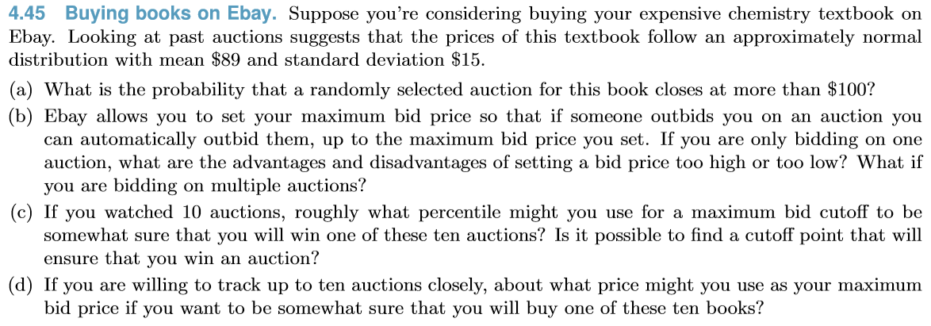

Solution (a): 0.232

Slide 3
Solution (b): Setting a bid too high will mean we end up paying more then the cost its worth; and setting a bid too low would mean we may end up loosing the bid.
Doing it on multiple auctions with too high bid may probably result in not overpaying a lot of times; and doing it on multiple auctions with too low bid may probably result in winning the bid few times at good bargain.

Slide 4
Solution (c): Approx. around 85 to 90 Percentile
No, we cannot determine a cutoff that will always ensure us a win.

Slide 5

Solution (d): Using from (c), if we use 85 or 90 percentile then we can go with maximum bid of $104.55 or $108.22

