Slide 1
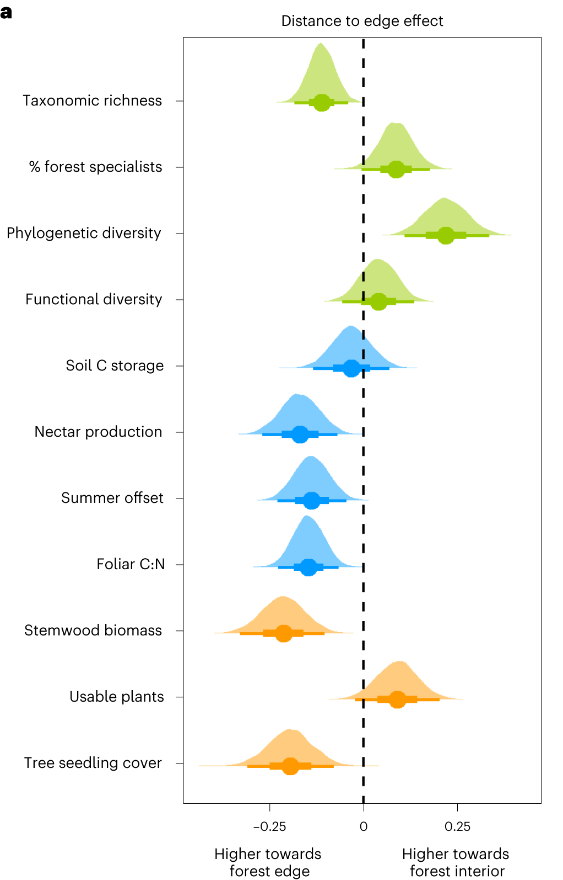
Ecosystem Services
Crop Diseases
Crop Pests
Productivity
Biodiversity
Water Erosion
Water Evaporation Potential
Water Minerals
Soil Water Holding Capacity
Soil Life
Soil Nutrients
Soil Organic Matter
Effect Size (ROM)

