Slide 1


NuvEEN
Sales analysis and forecasting
for nuveen

Slide 2
Background
Nuveen is a mutual fund company and a wholly owned subsidiary of financial planning firm TIAA headquartered in Chicago, with offices in major cities in the US and across the world. Nuveen is in the business of marketing and selling mutual funds to investors through investment professionals such as brokers, financial planners, and financial advisors.
Currently the market is highly competitive, as of 2018 there were 9,599 mutual funds in existence in the US. Sales costs are also expensive since wholesalers are highly compensated.
Therefore Nuveen needs to understand their data to improve their marketing strategy to effectively target and retain clients.

Slide 3
Project Objectives:
Predict potentially profitable financial advisors to assist sales and marketing improve their targeting
Predict the following year’s sales using data for previous year
Estimate the probability of adding a new fund the following year
These predictions will help Nuveen’s improve their targeting strategy and inform their acquiring, developing, and retaining (ADR) approach hence enable them acquire new clients cost-effectively, sell more to existing clients, and reduce redemptions.

Slide 4
Assumptions
Missing values or nulls signify a lack of activity, for example, no sale, or no new fund added. Missing values have therefore been replaced by zeros which has no increasing or decreasing effect on sales outcomes.
To enable standardization and normalization of data and deal with skewness, negative values have been replaced with zeros, again assuming this has no increasing or decreasing effect on sales outcomes.

Slide 5
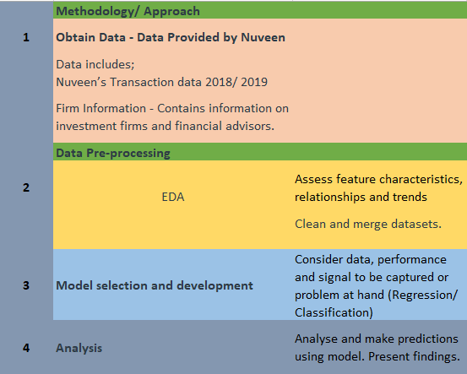
Methodology/ Approach

Slide 6
Analysis and Findings 1. Predict sales for next year using past year data (Regression)
Model selection: Owing to the high variance in our dataset and missing values, we selected a model that will address the high dimensionality and address multi-collinearity (high correlation amongst predictors).
Model Accuracy: 49%

Slide 7
Analysis Selecting prediction features
Feature Engineering: Combined sales “current month” with “sales for 12 months” to form “total sales” for the year which ranks top as a predictor for next year sales.
Feature Selection: Technique for selecting best predictors for our target, which is to predict next year’s sales.
Used SelectKBest and selected features that scored an f-score of above 500. This means these are the 16 most important features in predicting next year’s sales.

Slide 8
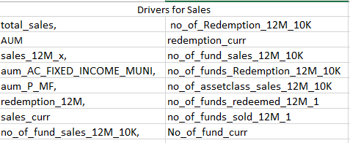
Features that influence sales for coming year: SelectKBest Results

Slide 9
Findings: What the data says Total Predicted Sales: A 43% reduction in sales.

Slide 10
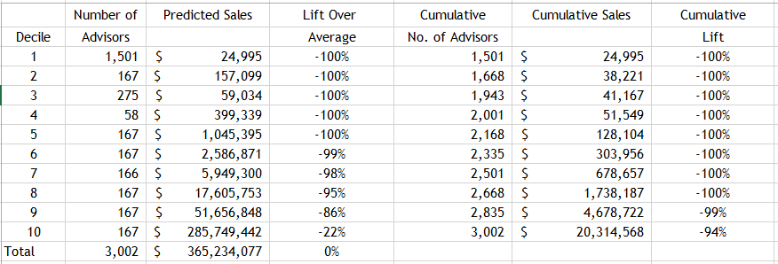
Predicted Sales: Lift Chart
The negative lift over average in our predictions indicates a drop in sales.
Total Predicted Sales: USD 365,234,077
No. of Advisors: 3002
Best performing advisors fall in decile number 10
Predicted total sales for decile 10: 285,749,442 which is 78.24% of total predicted sales.

Slide 11
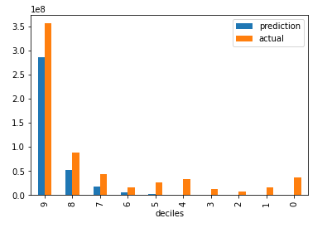
Overall sales predictions per decile, actual and predicted.
Predicts a dip in sales for all deciles in the coming year.
Indicates that the top decile is by far the highest contributor to total sales.

Slide 12
Financial advisors that fall in group 10 to account for most of the sales the coming year – 78.24% of predicted sales.

Slide 13
Overall predicted sales for top sellers next year to fall short of the current group of top advisors.

Slide 14
Individual advisor performance for advisors in top decile. Predictions indicate these top advisors will neither match nor exceed past year’s targets.

Slide 15
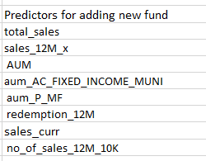
2. Estimate the probability of adding a new fund in the coming year (Classification)
Model selection: Model selected provided best performance in terms of prediction accuracy. Model is also simple and easy to interpret.
- Accuracy of the model is 80%
Feature Engineering: Combined sales “current month” with “sales for 12 months” to form “total sales” for the year which ranks top as a predictor for next year sales.
Feature Selection
- Recursive Feature Elimination (RFE) – Removes features of low importance so as to improve accuracy.
Imbalanced Learn: Helps to balance classification dataset which is highly skewed.
RFE Results

Slide 16
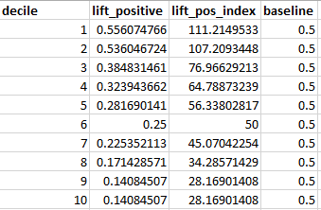
Lift Chart: Probability of adding a new fund
Probability of adding a fund increases as you move up the chart from rank 10 to those ranked number 1.
Advisors in decile 6 have a 50% chance to add or not add a new fund
Advisors above decile 6 have a higher chance of adding a new fund.
Advisors in decile 10 have the highest likelihood of not adding a new fund.
Our model predicts that advisors in decile 1 and 2 will add a new fund.

Slide 17
Recommendations
A forecasted drop in sales across all deciles signifies an impending overall drop in sales for the organization and this requires immediate action.
Ensure top decile 10 maintain their sales as they account for over 70% of the sales. Seek to understand what they are currently doing that enabled them to reach the past year’s sales target so as to try and maintain sales as they are currently if not possible to improve.
Have a retention strategy for decile 10. One that ensures a current understanding of their operating environment to be able to offer adequate and timely information and support as they are a fundamental part of the business.
Focus on advisors who are likely to add a fund the coming year to increase sales.
Have a long term strategy for decile 7, 8 and 9 with more focus on decile 9 as these deciles also drive in significant sales with decile 9 bringing in the bulk of it.
Focus on advisors who have above 50% probability of adding a new fund but less than a 100% to make sure you increase their chances. Then followed by those with a 100% to ensure they do not fall short of expectation.

Slide 18
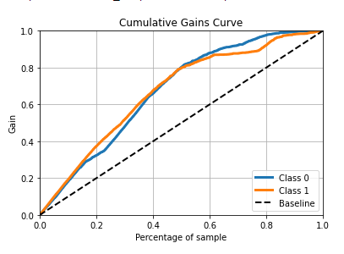
Appendix: Cumulative Gains Curve for Classification Problem

Slide 19
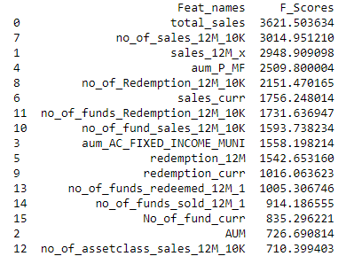
SelectKBest Results

Slide 20
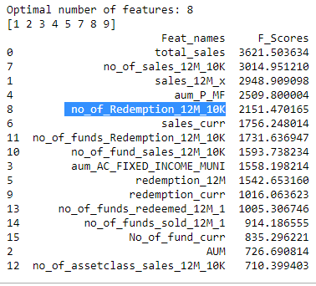
Recursive Feature Elimination: RFE Results

Slide 21
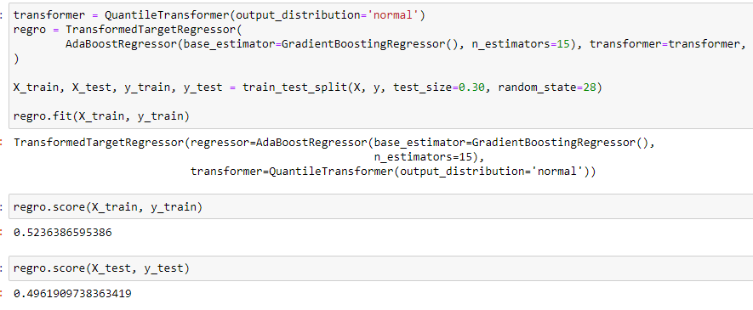
Code Regression Model Code (AdaBoostRegressor, GradientBoostRegressor base model)

Slide 22
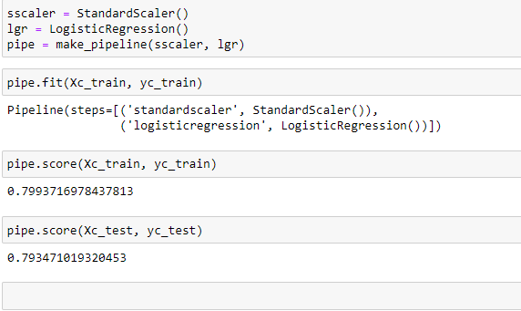
Classification Model Code Logistic Regression Model

Slide 23
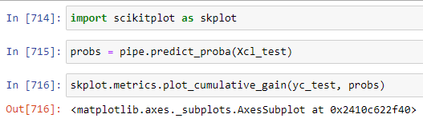
Cumulative Gains Plot

Slide 24
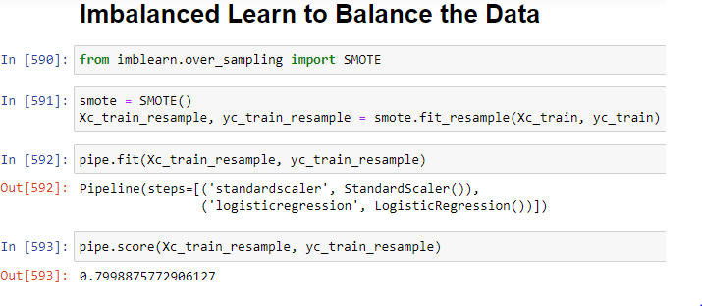
Balance Class Representation

Slide 25
End
Questions?

