Slide 1
Recommendation Engine for Tourists
Applied Data Science Capstone
IBM Data Science Professional Certificate
- Maitrey Talware

Slide 2
CONTENTS
Introduction
Data
Acquiring the Data
Preprocessing
Methodology
Content-Based Filtering
Results
Discussion section
Conclusion section

Slide 3
INTRODUCTION
We have to build recommender system which recommends tourist travel locations based on his previous rated venues.
Recommended engine is build on an observation that tourist always try to explore places which are nearby first. Let’s consider an example for simplifying things. Bob arrived in Toronto and wants to visit top places in Toronto, If he starts exploring a particular neighbourhood, he wants to finish exploring all good places in that neighbourhood before moving to other neighbourhood.
Keeping this in mind we have to recommend tourist a neighbourhood, with venues where he can visit.
We will be using location data to get best spots in neighbourhood. For getting location data we will use Foursquare API.

Slide 4
DATA
We will require data of all the neighbourhood in Toronto
We will need data about users previously rated venues
Acquiring the Data – Data is acquired from a Wikipedia page and foursquare api
Preprocessing- Data is preprocessed using pandas, numpy and many more libraries
NOTE : Please check the Jupyter notebook for how we get the data

Slide 5
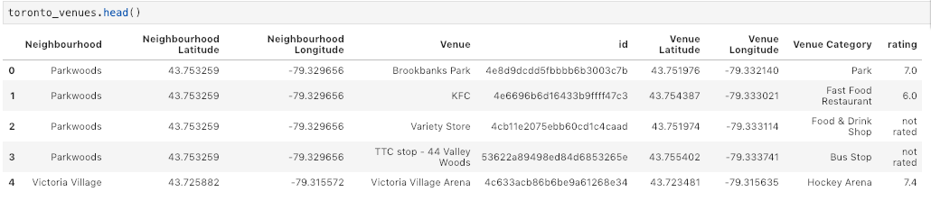
DATA (continued)
A dataframe with all the venues in the neighbourhood and their rating is prepared

Slide 6
METHODOLOGY
Content-Based Filtering
We will be implementing Content-Based or Item-Item recommendation systems. This technique attempts to figure out what a user's favorite aspects of an item is, and then recommends items that present those aspects. In our case, we're going to try to figure out the input's favorite venues from the places he has visited and ratings given.
For this we have to one hot encode the data to get it to the format, we need as shown on next side

Slide 7
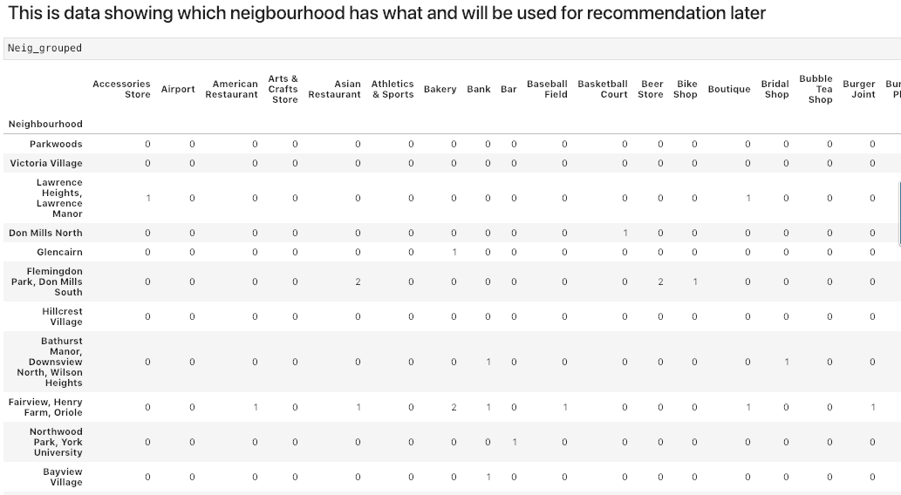
METHODOLOGY (continued)

Slide 8
METHODOLOGY (continued)
We have created dummy user rating data using data of other neighbourhood
Which is also one hot encode the data to get it to the format, we need as shown on next side
Getting User data to create user profile

Slide 9
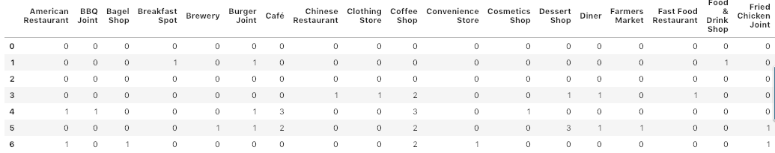
METHODOLOGY (continued)
User data

Slide 10
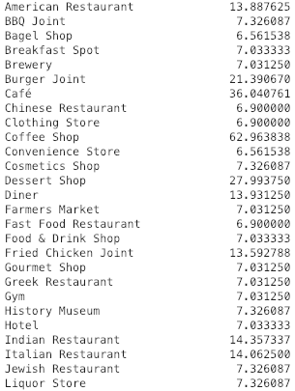
METHODOLOGY (continued)
User Profile

Slide 11

RESULTS
Following the Jupyter notebook, you can see that we can recommend user which neighbourhood he should visit first

Slide 12
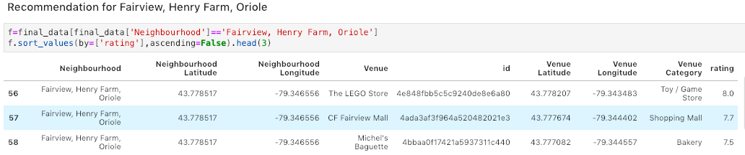
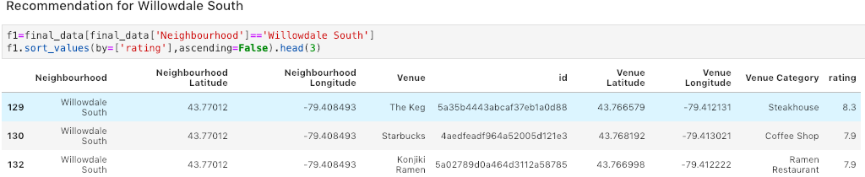
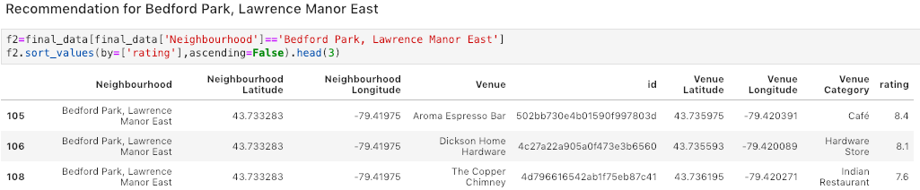
RESULTS (continued)

Slide 13
DISCUSSSION SECTION
Advantages and Disadvantages of Content-Based Filtering
Advantages
Learns user's preferences
Highly personalized for the user
Disadvantages
Doesn't take into account what others think of the item, so low quality item recommendations might happen
Extracting data is not always intuitive
Determining what characteristics of the item the user dislikes or likes is not always obvious

Slide 14
CONCLUSION
I conclude by saying that, this system has lot of scope and can be applied in many different fields. We concentrated on particular neighbourhood of Toronto due to limited Foursquare API calls and we can scale this project by buying more api calls from foursquare.
In the end, I want to thank IBM Applied Data Science Capstone Instructors for making this possible

